Slide 1
Secure file-sharing server
Afonso Pinto, 201704192
Gustavo Pereira, 201705672

Slide 2
Common uses of the service
Upload files
Manipulate the files remotely (delete them and grant access to other users)
Download files
To do: rename the files and personal web page

Slide 3
Interface
Using the bootstrap library for graphical web frontend
Login and register menus
Operations such as uploading, deleting or sharing files

Slide 4
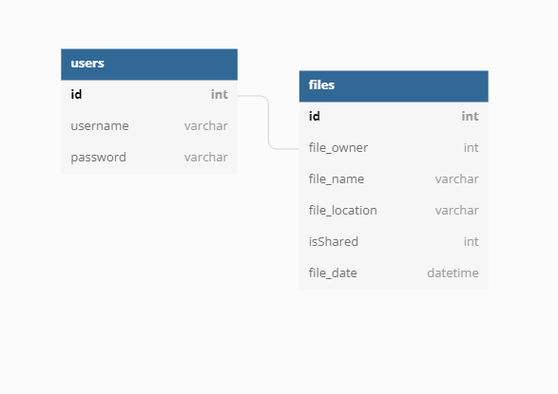
Database
SQL DB with two tables: file and user
Files are described by a unique ID, the file name, location, the ID of the owner, a flag that indicates if it's shared, and the date
Users are described by a unique ID, a hashed password, and its username

Slide 5
Authentication and access control
Encrypted passwords with SHA-256
Users must register or login to access their files
For any operation, the user must be authenticated
User can only access a file if he is the owner, or if the owner has granted him access

Slide 6
Additional security-oriented details
Flask – Most python frameworks come with their own sanitization functions. E.g flask.escape()
Flask_login – Functions like login_required guarantees that the user is logged in to access certain endpoints
Werkzeug - A simple collection of various utilities for web interfaces. Functions like secure_filename that returns a secure version of a filename.

Slide 7
Demonstration

