Slide 1
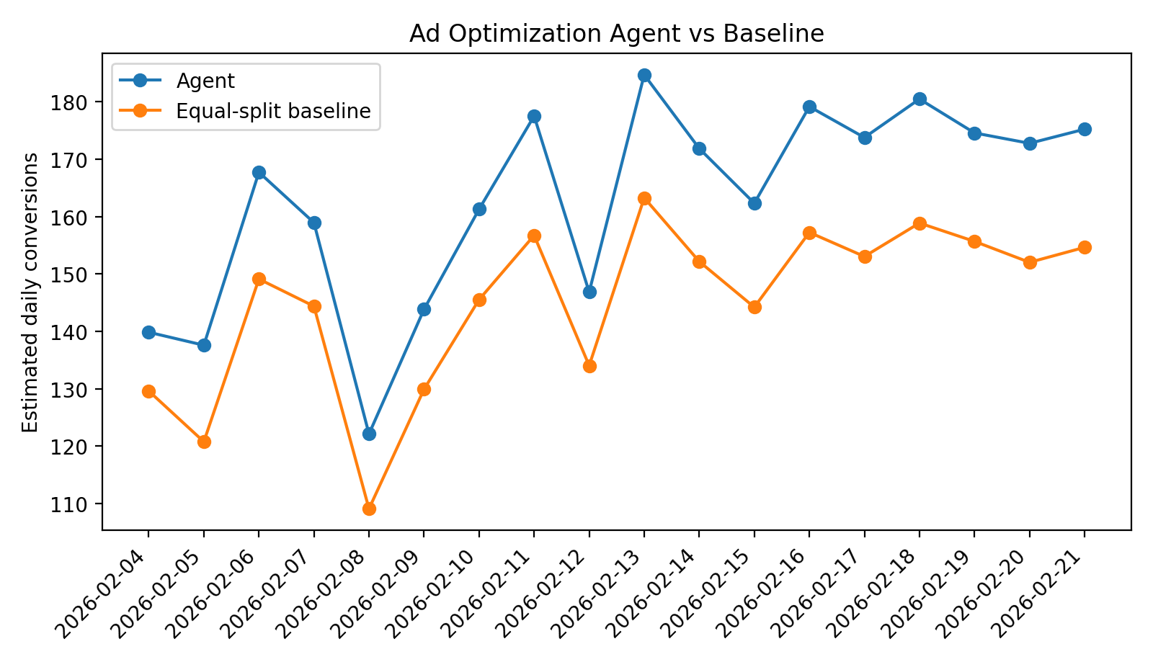
Build an Ad Optimization Agent
Prototype at a glance
1. Read daily channel metrics from CSV
Minimal submission-ready prototype: CSV input, budget policy, guardrails, offline evaluation, and a short presentation.
2. Score channels on conversions per dollar + CTR
Channels: Search, Social, Display
Objective:
maximize conversions while keeping exploration alive
Result:
+12.28% estimated lift vs equal split baseline
3. Apply floors, caps, and +/-20% daily move limits
4. Log rationale and compare against baseline
Offline backtest using the included 21-day mock dataset.
Notes:
Open by framing the assignment: one lightweight agent, one dataset, one evaluation loop. Close with the headline result so the audience knows the prototype actually runs. [Sources] - No external sources. All metrics and visuals are generated from the included mock dataset and local script.

Slide 2
Agent design and policy loop
Role, inputs, outputs, and guardrails - kept simple enough to explain and audit.
CSV input
Feature calc
Budget policy
Guardrails
Output
date
channel
spend
impressions
clicks
conversions
CTR
CVR
CPA
conv / $
75% conv / $
25% CTR
10% explore
floor 20%
cap 60%
move <= 20%
budget by
channel +
reason log
Inputs / outputs
Rules and guardrails
Input: channel-level daily aggregates from CSV only Output: recommended budget by channel, delta %, and rationale string Primary metric: total estimated conversions
• No PII required
• Neutral, factual brand tone
• Never starve a channel completely
• Log every move for auditability
Notes:
Walk left to right. This slide is the design doc in visual form: what goes in, how the budget is scored, what guardrails limit risk, and what comes out. [Sources] - No external sources. All metrics and visuals are generated from the included mock dataset and local script.

Slide 3
Mock dataset and example decision log
The included CSV uses 21 days of Search, Social, and Display performance.
Dataset schema
Example logged decision
date
channel
spend
impressions
clicks
conversions
Why this CSV is enough
• Simple channel-level inputs
• No attribution join required
• Easy to swap with real exports later
• Enough signal for a daily pacing demo
2026-02-04
Search up 20.0% | conv/$=0.215, CTR=3.06% based on trailing 3-day performance
Why it works
Guardrails
• Rewards better recent efficiency
• Keeps learning alive on weaker channels
• Avoids sudden budget whiplash
• Produces an audit-friendly rationale
max change: +/-20%
min share: 20%
max share: 60%
exploration: 10%
Data profile
21 days
3 channels
63 rows total
Search is strongest on conversions per dollar; Social is mid-tier; Display stays funded at the learning floor.
Notes:
Show that the dataset is deliberately small and clean. Then give one sample log entry to prove the script is explainable, not just optimized. [Sources] - No external sources. All metrics and visuals are generated from the included mock dataset and local script.

Slide 4
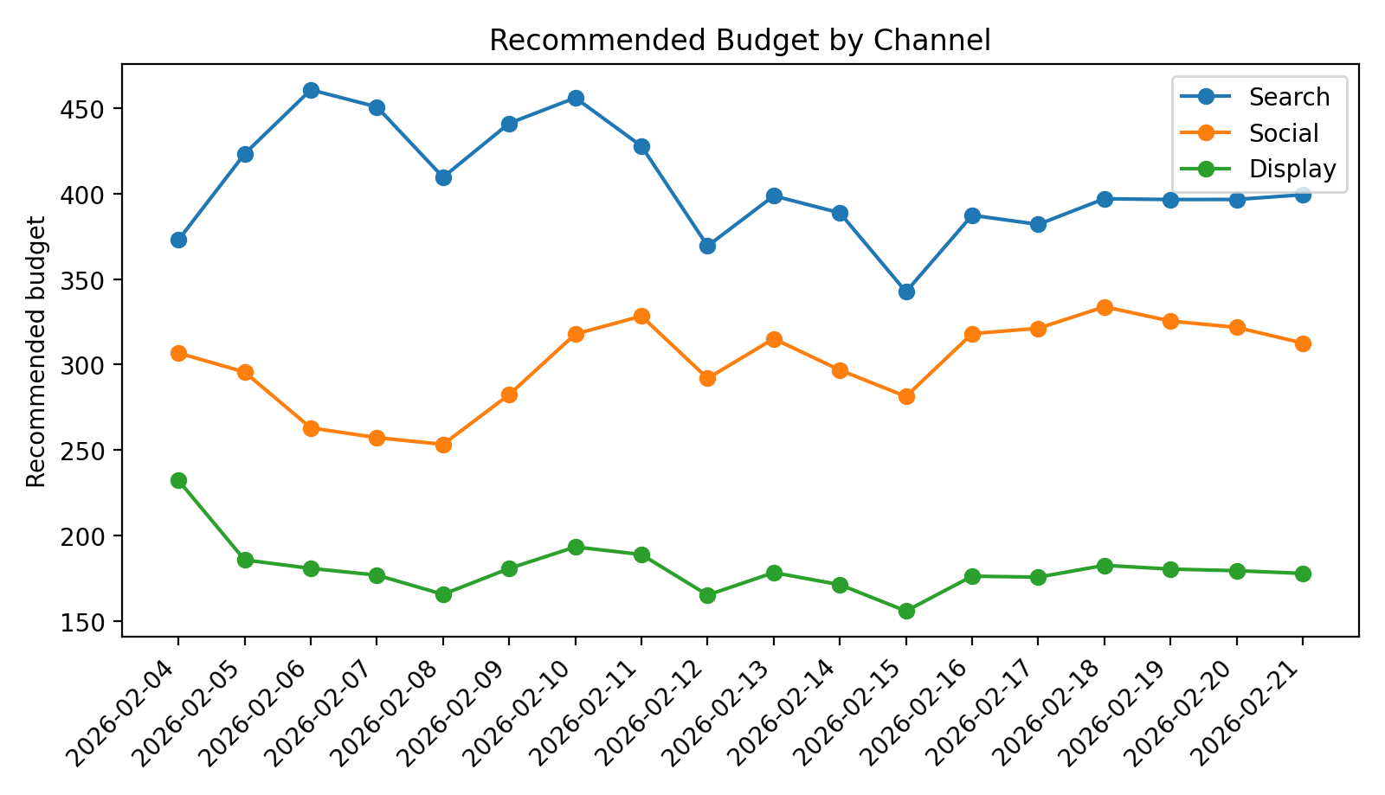
Evaluation snapshot
Compared against an equal-split baseline on the same total daily budget.
Headline metrics
Daily conversions
Recommended budget by channel
+12.28%
estimated conversion lift
$5.51
avg estimated CPA - agent
$6.18
avg estimated CPA - baseline
18 scored decision days
Notes:
This is the proof slide. Start with the lift and CPA, then point to the charts: the agent consistently beats equal split and naturally leans into Search while preserving learning on Social and Display. [Sources] - No external sources. All metrics and visuals are generated from the included mock dataset and local script.

Slide 5
Submission checklist + cloud scaling
Everything needed for the assignment is packaged in the project folder.
What is included
To run reliably in the cloud
• DESIGN_DOC.md
• ad_optimization_agent.py
• mock_ad_data.csv
• README.md
• SCALING_NOTE.md
• outputs/ successful run artifacts
• slides/ presentation deck
1. Observability
Structured logs, channel scores, budget deltas, dashboards, and stale-data alerts.
2. Retries + durability
Idempotent scheduled jobs, schema validation, durable storage, and exponential backoff on failures.
Final step: upload the folder to GitHub and paste your repo URL into the submission form.
3. Cost caps + safety
Hard budget ceilings, per-channel share caps, and manual review for unusually large allocation changes.
Run: python ad_optimization_agent.py --csv mock_ad_data.csv --output_dir outputs --generate_mock --days 21
Notes:
Finish by mapping each deliverable to a file and then giving the scaling note in one sentence each: observability, retries, and cost caps. [Sources] - No external sources. All metrics and visuals are generated from the included mock dataset and local script.

