Slide 1
Data Analytics and Visualization
Project 3 – Gustavo Garofalo

Slide 2
Problem Definition
Given that the world population is increasing, what is the level of food production we will have to grow ins order to sustain ourselves in the future years?
What amount of agricultural production crops will be destined as feed and what amount for food?
Provide two countries that represent a completely different scenario.

Slide 3
Data & Premise
Datasets from FAO.ORG (Food and Agriculture Organization of the United Nations);
Two datasets in CSV format;
Analysis were made in the jupyter notebook, using pandas, numpy, sklearn (linearRegression())
Population growth is the only variable that determines whether the agricultural productivity increases or not as well as FEED/FOOD proportion;

Slide 4
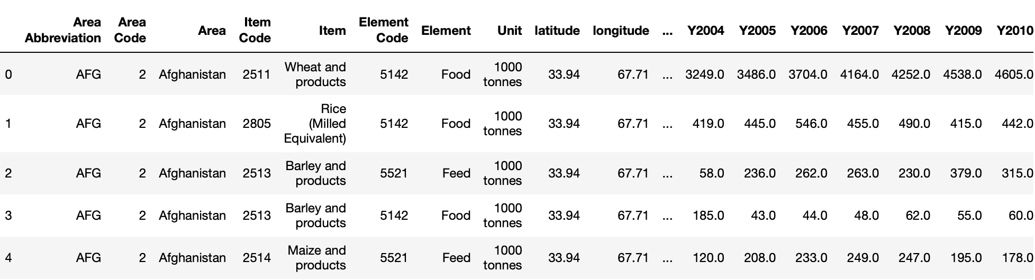
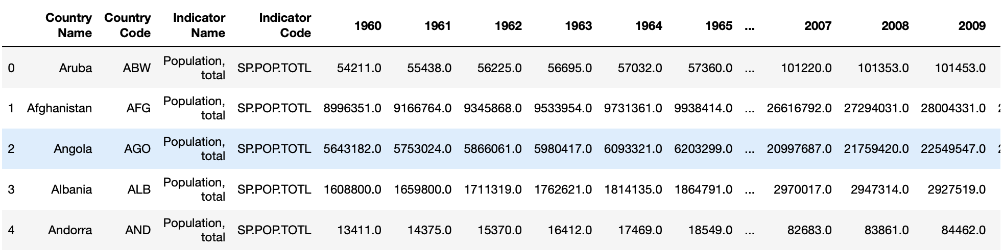
Dataset Preview

Slide 5
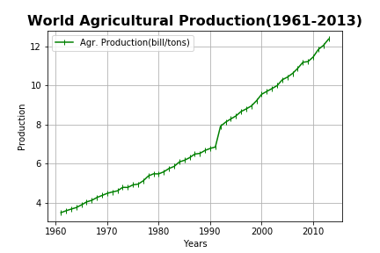
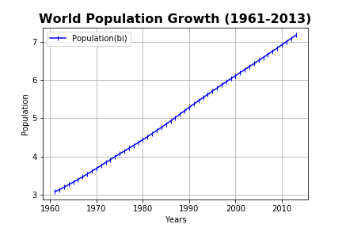
World Agricultural Production and Population Growth

Slide 6
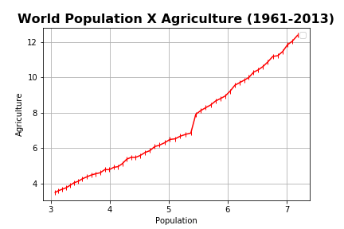
World Population X Agriculture
R-squared: 0.9774
MSE: 0.15

Slide 7
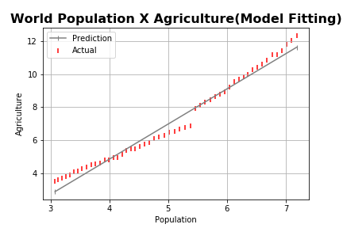
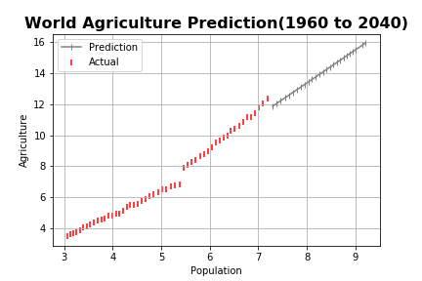
Model Fitting and Prediction

Slide 8
Primary conclusion
As population grows, so does the need to increase crop’s productivity (Food production grows in a higher rate);
Model predicted 2 billion populational growth and 4 billion in Agricultural output;
Growth rate in population has decreased since 1968 from 2.09% to 1.05%; Linear is no longer appropriate;
How can we be more efficient?

Slide 9
Secondary Analysis
Agricultural production can be divided in 2 different categories:
FOOD: plants/vegetables/grains we grow to eat;
FEED: plants/vegetables/grains we grow to feed livestock and poultry that will be served as food to us afterwards;

Slide 10
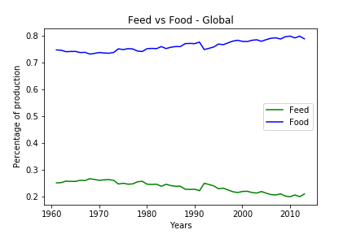
World Food and Feed ratio
As of 2013, roughly 80% of agricultural activity is towards FOOD and 20% FEED;

Slide 11
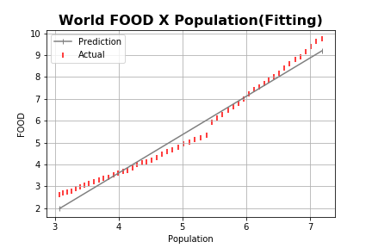
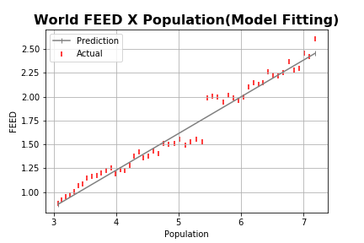
World Food and Feed x Population
R-squared: 0.9774
MSE: 0.15
R-squared: 0.9774
MSE: 0.15

Slide 12
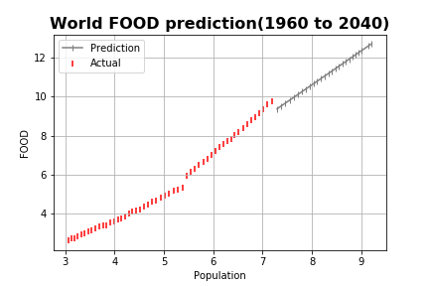
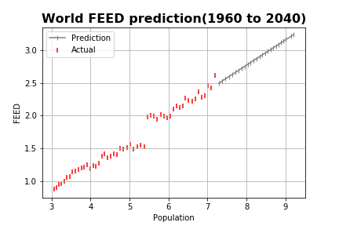
World Food and Feed x Population
X-coef.: 1.74
X-coef.: 0.38

Slide 13
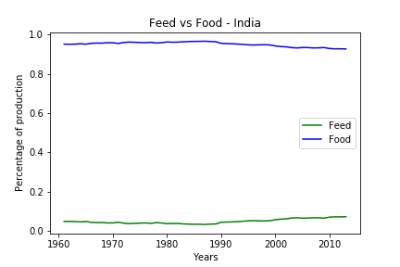
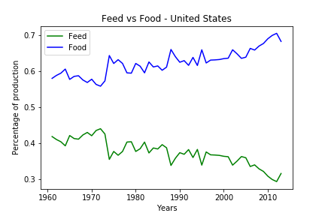
Finally something different: India and US
1,337 billion
327 million

Slide 14
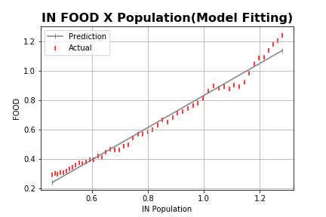
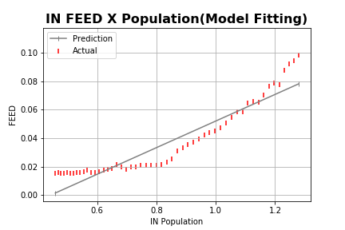
India: linear regression mode
Score: 0.98
Score: 0.87

Slide 15
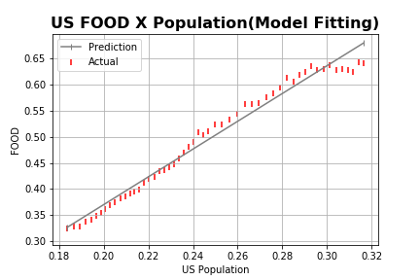
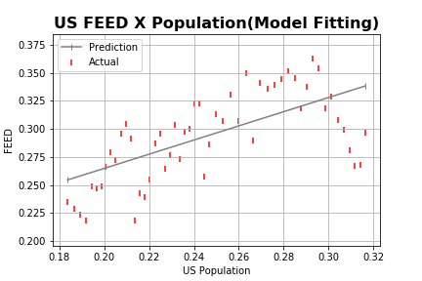
US: linear regression model
Score: 0.98
Score: 0.87

Slide 16
Final conclusion
Assume that crop yeld grow as overall population also grows;
More than 33% percent of agricultural land destined to Livestock(FEED);
Insufficient features analyzed in order to have a reliable prediction model and to raise awareness to the issue

Slide 17
If given more time
Work on getting more useful variables;
Apply different models for different sets of data;
Improve visualization delivery;

