Slide 1
wedy-miner
Clarissa Rodrigues clarissa.ar@gmail.com
Daniel Tamiosso danieltamiosso@gmail.com
Gustavo Togni gustavotogni@gmail.com

Slide 2
Sentiment Analysis
Sentiment analysis using machine learning is generally treated as a text classification problem.
Machine Learning-based approaches for sentiment analysis work in following phases:
1. Text preprocessing
2. Feature selection methods
3. Feature weighting and representation schemes
4. Machine learning algorithm

Slide 3
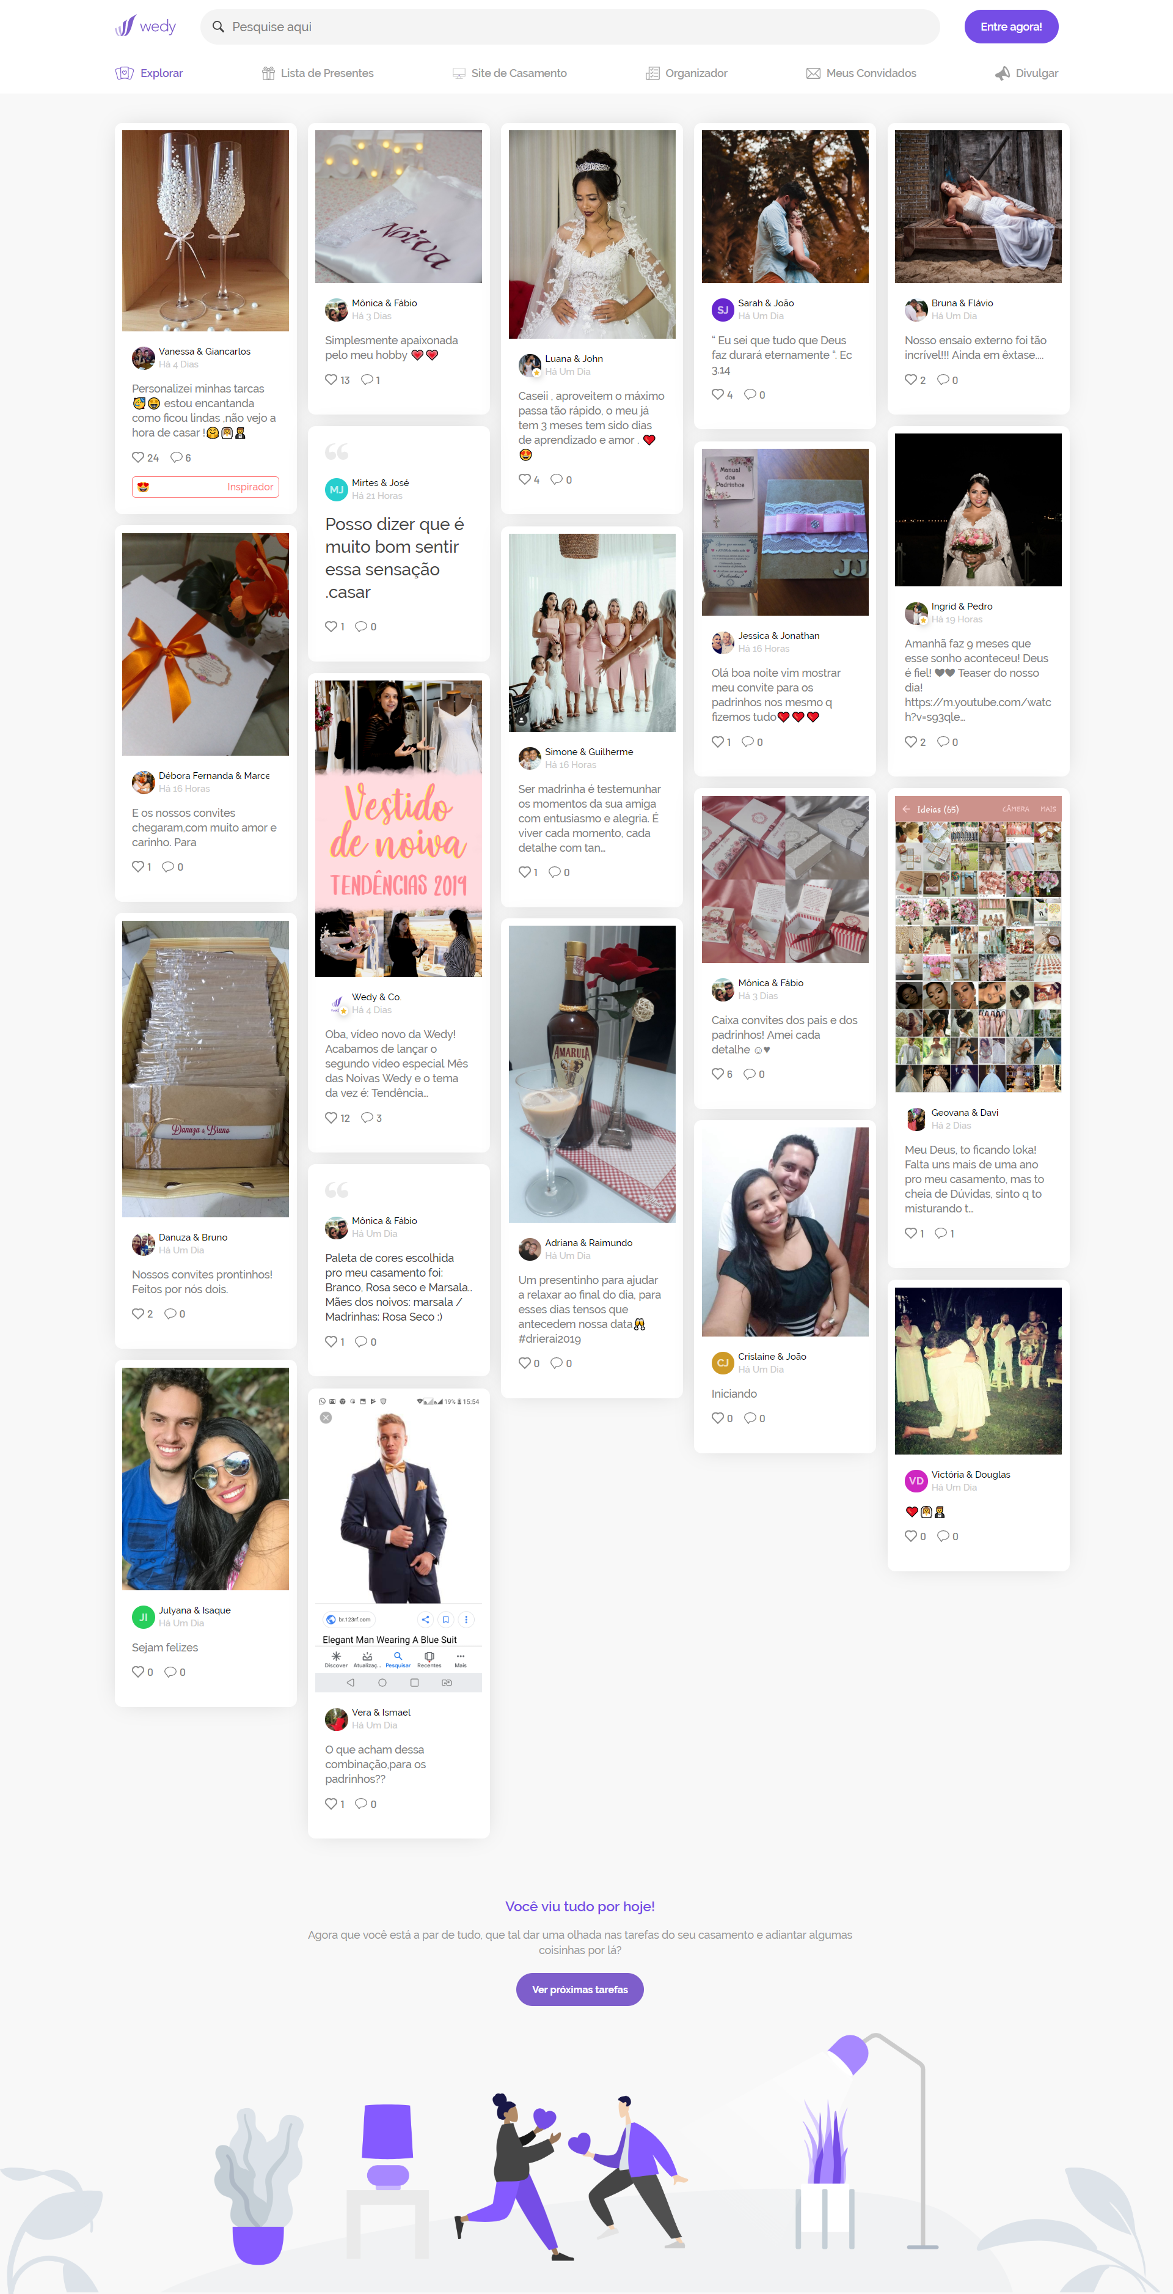



https://app.wedy.com/
wedy.com/graphql
json
https
wCrawler.py
source.csv
plot.png
wPlotter.py
wProcessor.py
wAnalyzer.py
output.csv

Slide 4
1. Text preprocessing
Text needs to be preprocessed as tokens or strings before applying machine learning models.
In preprocessing, stemming (reducing words to their stem or root form) and stop word removal methods are generally used for sentiment analysis [91].
Feature extraction from unstructured text is a key step in developing sentiment analysis models.
It is noted that most of the existing methods develop machine learning models based on unigrams, bigrams, trigrams, and dependency features.

Slide 5
2. Feature selection methods
The field of machine learning has provided many models that are used to solve sentiment analysis problem. Naive Bayes, SVM, decision trees, maximum entropy, and hidden Markov models are most popular among them for sentiment analysis.
Agarwal and Mittal [10] showed that BMNB classifier with mRMR(Minimum RedundancyMaximum Relevance) feature selection method can perform better than SVM classifier for sentiment analysis. They showed that the performance of the machine learning models can be improved by including more informative and less redundant features.

Slide 6
Full feature set example:
({'length': 52, 'lexdiv': 1.0, 'longestword': 'listenin', 'unigram(know)': True, 'unigram(listenin)': True, 'unigram(bad)': True, 'unigram(habit)': True, 'unigram(earlier)': True, 'unigram(started)': True, 'unigram(freakin)': True, 'unigram(part)': True, "bigram(('know', 'listenin'))": True, "bigram(('listenin', 'bad'))": True, "bigram(('bad', 'habit'))": True, "bigram(('habit', 'earlier'))": True, "bigram(('earlier', 'started'))": True, "bigram(('started', 'freakin'))": True, "bigram(('freakin', 'part'))": True, "trigram(('know', 'listenin', 'bad'))": True, "trigram(('listenin', 'bad', 'habit'))": True, "trigram(('bad', 'habit', 'earlier'))": True, "trigram(('habit', 'earlier', 'started'))": True, "trigram(('earlier', 'started', 'freakin'))": True, "trigram(('started', 'freakin', 'part'))": True}, 'neutral')

Slide 7
3. Feature weighting and representation schemes

Slide 8
4. Machine learning algorithm
In machine learning, naive Bayes classifiers are a family of simple "probabilistic classifiers" (a classifier that is able to predict, given an observation of an input, a probability distribution over a set of classes, rather than only outputting the most likely class that the observation should belong to) based on applying Bayes' theorem with strong (naive) independence assumptions between the features.
tl;dr: instead of classifiying "1" as an integer, they classify it having a 100% chance of being an integer, 0% of being a word, etc

Slide 9
3. Feature weighting and representation schemes
Accuracy:
0.3
Labels:
['neutral', 'sadness', 'happiness', 'worry', 'surprise', 'love', 'hate', 'relief']

Slide 10
24 Most Informative Features
unigram(hate) = True | hate : happin = 92.3 : 1.0
unigram(hates) = True | hate : happin = 78.6 : 1.0
unigram(stupid) = True | hate : love = 71.3 : 1.0
longestword = 'mothers' | love : hate = 71.1 : 1.0
bigram(('finally', 'home')) = True | relief : neutra = 64.6 : 1.0
bigram(('day', 'moms')) = True | love : worry = 58.5 : 1.0
bigram(('happy', 'mothers')) = True | love : hate = 55.1 : 1.0
trigram(('happy', 'mothers', 'day')) = True | love : hate = 54.2 : 1.0
trigram(('mothers', 'day', 'moms')) = True | love : worry = 50.9 : 1.0
bigram(('mothers', 'day')) = True | love : hate = 46.5 : 1.0
bigram(('love', 'u')) = True | love : neutra = 44.4 : 1.0
unigram(fuckin) = True | hate : neutra = 41.1 : 1.0
unigram(mothers) = True | love : hate = 37.5 : 1.0
unigram(fuck) = True | hate : neutra = 36.0 : 1.0
unigram(sucks) = True | hate : happin = 35.2 : 1.0
unigram(ugh) = True | hate : happin = 34.8 : 1.0
bigram(('love', 'ya')) = True | love : neutra = 34.4 : 1.0
longestword = 'sorry’ | worry : happin = 34.0 : 1.0
bigram(('ugh', 'hate')) = True | hate : worry = 33.3 : 1.0
unigram(sad) = True | sadnes : happin = 32.7 : 1.0
bigram(('day', 'mom')) = True | love : neutra = 32.7 : 1.0
unigram(mums) = True | love : worry = 32.7 : 1.0
longestword = 'love' | love : neutra = 31.9 : 1.0
bigram(('im', 'sad')) = True | sadnes : happin = 31.7 : 1.0

Slide 11
output
276,debora-marcelo-26-10-2019,"And our invitations arrived, with a lot of love and affection. For","['invitations', 'arrived', 'lot', 'love', 'affection']","{'length': 38, 'lexdiv': 1.0, 'longestword': 'invitations', 'unigram(invitations)': True, 'unigram(arrived)': True, 'unigram(lot)': True, 'unigram(love)': True, 'unigram(affection)': True, ""bigram(('invitations', 'arrived'))"": True, ""bigram(('arrived', 'lot'))"": True, ""bigram(('lot', 'love'))"": True, ""bigram(('love', 'affection'))"": True, ""trigram(('invitations', 'arrived', 'lot'))"": True, ""trigram(('arrived', 'lot', 'love'))"": True, ""trigram(('lot', 'love', 'affection'))"": True}",relief

