Slide 1

RELIABILITY ENGINEERING / INVESTIGATION REVIEW
Xcelodose 600S-
ME-5 Microbalance
Failure Investigation
Mechanical failure pathway, observed handling practices, and corrective-action direction
RCA
AUG–SEP 2026

Slide 2
The failure population separates into two distinct patterns
The mechanical pathway is concentrated in the units with visible deformation and corner-load failure.
4
2
2
1
microbalances reviewed
have visible mechanical abnormalities and out-of-service
current direct-load observations
most probable mechanical root cause
Unavailable between 2023–2026
██████ + ██████
17-AUG + 20-AUG
Handling control during cleaning
Takeaway
Repeated direct force on the fragile weigh pan is the strongest supported mechanical pathway; alignment and powder conditions remain contributing pathways that should be controlled and monitored.

Slide 3
Four failed / unavailable units
Mechanical Failure RCA basis upon historical evidence and observation.
Software Failure will be alleviated in the next phase of the Replacement and Reliability Plan.
██████
30-JUL-2026
██████
24-AUG-2023
██████
21-JUL-2026
MECHANICAL
MECHANICAL
INTERFACE / ELECTRONIC
Corner-load + linearity could not be adjusted
Failed corner load; could not be repaired
TW#151494 05-SEP-2023
Calibration software connection failure
Pan tilted left; multiple scuffs
Front springs visibly asymmetric
No visible tilt, scuffs, or external damage
RCA boundary
Mechanical root-cause analysis: ██████ + ██████. ██████ and ██████ remain separate failure modes requiring their own follow-up.

Slide 4
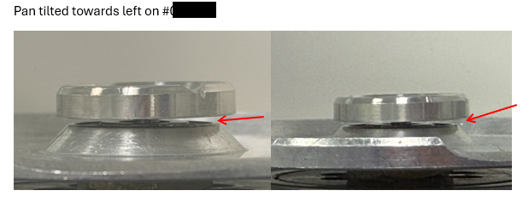
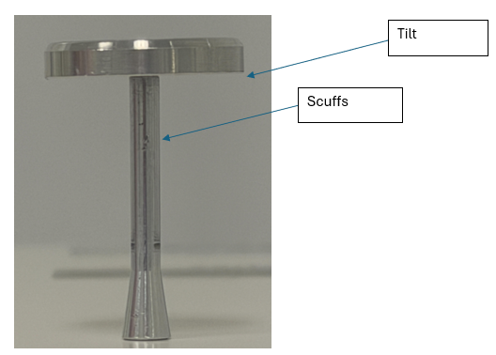
Mechanical abnormalities are visible on both corner-load failures
██████
Tilted weigh pan + scuff marks
Failed manufacturer specification; corner load and linearity could not be adjusted.
Visible geometry is consistent with deformation / misalignment.
The exact time and loading event that produced the deformation is not directly observed.

Slide 5
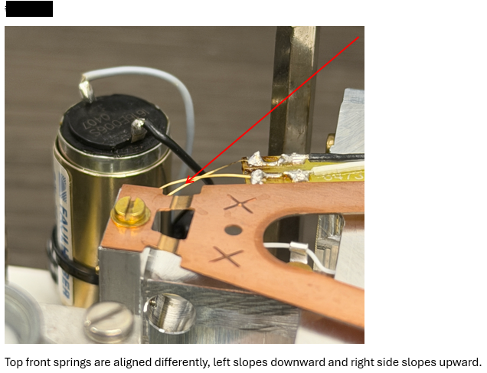
Mechanical abnormalities are visible on both corner-load failures
██████
Asymmetric front springs
Failed corner-load test; unit could not be repaired.
Visible asymmetry is consistent with spring deformation / mechanical misalignment.
This unit provides historical evidence of the same corner-load failure family.
This unit was investigated in TW#151494, direct loading was observed and determined as deformations cause; Pan bend observed similarly to #██████

Slide 6
Triangulate hardware evidence, observed practice, and controlled requirements
No single observation is treated as sufficient on its own, the mechanical cause was built by comparing multiple evidence streams.
FAILED-UNIT
INSPECTION
Tilt, scuffs, spring geometry
MANUFACTURING
GEMBA
Operation, cleaning, handling
SOP / PRACTICE
COMPARISON
What is required vs observed
PRODUCT DEV
COMPARISON
Different setup + cleaning practice
HISTORY +
SERVICE
2023 event, Technician findings
6M + 5-WHY
SYNTHESIS
Rank pathways + system cause
Evidence Flow | Historical Investigation->Observations and SOP Derivations->PD Observations and Comparisons

Slide 7
The strongest evidence emerged across repeated cleaning and alignment observations
14-AUG-26
17-AUG-26
20-AUG-26
(23–24)-AUG-26
31-AUG-26
01-SEP-26, PD
Vacuum-only minor cleaning
Direct weigh-pan loading
Behavior repeats
Alignment downtime + recovery
No-contact cleaning
Comparison run
No dry wipe; static alarms; Size 4 / prodger concerns raised
Pan pressed while vacuuming; unit energized; powder buildup seen
Pan held by hand while vacuuming; powder on pucks; 2nd shift pre-aligns
Xcelodose unavailable for reported misalignment; returned after alignment
Third shift cleans with no hand / nozzle contact; removable parts later removed for 1st Shift Handoff
No abnormal pan contact; pan removed before cleaning
Pattern across time
The critical handling condition was observed more than once, while later comparison runs demonstrated that cleaning can be performed without direct weigh-pan loading.

Slide 8
Direct weigh-pan force creates a credible load path into the weighing mechanism
This is the only mechanical pathway supported by repeated direct observation plus a relevant historical event.
DIRECT OBSERVATION
DIRECT OBSERVATION
SERVICE HISTORY
17-AUG-26
20-AUG-26
HISTORICAL
Operator applied downward force directly to the weigh pan while vacuuming. The system was energized.
The weigh pan was again held by hand during vacuum cleaning.
TW#151494 documented a mechanical failure associated with pressing the pan during cleaning.
Repeated direct-load behavior observed.
Confirms the handling behavior recurred.
Relevant historical event supports the same load pathway.
What this proves: the loading behavior exists. What still needs manufacturer confirmation: allowable load / damage threshold.

Slide 9
Other:
Powder and alignment conditions may amplify vibration and cause Downtime
This pathway is supported by observed buildup and operator / SME input, but it is not as direct as the pan-loading evidence.
Powder buildup
on / under puck
Incorrect puck
seating
Puck / prodger
misalignment
Vibration /
slippage / contact
Downtime +
performance failure
Size 4 / reduced
prodger contact
EVIDENCE
Observed: powder stuck on pucks (17 / 20 AUG) • Reported: Size 4 slippage + incomplete prodger contact
Observed: pre-alignment performed by 2nd shift • 23-AUG downtime reported as alignment-related

Slide 10
The same cleaning task can be performed without direct weigh-pan loading
MANUFACTURING
1st /2nd Shift — 17 / 20 AUG
THIRD SHIFT — 31 AUG
PRODUCT DEVELOPMENT
WEIGH-PAN CONTACT
Direct hand restraint / downward force
WEIGH-PAN CONTACT
No hand / vacuum-nozzle contact
WEIGH-PAN CONTACT
No abnormal contact observed
EQUIPMENT STATE
Energized during observed cleaning, Weigh Pan not removed
REMOVABLE PARTS
Removed, wiped, cleaned later
CLEANING METHOD
Weigh pan removed before cleaning
PUCK CONDITION
Powder buildup observed
ALARMS
None observed during cleaning
SME INTERPRETATION
Operational failure most likely when pan is contacted / loaded
RESULTING EVIDENCE
Credible external load path
VALUE OF COMPARISON
Shows no-contact method is feasible
VALUE OF COMPARISON
Reduces opportunity for direct loading
CONTROLLED LEARNING → Direct pan contact is not required to perform the cleaning activity.

Slide 11
Three observed gaps matter because each changes the mechanical risk during cleaning
01
CONTROL
OBSERVED
RISK LINK
Dry wipe + vacuum
Vacuum-only cleaning, weigh pan not removed observed on 14-AUG
Leaves a greater chance of powder remaining on / around removable parts
02
CONTROL
OBSERVED
RISK LINK
Protect fragile weigh pan from contact
Pan held / pressed instead of removal during cleaning on 17-AUG and 20-AUG
Creates a direct external mechanical load path
03
CONTROL
OBSERVED
RISK LINK
Clean in required de-energized state
Observed vacuum cleaning while energized
(6.13.1 USTP-608)
Adds unnecessary interaction with the live mechanism during handling
Positive practice to formalize
2nd-shift pre-alignment and no-contact cleaning technique provide practical controls worth standardizing

Slide 12

The hypotheses do not carry equal weight
HYPOTHESIS
STATUS
WHY
Direct external load on weigh pan
Evidence-supported
Repeated current observations + historical event
Puck / prodger misalignment
Supported
Alignment downtime, pre-alignment, SME / operator input
Powder buildup → improper seating
Supported
Caked / stuck powder observed on pucks
Operational vibration / contact
Possible
Size 4 slippage + scuff evidence; causal link not fully proven
Vacuum-related loading / static
Possible
Static alarms temporally associated with one cleaning event
Use this ranking to focus CAPA on the supported load path while continuing to trend the secondary contributors.

Slide 13
The 5-Why moves from the failed balance to the control that allowed repeat loading
1
Why did the scales stop functioning?
Corner-load / linearity performance failed because the weighing mechanism became mechanically misaligned or deformed.
2
Why did the weighing mechanism become deformed or misaligned?
The mechanism was exposed to an abnormal external mechanical load.
3
Why was abnormal external load applied to the weighing mechanism?
Direct downward force was applied to the weigh pan during cleaning.
4
Why was the weigh pan manually restrained during cleaning?
The pan was manually restrained / held as part of the cleaning behavior.
5
Why did the existing documentation and training fail to prevent this?
Existing handling controls and training did not consistently prevent direct loading of the weigh pan because the cleaning procedure wording was not explicit enough and did not emphasize pan removal as well as training did not fully address the specific handling risk.
The system-level failure is not “an operator mistake”; it is an ineffective control that allowed the same fragile-component loading behavior to recur.

Slide 14
Ineffective control of weigh-pan handling during cleaning
Repeated direct loading of the fragile pan provides the clearest supported path to mechanical deformation / misalignment and corner-load failure.
Most Probable Root Cause
Why this outranks the alternatives
Direct manual force was repeatedly applied to the weigh pan during cleaning; The existing handling controls and training did not consistently prevent recurrence.
REPEATED
Direct load observed 17-AUG and 20-AUG
HISTORICAL
2023 event links pan pressing with mechanical failure
PHYSICAL
██████ and ██████ show mechanical abnormalities
Mechanical consequence
External load → deformation / misalignment → corner-load and/or linearity failure
3rd shift and PD demonstrate no-contact cleaning is feasible
COMPARISON
Secondary contributors remain relevant: puck/prodger alignment, powder buildup, Size 4 slippage/vibration, and vacuum/static behavior should continue to be controlled.

Slide 15
Observations and Corrective actions
OBSERVED / DOCUMENTED
SUPPORTED INFERENCE
CONCLUSION / CORRECTIVE ACTION
Physical condition of failed balances
Direct load transfers into weighing mechanism
Most probable root cause: Training outdated and control gap leading to direct pan force
17 + 20 AUG direct pan loading
Powder can interfere with correct seating
Leads only should remove and install the microbalance
Powder buildup on pucks
Misalignment can increase contact / vibration
Reinforcement and Retraining Initiative
31 AUG no-contact cleaning
No-contact cleaning lowers loading opportunity
Pan removal reinforced in SOP, update language. Bold section 6.3.2.11.2 “Remove Weighing pan and spill tray…”; Add Pan removal to section 6.13.2 Minor Cleaning. All for USTP-608
PD pan-removal practice follows SOP and Weigh Pan removal
SOP-to-practice differences
MSAT Engineers get Method Development/
Super-User role and Trained Leads given Operator/Super-User
Primary internal sources: Xcelodose investigation, current RCA • Historical findings • 14–31 AUG Manufacturing observations
• Product Development comparison • SOP review vs Observations

Slide 16

Control the load path first, then standardize alignment and corrective action
CONTAIN NOW
STANDARDIZE
TRAIN
ACT
Reduce immediate exposure
Remove method variation
Make correct handling repeatable
Close remaining technical gaps
No direct force on weigh pan
Define cleaning procedure and removable-part cleaning
Demonstrate proper cleaning and correct pan removal
Update SOP Terminology and Cleaning sections
Adjust SOP and required equipment state to include pan removal during cleaning
Clarify pre-alignment ownership
Qualify operator / super-user alignment role
Inspect Operations after training
Keep pan isolated from vacuum / direct force
Assign MSAT to Method Dev/Super user and remove any Operator from roles with parameter adjustment
Training and SOP updates for Pan removal and no contact cleaning
Installation and Removal of balance by leads only.
Implementation principle → engineer out the contact opportunity where practical; do not rely on memory alone.

Slide 17

The mechanical pathway is actionable now
Formalize Controls, assign ownership and verify effectiveness
1
Approve the cleaning / handling control direction
No direct weigh-pan force; define removal / isolation and equipment-state requirements.
2
Assign alignment ownership + training
Decide who can perform pre-alignment, removal and installation;
As well as how competency is documented.
3
Implement physical damage-prevention controls
Lead operator routine inspections. Leads verify retraining effectiveness and document repeat pan contact, misalignment, or damage.
4
Track recurrence and reliability performance
Document scale failures, alignment issues, damage events, and repeat maintenance calls and confirm whether the new controls are reducing failures over time.
CURRENT CONCLUSION
Most probable root cause: ineffective control of direct weigh-pan handling during cleaning.

