Slide 1
GNU Radio: gr-radar pt.2
Samson Aggelopoulos, Willy Chang, Brian Lu, and Matthew Sahara
October 8, 2020

Slide 2
Topics
Hardware and Software Configuration
Introduction to FSK
GNU radar code review
Data Logging code review
Transponder updates

Slide 3
Hardware and Software
Software
GNU Radio companion (3.8.2)
Gr-radar (3.8)
Hardware
LDPA / Omni-directional / 2.4Ghz Yagi
USRP N210

Slide 4
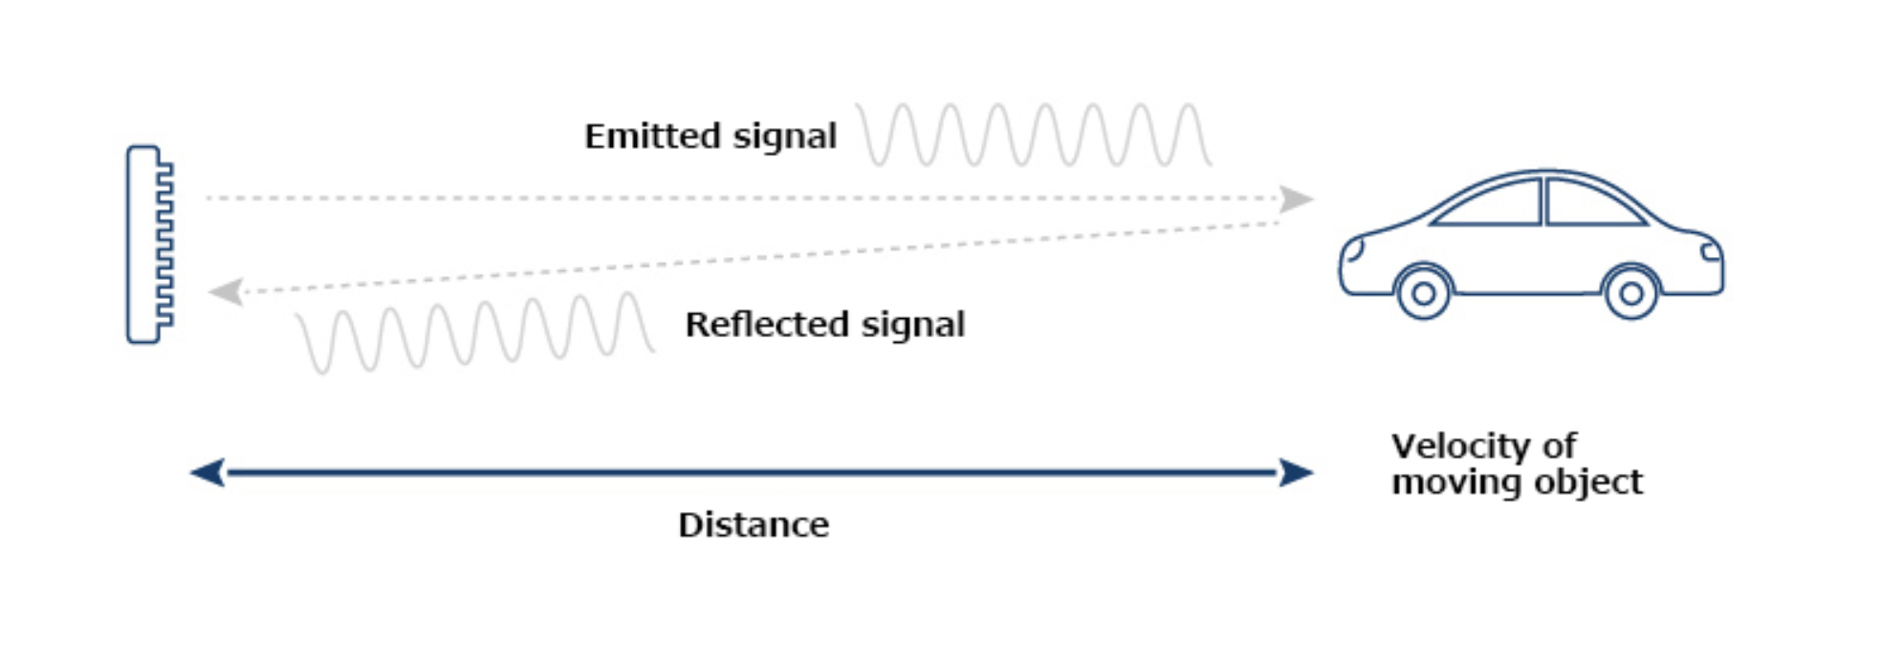
Introduction to FSK
Frequency Shift Keying (FSK) Radar
Measure range and radial velocity

Slide 5
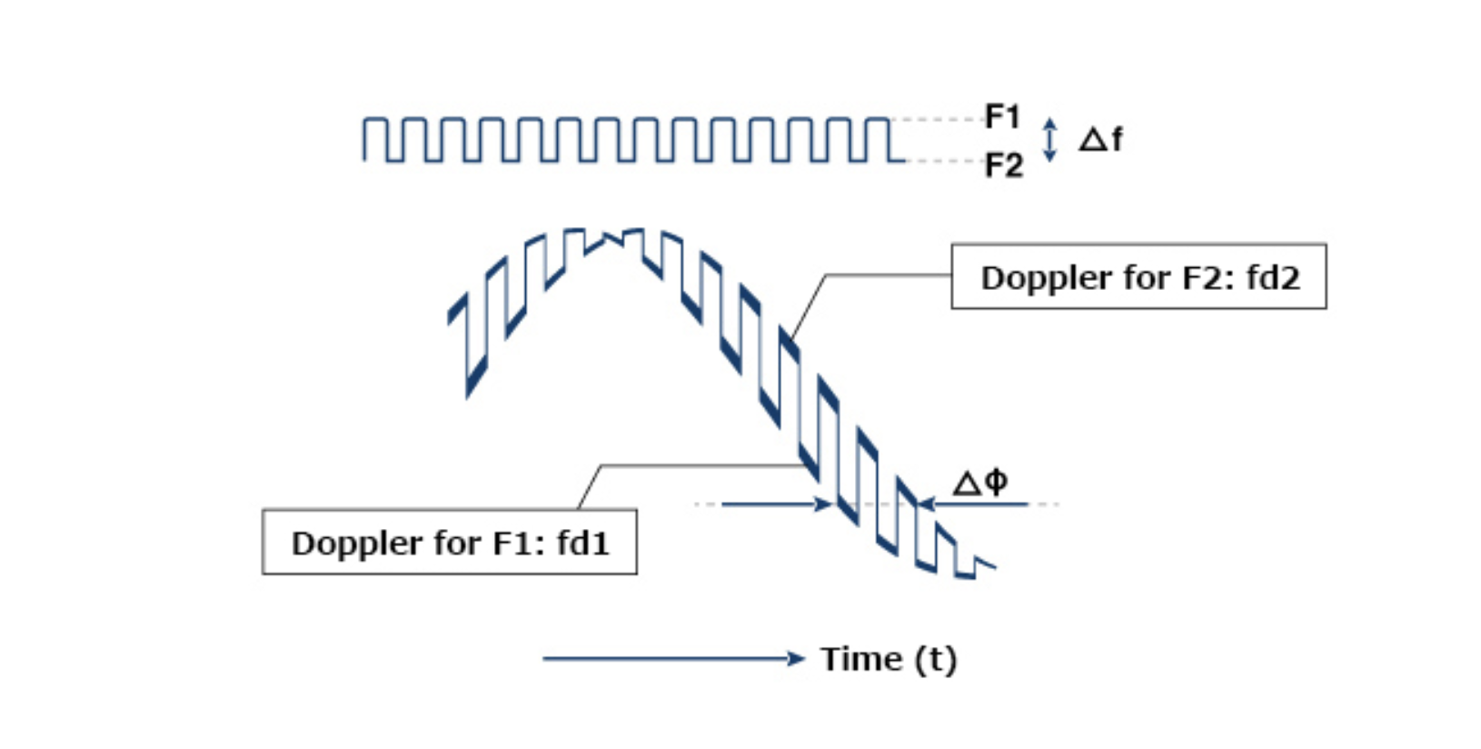
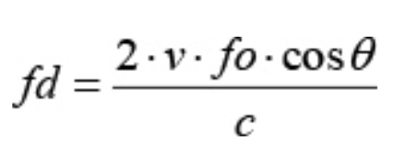
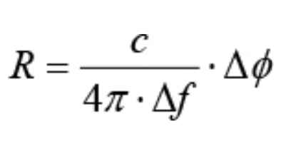
Introduction to FSK

Slide 6
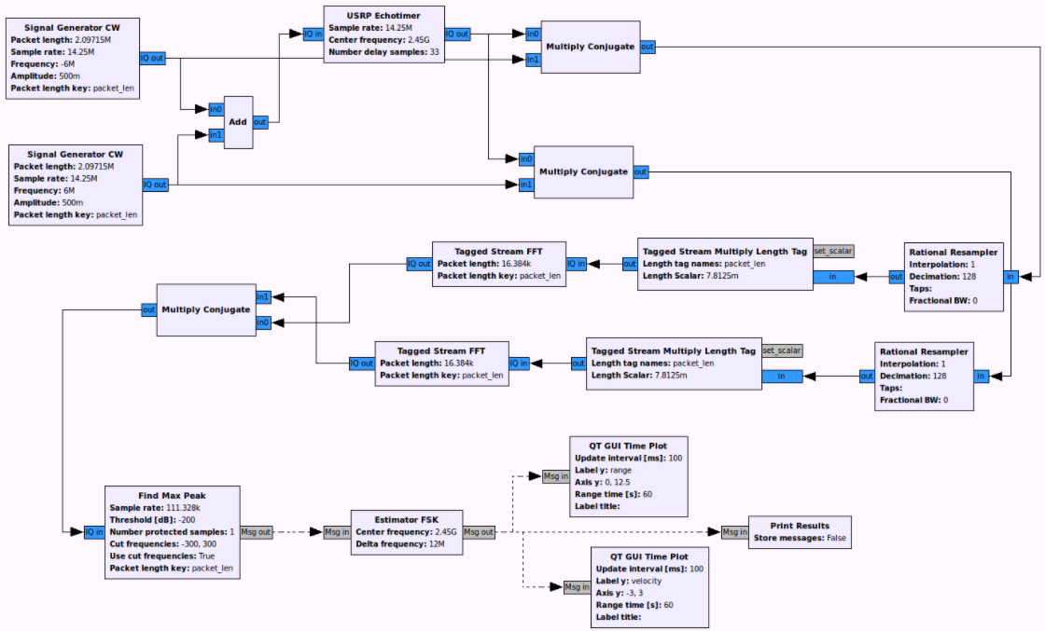
Code Review

Slide 7
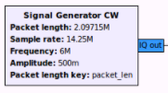
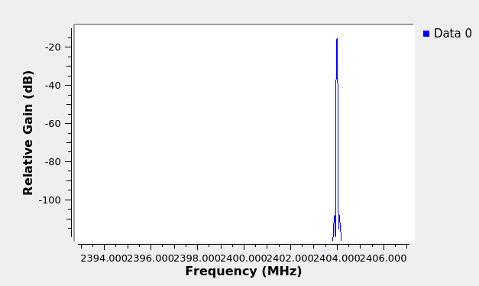
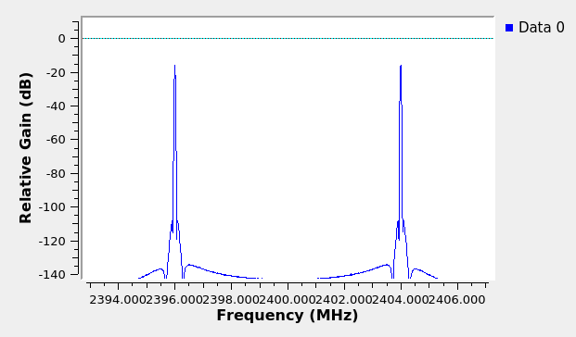
Signal Generator CW
Sends a continuous wave signal
USE
Dual CW
Each have a frequency ± X Hz from the center frequency

Slide 8

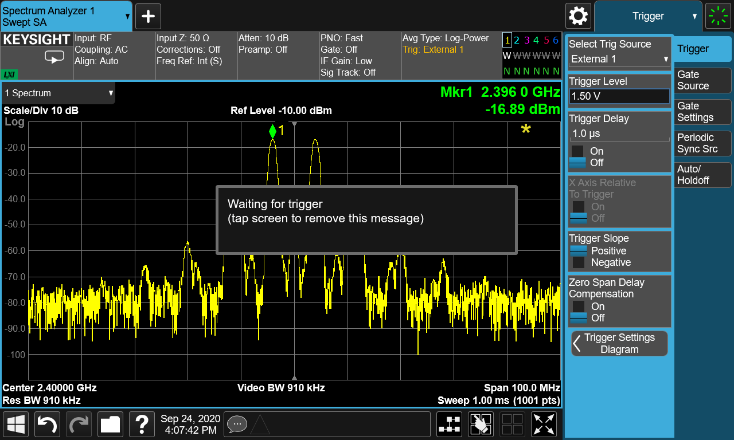
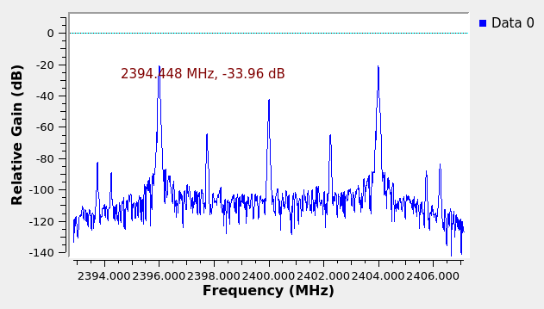
Signal Generator CW
Sends signal through USRP
Receives signal

Slide 9

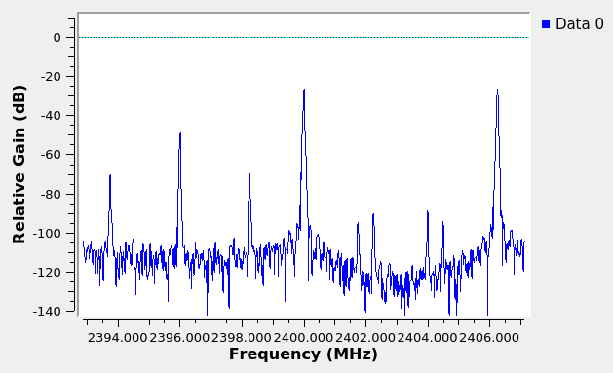
Multiply Conjugate
Multiply in0 by conjugate of in1
Remove phase difference
“Center Signal”

Slide 10

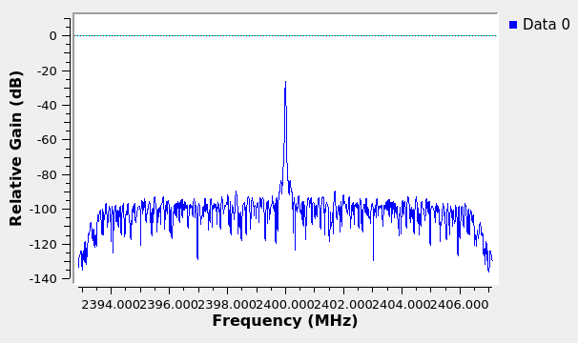
Rational Resampler
Upsample
Interpolation Factor
Down-sample
Decimation

Slide 11

Tagged Stream Multiply Length Tag
Attaches a tag to the signal

Slide 12

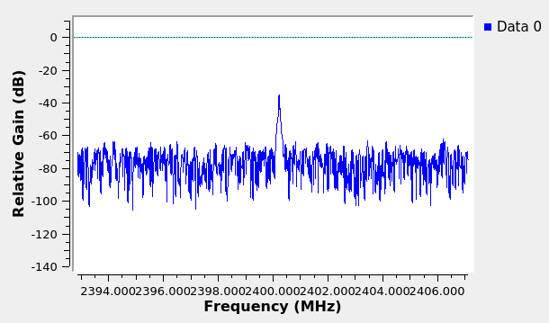
Tagged Stream FFT
Attaches a tag to the signal
FFT on signal

Slide 13
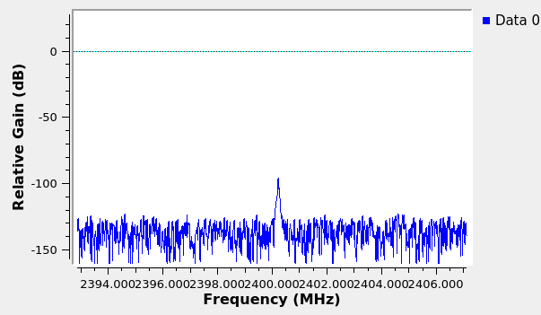
Multiply Constant
Modifies gain

Slide 14

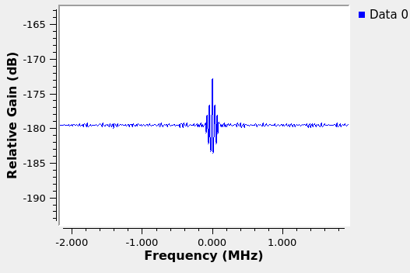
Multiply Conjugate… Again!

Slide 15
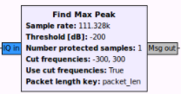
Find Max Peak
Determine the following
Frequency
Power
Phase

Slide 16

Estimator FSK
Calculate velocity
Frequency * Speed of Light (3e8) / [2*Center Freq]
Calculate range
Phase * Speed of Light / 4πΔf
Note: Speed of Light = 3e8

Slide 17
Data Logging
Tasks are as follows:
Logging of range
Logging of velocity
Logging of strength
Logging with timestamp

Slide 18
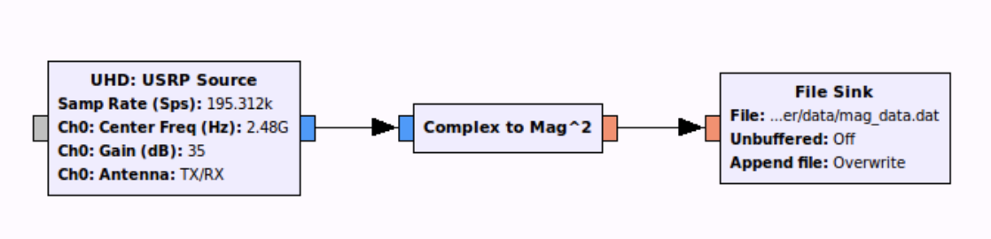
Logging of Range and Velocity
File Sink
GNU Radio has built in block called File Sink
File sink can be added to any part of the flowchart and will dump the ingoing data to a specified folder
Can be used to save each data point on the plot
Notes:
Complex 32 bit floating point for both I and 32 Q
Float 32 bit single precision floating point
Integer 32 bit signed integer
Short 16 bit signed integer
Byte 8 bit signed integer
https://adamgannon.com/2014/11/18/gnuradio_offline_pt1/

Slide 19
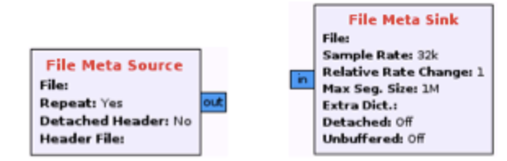
Timestamp
Use File Meta Sink
Adds header information to each sample when using File Sink Block
If USRP has GPS module, Meta Sink can save real time
Notes:
https://lists.gnu.org/archive/html/discuss-gnuradio/2017-03/msg00014.html

Slide 20
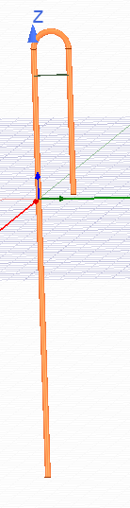
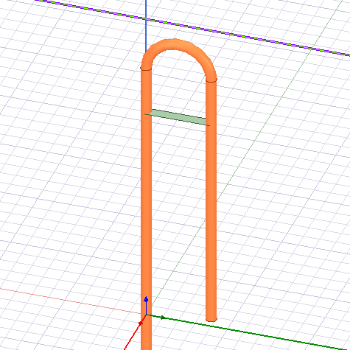
Dimensions
16.534 mm
Distance b/n wire = 4 mm..?
48.60 mm

Slide 21
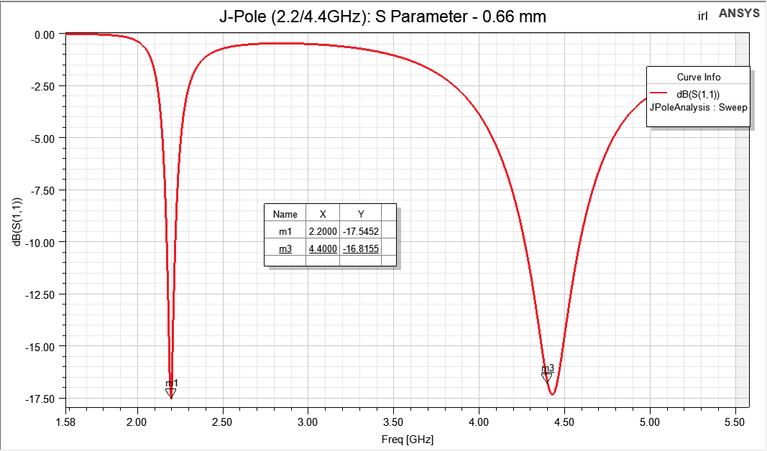
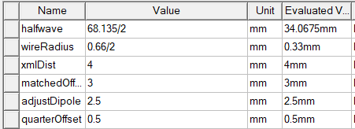
Transponder: J-Pole
Wire diameter: 0.66mm
S11 -17.55 dB @ 2.2 GHz -16.82 dB @ 4.4 GHz

