Slide 1
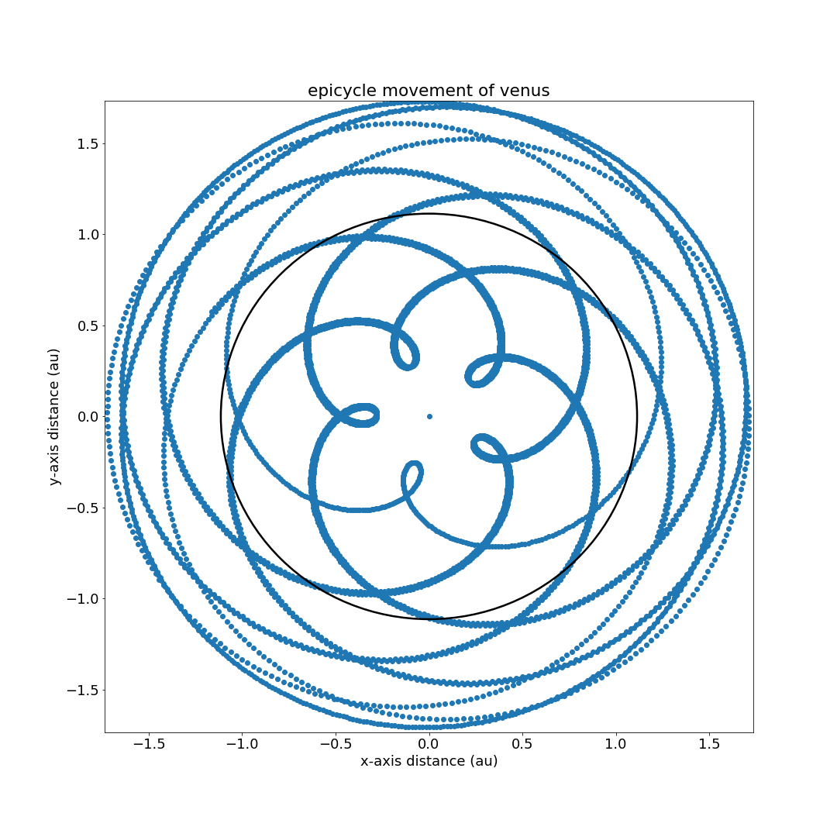
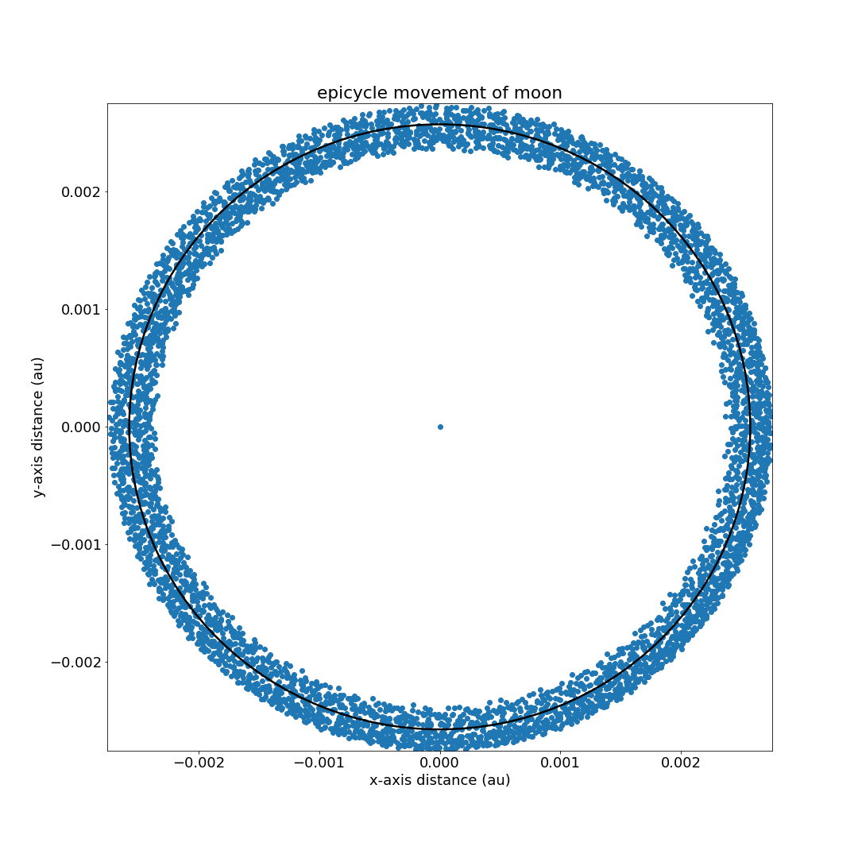
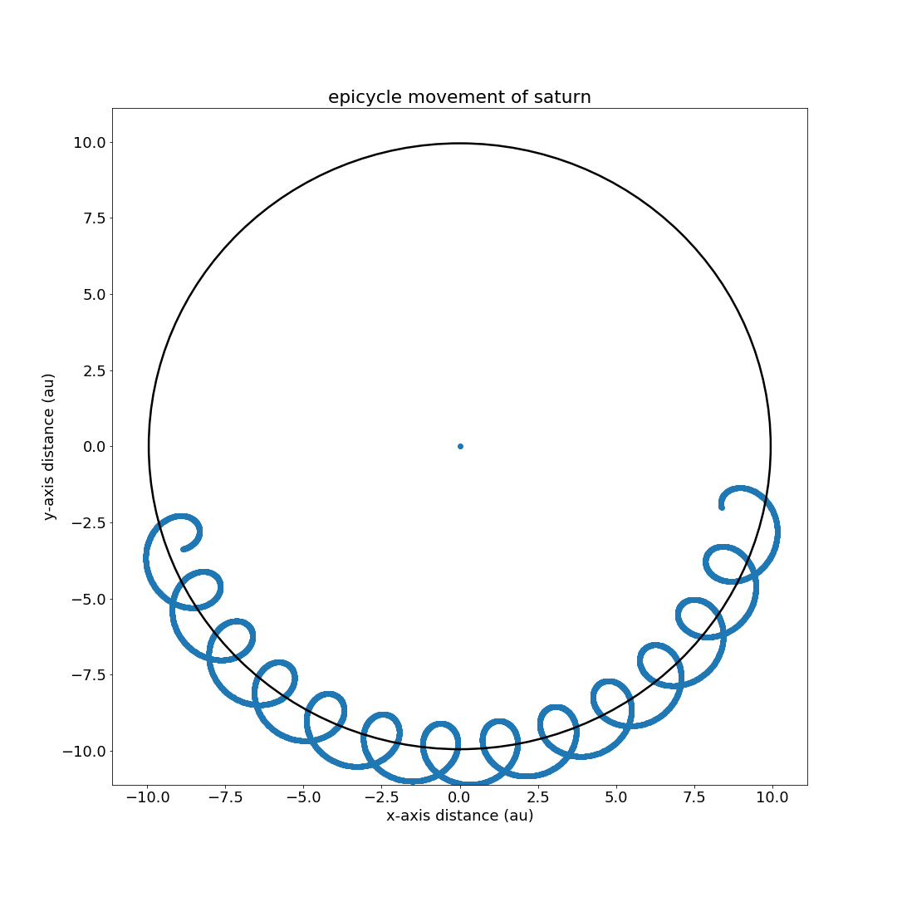
Ancient Indian’s Pulsating Epicycle Model
Vikash Raja, Musa Jalis, Otto Kwon, Anika Rede

Slide 2
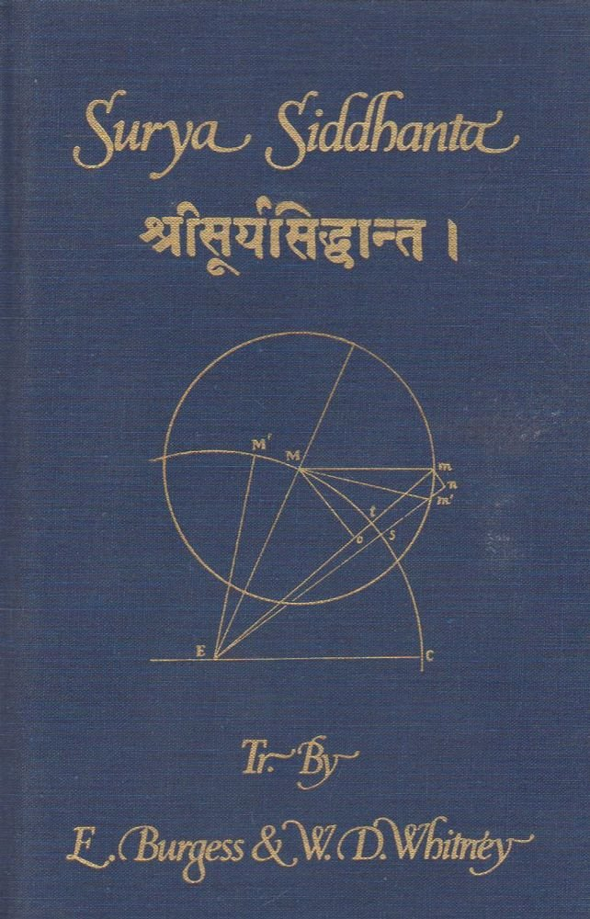
Introduction
Use Surya Siddhanta for the mathematical model
Core to advancement of this project
Understanding astronomical measurements and function parameters key
Kept within certain limitations: only used 2D measurements (no azimuth or right ascension) so we only used parameters like ecliptic longitude
Subdivided model into two parts:
Planetary motion
Eclipses / Moon phases

Slide 3

Data Used
Came in knowing our mathematical model
Saw Early S projects didn’t have parameters we needed → we used one of their references to generate and clean the data ourselves: skyfield
Used skyfield API which contained constants, units, and variables needed
Skyfield dataset contained data from year -3000 to 3000 which we took a portion of (years around creation of Surya Siddhanta) for our models

Slide 4
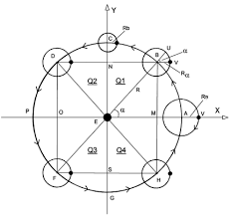
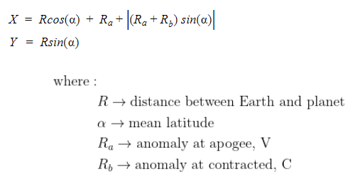
Mathematical Model: Planetary Motion
Ancient Indians believed that the planets, sun, and moon were circularly orbiting around Earth in epicylical manner where angular velocity expands and contracts depending on each quadrant
The model can be characterized by the equations:

Slide 5
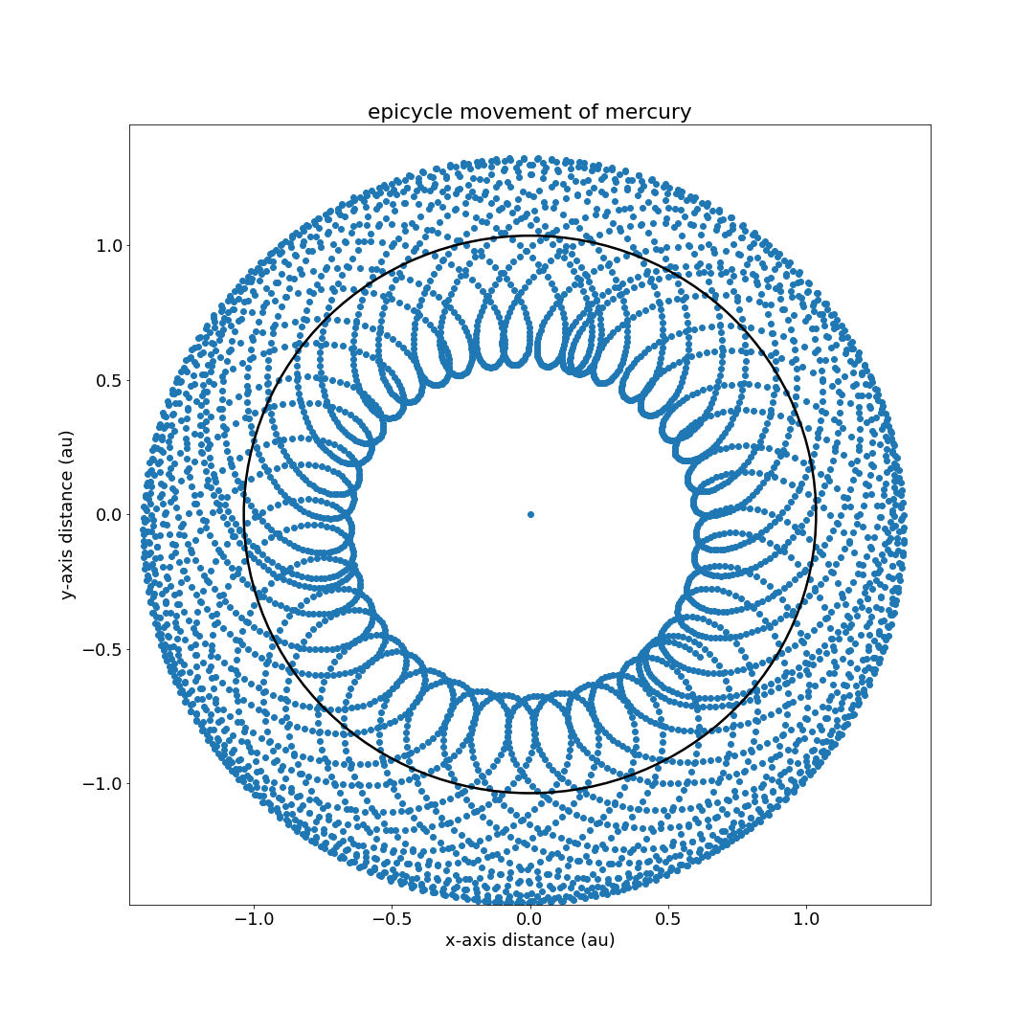
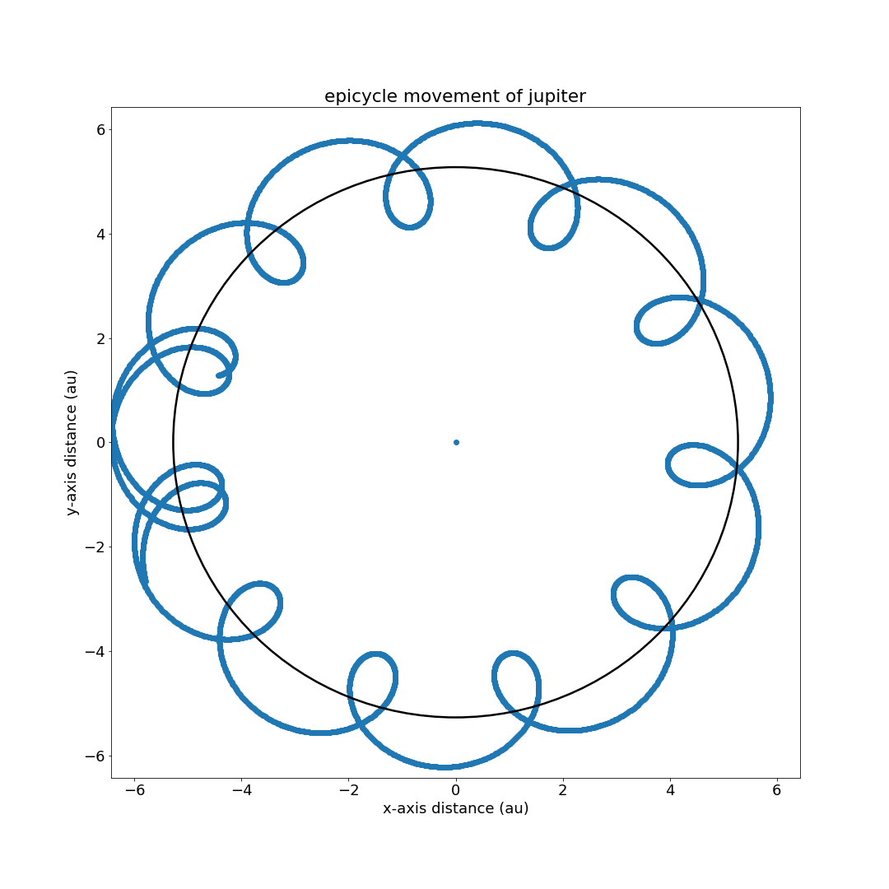
Mathematical Model: Planetary Motion
Examples:

Slide 6
ML Model: Planetary Motion
Although ancient Indians knew the existence of azimuth and right ascension, their astronomy model dealt with only ecliptic longitude so we limited our ML model input to ecliptic longitude.
Limited to 2D, we found fourier transformation to work best because it deals with explaining anything related with circular motion in terms of sine function
Found that all planets, sun and moon follow cyclical trajectory
Movement must involve some form of sine function
Focused on finding that sine function by applying fourier series and curve-fit it to find optimal sine function with least errors that deals with the planet data
Applied regression to predict our motion

Slide 7

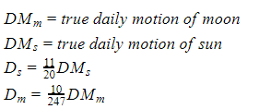
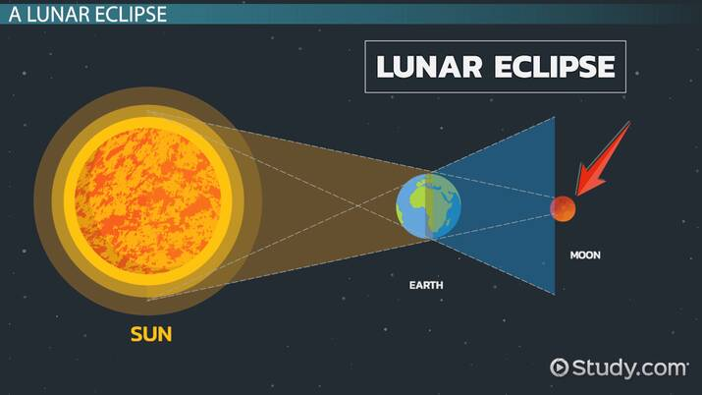

Mathematical Model: Eclipses
How did ancient Indians model eclipses? They estimated the obscured portion on an eclipsed body happening from the eclipser → to do this, we need to estimate many factors including: angular diameter of celestial bodies, moon’s latitude, and finally the obscured portion
Angular diameter: estimated by:

Slide 8
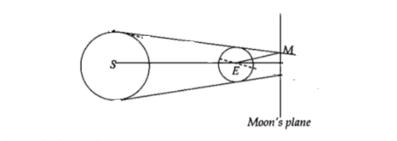
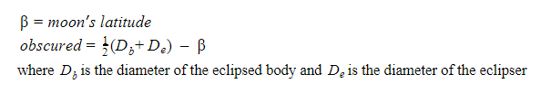
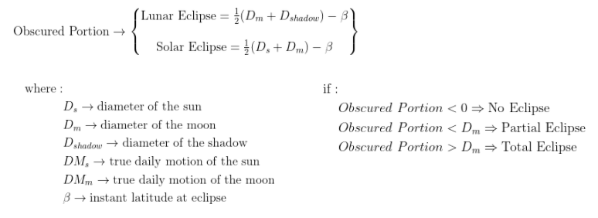
Mathematical Model: Eclipses
Moon’s Latitude
Description not clear, struggled with it and tested out various methods to reach it
Through a lot of research, found that this value means ecliptic latitude in celestial coordinate system and retrieved proper parameter from skyfield API
Obscured Portion:

Slide 9
ML Model: Eclipses
Due to limitations from the skyfield API, we could not test solar eclipses (we had no access to the true values)
Due to the nature of the mathematical model, we decided to use three approaches to calculate the maximum number of eclipses:
Calculating with the ancient Indian lunar eclipse formula
Using ML to generate classifier
Started with Gradient Boosting Classifier input with angular diameters, moon phase, and moon’s latitude
Tuning hyperparameters, we reduced subsample to 0.0099 → less than 1 meant this was effectively a Stochastic Gradient Boosting Classifier
Curve-fitting a sinusoidal model

Slide 10
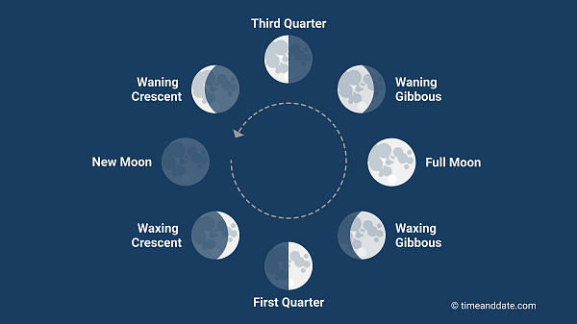
ML Model: Lunar Phases
No ancient Indian formula for calculating the phases of the moon
Used the illuminated fractions of the moon to calculate model
Lunar phases cyclic in nature so sinusoidal model fit aptly
Utilized curve-fitting to produce an accurate predictor

Slide 11
Results: Planetary Motion
Found Ra and Rb values for the planetary motion to approximate the epicyclic orbits
As amount of training data points reach beyond an upper limit, the Fourier series undergoes overfitting and leads to poor accuracy
When it was below the lower limit, the model again predicted inaccurately
e.g. when N (# of training points) was 50, the prediction for sun had mean absolute error of 0.02 au; when it reaches beyond 70, the error increases to 0.9 au (~450% previous error)
What does this show? → the sine function was not enough to clearly express the pattern of the universe

Slide 12
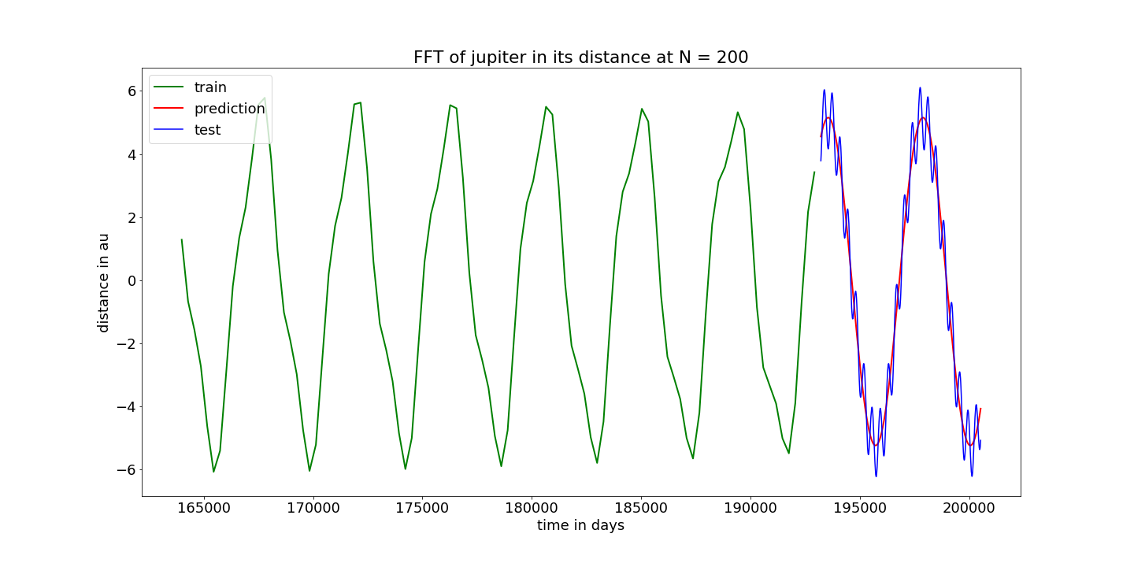
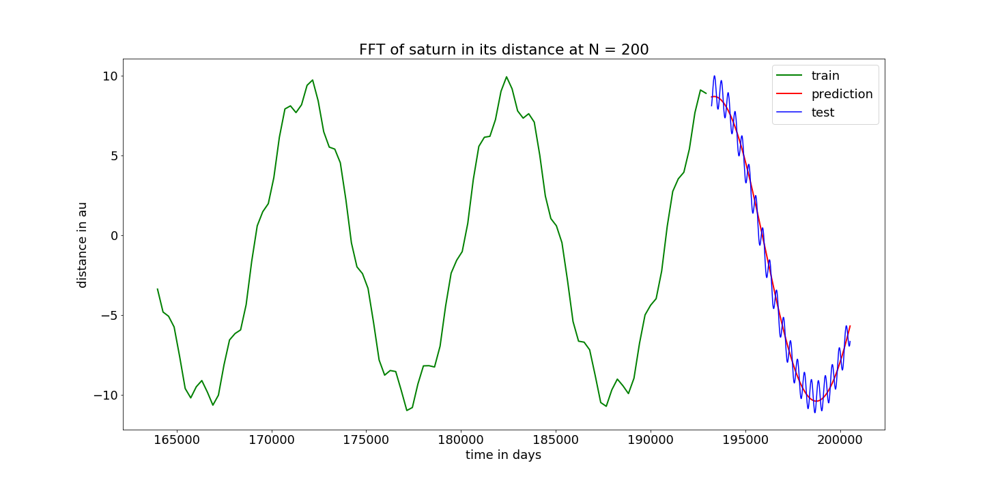
Results: Planetary Motion

Slide 13
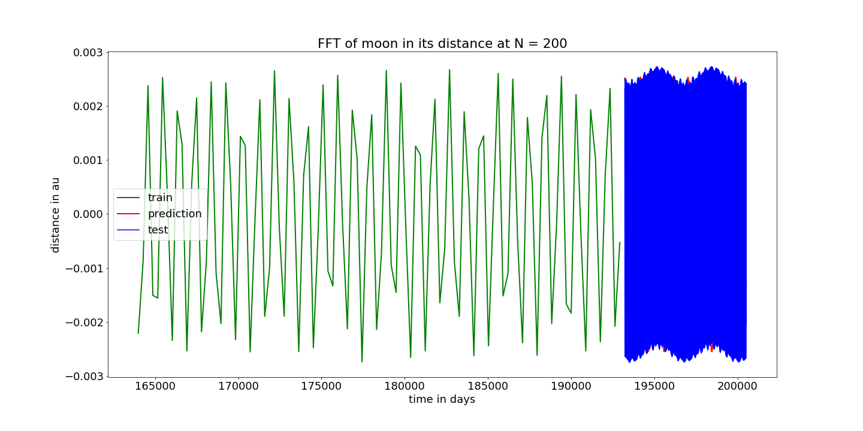

Slide 14
Results: Eclipses
Accuracy of eclipse count boosted up 10% after fixes to mathematical model
Inaccurate reading for times of eclipses -- found that this was not fault of our ML model but because of the mathematical model:
“The rules given by Brahmegupta, Varah-Acharija, and Aryabhatta may be used with such precautions. Any person may compose a set of rules for the common purposes of astronomy, but with regard to the duties necessary in eclipses, the computation must be made by the books of the Munis and the Bija applied” [1].
Ancient Indian Model
Mean-squared error: 0.01698
Accuracy score: 99.04 %
Stochastic Gradient Boosting Classifier
Mean-squared error: 0.01423
Accuracy score: 98.99%
[1] Brennand W. (1896) Hindu Astronomy . London: Chas. Straker and Sons, LTD.

Slide 15
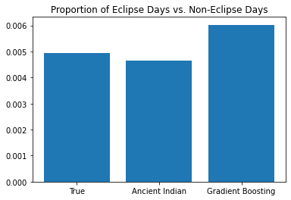
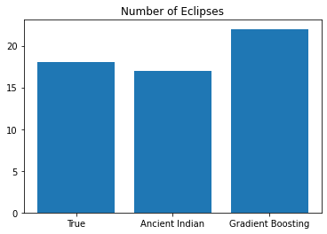
Results: Eclipses
Ancient Indian model slightly underestimated the maximum number of eclipses
Stochastic Gradient Boosting Classifier determined a maximum number of eclipses slightly greater than the true value

Slide 16
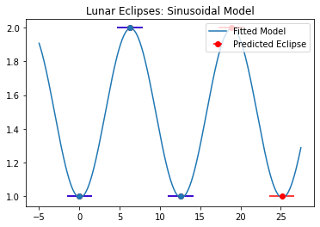
Results: Sinusoidal Eclipse Model
The midpoints of eclipse pairs are fitted with a sinusoidal model
Edges of “error-bars” are the prediction for the eclipse
ie. two eclipses at each maximum and minimum
Sinusoidal model predicts accurately in a small time frame
Discrepancies that occur between larger lunar cycles (ie. occasionally three consecutive full eclipses) prevent the model from achieving accuracy over a larger time frame

Slide 17
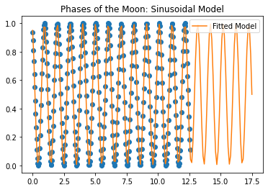
Results: Lunar Phases
Sinusoidal model provided a tight fit to the data after curve-fitting
Mean-squared error: 0.2389

Slide 18
Conclusion
Given the mathematical model of Surya-Siddhanta’s Heavenly Motion and the pulsating epicycle, we were able to model planetary motions, eclipse count over time, and moon phases. Our results tested well against the true values given the limitations.
Our unique approach (and contribution) was to look through a time-series approach. In all our sections, we tried understanding the astronomical events through a time series fitting to a sine wave whenever possible.
Next steps:
Find optimal number of samples for each object in planetary motion model
Get true values for solar eclipses and test the predicted values
Improve accuracy on timing for eclipses (i.e. dive back into the math)

