Slide 1

SRS and Design Presentation By Phuong Nguyen https://github.com/phuongnguyen0610/CS499-SWE

Slide 2
Summary
1. Project
The problem to be solved
Objectives
2. Vision
Problem Statement
Position Statement
3. SRS
Key Abstractions
Solution Design
VOPC Diagram
Class Diagram

Slide 3

Problems to be solved
Service details of the salon are written in papers; which always lead to misplaced information
The owner has no proper way to manage her employees and the services.

Slide 4

Objectives
Web Based system: help the owner and employees to successfully manage the salon by helping them create flexible work schedules, turn, tip, income integration.

Slide 5
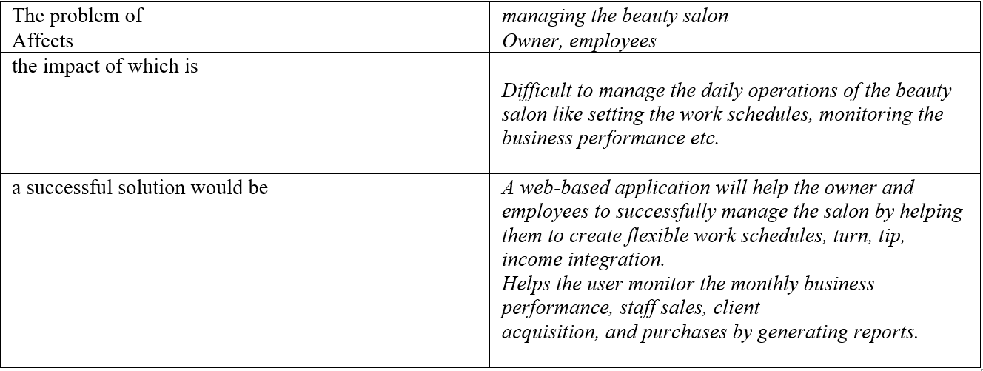
Vision - Problem Statement

Slide 6
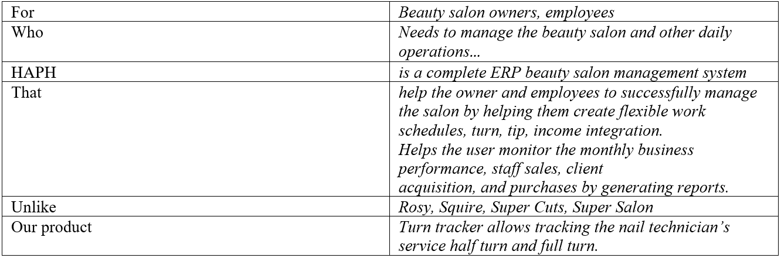
Product Position Statement

Slide 7
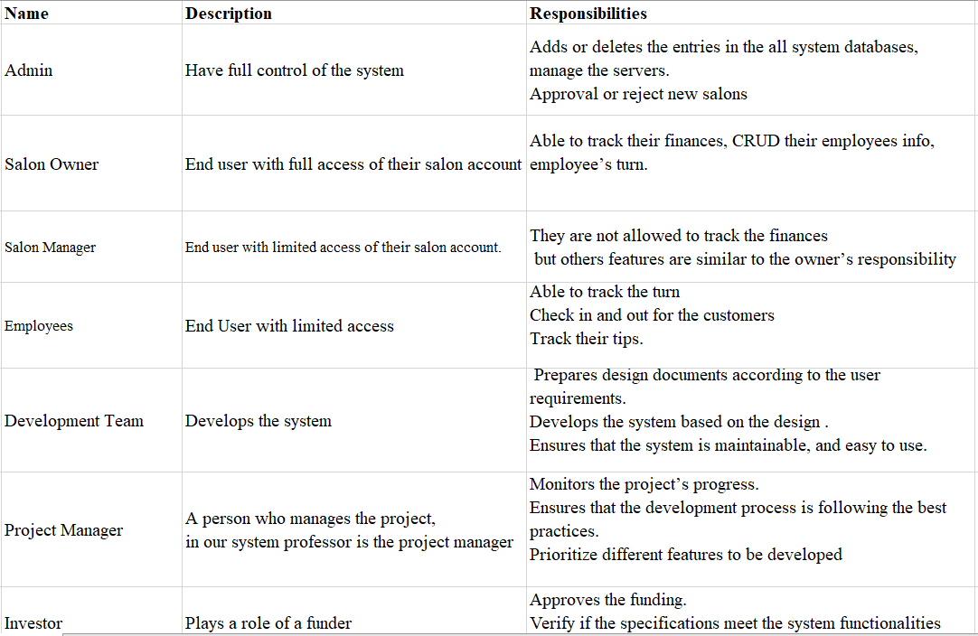
Stakeholder Summary

Slide 8
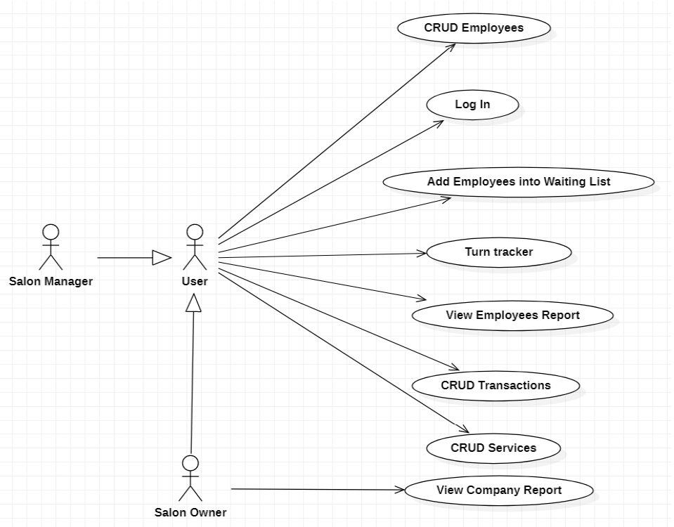
UseCases

Slide 9
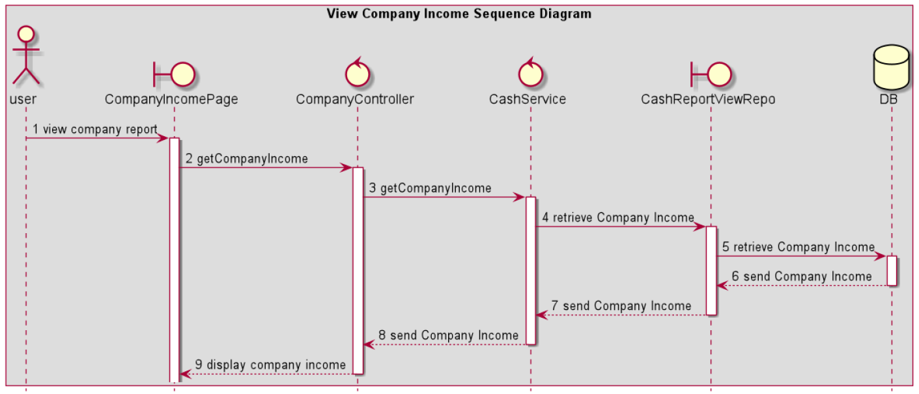

Slide 10
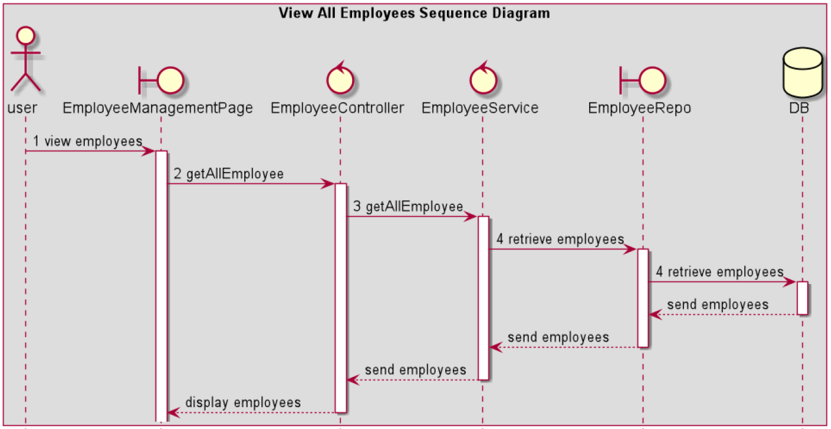

Slide 11
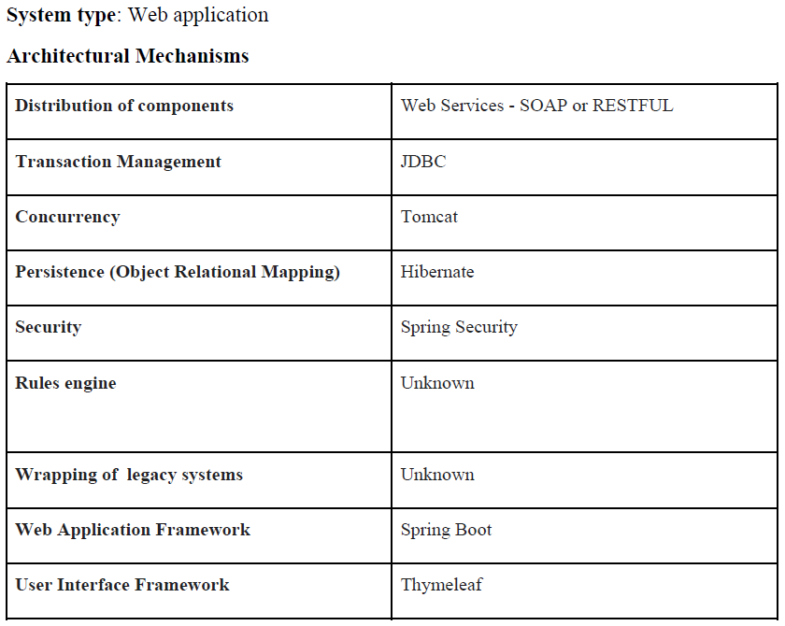
SRS - Architectural Mechanism

Slide 12
SRS - Key Abstractions
Employee
Service
Transaction
User

Slide 13
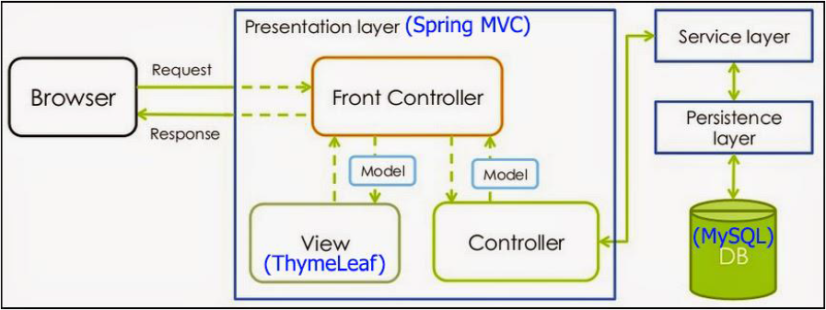
SRS - Solution Design

Slide 14
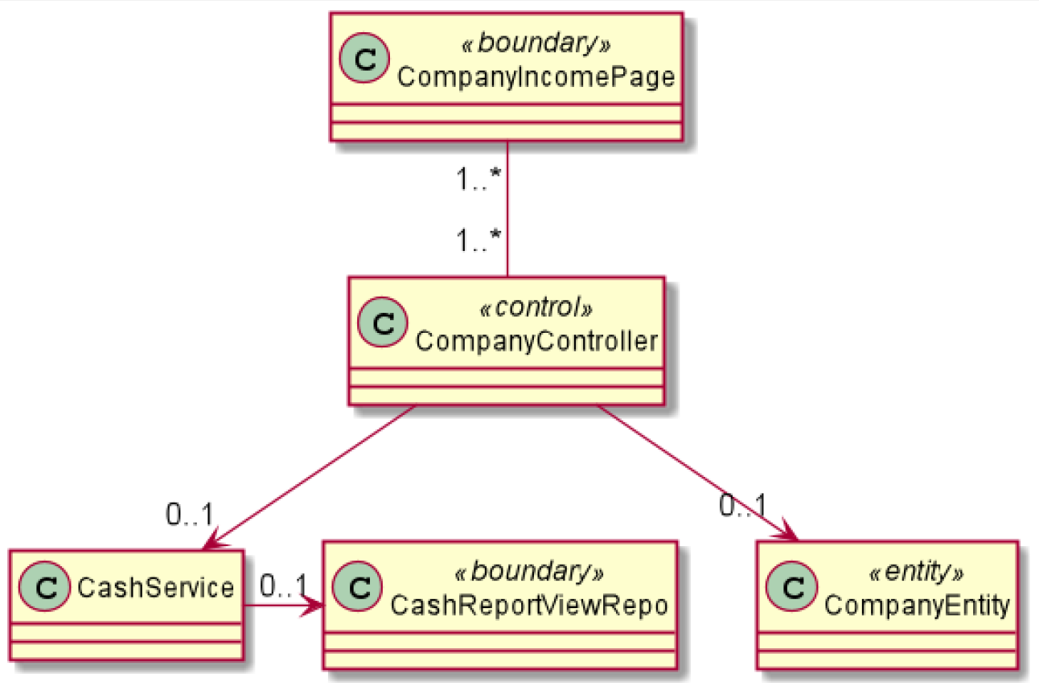
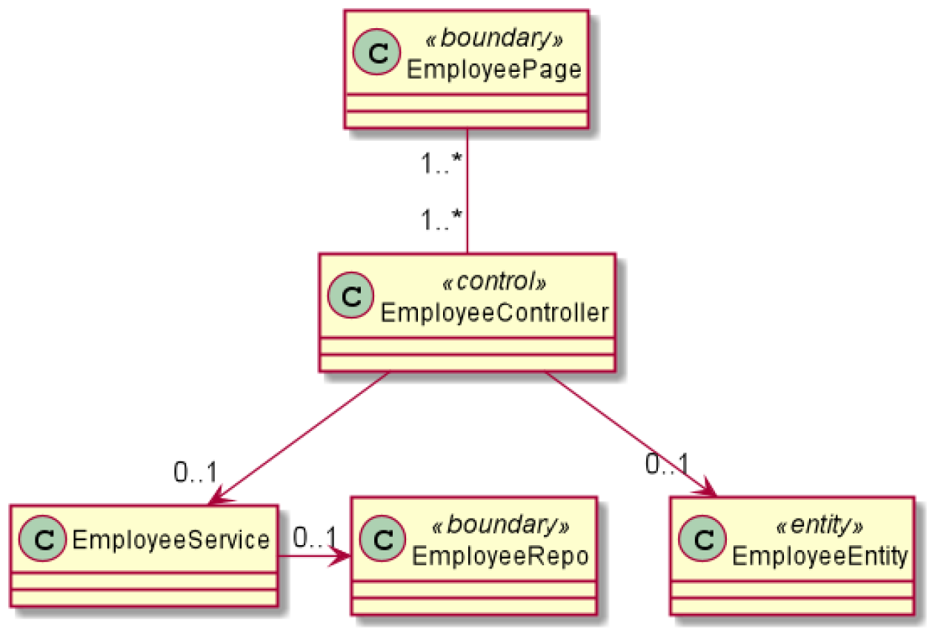
SRS - VOPC Diagram
View Company Income
View Employee

Slide 15
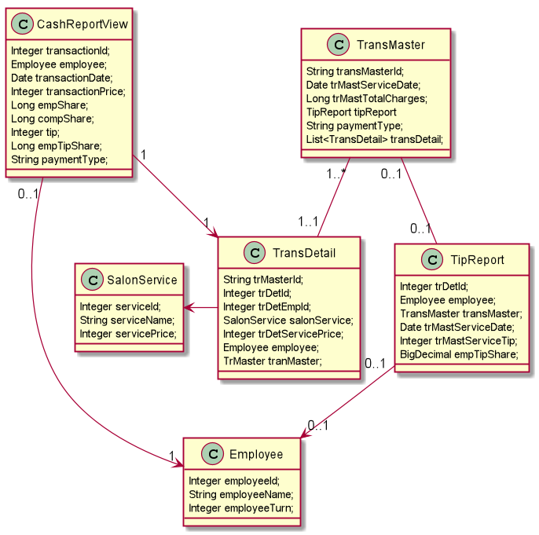
Class Diagram

Slide 16


