Slide 1
Data Wrangling in R Part I
Basics of importing files and working with lists

Slide 2
Prerequisites
R + Rstudio installed: https://www.rstudio.com/products/rstudio/download/ (Note: I have R version 3.5.0 (2018-04-23) -- "Joy in Playing”)
Tidyverse: https://github.com/tidyverse/tidyverse (Note: I have tidyverse version 1.2.1)
Data.table: https://github.com/Rdatatable/data.table/wiki/Installation#openmp-enabled-compiler-for-mac (Note: I have version 1.10.4 installed)
Janitor: https://github.com/sfirke/janitor
repurrrsive: https://github.com/jennybc/repurrrsive
Git clone git@github.com:dpolychr/personal.git

Slide 3
Importing csv and excel files from the web: readr
read_delim
read_csv
read_tsv
Useful arguments:
skip specifies the number of lines you're ignoring in the flat file before actually starting to import data
n_max specifies the number of lines you're actually importing
Go to 1_readr_example.R

Slide 4
Importing csv and excel files from the web – data.table
fread similar to read.table() but more convenient to use
- Infers column types and separators
- extremely fast
Two arguments of the function: drop and select, to drop or select variables of interest.
Example: Suppose you have a dataset that contains 5 variables and you want to keep the first and fifth variable, named "a" and "e". The following options will all do the trick:
fread("path/to/file.txt", drop = 2:4)
fread("path/to/file.txt", select = c(1, 5))
fread("path/to/file.txt", drop = c("b", "c", "d")
fread("path/to/file.txt", select = c("a", "e"))
Exercise: Report genomes and delivery version delivered by Illumina. Tabulate delivery version
Steps:
1. Download Illumina’s upload report (https://upload-reports.gel.zone/upload_report.latest.txt)
2. Select appropriate columns
2. Tabulate delivery version
Solution: 2_fread_example.R

Slide 5
Importing confluence pages – rvest
Websites do not always have an API thus the need for web scraping
Web scraping: grabbing the raw HTML of a website and then extracting values from it
Works by filtering the HTML of a webpage to just the bits you want using some kind of identifier
Use of selectors: basically a browser plugin or extension which when you mouse over an element of a page tells you what categories it falls into for ID purposes
Rvest is a dedicated web scraping package
Read HTML page with read_html(url=)
Read_html() returns an XML documents
Use html_node() to extract content with XPATHs
html_table(): extracts tables. It accepts a node containing a table object, and outputs a data frame.
Go to 3_rvest_example.R

Slide 6
Working with lists in R - Basics
R’s vectors:
• R vectors require all elements to have the same data type (that is, vectors are
homogenous)
• They only support the six data types (integer, double, character, logical, complex, and raw)
(In contrast) R lists are more versatile:
• Lists can contain elements of different types (they are heterogeneous)
• Elements can be any object in R (vectors with different types, other lists, environments,
dataframes, matrices, functions, etc.)
• Because lists can store other lists, they allow for storing data in a recursive way
(in contrast, vectors cannot contain other vectors)

Slide 7
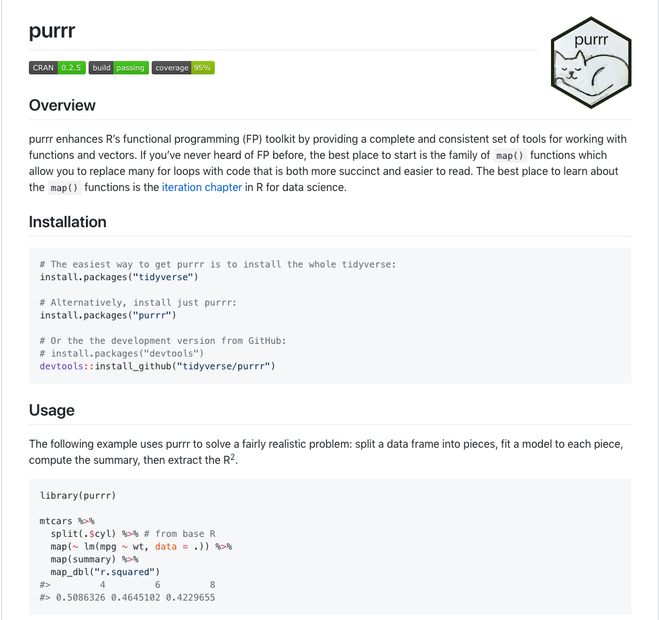
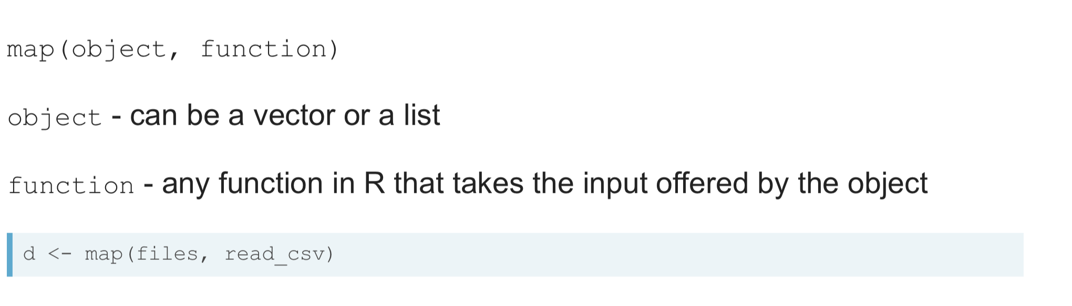
The power of iteration - purrr

Slide 8
Why using purrr?
1. Handy shortcuts for specifying .f
2. much more consistent than sapply(), lapply(), which makes them better for programming
3. Takes much less time to solve iteration problems
map() returns a list or data frame
4. Other nice features of the map functions are that they're implemented in C, which makes them really fast, and that they generally preserve names from their input in the output
The map functions are type consistent. This means you know exactly what type of output to expect regardless of the input. map_lgl() either returns either a logical vector or an error. map_dbl() either returns either a double or an error.

Slide 9
Examples working with lists
Map_*
Pluck: extract elements from lists
purrrlyr: Tools at the Intersection of 'purrr' and 'dplyr’
lift_dl(): transform a regular function to one that takes a list. This is often essential for composition with purrr functional tools. Since this is such a common function, lift() is provided as an alias for that operation.
set_names: Set names in a vector
unnest: unnest a list column
Go to 4_purrr_example.R

Slide 10
What to do if things go awry with a list
possibly
safely
Go to 4_purrr_example.R

