Slide 1
TEAM SEGFAULT
SAS Challenge

Slide 2
The task
Analyze an 8.22 GB (85000000 records) text file with data about different people, containing an ID and (if they exist) friends, marriages, etc.
3466232473311746214
{
FRIEND_OF 4933548186384615899
HAS_DATED 9018986335256550605
MARRIED_TO 9037928425569316821
MARRIED_TO 5926362644764317368
}
8834759487259564337
{
MARRIED_TO 4576338204450594741
HAS_DATED 6145390101227467620
MARRIED_TO 404842401115807823
}

Slide 3
Design
DATA STRUCTURE
Load the data into linked list and convert it to a hash map
Use a person’s ID as the key and their relationships as values which are represented via a set of linked lists
These lists are stored in arrays based on their type – incoming or outgoing relationships

Slide 4
Design
DATA STRUCTURE

Slide 5
Design
DATA STRUCTURE

Slide 6
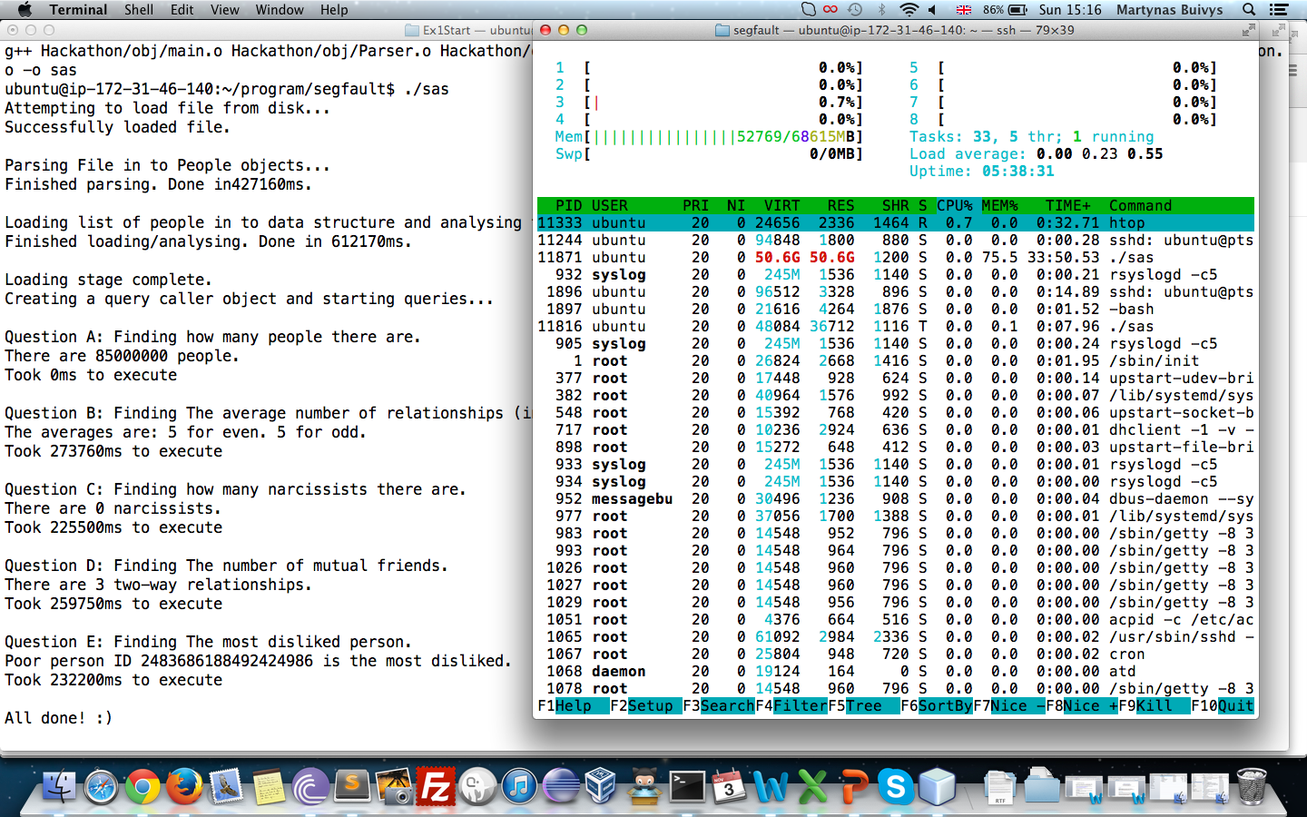
Design
DEPLOYMENT
Make use of Amazon Web Services
Use a large server to load all data into RAM
Perform queries on the data
Almost 53G RAM usage

Slide 7
Implementation
Use C++
Generally faster execution compared to Java
Can take advantage of the STL for building the data structures
Part of our team are already familiar with C++

Slide 8
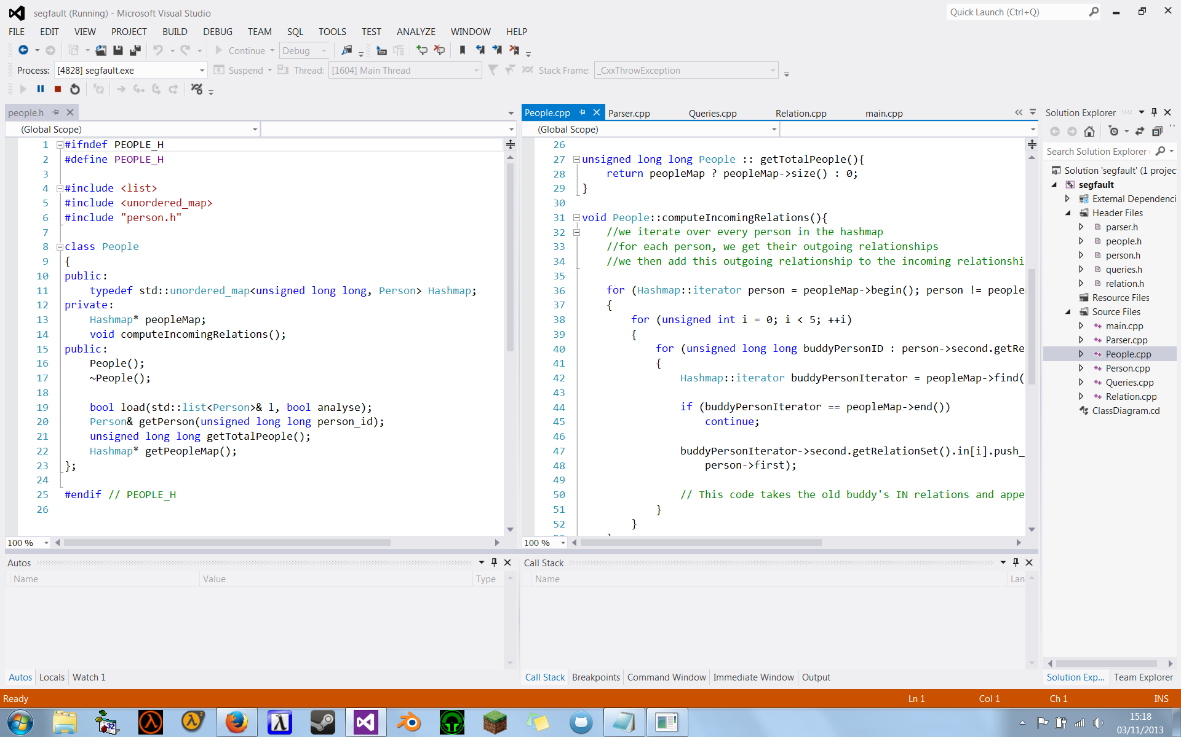

Slide 9
Query Results
Query A: 85 million people / 0 ms
Query B: 5 for even, 5 for odd / 273,760 ms
Query C: 51 people / 226,560 ms
Query D: 3 two-way relationships / 259,750 ms
Query E: Person ‘2483686188492424986’ is the most disliked one / 232,200 ms
Task F: Implemented

Slide 11
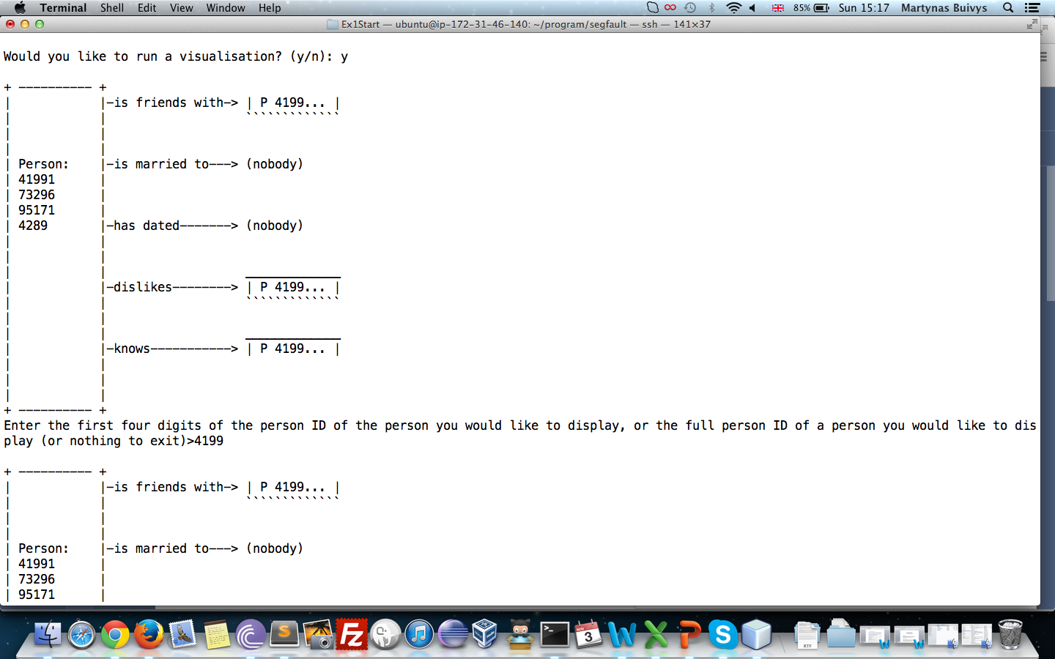

Slide 12
What we learned from doing this challenge:
How to approach working with big data
Implementing ADTs with C++
Performance monitoring
The power of the Standard Template Library
How to Amazon Web Services for testing
Working with technical constraints

