Slide 1
Portfolio Milestone Syracuse University, School of Information Studies M.S., Applied Data Science
Leland M. Ball

Slide 2
Portfolio Milestone
Report and Presentation
Notes:
There are two key components to this Portfolio Milestone: The Portfolio Report, and this presentation, which is a summary of the Portfolio Report

Slide 3
Roadmap
Data Science: An Overview
Learning Goals: Summarized
Course Deliverables: 4 Examples of Data Science
Review and Conclusions

Slide 4
Data Science
An Overview

Slide 5
Many Components
To name a few,
Data Mining
Data Analysis
Data Visualization
Predictive Analytics
Machine Learning
Statistics

Slide 6
Three Main Foci
What makes a Data Scientist? Several things:
Statistics
Math
Data Expertise
Programming
Visualization
Subject Expertise
Communication
Business Rules
Ethics
Statistics
Data Expertise
Subject Expertise

Slide 7
Learning Goals
For the Applied Data Science Program at Syracuse

Slide 8
A Practitioner’s Approach
From theory to application, the Applied Data Science program focuses on application of theory to real-world decision making
Learning Goals
Data Collection and Organization
Data Analysis and Visualization
Data-Based Strategy and Decision-Making
Implementing Data-Based Discoveries
Ethics and Communication
Notes:
Not content to remain entirely in the theoretical realm, the Applied Data Science program takes a Practitioners Approach by focusing on the following learning goals to apply theory to the real-world

Slide 9
Course Deliverables
Four Examples of Data Science

Slide 10

Electricity Bill Process Improvement
MBC-638 Data Analysis and Decision-Making
Notes:
I will begin with one of the first classes I took in the program. My Final Project for the Data Analysis and Decision-Making course required amalgamating multiple sources of data, analysis and visualization of the data, and application of statistics to determine actual effectiveness of a process. The resulting recommendations for the process improvement carried real weight as a way to improve the process, in this case- my electric bill.

Slide 11
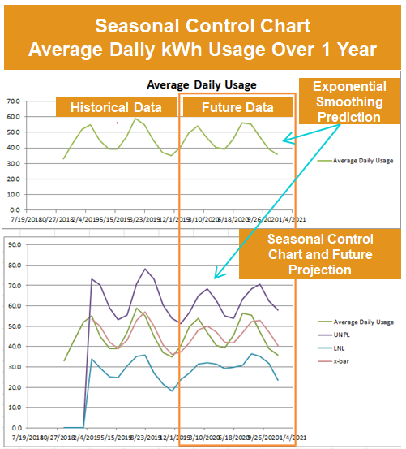
Project Description
Lowering an above-average electric bill
Data sources include temperature, weather conditions, household occupancy, thermostat adjustments, and energy usage
Statistical significance of each factor
Data mining discovered tenant’s AC unit
Data-based decision making enabled measurement of future success
Process control chart with seasonality
Notes:
After obtaining hourly data for the temperature, weather conditions, household occupancy (as determined by cellphone network presence), thermostat adjustments, and household power meter readings, I was able to thoroughly investigate why my electric bill was higher than average.
One surprising result of this statistical analysis was discovering that only one of us four tenants had a statistical impact on the power usage. I determined this was due to my house-mate’s window AC unit, which he turned on manually when returning home from work.
While the above-average power consumption was not significantly different after making process adjustments, I was able to develop a process control chart that handled seasonality, which gave the ability to determine the effectiveness of process changes in the future.

Slide 12
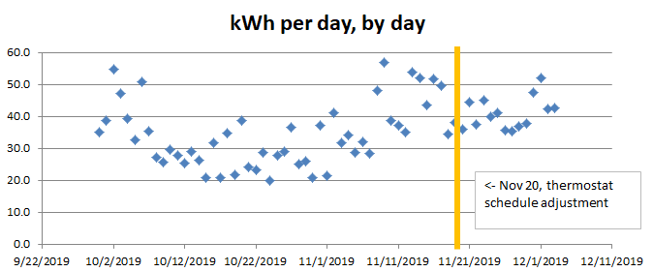
Learning Goals Demonstrated
Electricity Bill Process Improvement
Home Electricity Usage before and after process adjustments
Goal | Demonstrated
Data Collection and Organization | Multi-Source CSV and Custom Data
Data Analysis and Visualization | Excel-Based Plots and Charts
Data-Based Strategy and Decision-Making | Process Control Method
Implementing Data-Based Discoveries
Ethics and Communication | Data Privacy, Data Sanitization
Notes:
The following learning goals were demonstrated by my successful completion of this project

Slide 13

Hotel Recommendations
IST-687 Applied Data Science
Notes:
The next project I chose for my portfolio is my group assignment and Final Project in the Applied Data Science course. The goal of this project was to take a provided set of hotel customer satisfaction surveys, and determine what this large hotel chain could do to improve its customer satisfaction rating.

Slide 14
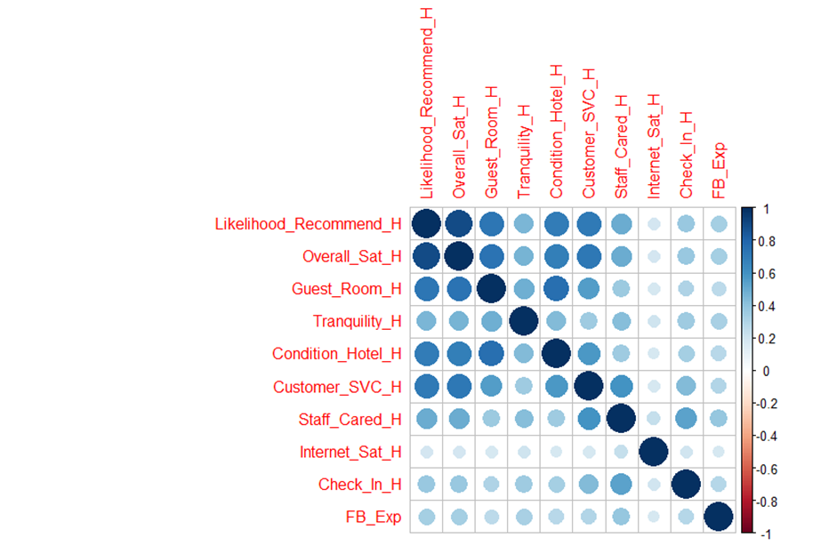
Project Description
Increasing Customer Net Promoter Scores (NPS) for Major Hotel Chain
Survey data mined for
Strategies and Implementation details produced to improve business
Able to determine ineffectiveness of certain initiatives in customer rating of hotel
Correlations of Customer survey Variables
Notes:
Customer satisfaction in the customer service industry is often measured using the Net Promoter Score (or NPS)
NPS is a 1 to 10 measurement of customer experience, with
0-6=Detractor, 7-8=Passive, 9-10=Promoter
Our project required mining a provided dataset to discover any correlations within the data that could be leverage to provide a more positive experience to customers.

Slide 15
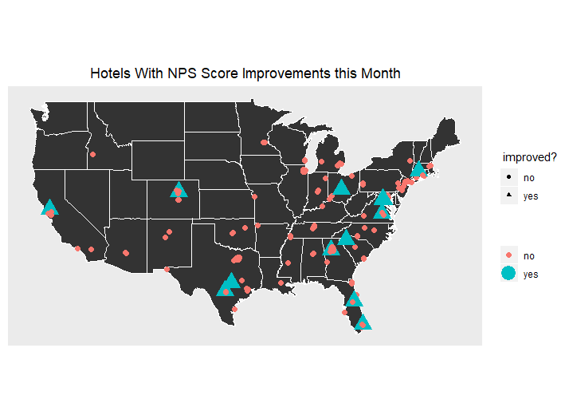
Learning Goals Demonstrated
Increasing Customer Net Promoter Scores (NPS) for Major Hotel Chain
Hotels showing net promoter score increases
Goal | Demonstrated
Data Collection and Organization
Data Analysis and Visualization | R-Based Visualizations
Data-Based Strategy and Decision-Making | Statistics-Based Hotel Performance
Implementing Data-Based Discoveries | Long-Term Strategies Produced
Ethics and Communication | Statistics for C-Level Audience
Notes:
The Hotel Recommendations project demonstrates my accomplishment of the following learning goals
Data analysis and Visualization of that analysis, as can be partially seen in the included visuals
In the way of Long-term strategies, myself and my team were able to determine that membership in a tiered program (Silver/Gold/Platinum memberships) was ineffective at increasing NPS scores
The goal of producing data-based discoveries is demonstrated by the immediate insights my team was able to provide. Insights such as which hotels are not just above and below median, but doing statistically better relative to their peers.
Finally, the communication goal was demonstrated as we were able to take technical regression analyses and explain to a non-technical audience why certain factors do or do not play a significant role in a customer’s perception of the hotel

Slide 16

US Vaccine Analysis
IST-772 Statistical Methods in IST
Notes:
I have also chosen to include an example of my ability to employ both Frequentist and Bayesian statistical methods.
The US Vaccine Analysis was a written test given to us in my Statistical Methods class. The test was formatted to be a request from a School District Supervisor, who was interested in the current vaccination status of California schools and how they compared to the rest of the country, in addition to requesting detailed, supportable strategies for increasing vaccination rates.

Slide 17
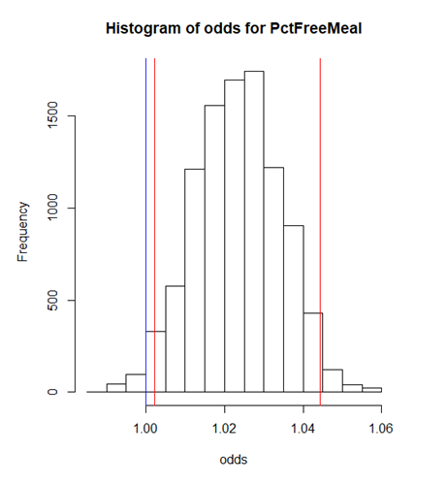
Project Description
Analyze School Vaccine Rates in the USA
Advanced statistical analysis of vaccine data
Produced tactical answers to questions
And additionally, recommendations for strategies to increase vaccination rates
Highest Density Interval log-odds for variable showing significance
Notes:
The final test of every ounce of statistical knowledge I have been taught, this report showed the side of data science that can be heavy on the stats. In the report, I detailed both strategic and tactical answers to what may increase vaccination rates among Californian schools. These answers were conveyed to an audience of school district statisticians, in addition to a less-technical group of school district supervisors. One interesting but expected finding in the report was the possibly confounding correlations between children receiving free meals and children or families noted as being in poverty. These variables were important to sort through and understand, so as to arrive at correct and supportable conclusions.

Slide 18
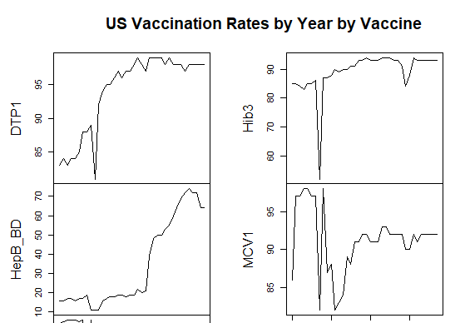
Learning Goals Demonstrated
Analysis of School Vaccination Rates
US vaccination rates by year, by vaccine type
Goal | Demonstrated
Data Collection and Organization
Data Analysis and Visualization | R-Based Visualizations
Data-Based Strategy and Decision-Making | Long-Term Strategies Identified
Implementing Data-Based Discoveries | Short-Term Action-Items Produced
Ethics and Communication | Technical and Non-Technical Audiences
Notes:
The learning goals exemplified in this report begins with the advanced statistical analysis and visualizations. This was all accomplished using the Frequentist and Bayesian statistics packages available in R, as well as R’s visualization libraries.
I demonstrated using data to support strategies and decision-making in this report, showing that student poverty and district size can each play a role in vaccination rates, and suggesting strategies for directing funds in different ways to address vaccination rates in both richer and poorer neighborhoods.
In this report I discussed discoveries made in the data, and was able to identify further areas of research to include geographic differences that may turn up additional insights into student vaccination rates in California.

Slide 19

Salary for a Syracuse Football Coach
IST-718 Big Data Analytics
Notes:
In this project for the Big Data Analytics course, I demonstrated the achievement of multiple learning goals by using data in my investigation of just what the salary should be for a coach of Syracuse’s football program.

Slide 20
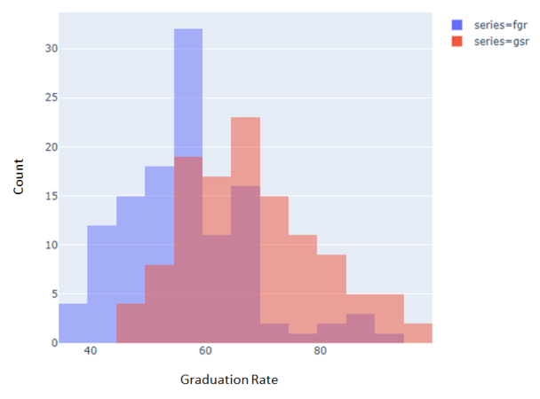
Project Description
Determining a Salary for the Syracuse Football Coach
Multiple online data sources scraped
Data mined for significant variables
Models created to determine salary range for coach, given past performance
Report catered to both technical and non-technical audience
Actionable implementation of results
Two methods of measuring graduation rate compared- further investigation showed no significance to coach salaries
Notes:
In a great example of obtaining data, multiple data sources were programmatically scraped from websites like wikipedia and the NCAA
My analysis showed multiple variables that were significant, and some variables that seemed significant at first, but weren’t. One such example is the graduation rate of players, as seen in the chart on the right
FGR and GSR are two methods of measuring graduation rates, neither of which appeared to be significant to a team’s performance
I was able to deliver a series of actionable results: the salary of the coach, and a model to determine what a given coach’s salary should be, as described by past performance and membership in a given conference, among other things.
Finally, this project is a demonstration of how I took technical data and communicated it to audiences in a way that was appropriate for their level of technical understanding.

Slide 21
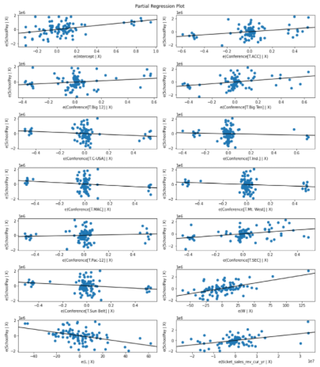
Learning Goals Demonstrated
Determining a Salary for the Syracuse Football Coach
Partial regressors for variables affecting coach salaries
Goal | Demonstrated
Data Collection and Organization | Multi-Source Python Web-Scraping
Data Analysis and Visualization | Python-Based Visualizations
Data-Based Strategy and Decision-Making | Variable Importance Ranking
Implementing Data-Based Discoveries | Models Developed show Salary Ranges
Ethics and Communication | Technical and Non-Technical Report
Notes:
As I mentioned in the previous slide, this project was exemplary of many categories of learning goals,
From collecting and organizing data from disparate sources to analyzing and visualizing that data with Python. I was able to demonstrate strategy and decision making by identifying just what factors go into determining what salary a coach should earn, and then implemented a model to produce a dollar-amount salary based on my discoveries in the data.
The final form was delivered to audiences both technical and not, communicating the important details clearly, without sacrificing technical detail.

Slide 22
Review and Conclusion

Slide 23
Demonstrated Achievement of Learning Goals
Data Collection and Organization
Data Analysis and Visualization
Data-Based Strategy and Decision-Making
Implementing Data-Based Discoveries
Ethics and Communications
Notes:
In my study of Data Science at the Syracuse School of Information Studies, I have acquired the skills to perform increasing complex data collection, analysis, and visualization tasks.
This program has equipped me to tackle a range of data-related problems, and has given me the tools needed to develop data-based strategy and implement data-based discoveries, then communicate these solutions and observations to a variety of audiences and stakeholders.
This program has proved to be a cohesive unit, walking me through the path that is these learning goals. Along the way I have demonstrated each of them in different ways. The three projects I have shown in this presentation are but a sample. The written report contains a little bit more.
It has been my pleasure to attend this program, and I thank you for watching my presentation of my Portfolio Milestone

Slide 24
Thank You
Please see Portfolio Milestone Paper for three additional Data Science project examples
Leland M. Ball
Portfolio Milestone Syracuse University, School of Information Studies M.S., Applied Data Science

