Slide 1
Mutual Fund Analytics Dashboard
Bluestock Fintech Capstone Project
Prepared by: Sai Ram Reddy
Tools: Power BI • Excel • CSV • Data Analytics

Slide 2
Project Overview
• Built an interactive Power BI dashboard for Mutual Fund Analytics.
• Analyzed Assets Under Management (AUM), NAV, SIP inflows, fund performance, and investor behavior.
• Designed interactive charts, KPIs, slicers, and trend analysis.
• Focused on business insights for data-driven decision making.

Slide 3
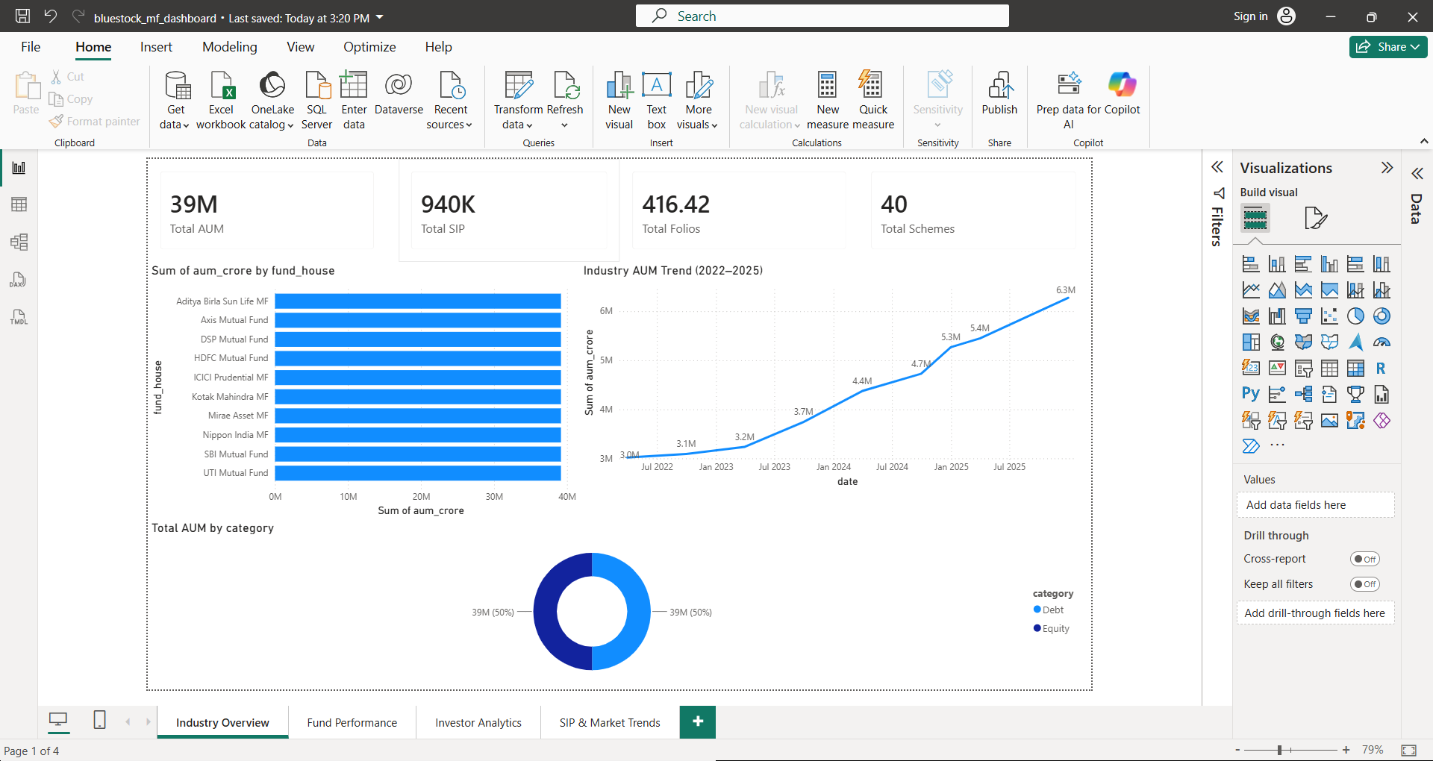
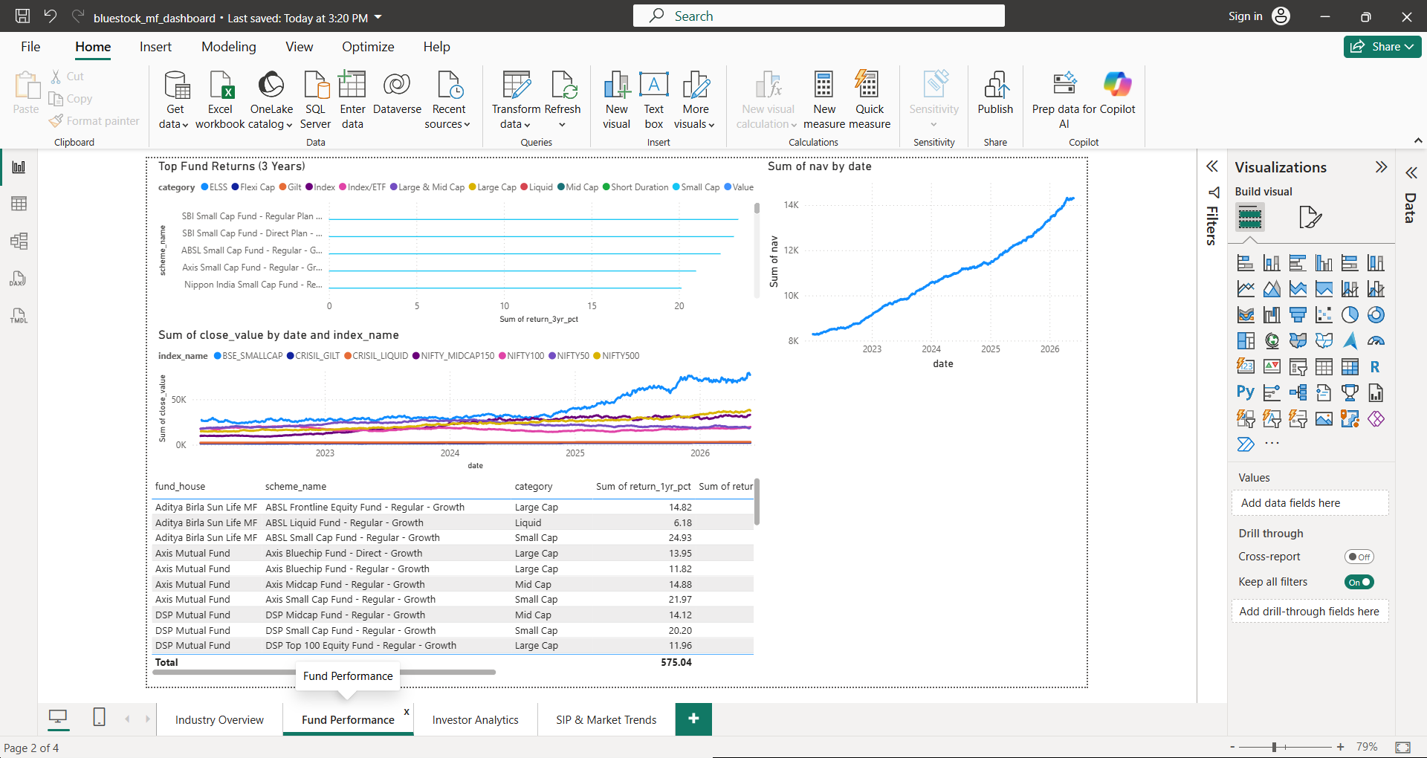
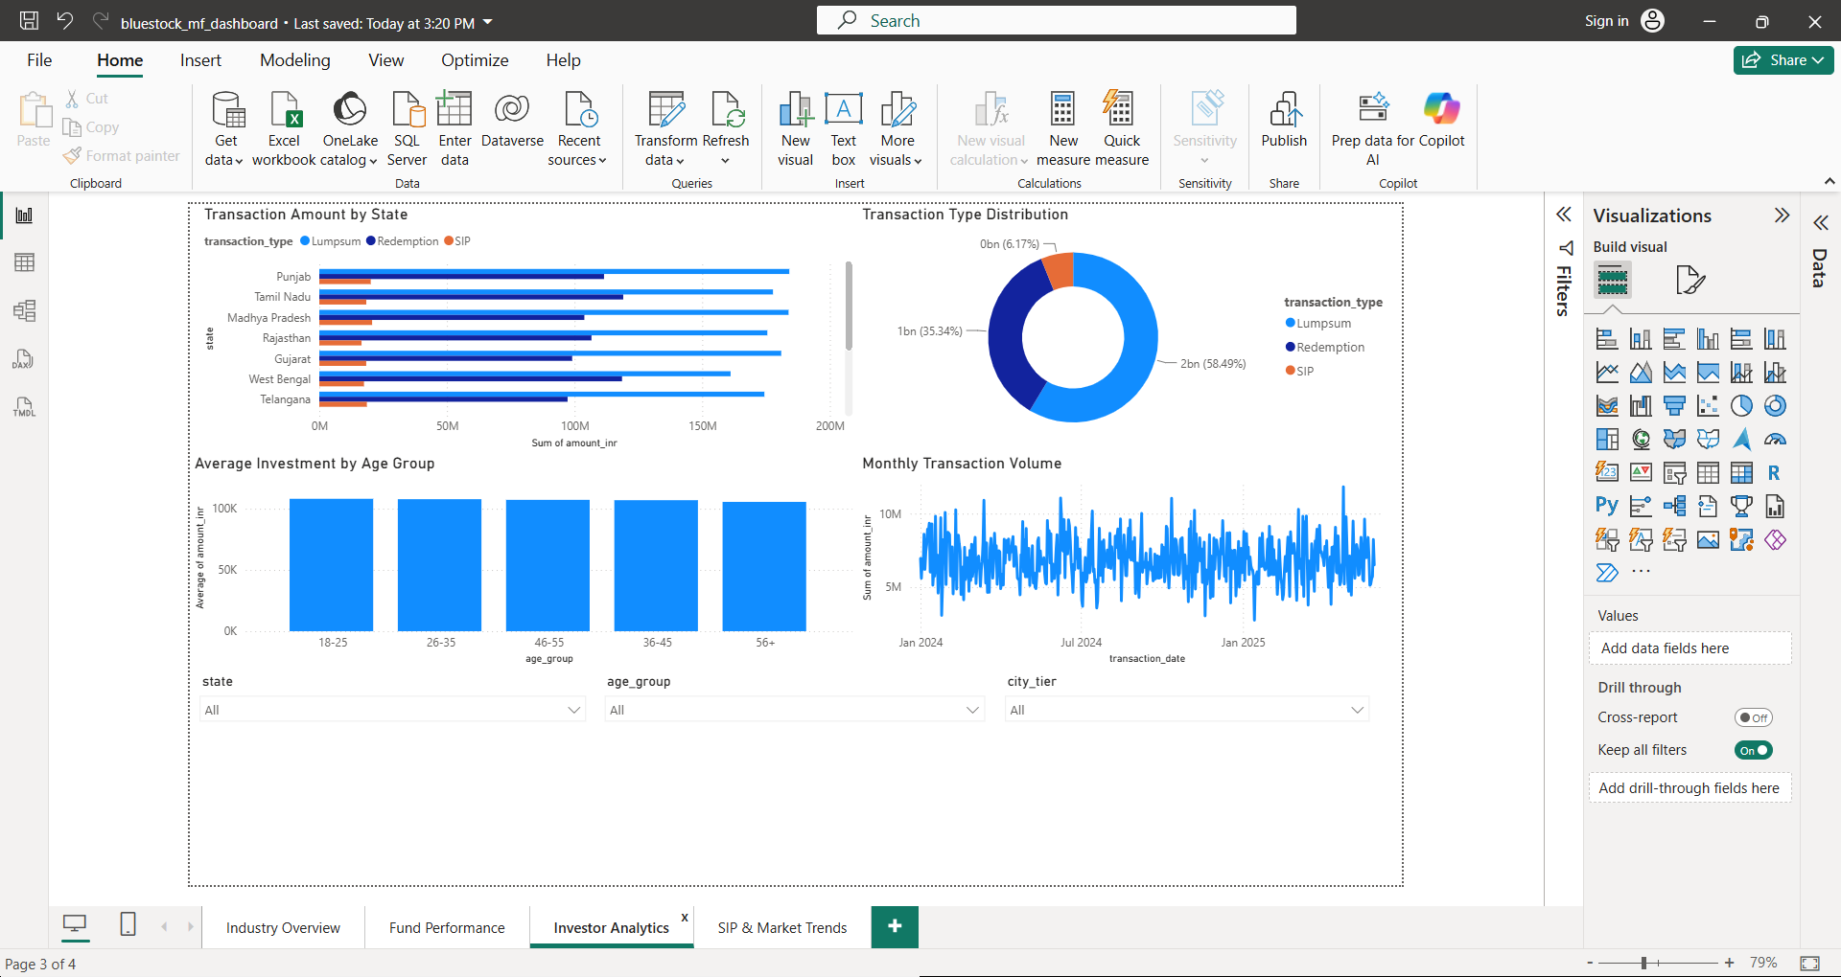
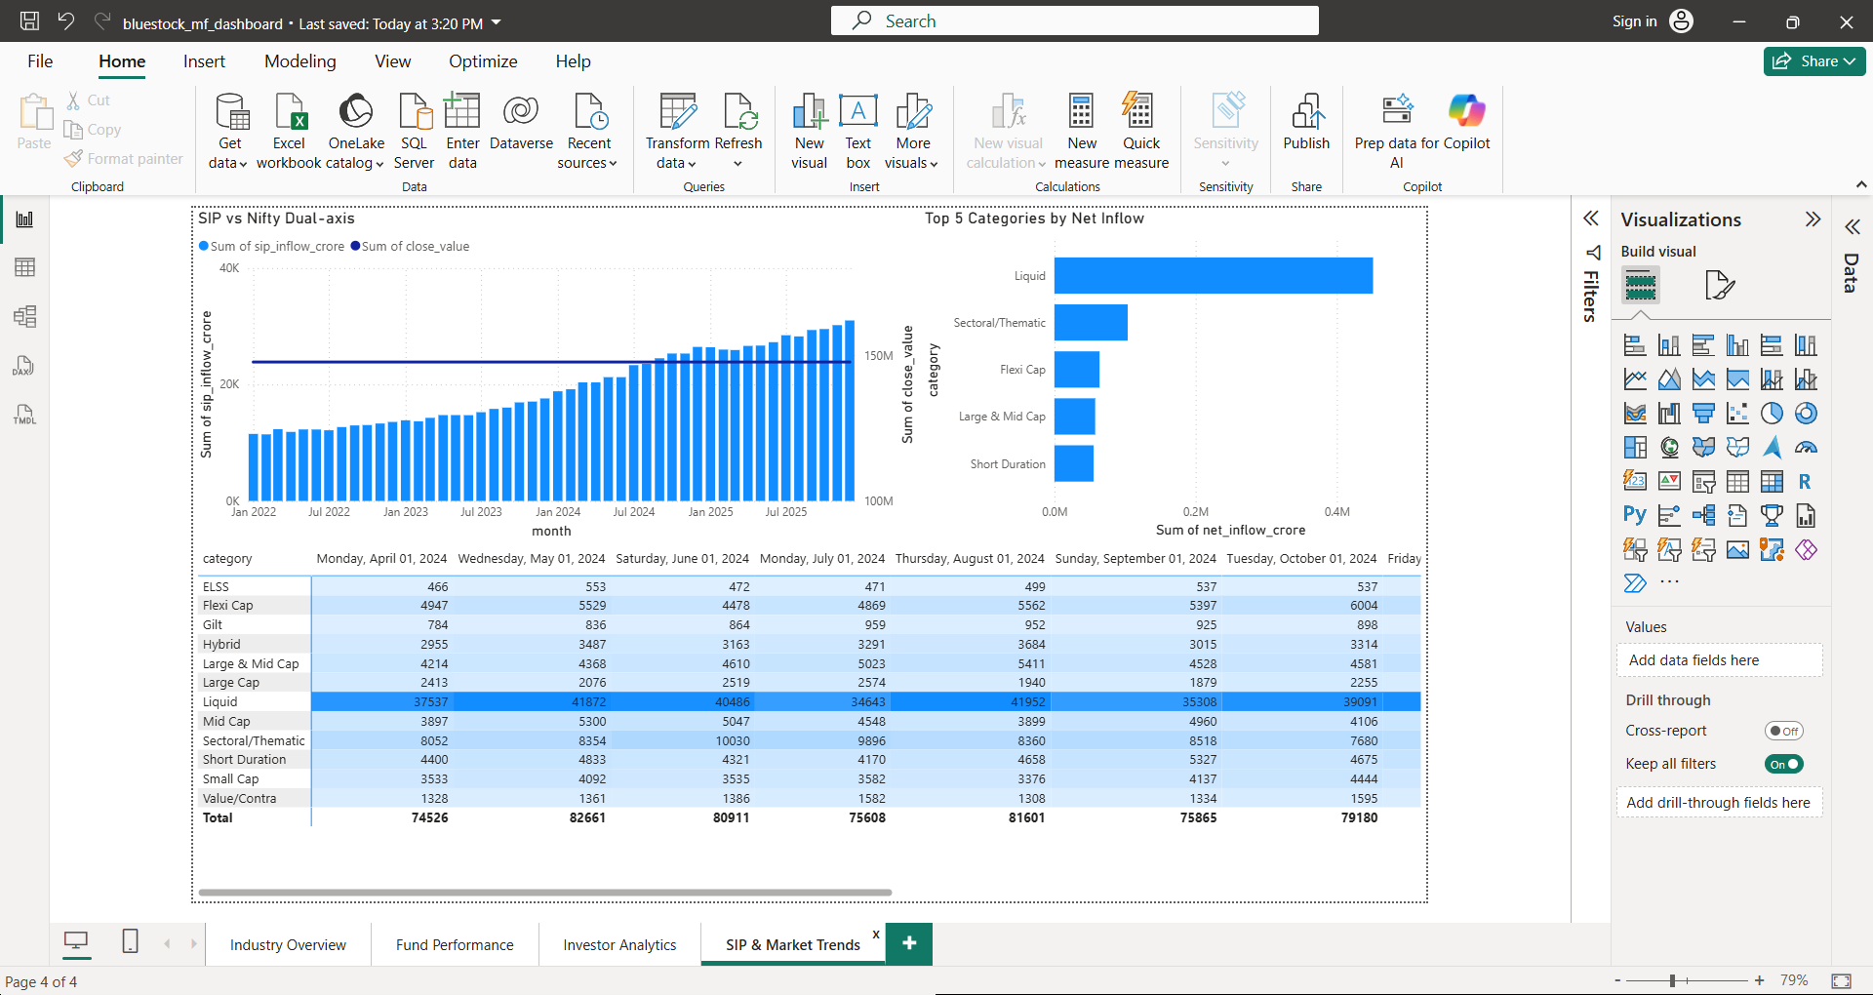
Dashboard Overview
• Page 1: Industry Overview
• Page 2: Fund Performance
• Page 3: Investor Analytics
• Page 4: SIP & Market Trends
Industry Overview Paste Screenshot Here
Fund Performance Paste Screenshot Here
Investor Analytics Paste Screenshot Here
SIP & Market Trends Paste Screenshot Here

Slide 4
Key Insights
• Industry AUM shows sustained long-term growth.
• SIP inflows increase consistently over time.
• Benchmark indices highlight overall market performance.
• Interactive slicers enable dynamic analysis by category, state, and investor profile.
• Dashboard supports quick business intelligence and decision-making.

Slide 5
Conclusion
• Developed a professional end-to-end Power BI dashboard.
• Implemented KPIs, trend analysis, comparisons, and interactive filtering.
• Project demonstrates practical data visualization and analytics skills.
• Thank You!

