Slide 1

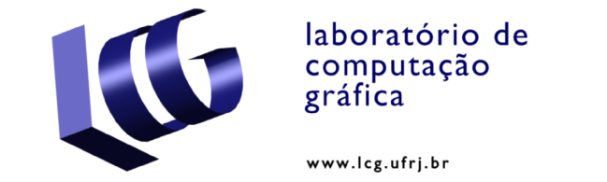

WebcamPaperPen:
A Low-Cost Graphics Tablet
Gustavo T. Pfeiffer, Ricardo G. Marroquim, Antonio A. F. Oliveira
LCG-COPPE-UFRJ

Slide 2
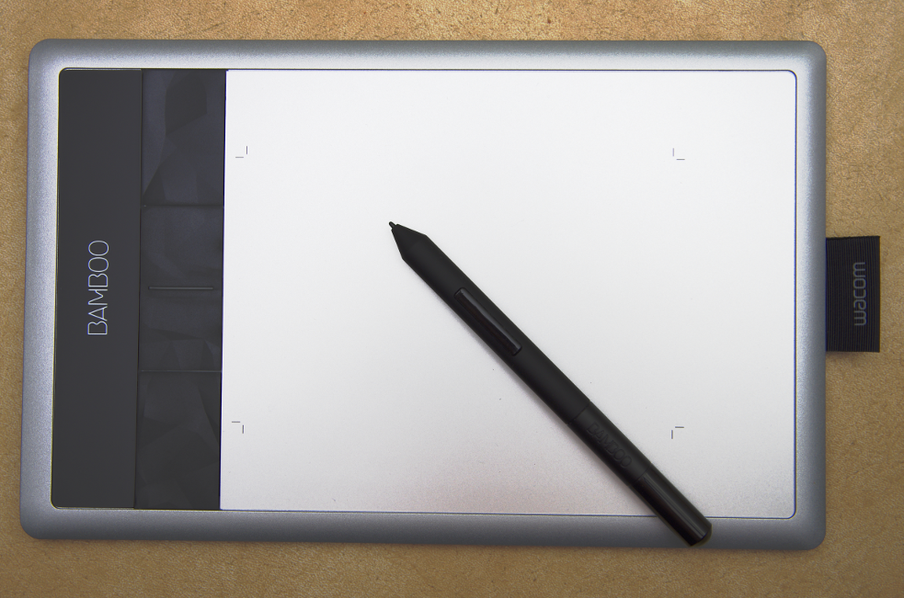
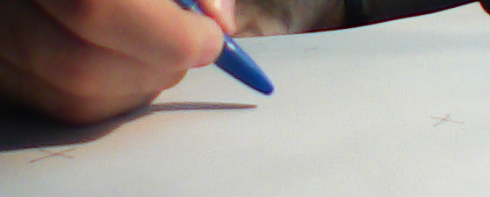
WebcamPaperPen: A Low-Cost Graphics Tablet
Goal: Replace the graphics tablet by webcam, paper and pen
?
(http://en.wikipedia.org/wiki/File:Wacom_Bamboo_Capture_tablet_and_pen.jpg)
WebcamPaperPen
  improvisable vision-based HCI alternative
      low-cost
      practical
      easy to set up
Graphics Tablet
    Device used to draw and handwrite
    Also controls the mouse cursor

Slide 3
WebcamPaperPen in Action

Slide 4
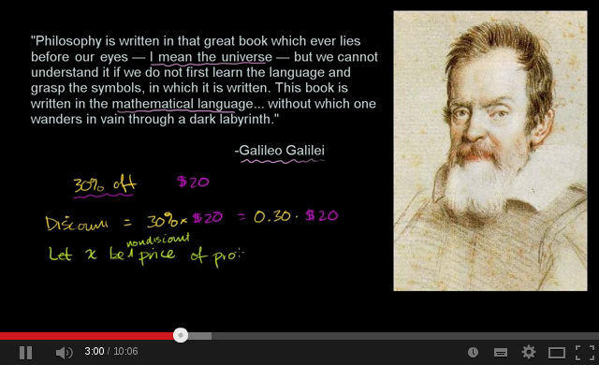
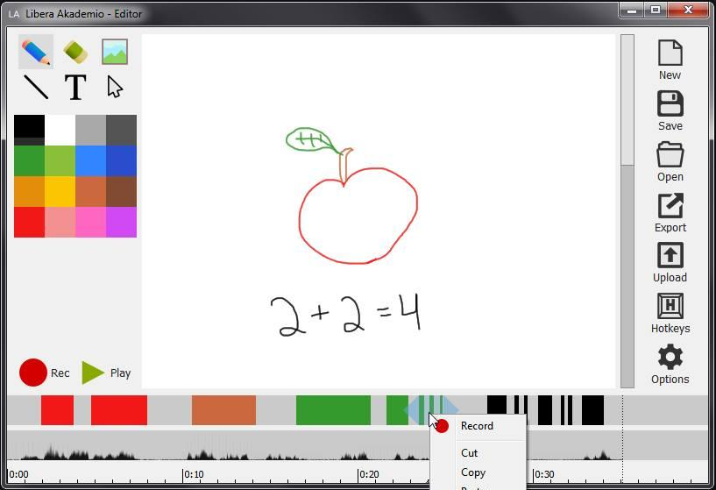
Motivation – Project Libera Akademio
Video lectures to the masses
    collaborative
    extremely low-cost
    similar to Khan Academy in style
Khan Academy video
(http://www.youtube.com/watch?v=kpCJyQ2usJ4)
Libera Akademio Editor

Slide 5
Motivation – Project Libera Akademio
Video lectures to the masses
    collaborative
    extremely low-cost
    similar to Khan Academy in style
But requires the graphics tablet
    Wouldn't webcam, paper and pen be much better?
Khan Academy video
(http://www.youtube.com/watch?v=kpCJyQ2usJ4)
Libera Akademio Editor

Slide 6
Related Work

Slide 7
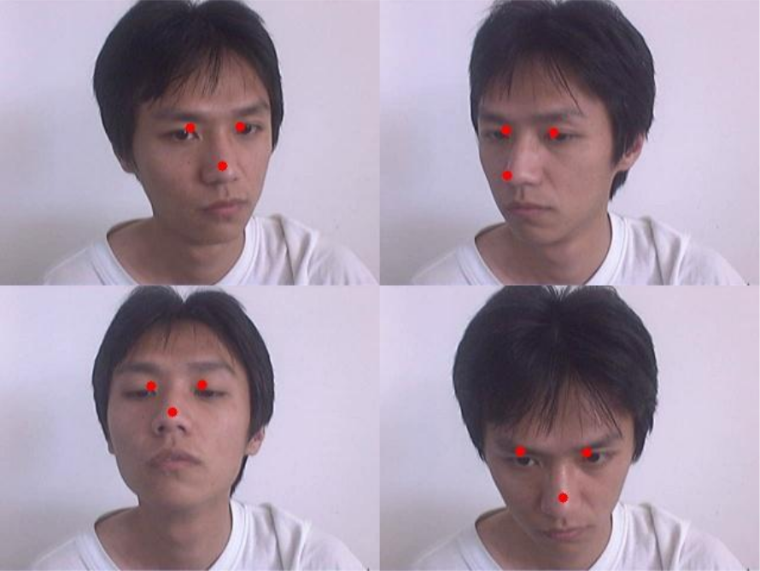
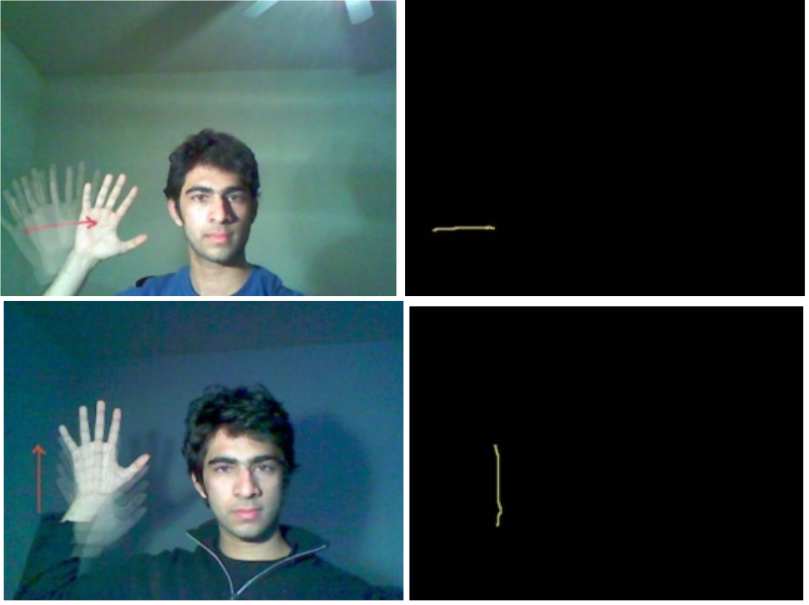
Related Work
Body Parts Tracking
HAO and LEI, 2008
MANCHANDA and BING, 2010

Slide 8
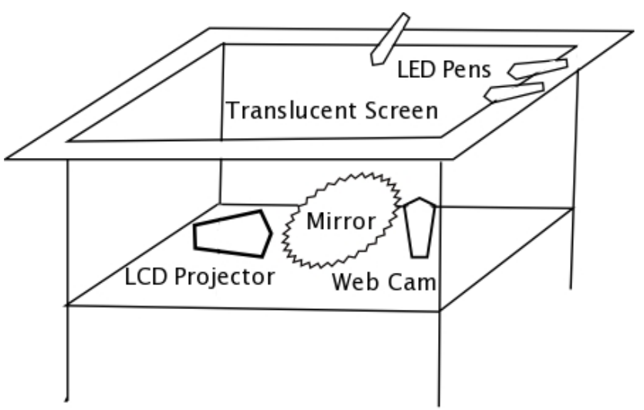
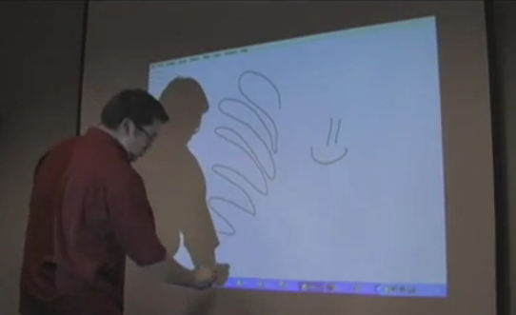
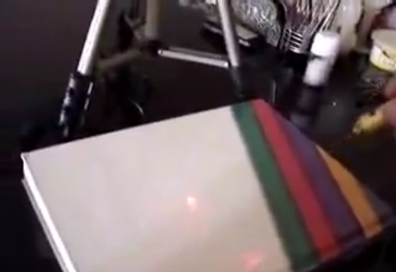
Related Work
Body Parts Tracking
Light Tracking
PIAZZA and FIELD, 2007
HAO and LEI, 2008
http://www.wiimoteproject.com/
MANCHANDA and BING, 2010
http://laserinteraction.codeplex.com/

Slide 9
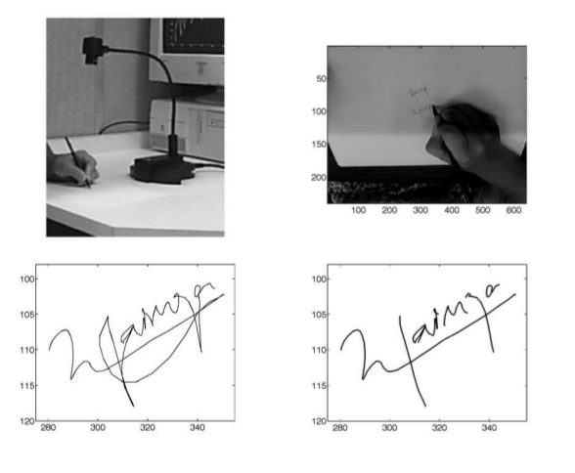
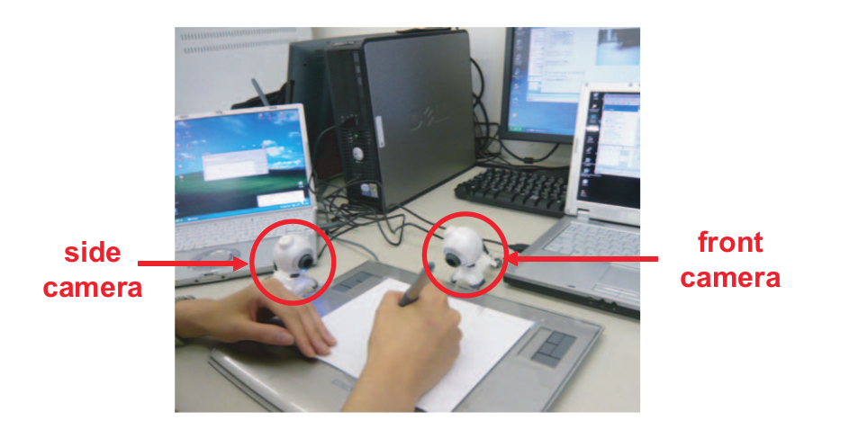
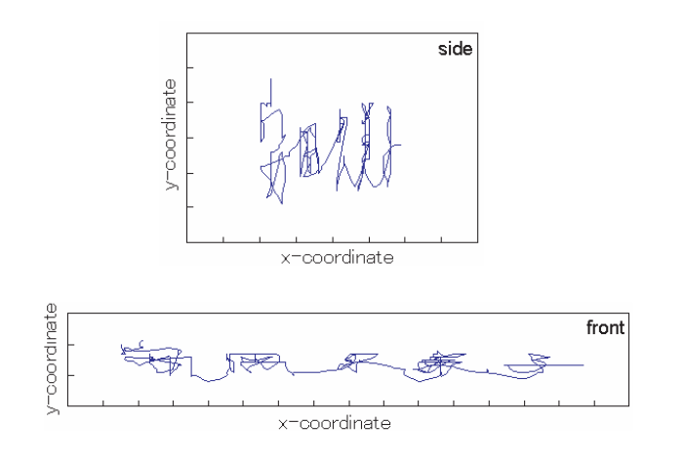
Related Work
Light Tracking
Pen Tip Tracking
Body Parts Tracking
PIAZZA and FIELD, 2007
MUNICH and PERONA, 2002
HAO and LEI, 2008
http://www.wiimoteproject.com/
MANCHANDA and BING, 2010
http://laserinteraction.codeplex.com/
YASUDA et al., 2010

Slide 10
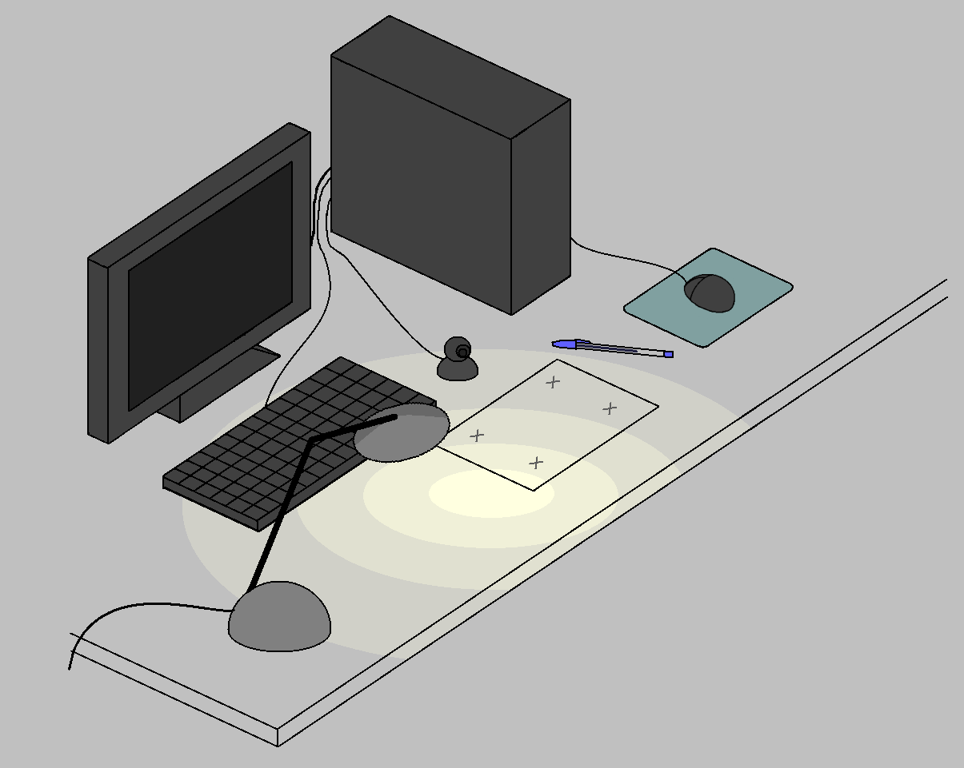
Fundamentals of WebcamPaperPen
pen cap tip
tracking
shadow tip tracking
projection
(hitting point prediction)
hitting point
rectification

Slide 11
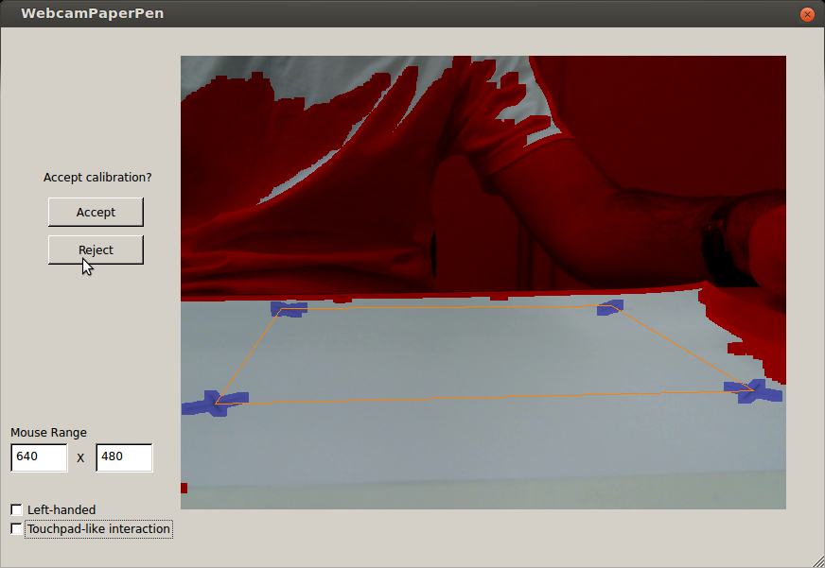
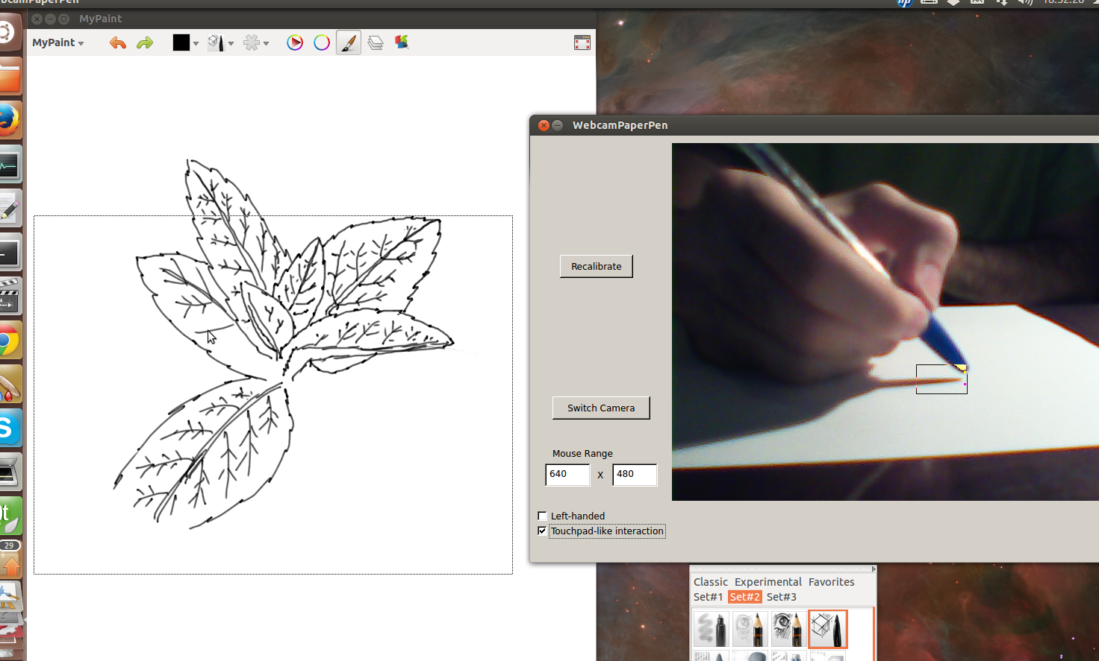
Calibration
Calibration Step
Drawing Step

Slide 12
Method – Calibration
1. Search the paper,
get mean intensity

Slide 13
Method – Calibration
outliers
inliers
p(x,y) = Ax² + Bxy
+ Cy² +Dx + Ey + F
1. Search the paper,
get mean intensity
2. fit intensity to a
quadratic function

Slide 14
Method – Calibration
outliers
inliers
p(x,y) = Ax² + Bxy
+ Cy² +Dx + Ey + F
1. Search the paper,
get mean intensity
2. fit intensity to a
quadratic function
3. Compare pixelwise to fitted function

Slide 15
Method – Calibration
outliers
inliers
p(x,y) = Ax² + Bxy
+ Cy² +Dx + Ey + F
1. Search the paper,
get mean intensity
2. fit intensity to a
quadratic function
3. Compare pixelwise to fitted function
4. Classify connected
components

Slide 16
Method – Calibration
outliers
inliers
p(x,y) = Ax² + Bxy
+ Cy² +Dx + Ey + F
1. Search the paper,
get mean intensity
2. fit intensity to a
quadratic function
3. Compare pixelwise to fitted function
4. Classify connected
components
minimum
5. minimum intensity
after blur

Slide 17
Method – Calibration
outliers
inliers
p(x,y) = Ax² + Bxy
+ Cy² +Dx + Ey + F
1. Search the paper,
get mean intensity
2. fit intensity to a
quadratic function
3. Compare pixelwise to fitted function
4. Classify connected
components
minimum
5. minimum intensity
after blur
6. update using quadratic fit

Slide 18
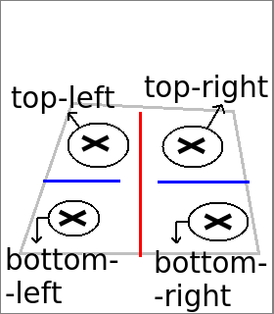
Method – Calibration
outliers
inliers
p(x,y) = Ax² + Bxy
+ Cy² +Dx + Ey + F
1. Search the paper,
get mean intensity
2. fit intensity to a
quadratic function
3. Compare pixelwise to fitted function
4. Classify connected
components
minimum
5. minimum intensity
after blur
6. update using quadratic fit
7. Classify crosses

Slide 19
Pen Cap Tip Tracking

Slide 20
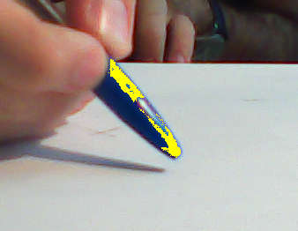
Method – Pen Cap Tip Tracking
1. Apply blue filter and
maximize 2y+x

Slide 21
Method – Pen Cap Tip Tracking
1. Apply blue filter and
maximize 2y+x
2. Minimize sum (hor.)
Maximize Sobel (ver.)

Slide 22
Method – Pen Cap Tip Tracking
1. Apply blue filter and
maximize 2y+x
2. Minimize sum (hor.)
Maximize Sobel (ver.)
3. Search pixel that
maximizes objective
function

Slide 23
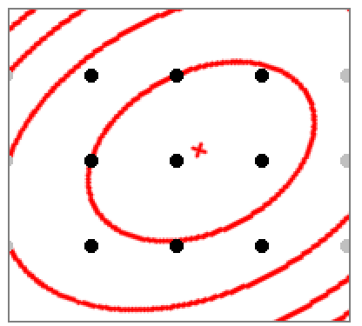
Method – Pen Cap Tip Tracking
1. Apply blue filter and
maximize 2y+x
2. Minimize sum (hor.)
Maximize Sobel (ver.)
3. Search pixel that
maximizes objective
function
4. Subpixel estimation using quadratic fit

Slide 24
Hitting Point Prediction
projection

Slide 25
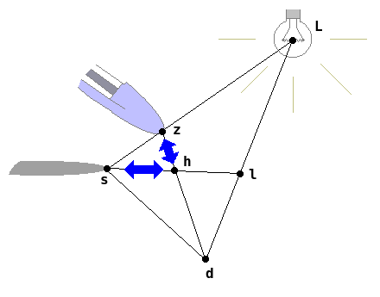
Theory - Hitting Point Prediction
h=(z×d)×(l×s)
Assumption:
l=(1,0,0)
d=(0,1,0)

Slide 26
Shadow Tip Tracking

Slide 27

Method – Shadow Tracking
#paper
Occurrences per line
70%of the line
y
Threshold: 75% of paper intensity

Slide 28
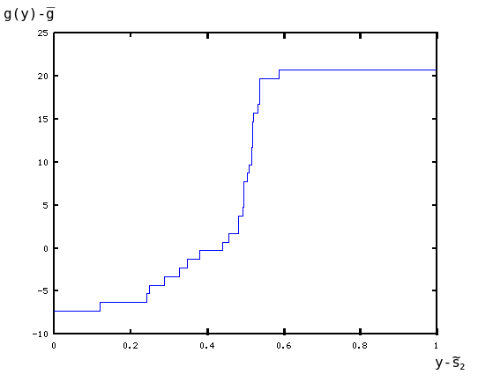
Method – Shadow Tracking
#paper
Occurrences per line
70%of the line
y
Use linear interpolation?
Threshold: 75% of paper intensity
Linear
interpolation
Actual (?)
curve

Slide 29
Method – Shadow Tracking
#paper
Occurrences per line
70%of the line
y
Threshold: 75% of paper intensity
y
y+1

Slide 30
Method – Shadow Tracking
#paper
Occurrences per line
70%of the line
y
Threshold: 75% of paper intensity
Linear interpolation after
gamma correction
y
p(x,y)
y+1
paper intensity
p(x,y+1)
y
y+1
?

Slide 31
Method – Shadow Tracking
#paper
Occurrences per line
70%of the line
y
Threshold: 75% of paper intensity
Linear interpolation after
gamma correction
y
p(x,y)
y+1
paper intensity
p(x,y+1)
y
y+1
?

Slide 32
Method – Shadow Tracking
#paper
Occurrences per line
70%of the line
y
Interpolation
by sorting
Threshold: 75% of paper intensity
Linear interpolation after
gamma correction
y
p(x,y)
y+1
paper intensity
p(x,y+1)
y
y+1
?

Slide 33
Method – Mouse Motion
Rectification
(homography)
four crosses' convex hull
mouse range window
Rounded off using hysteresis technique

Slide 34

Method - Conditions for Mouse Click
h
1. Pen and shadow must
be near each other

Slide 35
Method - Conditions for Mouse Click
h
1. Pen and shadow must
be near each other
ignore
pen area
high variance
(σ/µ = H)
low variance
(σ/µ = L)
2. Variance must be high

Slide 36
Method - Conditions for Mouse Click
h
1. Pen and shadow must
be near each other
ignore
pen area
high variance
(σ/µ = H)
H
σ/µ
threshold
low variance
(σ/µ = L)
L
2. Variance must be high
Adaptive Threshold and
Hysteresis

Slide 37
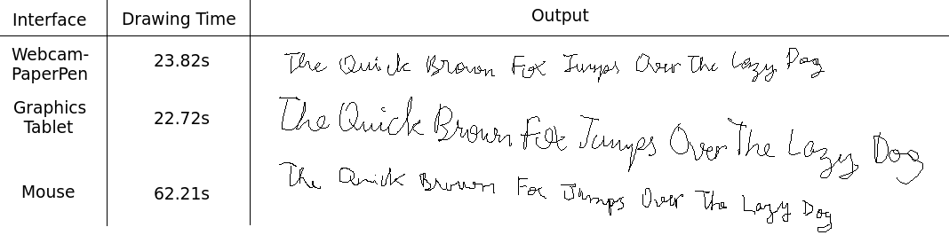
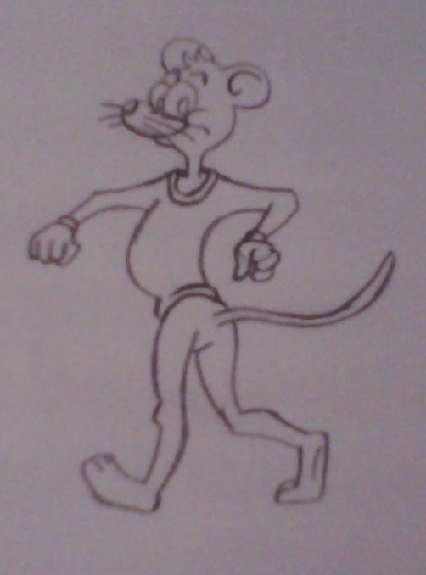
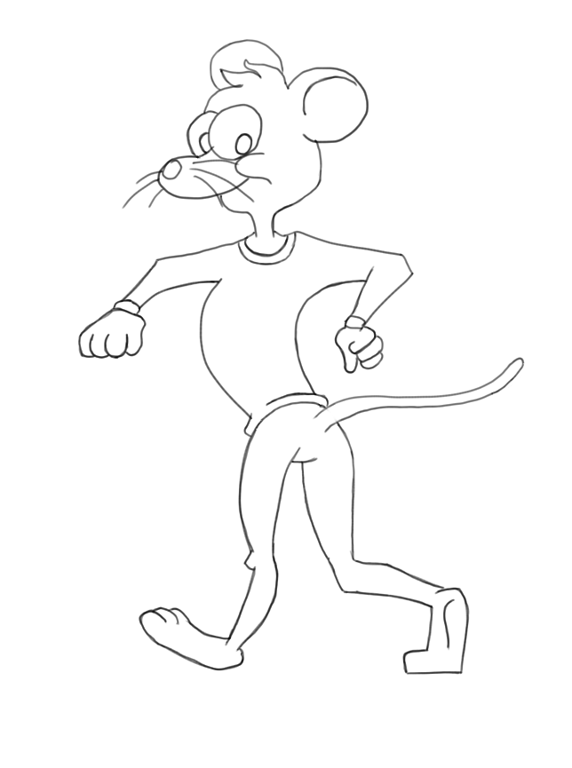
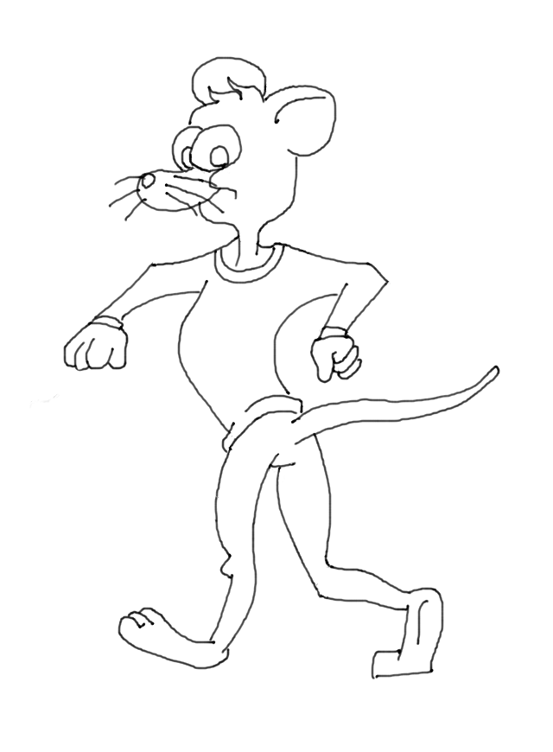
Results: Comparisons with Graphics Tablet
Pencil and Paper
Graphics Tablet
Our Method

Slide 38
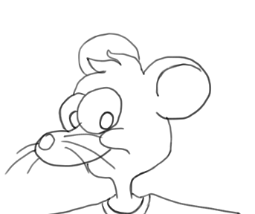
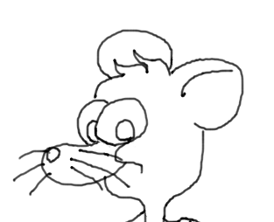
Precision Detail
Graphics Tablet
Our Method

Slide 39
Limitations
Restrictions in illumination, webcam, way of holding
the pen, etc.

Slide 40


Limitations
Restrictions in illumination, webcam, way of holding
the pen, etc.
“Serif” effect:

Slide 41
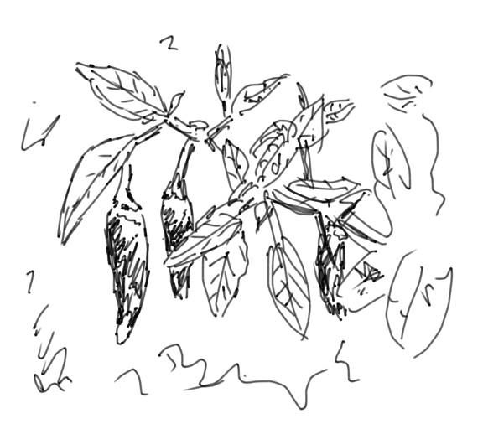
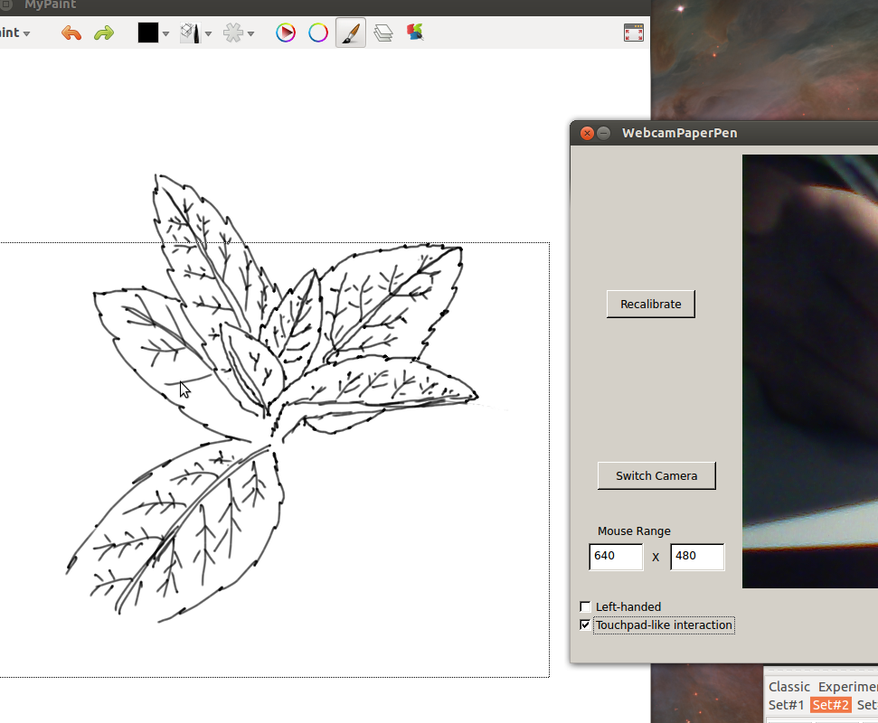
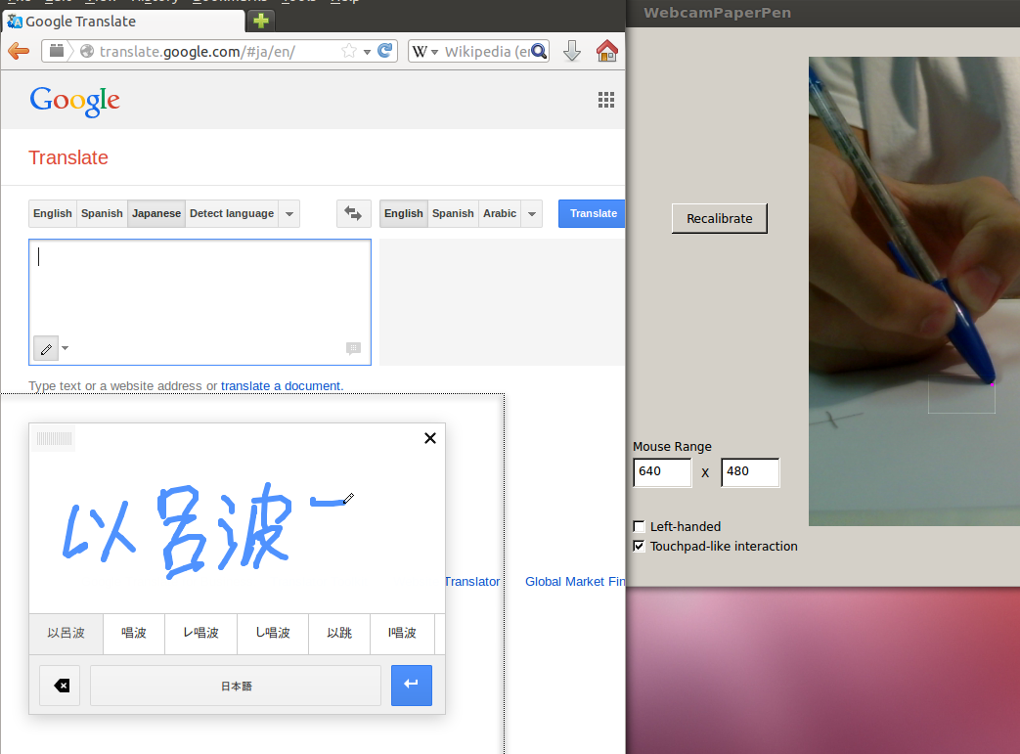

More Results

Slide 42
Supplementary Video

Slide 43
Conclusions
Our system is
  low-cost
  practical
  easy to set up
  modestly precise
Good for handwriting and simple drawings
  But not enough for more artistic purposes

Slide 44
Future Work
Increase flexibility and stability
  Less setup restrictions
Try something with the 3D position of the pen
  can be easily calculated using the shadow

Slide 45
Thank you for your attention!
Downloads, source code, etc.:
  http://www.lcg.ufrj.br/Members/gustavopfeiffer/WPP/en.html
Questions?
Comments?

Slide 46
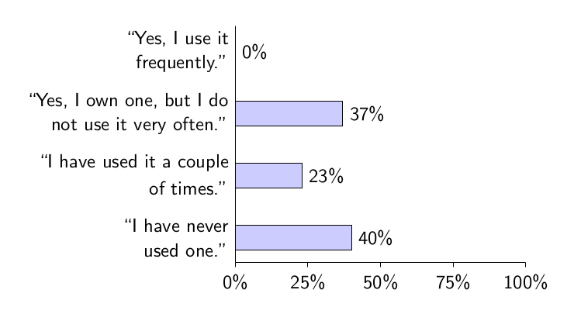
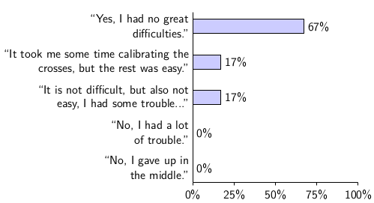
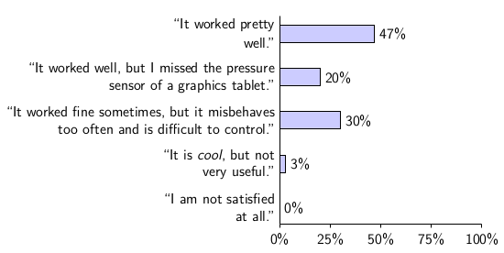
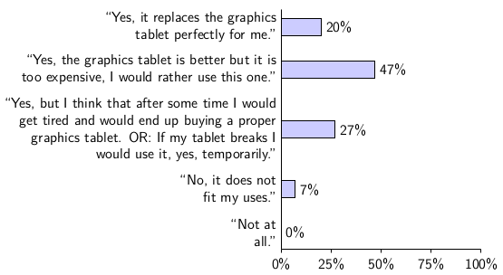
Survey
Familiarity with graphics tablets
Ease of setup
Control Quality
“Would you use it?”
Most reported problems: undesired click (47%), “serif” effect (40%)

Slide 47
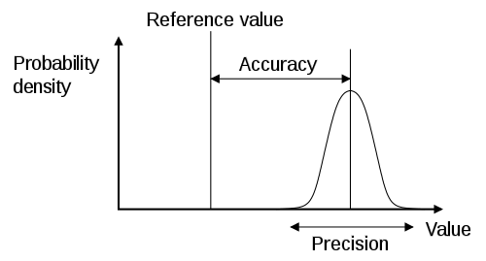
Quantitative Precision Measurement
Asked a user to hold
the pen still in some
positions and poses
Estimated σ using
|f(t) – f(t-1)|
(http://en.wikipedia.org/wiki/Accuracy_and_precision)
Discarded values above 0.5,
corresponding to
  12.0% of the values for hor. pen tip
  9.8% of the values for ver. pen tip
  2.1% of the values for shadow tip
Obtained
  σ=0.116 for hor. pen tip
  σ=0.103 for ver. pen tip
  σ=0.095 for shadow tip

Slide 48
Why use the cap shut?
Easier to track
Users won't look at the paper, but at the monitor
More applications
    If you can look at the paper, you need no online processing
Less paper is consumed

Slide 49
References
M. R. Salomão, “Libera Akademio: An authoring tool for low-cost educational video creation, edition and translation”. Rio de Janeiro. Escola Politécnica / UFRJ, 2014.
Z. Hao and Q. Lei, “Vision-based interface: Using face and eye blinking tracking with camera,” in Intelligent Information Technology Application, 2008. IITA ’08. Second International Symposium on, vol. 1, Dec. 2008, pp. 306–310.
K. Manchanda and B. Bing, “Advanced mouse pointer control using trajectory-based gesture recognition,” in IEEE SoutheastCon 2010 (SoutheastCon), Proceedings of the, Mar. 2010, pp. 412–415.
T. Piazza and M. Fjeld, “Ortholumen: Using light for direct tabletop input,” in Horizontal Interactive Human-Computer Systems, 2007. TABLETOP ’07. Second Annual IEEE International Workshop on, Oct. 2007, pp. 193–196.
http://www.wiimoteproject.com/, accessed in March 2014.
http://laserinteraction.codeplex.com/, accessed in March 2014.
M. E. Munich and P. Perona, “Visual input for pen-based computers,” IEEE Trans. Pattern Anal. Mach. Intell., vol. 24, no. 3, pp. 313–328, Mar. 2002.
K. Yasuda, D. Muramatsu, S. Shirato, and T. Matsumoto, “Visual-based online signature verification using features extracted from video,” J. Netw. Comput. Appl., vol. 33, no. 3, pp. 333–341, May 2010.

