Slide 1
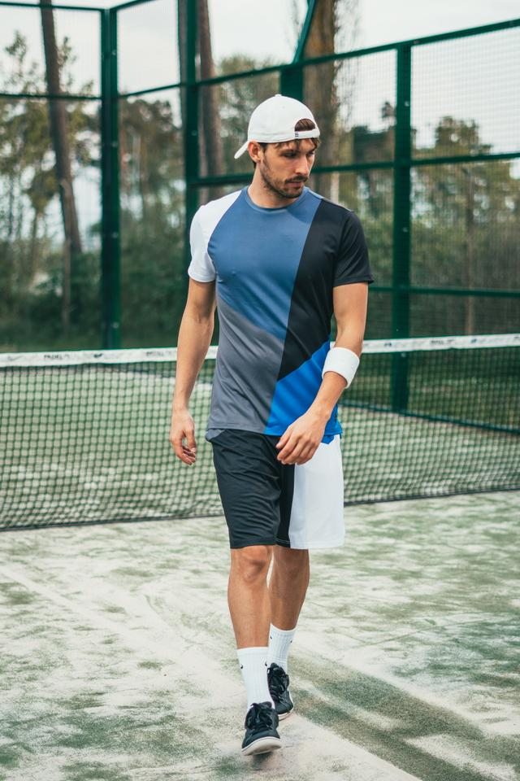
Human Body Skeleton Detection and Tracking using OpenCV
Ananya Verma, Arundhati Roy and Abhishek Kumar
Track 2: Data Science and Machine Learning
Technology Showcasing Challenge 2019
Under the supervision of
Dr. Santosh Kumar

Slide 2
Motivation
Motion Sensing technology is increasingly deployed in many applications where human detection is required such as gaming, security and military.
Motion sensing input device such as Microsoft’s Xbox 360 Kinect provides this applicability using infrared sensors. IR sensors are much more expensive compared to optical cameras.
Installation procedure is hectic and inconvenient to be widely used.
Pose Estimation is a general problem in Computer Vision where we detect the position and orientation of an object. This usually means detecting key point locations that describe the object.

Slide 3
Objective
A model is developed to detect the major key points of the body in the image/video using the image/video as the input stream and track the movements of the key – points using OpenCV to reduce the overheads of installation of Motion Sensing Technology which uses Infrared Sensors

Slide 4
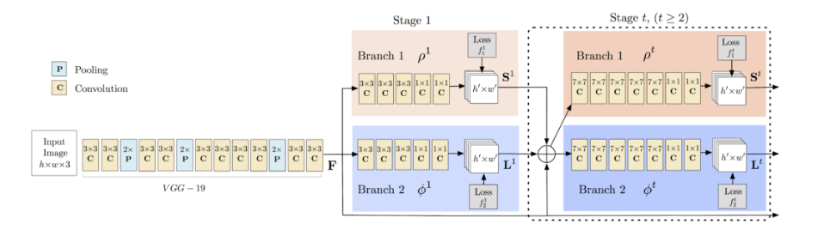
Implementation
Datasets used are:
COCO dataset
MPII dataset
Model Architecture
The model takes as input a colour image of size w × h and produces, as output, the 2D locations of key points for each person in the image.

Slide 5
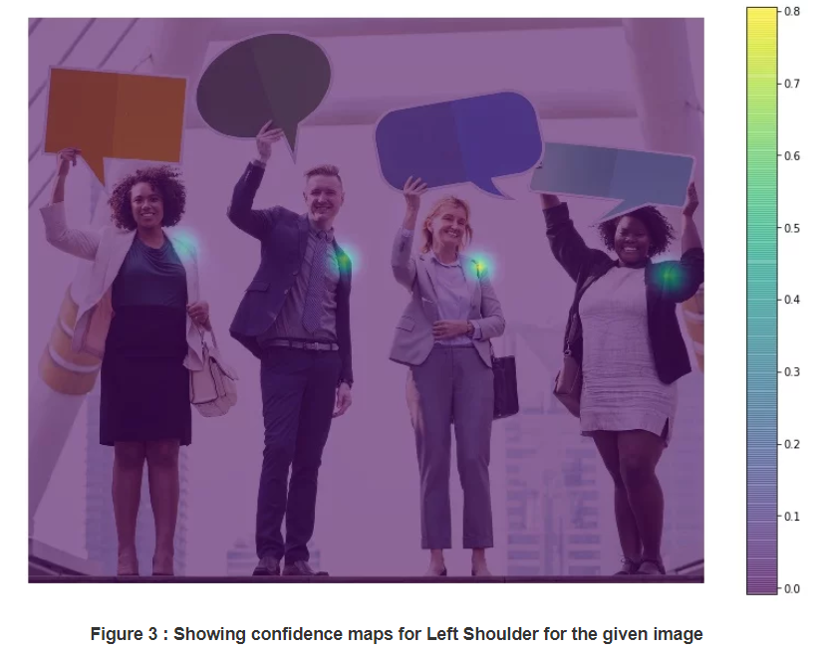
Implementation
Stages
Stage 0: The first 10 layers of the VGGNet are used to create feature maps for the input image.
Stage 1: Branch 1 output – predicts confidence maps of different points of the body.

Slide 6
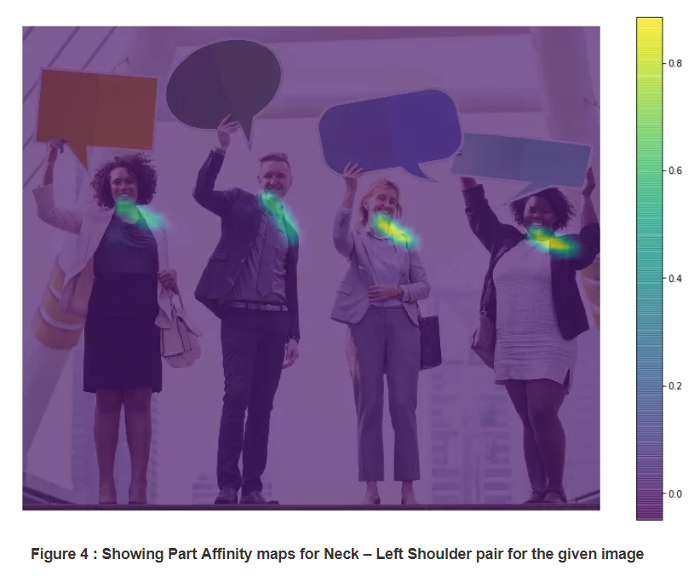
Implementation
Stages
Stage 1: Branch 2 output - a set of 2D vector fields of part affinities, which encode the degree of association between parts.
Stage 2: Produces all the key points of the body in the image.

Slide 7
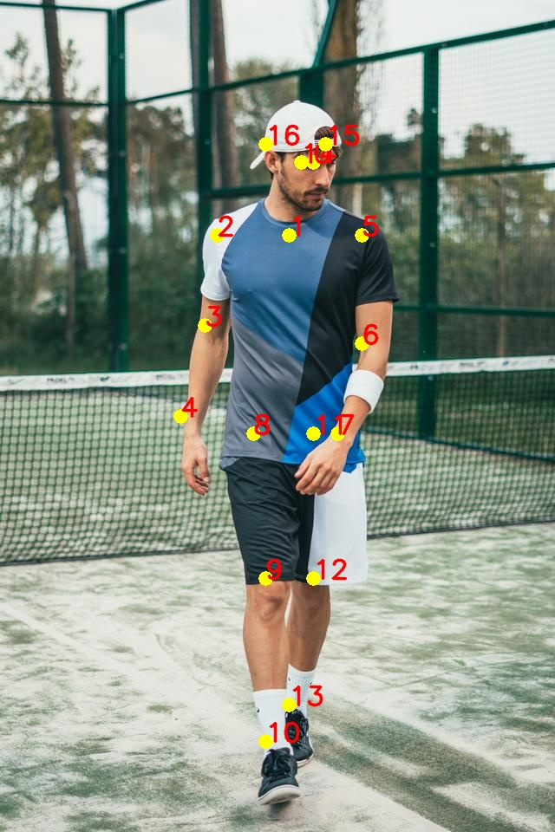
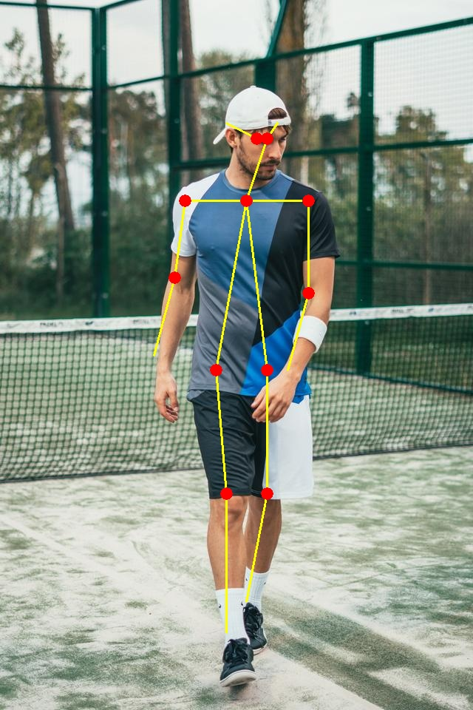
Input Image
Output-Key Points
Output - Skeleton

Slide 8
Applications
Can be used to understand the gameplay of a player and his next moves to improve the game strategy.
Orthopaedic patient diagnosis - can be used to by the Doctors to understand the key points while analysing the body postures of the patients.
Can be used by the sport authorities to live track the player’s movements and detect the key points of the body to understand the injury reasons if occurred any.
Can be used by the gymnastic person to improve their movements in order to prevent any future injuries.
Surveillance Activities - Action and behaviour analysis, detection of abnormal activities.

Slide 9
Thanks for your attention
Any question?
Every Ending is
Really Just A New Beginning!

