Slide 1
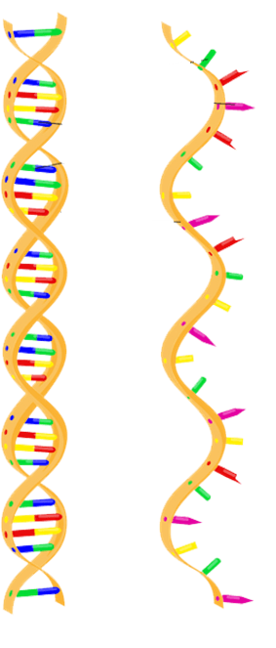
asfafas
http://www.aboutthemcat.org/images/biology/dna-vs-rna.png

Slide 2
(n₁,n₂+1)
k_{p} n₁
γ_{p} (n₂+1)
k_{r}d
k_{r}d
(n₁-1,n₂)
(n₁,n₂)
(n₁+1,n₂)
γ_{r} n₁
γ_{r} (n₁+1)
k_{p} n₁
γ_{p} n₂
(n₁,n₂-1)

Slide 3
Replication
DNA Polymerase
DNA
Transcription
RNA Polymerase
mRNA
Translation
Ribosomes
Protein

Slide 4
DNA (d)
k_{r}
γ_{r}
mRNA (n₁)
k_{p}
γ_{p}
Protein (n₂)

Slide 5
A.
Transcription factors
Promoter
Coding region
B.
RNApol
C.
Transcription begins

Slide 6
P₁
RBS
A
RBS
B
Ter.
P₂
RBS
C
Ter.
P₃
RBS
D
Ter.
S₁

