Slide 1
Design and analysis of algorithms
吴巍炜，方效林，单冯，王万元

Slide 2
Competition/project: game AI design
Goal:
  design your game AI with competitions/ranking
Rule：
  design by yourself (if copy&paste found, score*0%)
    idea from literature
    your own idea (preferred)
  Evaluate:
    Compete offline: design your AI, evaluate its strength, performance (e.g. what is your AI's peak power as the training time goes), compete with other teams,
    Compete online: submit&update in the platform and get good rank
  introduce your design/idea in details
  score = score of your normalized ranking*30%+score of report/idea*70%
  # of Each team: 1-2 members (if #=1, score*115%,if #=2, score*100%)
  Register id with your name: Lilei***,LileiHanmeimei***
  duration: weeks 1-13 starting from now

Slide 3
Competition/project: game AI design
Game: Gomoku
    you can also test your AI with specified opponent or in the online platform
submit:
  five reports starting from now, respectively on end of week 3,5,7; 10,13
  each report: pdf file with your name, student #, to your class monitor
    cover page: your id, name and student #, your current version #,
    current score: your score/history of competion or your current rank in the platform/date when you get the rank.
    review your old versions, introduce the literatures you read or you used
    introduce in detail your current improvement/idea of design (e.g., what is it, where does the idea come from, what is the expectation, how to implement, advantages of the design, weakness if any, future plans/potential improve direction)
    evaluate the performance of your design/improvement with the support of data (e.g., compare with your old versions, compare with other teams' AIs), draw some diagrams by comparing with some baselines (others' AIs and your old versions), evaluate by averaging over multiple runs,
    your code strureture and detailed implemenations
    Week 1-7: compete offline;
    Week 8-13: compete online (Platform: https://www.botzone.org, you can update your code and it will run and rank it daily)
    Specifically, k^{th} report: combine it with all your k-1 old versions of reports, all-in-one=final report

Slide 4
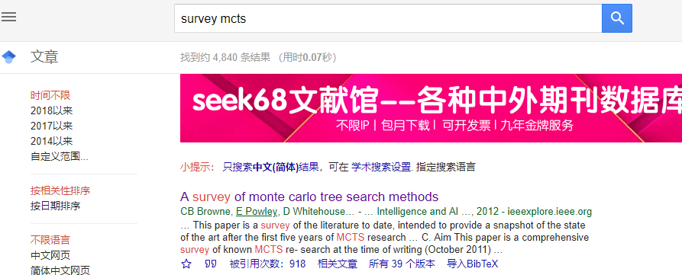
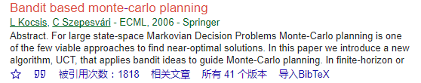
Survey skill
Useful links:
bing.com
https://xue.glgoo.net/
vpn
google/glgoo with key word; baidu
e.g. algorithm, MCTS, game, reinforcement learning,survey,...
scholar.google.com, xue.glgoo.net
e.g. # of cite, # of cited， to see the whole story

