Slide 1




Getting Started in Custom Programming for Sourcing Purposes
Glenn Gutmacher
VP, Diversity Sourcing
State Street Corporation
Kameron Swinton
Recruiting Manager
Amazon Web Services

Slide 2

The Least You Need to Have
An internet-connected computer. Mac users may have it slightly easier, but Windows is just fine (though it’s free to add a Linux OS bootup 2nd option)
Motivation to learn: best one is a business problem to solve (web scraping, other repetitive computer-based task, etc.) plus a sourcer’s curiosity
Just enough knowledge of a programming language (so many free courses, tutorials, videos, etc., nowadays – see Appendix) to follow and adapt example code you find online/from colleagues
Installed the key packages/modules for programming language(s) you need
A source code editor, ranging from text editors to graphical IDEs, to code in (recommend newbies use something full-featured such as Atom or Sublime; see comparisons of many editors and IDEs, some are programming-language specific such as PyCharm)
Ability to share code for usage/feedback (GitHub is currently #1, but you can just email files in a pinch – Facebook files and Slack are also popular)

Slide 3
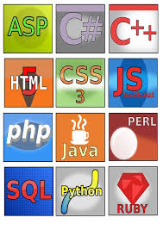
What programming language should I learn?
Knowing what you want to accomplish helps make the choice, but:
HTML & CSS: most fundamental, if you want to create websites
Javascript: controls behavior of websites; great follow-up to HTML. You can even save them as browser favorites (called “bookmarklets”)
VBA: “macros” are scripts containing code, saved to Microsoft Excel files, that can manipulate anything related to Microsoft Office apps/files, Outlook emails, etc.
Python: general-purpose language used in server automation, data science, web scraping, etc. Great language for beginners, as it’s easy to read and understand, but also versatile for experts
Java: unrelated to Javascript, used for anything from web applications to desktop and mobile apps, particularly in enterprise applications (bank, hospital, and university software). It also powers Android apps, so good for mobile development

Slide 4
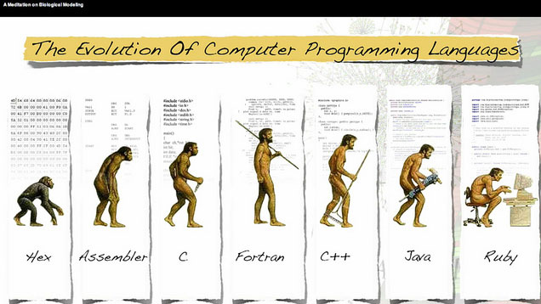
What programming language should I learn? (cont.)
Swift: main language for Apple iOS mobile apps (runners-up: Objective-C, Cocoa)
PHP: also popular for web programming; what Etsy, Facebook, WordPress, Drupal, etc., are written in
Ruby: associated with the Rails framework that helped popularize it. Widely used by startups and big companies, Ruby and Rails make it easy to transform ideas into working applications (e.g., Twitter, GitHub)
C#: main language for Microsoft .NET framework projects (runners-up: C, C++); used by the Xamarin IDE to develop cross-platform mobile apps that run on Windows mobile, Android and Apple phones
Read more in this Wade Christensen, Treehouse blog post, and this viewpoint.

Slide 5
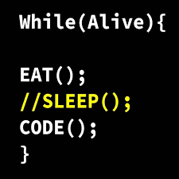

Fundamental Programming Concepts
Regardless of language, you will need to understand:
Variables: names for string (text), integer (number) and other value types to represent other things; they change as a result of calculations, inputs, etc.
Inputs: end-users enter values at prompts, select files to process, etc.
Control structures: what allows code to be processed in different order based on circumstances (if/then, for/while loops, etc.)
Data structures: lists, arrays, etc.
Syntax: every language is a bit different; if you mistype, it won’t work
Regular Expressions: regex is universal (with minor language syntax differences) to find patterns within strings; very useful in web scraping, etc.
Tools: as discussed in Appendix
Just google the concept with tutorial after it, and you’ll find useful how-to’s.

Slide 6
A JavaScript bookmarklet
TIP:
A bookmarklet is just regular JavaScript code with all spaces and line returns removed, but then it can be saved to (and run from) your browser’s bookmark folders
Drag the FindAllEmailsOnPage hyperlink in the 3rd paragraph of www.recruiting-online.com/bookmarklets.html into your browser’s favorites / bookmarks bar. That page also explains how to pull Glenn’s bonus sets of free bookmarklets into your browser (very useful to sourcers) but won’t teach you how to code them.
Actual code for FindAllEmailsOnPage is here, and is explained line-by-line here. (If wifi is faulty, see start of Appendix.) Test the script on a real webpage.
One of the ways to install any JavaScript bookmarklet in your browser:
Make a new favorite/bookmark in your favorites/bookmarks bar for any web page.
Highlight and copy the .js file code (including the starting javascript: )
Right click on the new bookmark/favorite and select Edit. Now remove the URL populating that bookmark and paste in the code (i.e., what began HTTP… is now gone and replaced with javascript:…) and then click OK to save/close it.

Slide 7
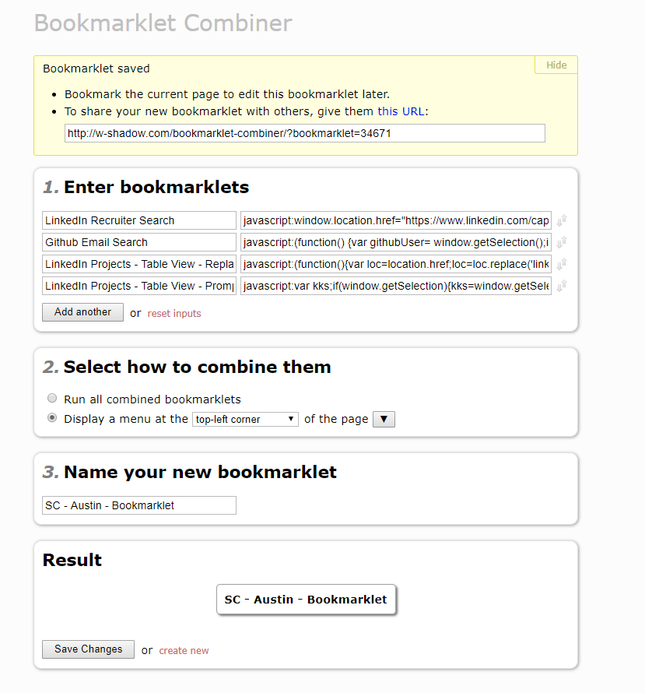
A JavaScript bookmarklet (cont.)
To use Bookmarklet Combiner, just drag the button after Result (at bottom of any pre-existing one) into your favorites bar or any other bookmarks folder. Example:
http://w-shadow.com/bookmarklet-combiner/?bookmarklet=34668
To create your own set, go to Bookmarklet Combiner and enter the name and javascript code for each bookmarklet in section 1 (click gray “Add another” button to add more). After populating sections 2-3, click gray Save Changes button at bottom.

Slide 8
A JavaScript bookmarklet (continued)
LinkedIn Recruiter Search - Selection
javascript:window.location.href="https://www.linkedin.com/cap/peopleSearch/doSearch?resultsType=search&keywords="+window.getSelection()
LinkedIn Projects - Table View - URL Replace
javascript:(function(){var loc=location.href;loc=loc.replace('linkedin.com/recruiter/projects/','linkedin.com/cap/project/savedProfiles/'); location.replace(loc)})()
LinkedIn Projects - Table View - Prompt
javascript:var kks;if(window.getSelection){kks=window.getSelection();}else{kks=document.selection.createRange().text;}var tellme=prompt('Enter LinkedIn Project #',kks); if(tellme){void(location='https://www.linkedin.com/cap/project/savedProfiles/'+escape(tellme)+'/');}else{void(kks);}
Github - Selection
javascript:(function() {var githubUser= window.getSelection();if (githubUser)location="https://api.github.com/users/"+escape(githubUser)+"/events";})()

Slide 9
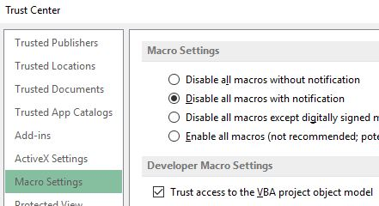
Setting up for Excel VBA
One-time steps that address the most common initial frustrations so you can run (or edit) code by anyone in VBA from your computer:
In Microsoft Excel’s File menu, select Options (at bottom left).
In left column menu, select Trust Center.
Click gray “Trust Center Settings” button (bottom right).
Under Macro Settings, select the “Disable all macros with notification” radio button and select the “Trust access to the VBA project model” checkbox. Click OK button at bottom to close.
TIP: When you open any Excel file containing a macro (typically filetype .xlsm), it may show a yellow Security Warning that macros have been disabled. You must click the “Enable Macros” button to run any macro(s), assuming you know they’re safe.

Slide 10
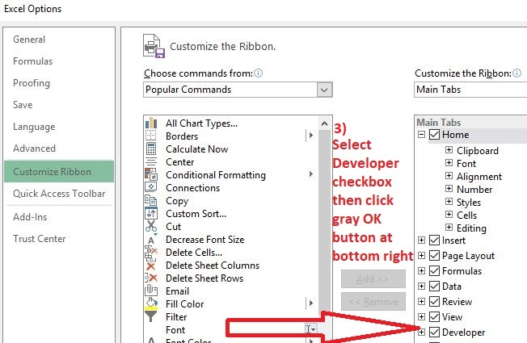
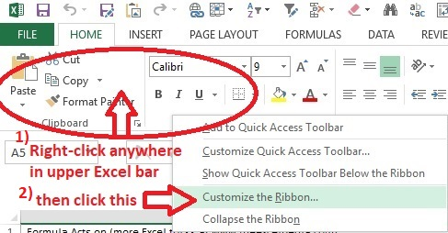
Setting up (cont.)
Is Developer mode in your Excel main menu? (You need it.)
If not, Customize the Ribbon and select the Developer checkbox as indicated below (& steps 1-3 of the screenshots at http://www.excel-easy.com/vba/create-a-macro.html) covering this one-time setup.

Slide 11
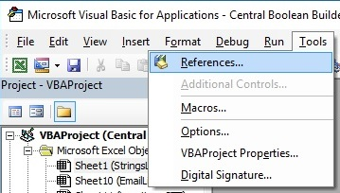
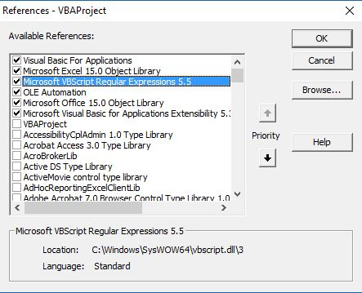
Setting up for Excel VBA (cont.)
You’ll want to pre-load some common reference libraries:
Click Developer tab (generated on previous slide), then click Visual Basic (leftmost button under that).
In the Tools menu, select References. Particularly select the checkboxes for “Microsoft VBScript Regular Expressions 5.5”, “Microsoft Office Object Library” and “Microsoft Visual Basic for Applications Extensibility”. (These may be further down the list, in alphabetical order.)
Unfortunately, you need to make sure other users of your macro also selected these (if needed by your macro), but at least you see it’s a quick, one-time procedure (see the top-voted answer here to learn more).
See Appendix for additional setup steps you *might* need.

Slide 12
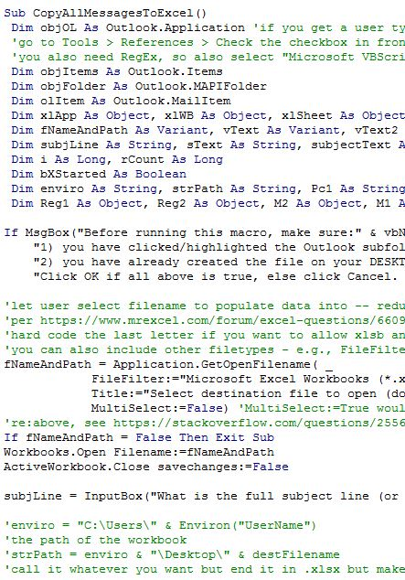
An Excel VBA code example
Business need: You want to send an email campaign to people across a whole particular Outlook folder of emails. This macro:
lets you select any Outlook (sub)folder in your mailbox or any shared box (personal or corporate Outlook Exchange);
automatically grabs all the email addresses in the body of those messages (including the senders);
plops them into an Excel file;
de-duplicates and sorts the results; and
inserts references after each email address with subject line, sent date and message sender, to make it convenient to trace the source for context/reference.
Let’s look through highlights in the code…

Slide 13
An Excel VBA example (cont.)
The usual first set of statements are to dimension (set the type of) your variables. Some types are unique to MS Outlook (more here). String, Long, Object, Range and Boolean are more universal.
Dim objItems As Outlook.Items, objFolder As Outlook.MAPIFolder, olItem As Outlook.MailItem
'Dim is the command preceding var As type; above ones are Outlook-specific, below are some more common ones:
Dim xlApp As Object, xlWB As Object, xlSheet As Object, ws As Worksheet
Dim fNameAndPath As Variant, deduperList(), foundEmails() 'Variant is default when you don't specify a type
'but a var name immediately followed by () implies it will be an array
Dim sText As String, OneRange As Range, SortCell As Range 'Range refers to a span of one or more cells; String is for text
Dim a As Long, i As Long, messageCount As Long, LastRow As Long 'Integer works for smaller numbers,
'but Long works regardless how large your var gets & runs faster than Integer, so always use Long!
Dim bXStarted As Boolean 'True or False
Dim Regex As Object, olMatches As Object, Match As Object, M As Object 'used to find pattern matches to regular expressions

Slide 14
An Excel VBA example (cont.)
Other interesting parts of the code that we’ll cover as time allows (also read the extensive comments later), and let’s run it on a typical Outlook folder:
Selecting a file for later use, adding new worksheets to it (for our data to come)
Regular expressions (regex) to find the pattern of all email addresses (and adding values to worksheet)
Adding other Outlook message item fields to worksheet
Removing duplicate values
Alpha-sort the final results

Slide 15
Setting up for webscraping in Python
Using Kameron Kales’ example (with permission) since it explains the process for Mac users but we’ll be showing things on a WinPC (see Windows video) so steps will differ slightly...
1.Learn the Terminal/Command Prompt
2.Install XCode
3.Install Python 2.7
4.Install Text Editor (Sublime)
5.Install PIP
6.Install GIT
7.Register for a GitHub Account
8.Clone a repository
9.Start scraping!
(alternatively, see “Alternative Detailed
Python Setup” slide in Appendix)
This setup example leads to his other GitHub repo with actual webscraping code.
Bonus: For an expanded version of this code that scrapes the same website but 1) pulls more data from each person and 2) data saved is in a more ready-to-use format, see Glenn’s Sourcers Who Code post.

Slide 16
A simple Python example
Big thanks to Kameron Kales for sharing his Python code related to the Lusha API with nice instructions on the README file. This is all you have to do to install/run it (reference this in combination with his instructions):
Time-saving & error-reducing tip: How to copy/paste text into a command prompt. You don’t want to retype stuff because spacing and capitalization matters. But you can’t just ctrl + v here! After you copy (ctrl+c), to paste text into a command prompt:
in Windows: press Alt key + space bar together, then e (Edit), then p (Paste) or this method for Powershell
in Linux: Ctrl + Shift + v
Launch your command prompt app, then type: ls (yes, just those 2 lowercase letters, followed by Enter key) (This will show you what’s in the path/folder level where you’re at. You’ll be installing a clone of Kam’s Python project here in the next step. But if that is NOT the place on your computer where you want to store it, then first type cd followed by 1 space and the subfolder name in which you’d want to install it, and hit Enter. Or type cd ../ if you want to go 1 path level HIGHER before installing it.)
Once at the desired location, type first line of next slide at command prompt to automatically create a new folder called lusha-api-python that will contain Kam’s files (or copy/paste it using sidebar tip →)

Slide 17
A simple Python example (continued)
git clone https://github.com/KameronKales/lusha-api-python.git
Then type: cd lusha-api-python (will put you into that new folder)
Then: pip install -r requirements.txt (to install some required modules)
Note that to use the Lusha API, even though it’s up to 30 contacts free, you need to be on a PAID account tier to get an API key. If you don’t have Lusha, they do offer a free trial of their Pro tier when you register at www.lusha.co (that’s .co, not .com) but if you already have a free account, you won’t get an API key on the API page (https://www.lusha.co/api_pricing) unless you upgrade to a paid plan first.
Using your code editor (Atom, PyCharm, Sublime or whatever app), open the Python file api.py in the cloned folder and edit it by entering the value of your API key in line 27 and the desired domain in line 37 to find data for.
Save and run the file/code!

Slide 18

Appendix
Useful stuff on the following pages that we won’t have time to cover today, but you can follow the steps… or contact a member of Sourcers Who Code or someone in IT/sw dev at your company to help you!

Slide 19
A JavaScript bookmarklet
Code highlights from FindAllEmailsOnPage line-by-line version here:
/* Everything inside these slash-asterisk pairs is a comment in JavaScript and is ignored by the computer, but it's helpful to us humans in order to figure out what was intended by the programmer, so comment generously. If your comment is not more than one line long, you can use a leading double slash and nothing afterwards. Both comment types are used below. See http://javascript.crockford.com/code.html for more tips around recommended syntax in JavaScript */
/* normally, a javascript file ends in filetype .js so you don't have to tell the computer it's JavaScript, but because you'll place the code in a bookmarklet stored in your web browser, we must begin the code with javascript: and remove all the spaces in the code. Spaces, tabs, etc., are ignored in JavaScript but do help readability so we keep them in .js file versions */

Slide 20
A JavaScript bookmarklet
DL = document.links;
/* above code line sets variable DL to equal all hyperlinks on the current webpage
(called "document" in JavaScript), and end your statement with a semicolon */
WN = open('','Z6','width=800,height=400,scrollbars,resizable,menubar');
/* unpacking the above line:
- first we create a variable WN that will open a new window
- inside the parentheses are various parameters, the first being URL of page to open in new window, but by making this blank (2 apostrophes and nothing between is an empty string), a new window with about:blank is opened
- next parameter is name of the window in case we want to reference it later; we'll just call it Z6
- next parameter is specs, each separated by a comma. Like most open parameters, these are optional, but a few are worth having for convenience, such as width and height in pixels, whether you want the new window to have scrollbars, be resizable and have a menu bar
- for details on all parameters, see www.w3schools.com/jsref/met_win_open.asp */

Slide 21
A JavaScript bookmarklet
So, in the "for" line of code at left:
- our new variable JK starts off equaling zero,
- the loop will run as many times as JK is less than the total # of links on page,
- variable increments by 1 each time it loops (what double plus sign does; for more, see https://docs.microsoft.com/en-us/scripting/javascript/reference/increment-and-decrement-operators-javascript
- code line ends with a left curly bracket, indicating the start of a code block associated with this loop
for(JK=0; JK < DL.length; JK++) {
/* for loops in JavaScript start w/format: (initialization; condition; update).
Note the use of a semicolon to separate statements, which is only obligatory when
you have 2+ statements on the same line. However, when we remove all the spaces
and line breaks for the bookmarklet, that will cause things to be on the same
line, so it is good practice to end each statement with a semicolon.
Blocks of code are surrounded with curly brackets. If you only have one statement
inside a block, you don't need a semicolon. Never put a semicolon after a closing
curly bracket except for assignment statements. For a great explanation on all
this, see www.codecademy.com/en/forum_questions/507f6dd09266b70200000d7e
*/

Slide 22
A JavaScript bookmarklet
if (DL[JK].protocol == 'mailto:')
/* Indenting code lines by 4 spaces inside your for loop is a convention for readability, but not required. Above code says: if whatever document link # you're up to has the protocol (type) mailto: (email address), then do the following */
{rr = DL[JK].toString() ;
/* another left curly bracket indicates the start of a code block associated with this "if" statement, followed by
a new variable rr storing the value in the found mailto: link as a string.
FYI, if you used DL[JK].toString().link(DL[JK]) instead of above code, you'd get the full hyperlink starting with <a href=" ending with ">whatever</a> whereas DL[lK].toString() just returns what's between the quotation marks being hyper-
linked. This is advantageous in situations such as where the page displays the hyperlinked words Email me, but the href is mailto:something@whatever.com -- this script grabs the actual email address rather than the words "Email me". */

Slide 23
A JavaScript bookmarklet
WN.document.write(rr.substring(7, rr.length) + '<br>' ;)
/*
- WN.document.write says that we will write what follows to the new window, which will be wrapped in parentheses
- take the portion (substring) of variable rr starting at character #7, running through the end/length of rr, which is because you'll recall what's inside the quotation marks of a hyperlink is a string starting with mailto: followed immediately by the email address, so this omits those first 7 chars and we're left with just the email!
- plus we add a line return after each email address using +'<br>' (<br> is HTML's standard tag for a line break) so the final output is easy to read, then
- end-of-statement semicolon, right parentheses to indicate end of what's being written to the new window */
}}
/* the first curly bracket ends the "if" loop block (which was nested inside the "for" loop), and the second curly bracket ends the "for" loop. We’re done! Once you remove the comments, spaces and line breaks, it will look like this (feel free to copy): https://github.com/gutmach/SourceConExtras/blob/master/find_MailTo_emails.js - just add to your browser! */

Slide 24
Setting up for Excel VBA (continued)
For macros you will use yourself and probably not share, leverage the existing Personal.xlsb file on your computer (read this to learn how to open or create it, if it doesn’t already open automatically when you launch Excel. The resulting file will reside at C:\Users\yourusername\AppData\Roaming\MicrosoftExcel\XLSTART
Or for a macro you’ll likely share, create and save a new Excel macro-enabled file. If you choose this option, in the File –> Save As dialog, make sure to change the Save As Type menu value from the default “Excel Workbook” to “Excel Macro-Enabled Workbook”. This will result in a file ending in .xlsm as opposed to .xlsx default.
Whichever option you choose, now: 1) open your VBE (Visual Basic Editor) by clicking the Developer tab in the upper horizontal Microsoft Excel menu, then click the “Visual Basic” button below and to the left (some keyboards allow the Alt+F11 shortcut to access this).
If you do web scraping in VBA, you may need additional Tools → References from the web-browser interaction ones as described here

Slide 25
Setting up for Excel VBA (continued)
2) Right-click on your workbook file name in the “Project-VBAProject” pane (at top left of the editor window) and select Insert –> Module from the menu (not Class Module)
3) Copy-Paste all the macro below code into the large empty right-hand pane, and note the name of the macro (what follows Sub near the start of the macro code).
4) Close the VBA editor by clicking the X at upper right (macro code is automatically saved upon close).
5) To run the macro, in Excel’s upper horizontal menu, select View, then Macros, then View Macros, click/highlight the name of the macro you want to run, then click Run button. For a nice step-by-step of the above with annotated screenshots, see this, or if you prefer videos, see this (the whole Excel VBA video series by Alex Cantu is well done).

Slide 26
Alternative detailed Python setup
1. To get a full version of Python with many common add-ons, go to continuum.io/downloads and download Anaconda (full versions for Windows, Mac, and Linux are free). You should do it on your personal computer unless you have admin rights on your work computer. It does take up a lot of disk space so you can install the Miniconda option instead if need be. It offers Python v 2.7 (a/k/a python2.7) or 3.x as the default: pick 2.7.
Alternatively, install Python from here (other useful info here)
2. Install PyCharm (free community edition) as explained here
NOTE: Whenever you see a command line that starts with: pip
or a line containing the pip command like:
python -m pip install -U pip setuptools
that is something you type after a command prompt. All Windows machines have the Command Prompt *and* the PowerShell application loaded, either of which allows this.
3. Just type command prompt (or powershell) under your Windows start button and it will appear as the top choice in your Programs list which you can click, and it will have a prompt starting with a $ or >> ready for you to type your line of commands.
4. Install requests and BeautifulSoup (if you’re missing anything else when you run Python code, an error message will clue you in) as follows:
pip install requests
pip install beautifulsoup4

Slide 27
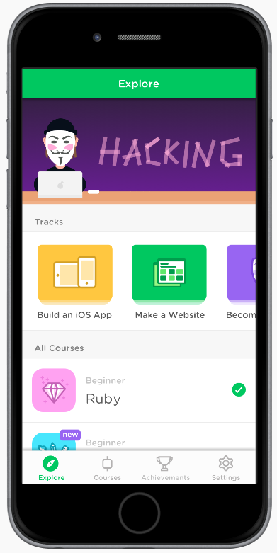




How can I learn more?
…and all the peeps presenting in this track!

Slide 28
Recommended* to learn how to code
Some of the better free resources (best way to start before you commit) are in this great categorized annotated list at LearnToCodeWithMe which includes popular online class environments sites Codecademy (bite-size chunks in interactive coding environment), Coursera, and video-skewing ones like Khan Academy, etc., vs. blogs (good if you like reading step-by-step). They even list specific sites for popular languages such as A Byte of Python and LearnPython (and see Dr. Chuck’s Python for Everybody).
Mix of paid and free:
Universally acclaimed are the Learn Code the Hard Way series courses, such as C, JavaScript, Python (and a follow-up course for junior Python developers), Ruby, SQL, Unix, etc.
CodeSchool by PluralSight
If you need more hands-on learning support in a traditional class environment, there are many coding bootcamps (not cheap but little/no upfront tuition if you pay in an income sharing agreement)
* Either we’ve used them, or other trusted sources like these
How Not to Learn Coding
People debate this, but if you skip the step-by-step learning and go straight to finding code samples on sites like StackOverflow, then just insert them in your code with minor tweaks, are you really understanding it? Take time to see HOW they solved it. Trying to solve the question/problem posed by the original poster (OP) yourself is better practice. More good tips in this post.

Slide 29
Installing Linux alongside Windows
Why do it? This article has pros and cons. Linux is an open operating system and programmer-friendly coding environment so familiarity with it will help your resume. But it’s not necessary: Windows is just fine to code in – whatever you need should have a Windows version nowadays.
But it’s easy and free if you want both options on your computer. The following could take 30+ minutes so you need to stick around, and you can't do anything else on your machine during that time, so schedule accordingly:
This how-to video is a great step by step for the process - you can follow him exactly.
The only hitch you may face is around the 1:45 point in the video, the narrator says to reboot and then you'll have the Ubuntu setup screen. If so, that's great and you can continue with the rest of the video as is. This did NOT happen for me, however: my computer rebooted in normal Windows 10 mode, even though I left my USB flash drive inserted.
If that happens to you, watch this other video, but NOT the whole thing: You only need to follow her instructions from 15:40 through 16:32. That will resolve.
Then you can continue from the 2:00 mark in the first video and run through the end, and you'll have Windows and Linux on your PC, which you can choose between each time you boot up!

