Slide 1
Finding suitable neighborhoods when moving from São Paulo to Camberra and vice-versa
Capstone Project by José Augusto Meirelles

Slide 2
Introduction
The objective is compare neighborhoods from São Paulo/Brasil with Canberra/Australia to provide information to people who wants to move from the first one to the second one and vice-versa.
This way neighborhoods of both cities will be grouped by it's similarities and main venues characteristics.

Slide 3
Data
Source of data:
  Boroughs and Neighborhoods
    São Paulo was obtained from https://www.prefeitura.sp.gov.br/cidade/secretarias/subprefeituras/subprefeituras/dados_demograficos/index.php
    Camberra was obtained from https://en.wikipedia.org/wiki/List_of_Canberra_suburbs
  Geo Location of the Neighborhoods was obtained from Nominatim from geopy
  Trending Venue data from foursquare api

Slide 4
Methodology
Data gathering
  First we collected the data of neighborhood from the both cities, find all geolocations using geopy
  After that we merge all neighborhoods in a single dataframe with a distinctive city index
  After the first foursquare exploration I discovered that's Camberra have significantly less venue data than São Paulo (767 vs 2658) when is used a radius of 500 meters for both, so I tripled the radius just for Camberra.
Data preparation
  Transpose venue category information to columns
  Summarize categories by neighborhood using mean for normalization
  Sort top 10 venue categories by neighborhood
Clustering
  Clustering neighborhoods alltogether using K-Means considering top 10 venue categories
Comparison
  Plot clustered maps side by side to visualize similar neighborhoods
  Compare the characteristics of the nth more common venues categories

Slide 5
Analysis
The first discovery that's Camberra have significantly less venue data than São Paulo (767 vs 2658) when I used a 500 meter radius, what make me think that Camberra could be a much more residential city than São Paulo. To have a similar amount of venue data I had to triple the radius for Camberra's exploration (2802 vs 2658).
Even using a larger radius for Camberra it has fewer venue categories than São Paulo (215 vs 290) which implies that São Paulo has a variety of venues 34,88% bigger even exploring a radius 3 times smaller.

Slide 6
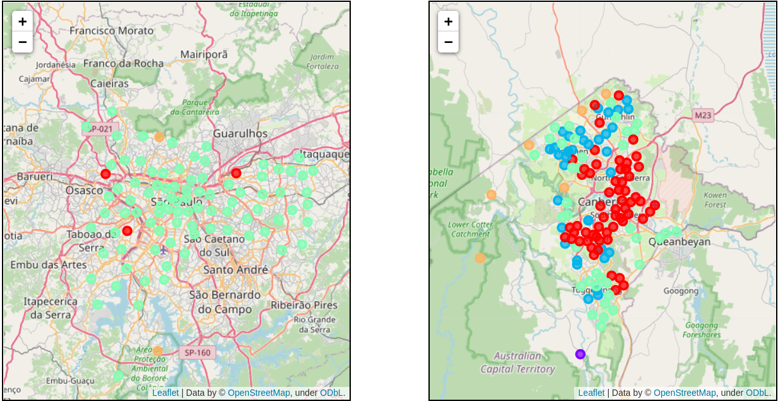
All Clusters in Maps
São Paulo and Camberra have different predominant clusters
Also as can be seen Camberra had its neighborhoods more distributed in different clusters, but São Paulo have the majority clustered all together

Slide 7
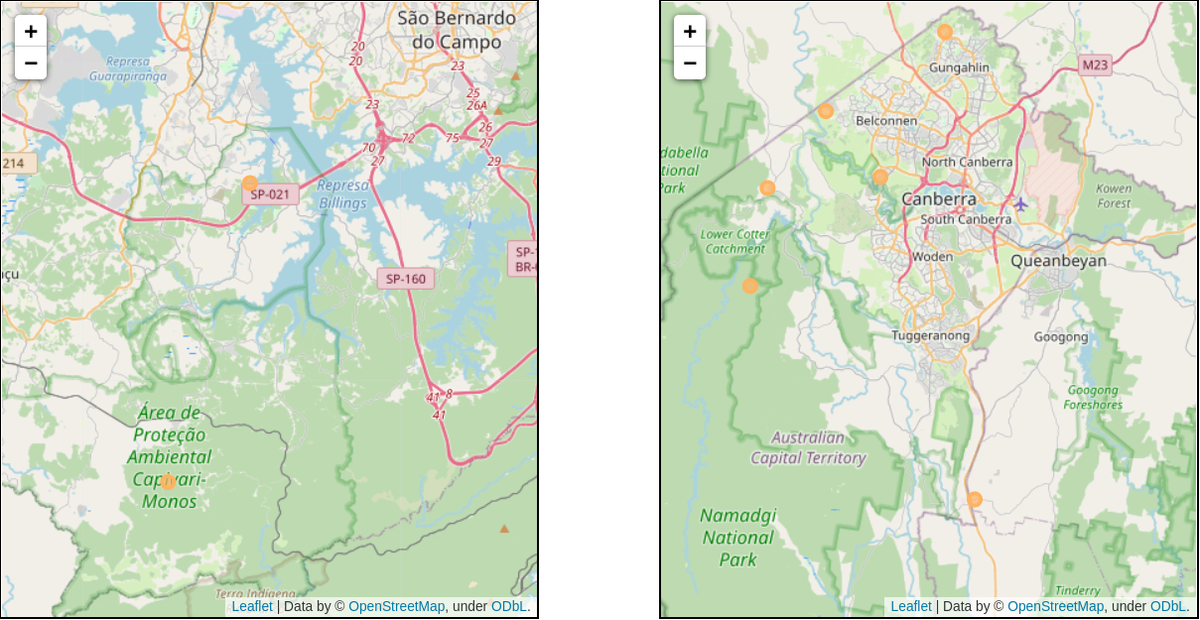
No venue data (non-clustered nbs)
It's possible to observe that these neighborhoods are located mainly and in forest and preservation areas

Slide 8
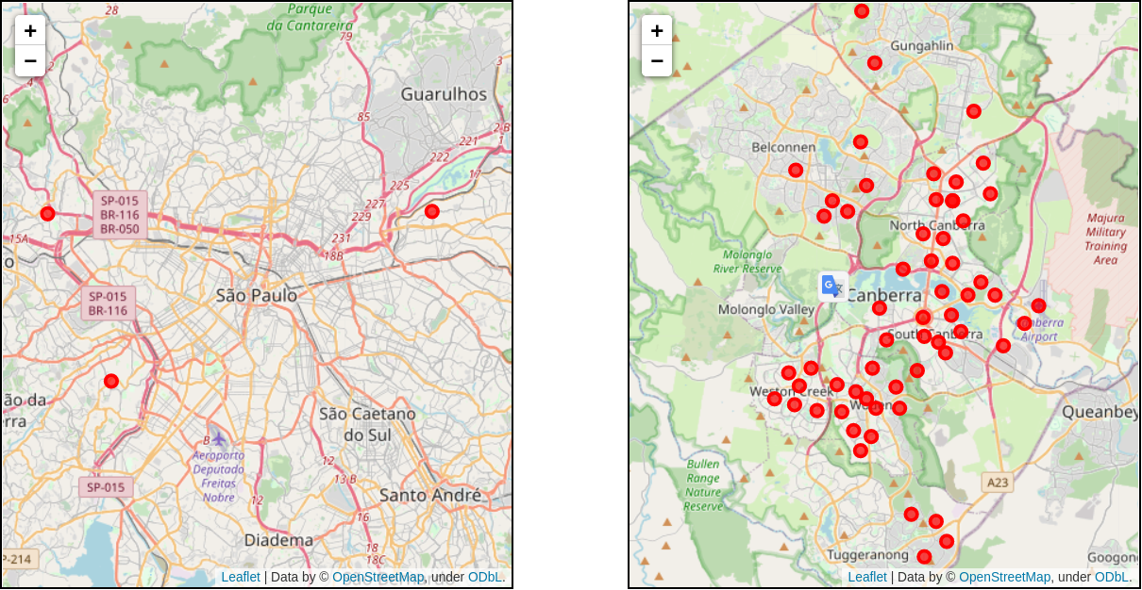
Cluster 0

Slide 9
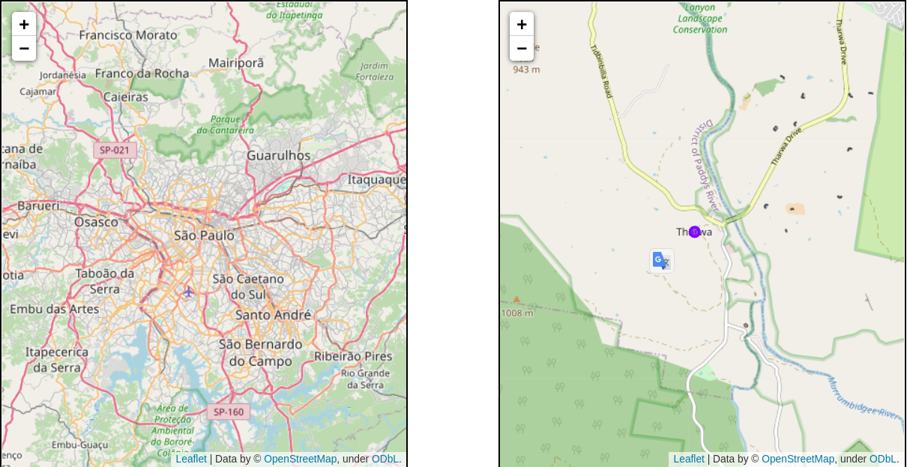
Cluster 1 – no match on SP

Slide 10
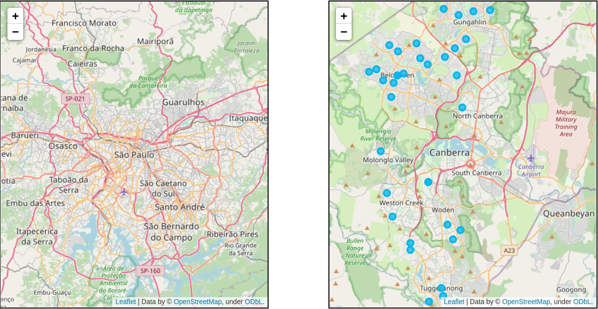
Cluster 2 – no match on SP

Slide 11
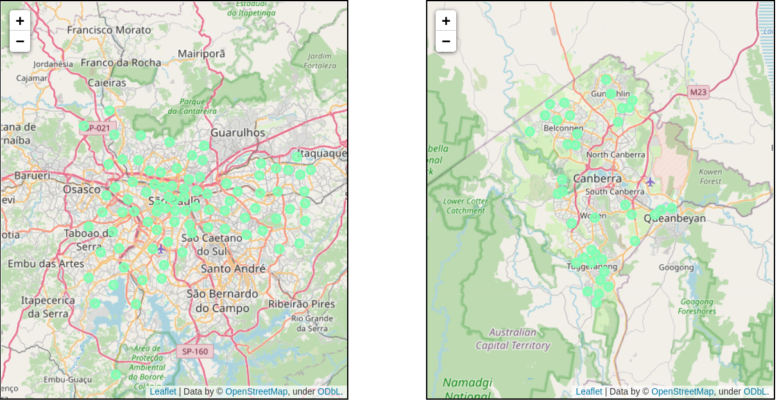
Cluster 3 – best matching in both

Slide 12
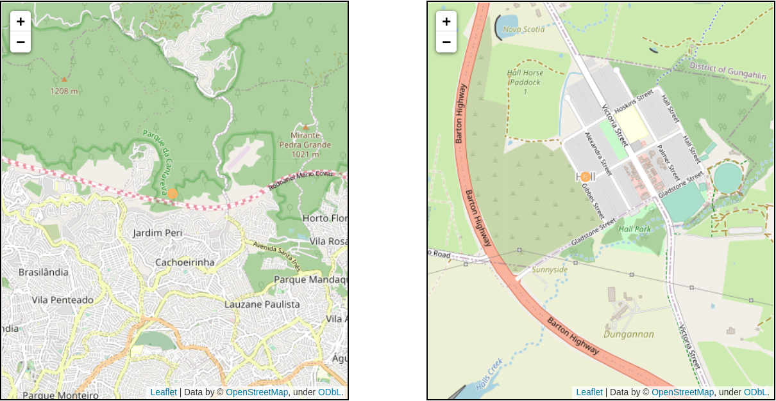
Cluster 4

Slide 13
Results and Discussion
São Paulo and Camberra are very different, although both are large Metropolis, some clusters in Camberra has no equivalence in São Paulo. However all neighborhoods in São Paulo have correspondence in Camberra.
Clusters who has large amount of elements in Camberra have few elements in São Paulo and vice-versa. Only one cluster has a significant amount of elements in both cities.
The exchangeble neighborhoods follows:

Slide 14
Similar neighborhoods
Cluster 0
  SP neighborhoods:
    "Morumbi" "Tremembé" "Jaguara" "Cangaíba"
  CB neighborhoods:
    "Aranda" "Bruce" "Cook" "Lawson" "Jamison Centre" "Page" "Acton" "Ainslie" "Barton" "Braddon" "Campbell" "Duntroon" "Capital Hill" "City" "Deakin" "Dickson" "Dickson Centre" "Downer" "Forrest" "Fyshwick" "Griffith" "Manuka" "Hackett" "Kingston" "Lyneham" "North Lyneham" "Parkes" "Red Hill" "Reid" "Russell" "Turner" "Watson" "Yarralumla" "Jacka" "Kenny" "Kinlyside" "Nicholls" "Canberra Airport" "Pialligo" "Chisholm" "Fadden" "Gilmore" "Macarthur" "Holder" "Rivett" "Stirling" "Waramanga" "Weston" "Weston Creek Centre" "Chifley" "Garran" "Hughes" "Lyons" "Southlands Centre" "O'Malley" "Pearce" "Phillip" "Woden Town Centre" "Swinger Hill" "Torrens"

Slide 15
Similar neighborhoods
Cluster 3
  SP neighborhoods:
    "Aricanduva" "Carrão" "Vila Formosa" "Butantã" "Raposo Tavares" "Rio Pequeno" "Vila Sônia" "Campo Limpo" "Capão Redondo" "Vila Andrade" "Cidade Dutra" "Socorro" "Casa Verde" "Limão" "Cidade Ademar" "Pedreira" "Cidade Tiradentes" "Ermelino Matarazzo" "Ponte Rasa" "Brasilândia" "Freguesia do Ó" "Lajeado" "Guaianases" "Cursino" "Ipiranga" "Sacomã" "Itaim Paulista" "Vila Curuçá" "Cidade Líder" "Itaquera" "José Bonifácio" "Parque do Carmo" "Jabaquara" "Jaçanã" "Barra Funda" "Jaguaré" "Lapa" "Perdizes" "Vila Leopoldina" "Jardim Ângela" "Jardim São Luís" "Água Rasa" "Belém" "Brás" "Mooca" "Pari" "Tatuapé" "Parelheiros" "Artur Alvim" "Penha" "Vila Matilde" "Anhanguera" "Perus" "Alto de Pinheiros" "Itaim Bibi" "Jardim Paulista" "Pinheiros" "Jaraguá" "Pirituba" "São Domingos" "Mandaqui" "Santana" "Tucuruvi" "Campo Belo" "Campo Grande" "Santo Amaro" "Iguatemi" "São Rafael" "São Mateus" "São Miguel" "Jardim Helena" "Vila Jacuí" "Sapopemba" "Bela Vista" "Bom Retiro" "Cambuci" "Consolação" "Liberdade" "República" "Santa Cecília" "Sé" "Vila Guilherme" "Vila Maria" "Vila Medeiros" "Moema" "Saúde" "Vila Mariana" "São Lucas" "Vila Prudente”
  CB neighborhoods:
    "Emu Ridge" "Dunlop" "Fraser" "Latham" "Macgregor" "Macquarie" "Melba" "Strathnairn" "Weetangera" "Narrabundah" "Franklin" "Gungahlin" "Gungahlin Town Centre" "Harrison" "Mitchell" "Moncrieff" "Throsby" "Beard" "Hume" "Oaks Estate" "Symonston" "Coombs" "Molonglo" "Sulman" "Wright" "Banks" "Calwell" "Conder" "Gordon" "Gowrie" "Greenway" "Monash" "Oxley" "Richardson" "Theodore" "Wanniassa" "Erindale Centre" "Fisher" "Harman"

Slide 16
Similar neighborhoods
Cluster 4
  SP neighborhoods:
    "Cachoeirinha"
  CB neighborhoods:
    "Hall"

Slide 17
No matching neighborhoods
Cluster 1
  CB neighborhoods:
    "Tharwa"
Cluster 2
  CB neighborhoods:
    "Belconnen" "Belconnen Town Centre" "Charnwood" "Evatt" "Florey" "Flynn" "Giralang" "Hawker" "Higgins" "Holt" "Kippax Centre" "Kaleen" "McKellar" "Scullin" "Spence" "O'Connor" "Amaroo" "Bonner" "Casey" "Crace" "Forde" "Ngunnawal" "Palmerston" "Denman Prospect" "Bonython" "Tuggeranong Town Centre" "Isabella Plains" "Kambah" "Kambah Village Centre" "Chapman" "Duffy" "Curtin" "Curtin Centre" "Farrer" "Isaacs" "Mawson"

Slide 18
Conclusion
Most of the people who wants to leave São Paulo will find a suitable neighborhood in Camberra, however the contrary situation don't have the same fitting.

