Slide 1
Final Project
Launch Chinese Restaurant in LA County
Gutuan Zheng
Nov 12, 2019

Slide 2
Business Problem
Best location to open a Chinese restaurant in Los Angeles County
Two Key Selection Metrics
Ethical Population: There shall be a plural Chines-Americans living in the nearby communities to maintain the foot traffics.
Competition: There shall not be too many niche restaurants operating in the same area, so enough revenue can be expected to offset fixed cost and realize sizable profit.
Location ! Location ! Location !
60 percent of new restaurants failed within the first year
80 percent closed door before their fifth anniversary

Slide 3
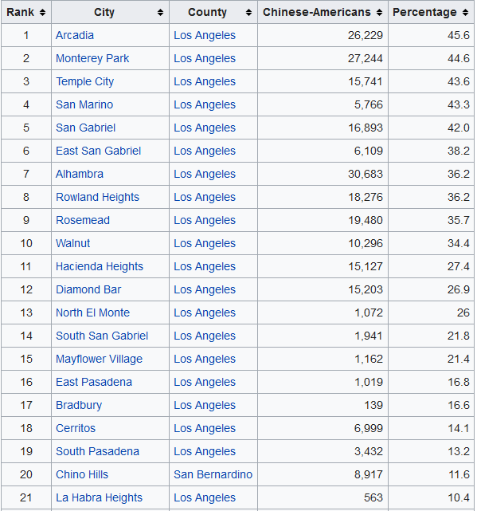
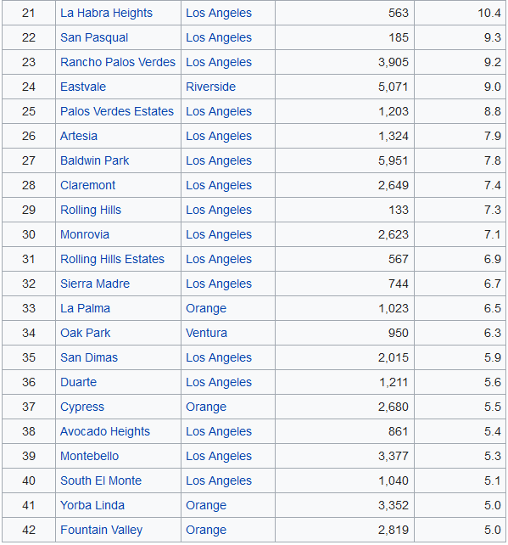
Top Cities with Chinese-American populations in Los Angeles Area

Slide 4
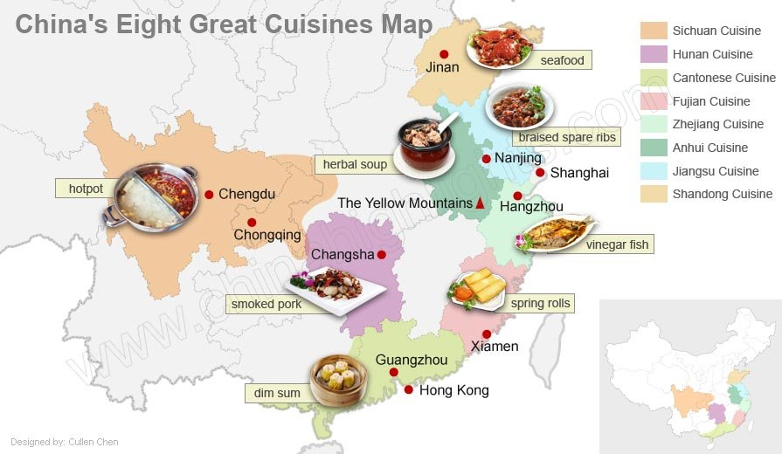
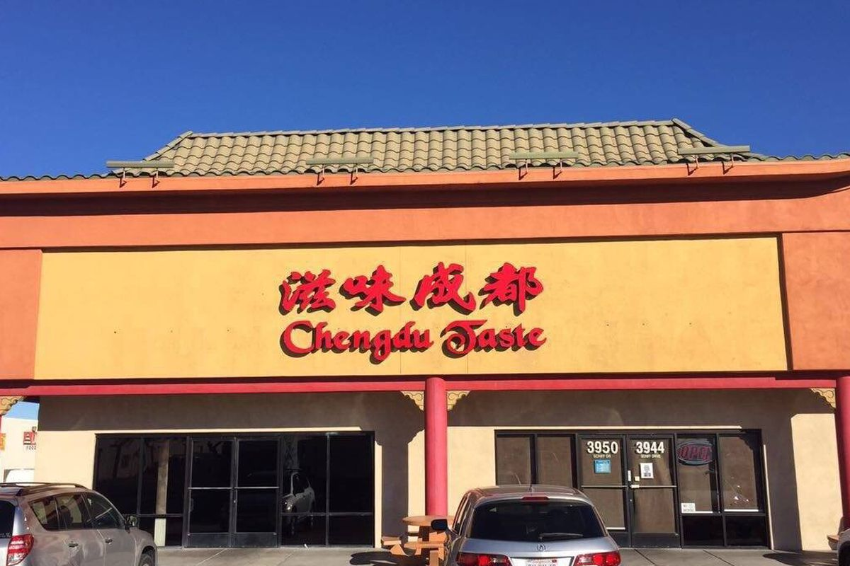

Chinese Restaurant Business in Los Angeles Area
Variety of Chinese dishes are served among fierce competition
Upscale new restaurants established recently to attract the new affluent generation of Chinese Americans

Slide 5
Methodology
Approach
Identify the cluster of cities that do not have any Asian restaurants, or have only a few ones. By doing so, we exclude the area where the business had been presented, or even saturated.
Visualize the cluster of cities per the Asian restaurant features, and further exclude those cities that does not have Asian restaurants, but in the close proximity to the high density of competing business.
Data Science Techniques
  Geolocator to derive the location information
  K-Cluster to group the cities based on relevant features
  Folium to plot the Los Anlage’s area analytical information
  Foursquare platform to acquire the aggregated city venue data

Slide 6
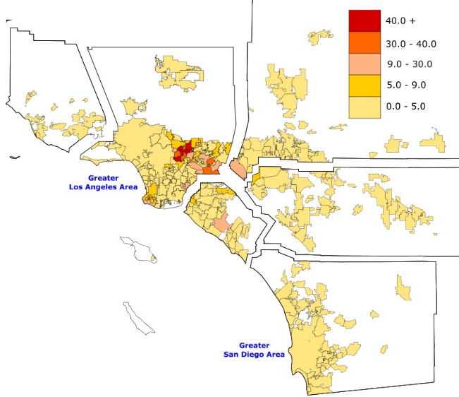
Results
Top 42 Cities with High Level Population of Ethical Population
88 Cities in LA County → 42 Cities
Penetration (%)

Slide 7
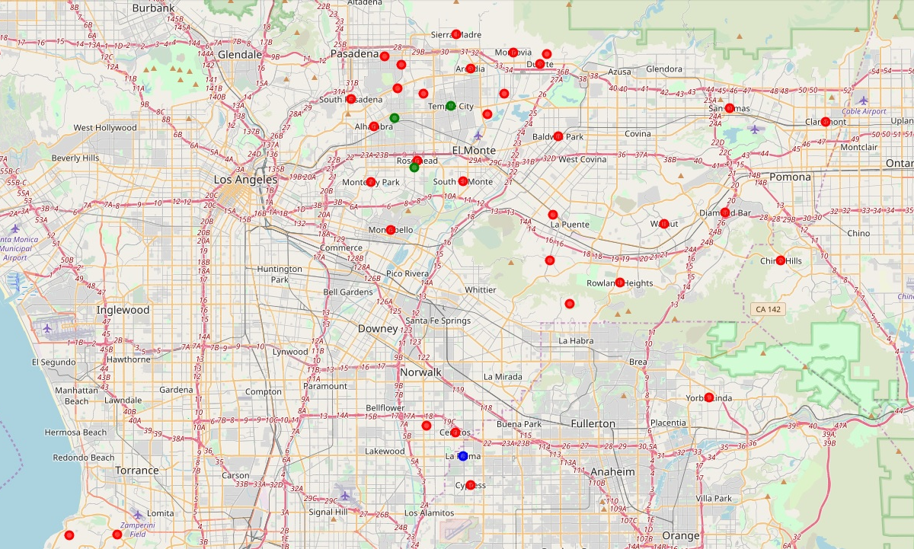
Results
K-Cluster per Competitions
Cluster 0: (Red) With few Chines and Asian restaurant
Cluster 1: (Blue) With some competition
Cluster 2: (Green) With intensive competition

Slide 8
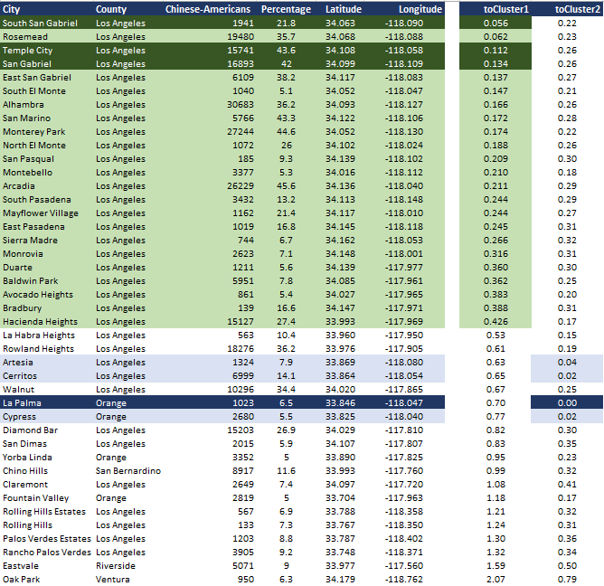
Results
Top 16 Cities with Less Competitions, after generalized the clusters per proximity
42 Cities in LA County → 15 Cities

Slide 9
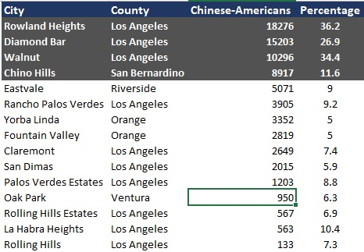
Results
Top 4 Cities with Less Competitions and Decent Ethical Populations
15 Cities in LA County → 4 Cities

Slide 10
Discussion
Analysis is at the city level, narrowed down total 88 cities in the Los Angeles area into 4, with additional 11 as next tier hopefuls.
Further Suggested Investigation:
Neighborhood within the city – Zoning, ethical population, crime rate, affluence
Street location – Parking, accessibility, visibility
House Facility - Housing price, utilities, equipment
Niche selection – Upscale or discount business

Slide 11
Conclusion
Start a Chinese restaurant in the further east suburban
Chinese American ethical population is increasing quickly
Competition has yet to catchup
Diamond Bar
Walnut
Chino Hills
Rowland Heights

