Slide 1
Opening a Chinese Restaurant in Manhattan

Slide 2
Introduction
Manhattan is most densely populated of the five boroughs of New York City.
The borough consists mostly of Manhattan Island, bounded by the Hudson, East, and Harlem rivers; as well as several small adjacent islands.
Manhattan has been described as the cultural, financial, media, and entertainment capital of the world.
During the Gold Rush, thousands of Chinese Immigrants came to the US, and expanded though all the country. In New York City, they make the 8% of the population.
The business plan is to open a restaurant in Manhattan, with the best location, less competition, and better income of habitants.

Slide 3
Data acquisition
To find the best location to open a Chinese restaurant, I will use New York City data that contains the latitude and longitude of all Chinese restaurants in Manhattan. The data is public available: https://cocl.us/new_york_dataset
To have more information on each Chinese restaurants, will use the Foursquare API.

Slide 4
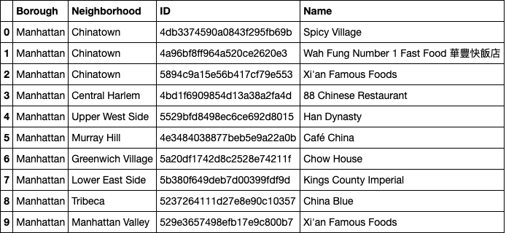
Number of Chinese Restaurants in Manhattan
There are a total of 9 restaurants

Slide 5
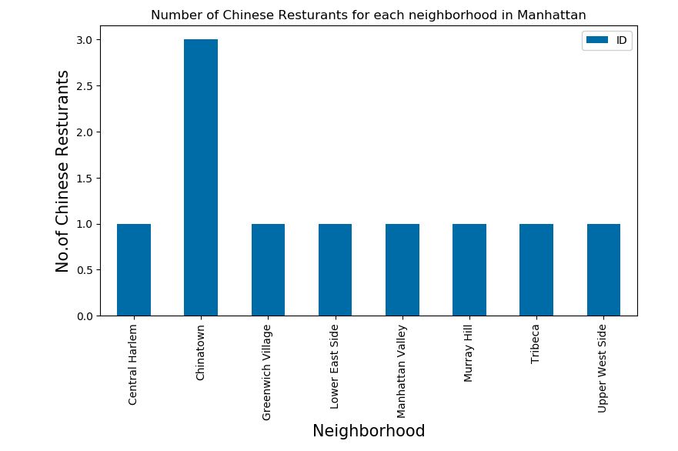
Plot of number of restaurants in all the neighborhoods
As seen, Chinatown has the most restaurants with 3.

Slide 6
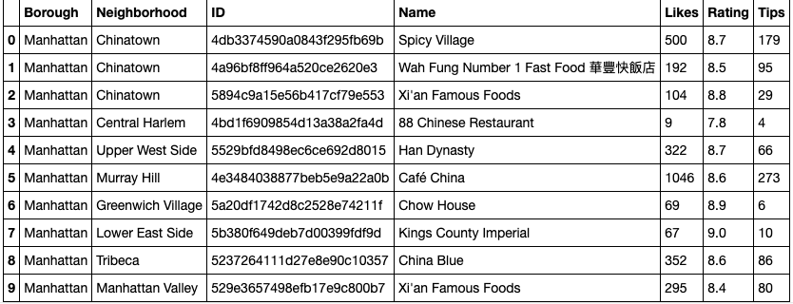
Stats of the Restaurants.
The most liked restaurant is Café China, and the best rating is Kings County Imperial with a 9.0.

Slide 7
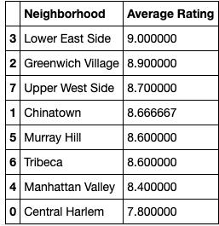

Neighborhoods with the best average rating.
Lower East Side has the highest average rating with a 9.

Slide 8
Conclusion
As we can see, the area where Chinese Restaurants have the best likes and rating is Low East Side. There is only one restaurant with more than a 9 of rating. Kings County Imperial has a 9 of rating but only 67 likes and 10 tips. This makes this are the best to open a Chinese Restaurant because of the high rating for Chinese Food and low competition

