Slide 1

Cryptographic algorithms
Prof. Bart Preneel
COSIC
Bart.Preneel(at)esatDOTkuleuven.be http://homes.esat.kuleuven.be/~preneel
© Bart Preneel. All rights reserved

Slide 2
Outline
1. Cryptology: concepts and algorithms
symmetric algorithms for confidentiality
symmetric algorithms for data authentication
public-key cryptology
2. Cryptology: protocols
identification/entity authentication
key establishment
3. Public-Key Infrastructure principles

Slide 3
Outline (2)
4. Networking protocols
– email, web, IPsec, SSL/TLS
5. New developments in cryptology
6. Cryptography best practices
7. Hash functions

Slide 4
Definitions
data
entities
Confidentiality
Integrity Availability
confidentiality
encryption
anonymity
authentication
data authentication
identification
Authorisation
Non-repudiation of origin, receipt
Don’t use the word authentication without defining it
Contract signing
Notarisation and Timestamping
4

Slide 5

Cryptology: basic principles
Alice
Eve
Bob
Clear text
CRYP TOB OX
%^C& @&^(
%^C& @&^(
CRYP TOB
OX
Clear text

Slide 6
Symmetric cryptology: confidentiality
old cipher systems:
– transposition, substitution, rotor machines
the opponent and her power
the Vernam scheme
DES and triple-DES
AES
RC4

Slide 7
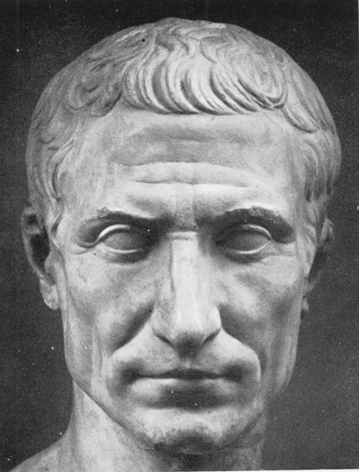
Old cipher systems (pre 1900)
Caesar cipher: shift letters over k positions in the alphabet (k is the secret key)
THIS IS THE CAESAR CIPHER WKLV LV WKH FDHVDU FLSKHU
Julius Caesar never changed his key (k=3).
7

Slide 8
Cryptanalysis example:
TIPGK | RERCP | JZJZJ | WLE | GVCTX | EREPC | WMWMW | JYR
UJQHL | SFSDQ | KAKAK | XMF | HWDUY | FSFQD | XNXNX | KZS
VKRIM | TGTER | LBLBL | YNG | IXEVZ | GTGRE | YOYOY | LAT
WLSJN | UHUFS | MCMCM | ZOH | JYFWA | HUHSF | ZPZPZ | MBU
XDTKO | VOVGT | NDNDN | API | KZGXB | IVITG | AQAQA | NCV
YNULP | WKWHU | OEOEO | BQJ | LAHYC | JWJUH | BRBRB | ODW
ZOVMQ | XKXIV | PFPFP | CRK | MBIZD | KXKVI | CSCSC | PEX
APWNR | YLYJW | QGQGQ | DSL | NCJAE | LYLWJ | DTDTD | QFY
BQXOS | ZMXKX | RHRHR | ETM | ODKBF | MZMXK | EUEUE | RGZ
CRYPT | ANALY | SISIS | FUN | PELCG | NANYL | FVFVF | SHA
DSZQU | BOBMZ | TJTJT | GVO | QFMDH | OBOZM | GWGWG | TIB
ETARV | CPCNA | UKUKU | HWP | RGNEI | PCPAN | HXHXH | UJC
FUBSW | DQDOB | VLVLV | IXQ | SHOFJ | QDQBO | IYIYI | VKD
Plaintext?
k = 17
8

Slide 9
Old cipher systems (pre 1900) (2)
Substitutions
–
! Easy to
ABCDEFGHIJKLMNOPQRSTUVW _{break using}
XYZ
statistical techniques
–
MZNJSOAXFQGYKHLUCTDVWBI PER
ORI S NOTIT
OSAN P
TRANS
TraPnOsSpIoTsitions
IONS
9

Slide 10
Security
there are n! different substitutions on an alphabet with n letters
there are n! different transpositions of n letters
n=26: n!=403291461126605635584000000 = 4 . 10²⁶ keys
trying all possibilities at 1 nanosecond per key requires....
4.10²⁶ /(10⁹ . 10⁵ . 4 10²) = 10¹⁰ years
keys per second
seconds per day
days per year

Slide 11
Letter distributions

Slide 12
Assumptions on Eve (the opponent)
A scheme is broken if Eve can deduce the key or obtain additional plaintext
Eve can always try all keys till “meaningful” plaintext appears: a brute force attack
solution: large key space
Eve will try to find shortcut attacks (faster than brute force)
history shows that designers are too optimistic about the security of their cryptosystems

Slide 13
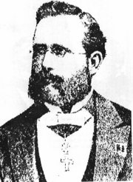
Assumptions on Eve (the opponent)
Cryptology = cryptography + cryptanalysis
Eve knows the algorithm, except for the key (Kerckhoffs’s principle)
increasing capability of Eve:
knows some information about the plaintext (e.g., in English)
knows part of the plaintext
can choose (part of) the plaintext and look at the ciphertext
can choose (part of) the ciphertext and look at the plaintext

Slide 14
New assumptions on Eve
Eve may have access to side channels
timing attacks
simple power analysis
differential power analysis
acoustic attacks
electromagnetic interference
Eve may launch (semi-)invasive attacks
differential fault analysis
probing of memory or bus

Slide 15

Side channel analysis
Oscilloscope
files transfer
Arm scope retrieve file
The image cannot be displayed. Your computer may not have enough memory to open the image, or the image may have been corrupted.
Restart your computer, and then open the file again. If the red x still appears, you may have to delete the image and then insert it
Scope trigger on IO
Current waveform acquisition
Server
store the files
and run the Treatment software
Main PC
run the Acquisition software
GCR
R
command emission
Card extention
Card reader
Protection box
15

Slide 16
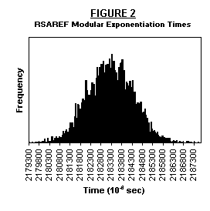
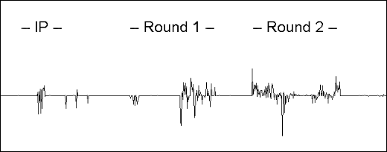
Timing attacks and power analysis
16

Slide 17
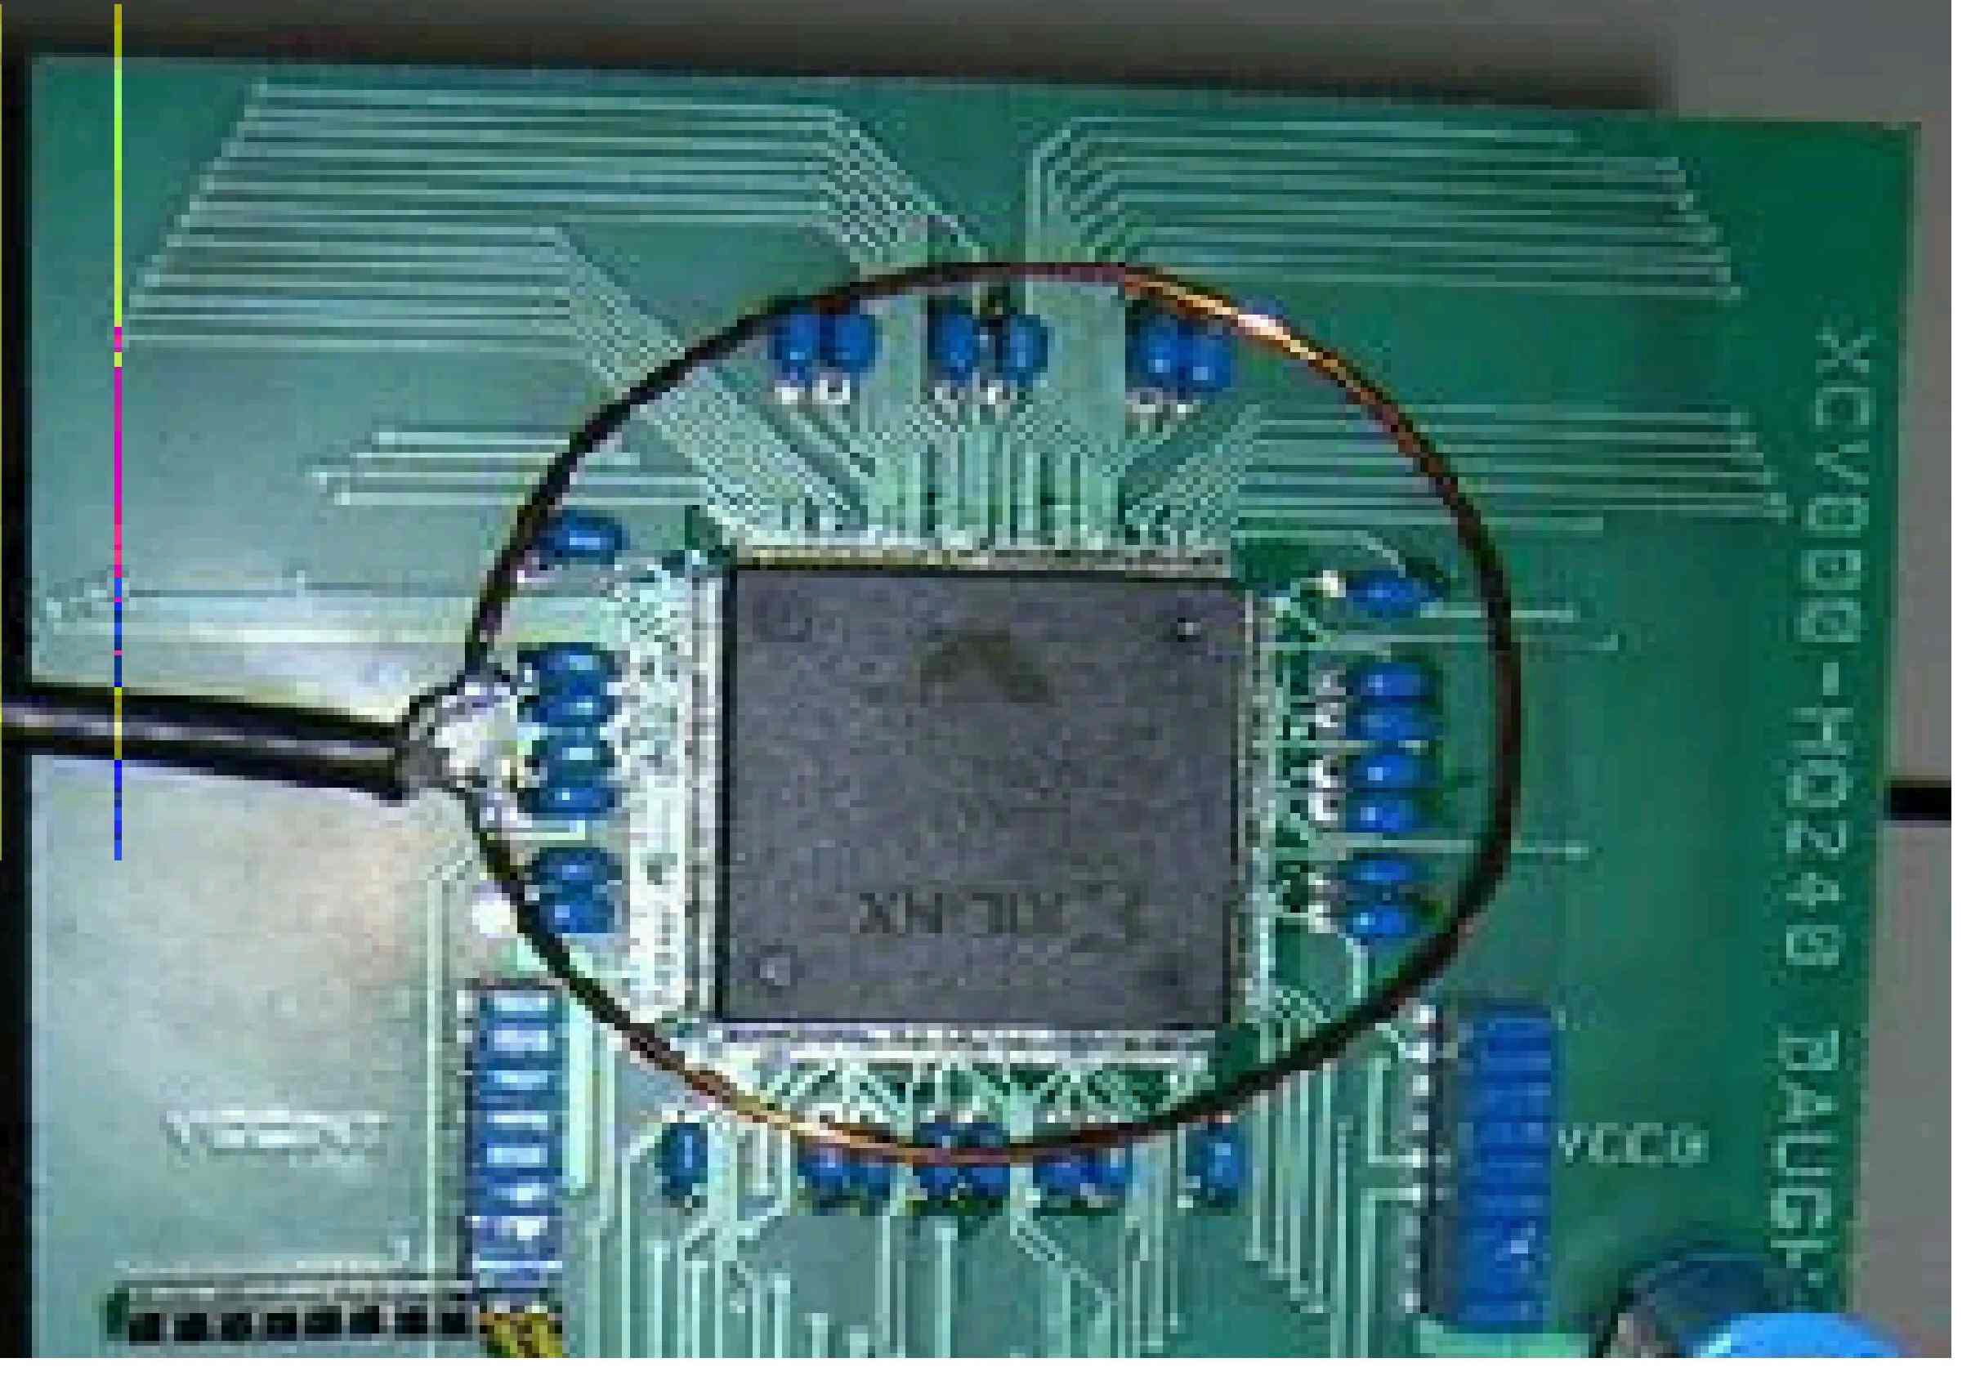
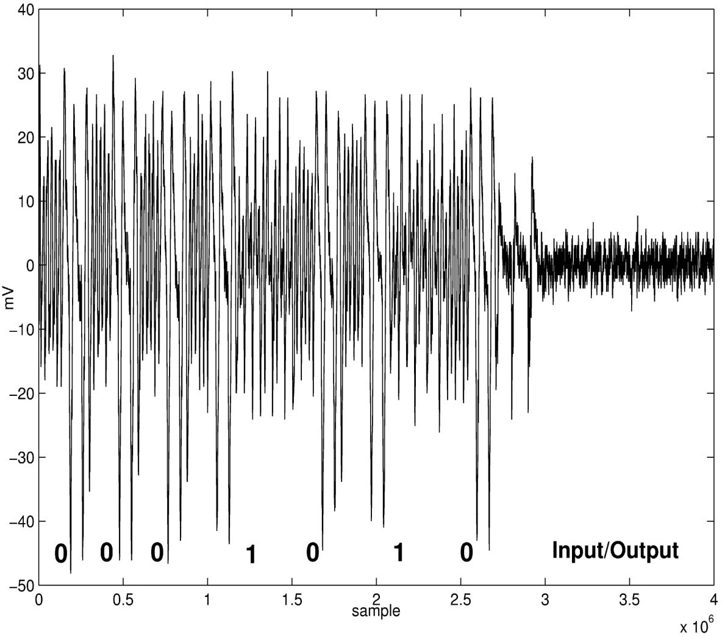
Side channel analysis: EMA
17

Slide 18



Cryptology + side channels
Eve
Alice
Bob
Clear text
CRYP TOB OX
%^C& @&^(
%^C& @&^(
CRYP TOB
OX
Clear text
18

Slide 19
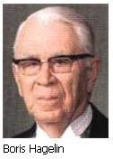
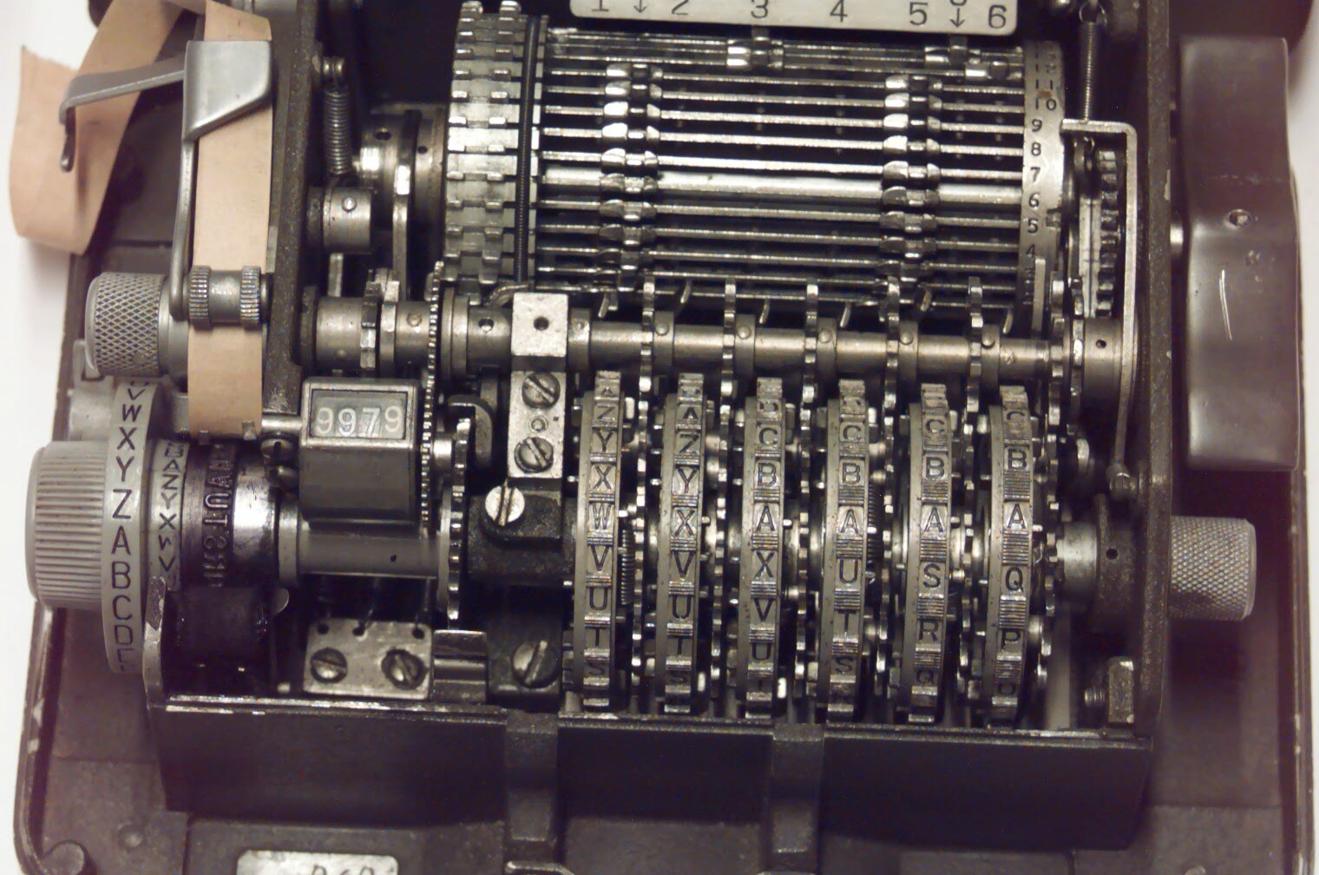
Mechanical: Hagelin C38
19

Slide 20
Problem: what is this?
Cryptogram [=14 January 1961 11.00 h]
<AHQNE LQWDB GEDBE XNZZH UOMWW OIJDR HSUIY FUVOA SHXRR
XVAZW BXFRZ HGMPS MEVGS LOGSO UEAAV PKFPZ WLSSD
IQFFR NJVYB GAZJK ANLLB ZWVVV RWYXH OSEAW ZVKPU
JENFV QVGOZ RDJQC DQCGF LDQNI PAWSV SUZMY ZSHKK
OUXBD KFYQV VJTEB PWCVR YTZAA CHTYN QDYEL PALWB 11205
MLQOK
AHQNE
141100>
20

Slide 21
The answer
Plaintext [=14 January 1961 11.00 h]
DOFGD | VISWA | WVISW | JOSEP | HWXXW
TERTI | OWMIS | SIONW | BOMBO | KOWVO
IRWTE | LEXWC | EWSUJ | ETWAM | BABEL
GEWXX | WJULE | SWXXW | BISEC | TWTRE
SECVX | XWRWV | WMWPR | INTEX | WXXWP
RIMOW | RIENW | ENVOY | EWRUS | URWWX
XWPOU | VEZWR | EGLER | WXXWS | ECUND
OWREP | RENDR | EWDUR | GENCE | WPLAN
WBRAZ | ZAWWC |  |  | 21

Slide 22
The answer (in readable form)
Plaintext [=14 January 1961 11.00 h]
TRESECV. R V M RIEN ENVOYE
PRINTEX. RUSUR.
PRIMO POUVEZ
REGLER. SECUNDO
REPRENDRE
DURGENCE PLAN BRAZZA VIS A VIS
JOSEP BOMBOKO
H. TERTIO MISSION VOIR TELEX CE SUJET
AMBABELGE. JULES.
22

Slide 23
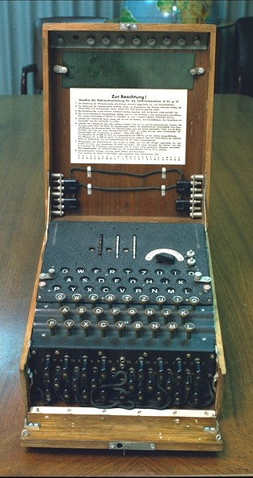
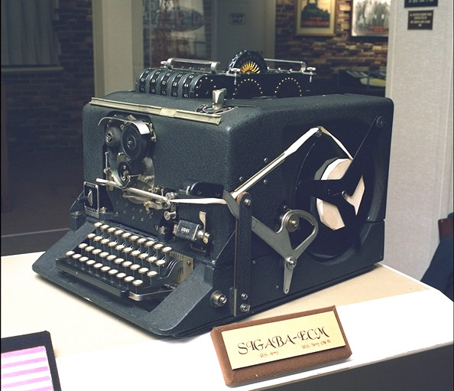
The Rotor machines (WW II)
23

Slide 24

Life cycle of a cryptographic algorithm
idea
mathematical analysis
publication
public evaluation
RIP
OK
hw/sw implementation
standardization
industrial products $$$
take out of service
24

Slide 25
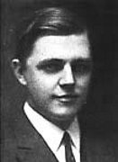
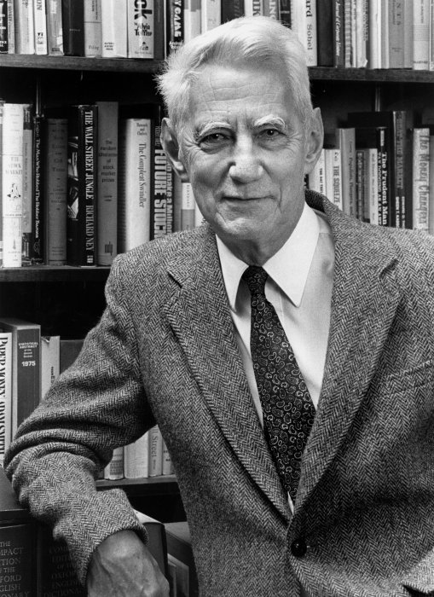
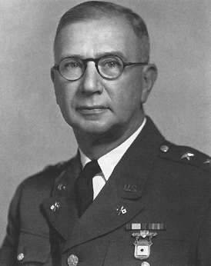
Vernam scheme
Shannon
(1948)
(1917)
Mauborgne: one time pad
(1917+x)
key is random string, as long as the plaintext information theoretic proof of security
P C
C
P
10010
⊕
11001
11001
⊕
10010
C
01011
01011

Slide 26
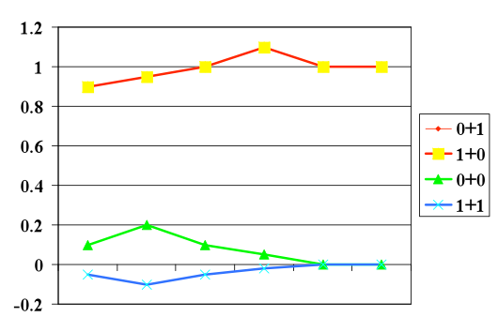
Vernam scheme
0 + 1 = 1
1 + 0 = 1
0 + 0 = 0
1 + 1 = 0
identical mathematical symbols can result in different electrical signals

Slide 27
Three approaches in cryptography
information theoretic security
ciphertext only
part of ciphertext only
noisy version of ciphertext
system-based or practical security
also known as “prayer theoretic” security
complexity theoretic security:
model of computation, definition, proof
variant: quantum cryptography

Slide 28
Model of a practical stream cipher
IV IV
next state function
next state function
output function
output function
“looks” random
C
P
P
28

Slide 29
A5/1 stream cipher (GSM)
18 0
21
0
22
0
Clock control: registers agreeing with
majority are clocked (2 or 3)
29

Slide 30
A5/1 stream cipher (GSM)
A5/1 attacks
exhaustive key search: 2⁶⁴ (or rather 2⁵⁴)
Hardware 10K$ < 1 minute ciphertext only
search 2 smallest registers: 2⁴⁵ steps
[BWS00] 1 minute on a PC
2 seconds of known plaintext
2⁴⁸ precomputation, 146 GB storage
[BB05]: 10 minutes on a PC,
3-4 minutes of ciphertext only
30

Slide 31
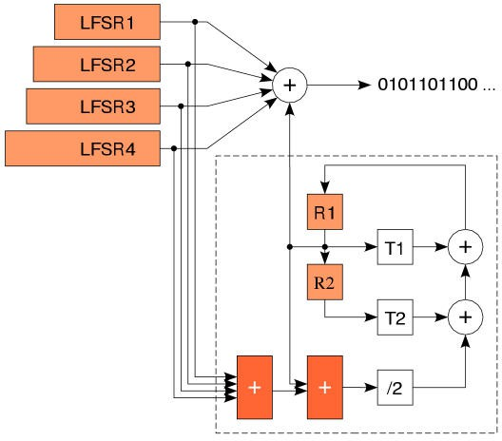
Bluetooth stream cipher
brute force: 2¹²⁸ steps
[Lu+05] 24 known bits of 2²⁴ frames, 2³⁸ computations, 2³³ memory
31

Slide 32
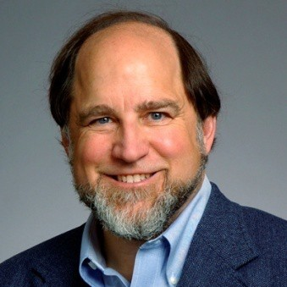
A simple cipher: RC4 (1987)
designed by Ron Rivest (MIT)
leaked in 1994
S[0..255]: secret table derived from user key K
for i=0 to 255 S[i]:=i j:=0
for i=0 to 255
j:=(j + S[i] + K[i]) mod 256 swap S[i] and S[j]
i:=0, j:=0
32

Slide 33
A simple cipher: RC4 (1987)
Generate key stream which is added to plaintext
i:=i+1
j:=(j + S[i]) mod 256 swap S[i] and S[j] t:=(S[i] + S[j]) mod 256 output S[t]
t
000 | 001 | 002 |  | 093 | 094 | 095 |  | 254 | 255
205
162
013
...
033
92
079
...
099
143
092
162
i j
33

Slide 34
RC4: weaknesses
often used with 40-bit key
US export restrictions until Q4/2000
best known general shortcut attack: 2²⁴¹
weak keys and key setup (shuffle theory)
some statistical deviations
e.g., 2nd output byte is biased
solution: drop first 256 bytes of output
problem with resynchronization modes (WEP)
33

Slide 35
Block cipher
large table: list n-bit ciphertext for each n-bit plaintext
if n is large: very secure (codebook)
but for an n-bit block: 2^{n} values
impractical if n ≥ 32
alternative n = 64 or 128
simplify the implementation
repeat many simple operations
35

Slide 36
Block cipher (2)
P1 | P2 | P3
block cipher
block cipher
block cipher
C1 | C2 | C3
larger data units: 64…128 bits
memoryless
repeat simple operation (round) many times
36

Slide 37
Data Encryption Standard (1977)
encrypts 64 plaintext bits under control of a 56-bit key
16 iterations of a relatively simple mapping
FIPS: US government standard for sensitive but unclassified data
worldwide de facto standard since early 80ies
surrounded by controversy

Slide 38

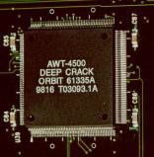
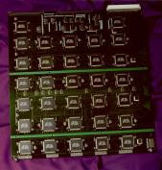
Security of DES (56 bit key)
PC: trying 1 DES key: 15 ns
Trying all keys on 250 PCs:
1 month: 2²⁶ x 2¹⁶ x 2⁵ x 2⁸⁼ 2⁵⁵
M. Wiener’s design (1993): 1,000,000 $ machine: 3 hours
(in 2010: 5 seconds)
EFF Deep Crack (July 1998) 250,000 $ machine: 50 hours…

Slide 39
DES: security (ct’d)
Moore’s “law”: speed of computers doubles every 18 months
key lengths need to grow in time
Use new algorithms with longer keys
adding 1 key bits doubles the work for the attacker
Key length recommendations in 2009
< 64 bits: insecure
80 bits: 3-5 years
– 100 bits: 20-25 years
39

Slide 40
Federal Register, July 24, 2004
DEPARTMENT OF COMMERCE
National Institute of Standards and Technology
[Docket No. 040602169– 4169– 01]
Announcing Proposed Withdrawal of Federal Information Processing
Standard (FIPS) for the Data
Encryption Standard (DES) and
Request for Comments
AGENCY: National Institute of Standards and Technology (NIST), Commerce.
ACTION: Notice; request for comments.
SUMMARY: The Data Encryption Standard (DES), currently specified in Federal Information Processing Standard (FIPS) 46–3, was evaluated pursuant to its scheduled review. At the conclusion of this review, NIST determined that the strength of the DES algorithm is no longer sufficient to adequately protect Federal government information. As a result, NIST proposes to withdraw FIPS 46–3, and the associated FIPS 74 and FIPS 81. Future use of DES by Federal agencies is to be permitted only as a component function of the Triple Data Encryption Algorithm (TDEA).
40

Slide 41
3-DES: NIST Spec. Pub. 800-67
(May 2004)
two-key triple DES: until 2009
three-key triple DES: until 2030
Clear text
%^C& @&^(
DES
DES⁻¹
DES
1
2
3
41

Slide 42



Symmetric Key Lengths and Moore’s “law”
AES
-128
3-key 3DES
2-key 3DES
DES
Moore’s “law”: speed of computers doubles every 18 months
42

Slide 43
AES (Advanced Encryption Standard)
open competition launched by US government (Sept. ‘97) to replace DES
22 contenders including IBM, RSA, Deutsche Telekom
128-bit block cipher with key of 128/192/256 bits
as strong as triple-DES, but more efficient
royalty-free
A machine that cracks a DES key in 1 second would take 149 trillion years to crack a 128-bit key
43

Slide 44
AES: Rijndael
Key Schedule
MixColumns MixColumns MixColumns MixColumns
S
S
S
S
S
S
S
S
S
S
S
S
S
S
S
S
round
round
S S S S
S S S S
S S S S
S S S S
round
Key length: 16/24/32 bytes
Block length:
Rijndael: 16/24/32 bytes
AES: 16 bytes only
.
.
round

Slide 45
AES Status
FIPS 197 published on Nov. 6, ‘01, effective May 26, ‘02
mandatory for sensitive US govt. information
mid 2003: AES-128 also for classified information and AES-192/-256 for secret and top secret information!
fast adoption in the market (thousands of products)
Feb. 2010: 1290 AES product certifications by NIST http:// csrc.nist.gov/groups/STM/cavp/documents/aes/aesval.html
standardization: ISO, IETF, IEEE 802.11,…
slower adoption in financial sector
software: 7.6 cycles/byte [Käsper-Schwabe’09]
hardware: Intel will provide AES instruction (Westmere, 2010) at 0.75 cycles/byte for decryption

Slide 46
Encryption limitations
Ciphertext becomes random string: “normal” crypto does not encrypt a credit card number into a (valid) credit card number
Typically does not hide the length of the plaintext (unless randomized padding)
Does not hide existence of plaintext (requires steganography)
Does not hide that Alice is talking to Bob (requires traffic confidentiality)

Slide 47
Symmetric cryptology: data authentication
the problem
hash functions without a key
MDC: Manipulation Detection Codes
hash functions with a secret key
MAC: Message Authentication Codes
47

Slide 48
Data authentication: the problem
encryption provides confidentiality:
prevents Eve from learning information on the cleartext/plaintext
but does not protect against modifications (active eavesdropping)
Bob wants to know:
the source of the information (data origin)
that the information has not been modified
(optionally) timeliness and sequence
data authentication is typically more complex
than data confidentiality
48

Slide 49
Data authentication: MAC algorithms
Replace protection of authenticty of (long) message by protection of secrecy of (short) key
Add MAC to the plaintext
CBC-MAC
HMAC
This is an input to a MAC algorithm. The input is a very long string, that is reduced by the hash function to a string of fixed length. There are additional security conditions: it should be very hard for someone who does not know the secret key to compute the hash function on a new input.
7E6FD7198A198FB3C

Slide 50







MAC algorithms
Clear text
Clear text
VER IFY
Clear text
Clear text
MAC

Slide 51
Data authentication: MAC algorithms
typical MAC lengths: 32..96 bits
Forgery attacks: 2^{m} steps with m the MAC length in bits
typical key lengths: (56)..112..160 bits
Exhaustive key search: 2^{k} steps with k the key length in bits
birthday attacks: security level smaller than expected

Slide 52
MAC algorithms
Banking: CBC-MAC based on triple-DES
Internet: HMAC and CBC-MAC based on AES
information theoretic secure MAC algorithms (authentication codes):
highly efficient
rather long keys
part of the key refreshed per message

Slide 53

CBC-MAC based on AES
P1
P2
P3
AES
AES
AES
C3
C1
C2
AES
security level: 2⁶⁴
select leftmost 64 bits
53

Slide 54
Data authentication: MDC
MDC (manipulation detection code)
Protect short hash value rather than long text
(MD5)
(SHA-1), SHA-256, SHA-512
RIPEMD-160
This is an input to a cryptographic hash function. The input is a very long string, that is reduced by the hash function to a string of fixed length. There are additional security conditions: it should be very hard to find an input hashing to a given value (a preimage) or to find two colliding inputs (a collision).
1A3FD4128A198FB3CA345932
54

Slide 55
MDC Security requirements (n-bit result)
preimage 2nd preimage
collision
?
x
≠
?
?
≠
?
h
h
h
h
h
=
h(x)
h(x)
=
h(x’)
₂n
₂n
₂n/2

Slide 56
Data authentication: MDC
n-bit result
preimage resistance: for given y, hard to find input x such that h(x) = y (2^{n} operations)
2nd preimage resistance: hard to find x’≠ x such that h(x’) = h(x) (2^{n} operations)
Collision resistance: hard to find (x,x’) with x’ ≠ x such that h(x’) = h(x)
(2^{n/2} operations)
56

Slide 57
MD5 and SHA-1
SHA-1:
– (2nd) preimage 2¹⁶⁰ steps
– collisions 2⁸⁰ steps
60 M$ for 1 year
Shortcut: Aug. 2007: 2⁶⁰ steps
MD5
(2nd) preimage 2¹²⁸ steps
collisions 2⁶⁴ steps
15 K$ for 1 month
Shortcut: Aug. 2004: 2³⁹ steps (today: milliseconds)
57

Slide 58
Public-key cryptology
the problem
public-key encryption
digital signatures
an example: RSA
advantages of public-key cryptology

Slide 59
Limitation of symmetric cryptology
Reduce security of information to security of keys
But: how to establish these secret keys?
Cumbersome and expensive
Or risky: all keys in 1 place
Do we really need to establish secret keys?

Slide 60



Public key cryptology: encryption
Clear text
CRYP TOB
OX
CRYP TOB
OX
Clear text
%^C& @&^(
%^C& @&^(
Public key
Private key

Slide 61
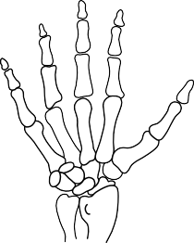
Public key cryptology: digital signature
Public key
Clear text
Clear text
VER IFY
Clear text
Clear text
SIGN
Private key

Slide 62
A public-key distribution protocol: Diffie-Hellman
Before: Alice and Bob have never met and share no secrets; they know a public system parameter α
_{α} x
generate x compute α ^{x}
generate y compute α ^{y}
α
y
compute k=(α ^{y})^{x} compute k=(α ^{x}) ^{y}
After: Alice and Bob share a short term key k
– Eve cannot compute k : in several mathematical structures it is hard to derive x from α ^{x}
(this is known as the discrete logarithm problem)
62

Slide 63
RSA (‘78)
Choose 2 “large” prime numbers p and q
modulus n = p.q
compute λ(n) = lcm(p-1,q-1)
choose e relatively prime w.r.t. λ(n)
compute d = e⁻¹ mod λ(n)
The security of RSA is based on the “fact” that it is easy to generate two large primes, but that it is hard to factor their product
public key = (e,n)
private key = d of (p,q)
encryption: c = m^{e} mod n
decryption: m = c^{d} mod n
try to factor 2419
63

Slide 64
Factorisation records
2009: 768 bits or 232 digits
1 digit ~3.3 bits
768 bits
512 bits
2000 2009

Slide 65
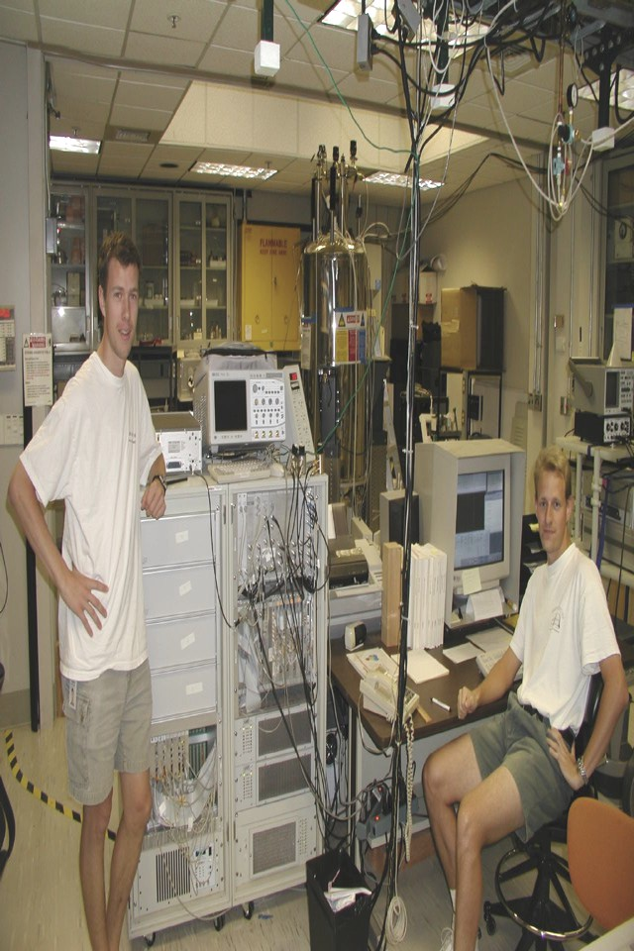
4-channel Varian spectrometer
Picture of the lab
11.7 T Oxford magnet, room temperature bore
15=5x3
grad students in sunny California...
65

Slide 66
Advantages of public key cryptology
Reduce protection of information to protection of authenticity of public keys
Confidentiality without establishing secret keys
extremely useful in an open environment
Data authentication without shared secret keys: digital signature
sender and receiver have different capability
third party can resolve dispute between sender
and receiver
66

Slide 67
Disadvantages of public key cryptology
Calculations in software or hardware two to three orders of magnitude slower than symmetric algorithms
Longer keys: 1024 bits rather than 56…128 bits
What if factoring is easy?
67

Slide 68
Crypto software libraries
http://ece.gmu.edu/crypto_resources/web_resources/libraries.htm
C/C++/C#
Botan (C++)
Cryptlib
Crypto++ (C++)
Libgcrypt (C++)
MatrixSSL (C++) embedded
Miracl (binaries)
OpenSSL (C++)
Java
SunJCA/JCE
BouncyCastle (BC)
CryptixCrypto (until ’05)
EspreSSL
FlexiProvider
GNU Crypto
IAIK
Java SSL
RSA JSafe
BouncyCastle (BC#)

Slide 69
Reading material
B. Preneel, Modern cryptology: an introduction.
This text corresponds more or less to the second half of these slides
It covers in more detail how block ciphers are used in practice, and explains how DES works.
It does not cover identification, key management and application to network security.
69

Slide 70
Selected books on cryptology
D. Stinson, Cryptography: Theory and Practice, CRC Press, 3rd Ed., 2005. Solid introduction, but only for the mathematically inclined.
A.J. Menezes, P.C. van Oorschot, S.A. Vanstone, Handbook of Applied Cryptography, CRC Press, 1997. The bible of modern cryptography. Thorough and complete reference work – not suited as a first text book. Freely available at http://www.cacr.math.uwaterloo.ca/hac
N. Smart, Cryptography, An Introduction: 3rd Ed., 2008. Solid and up to date but on the mathematical side. Freely available at http://www.cs.bris.ac.uk/~nigel/Crypto_Book/
B. Schneier, Applied Cryptography, Wiley, 1996. Widely popular and very accessible – make sure you get the errata.
Other authors: Johannes Buchmann, Serge Vaudenay
70

Slide 71
Books on network security and more
W. Stallings, Network and Internetwork Security: Priniples and Practice, Prentice Hall, 5th Ed., November 2009. Solid background on network security. Explains basic concepts of cryptography. Tends to confuse terminology for decrypting and signing with RSA.
Nagand Doraswamy, Dan Harkins, IPsec - The New Security Standard for the Internet, Intranets, and Virtual Private Networks, Prentice Hall, 1999. A well written overview of the IPsec protocol (but now outdated).
W. Diffie, S. Landau, Privacy on the line. The politics of wiretapping and encryption, MIT Press, 2007. The best book so far on the intricate politics of the
field.
71

Slide 72
More information: some links
IACR (International Association for Cryptologic Research): www.iacr.org
IETF web site: www.ietf.org
Cryptography faq: www.faqs.org/faqs/ cryptography-faq
Counterpane links: www.counterpane.com/ hotlist.html
Digicrime (www.digicrime.org) - not serious
but informative and entertaining
72

