Slide 1
Input
log₂(gene expression)
Domain-specific cut-off
Vehicle treated cells
Treated with Cipa cells
P < 0.05
|log₂(FC)| > 1
Dimension reduction
DEGs
6 categorical specimens
One way ANOVA
TUKEY test
Statictical tests
Validation
Gene ontology enrichment
KEGG pathways
Human protein-protein interaction network
Significant genes

Slide 2
A
B
-Log10[corrected p value]
-1.4 -1.3 -1.2 -1.1 0 1.1 1.2
Log2[vehicle treated cells and cells treated with Cipa Fold Change]

Slide 3
-

Slide 4
A
B
C
D

Slide 5
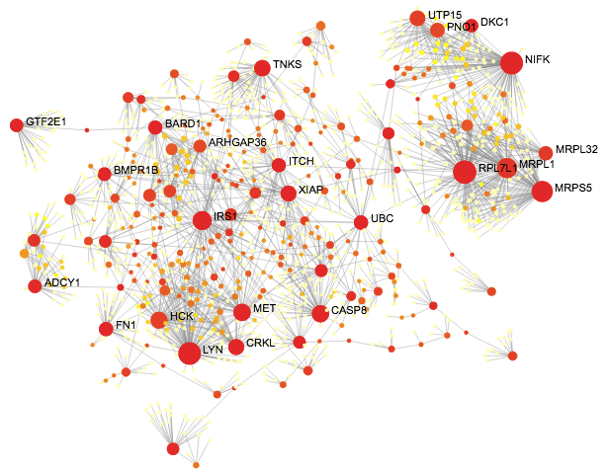

Slide 6
A
B
IL1R1

Slide 7
LYN
IGFBP5
IL1R1
IL13RA1

