Slide 1

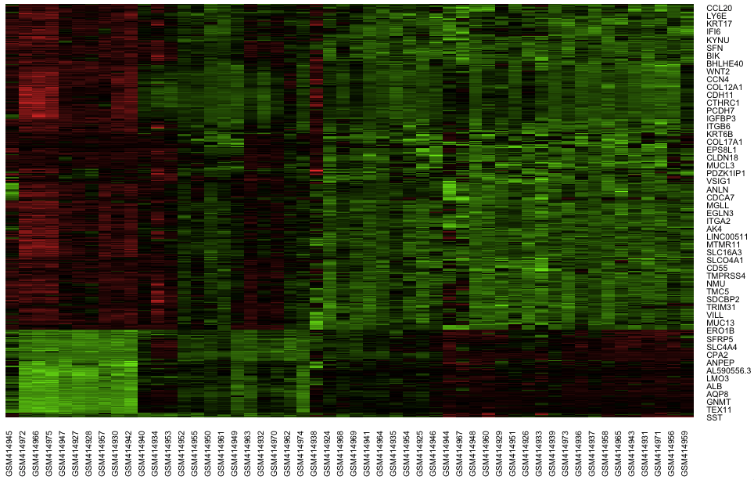

Slide 2
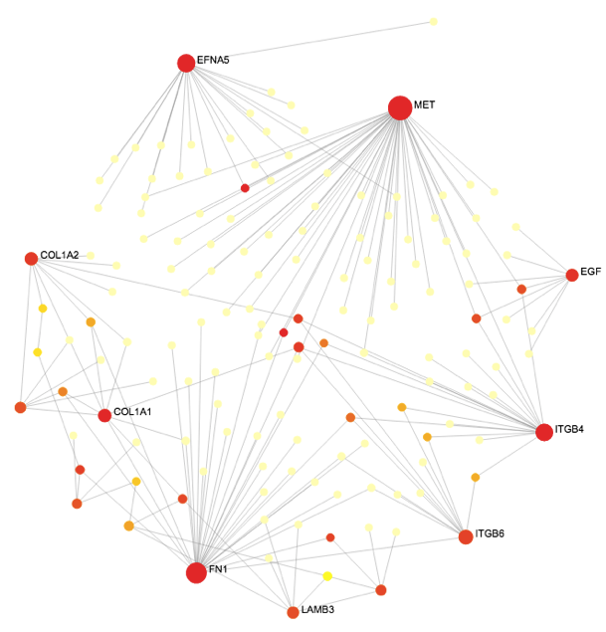
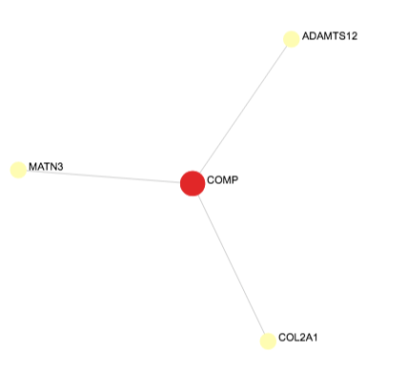
A
B

Slide 3
A
B
-log10(pvalue)
FC

Slide 4
A
B
C
D

