Slide 1
Craft Beers and Breweries in the United States
Zwei Group: Elisabet Zidow, Jonathan Franks, Shanqing Gu
Introduction
Each State contains its own unique drinking culture. Our Zwei Analytics attempts to review the available 2410 craft beers and 558 breweries in the United States in order to explore this culture.
There are two common beer measurements: Alcohol by Volume (ABV) and International Bitterness Unit (IBU). Rather than telling us how much alcohol there is like ABV, IBU measures the bitterness from hops in a beer on a scale of 0 to ~100.
Here, we provide the answers to these main questions and help you make your own own judgements about each states drinking culture :
How many breweries are present in each state?
What are the median ABV and IBU values for each state?
Which state has the maximum ABV or IBU beer?
Is there an relationship between the ABV and IBU?

Slide 2
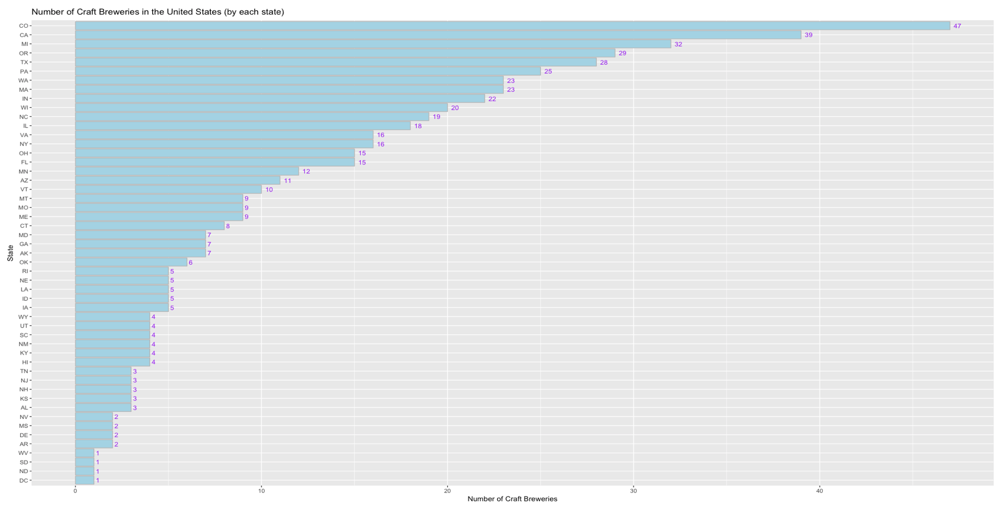
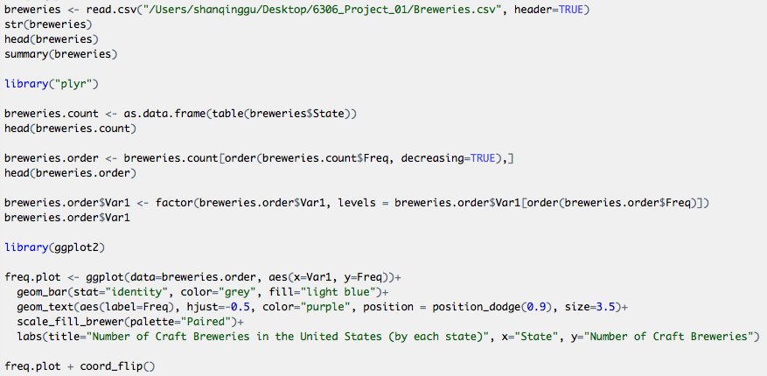
Q1: How many breweries are present in each state?
States with the most breweries are: CO, CA, ME, OR & TX
Texas is fairly saturated with 28 craft breweries already
Quality and matching the right flavor profiles with be of paramount importance in this market

Slide 3
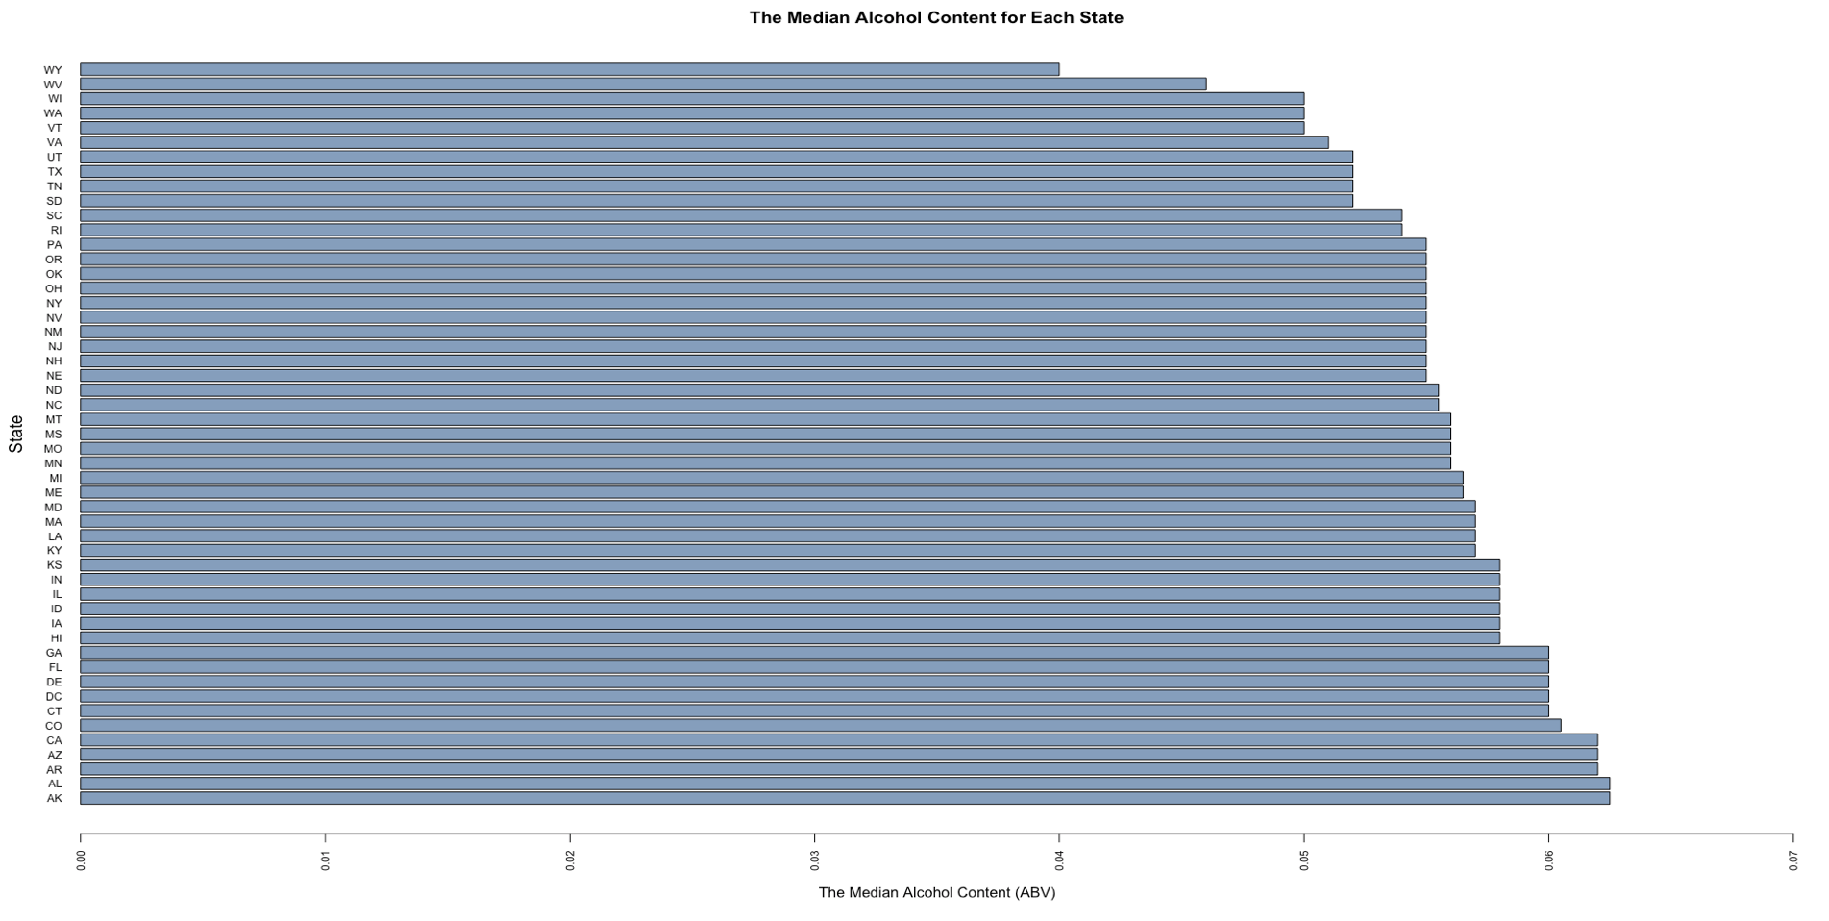
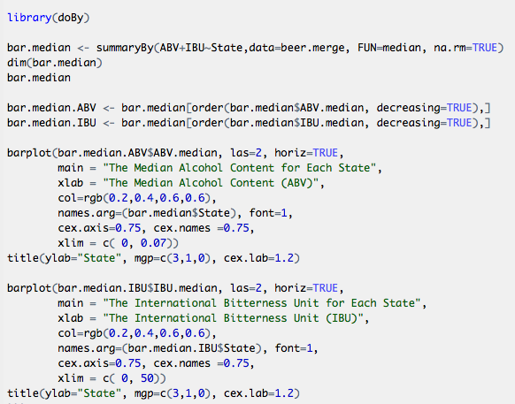
Q2: What are the median ABV values for each state?
States with the 5 highest median ABV values are: AK, AL, AR, AZ & CA
Texas has the 8th lowest median ABV.

Slide 4
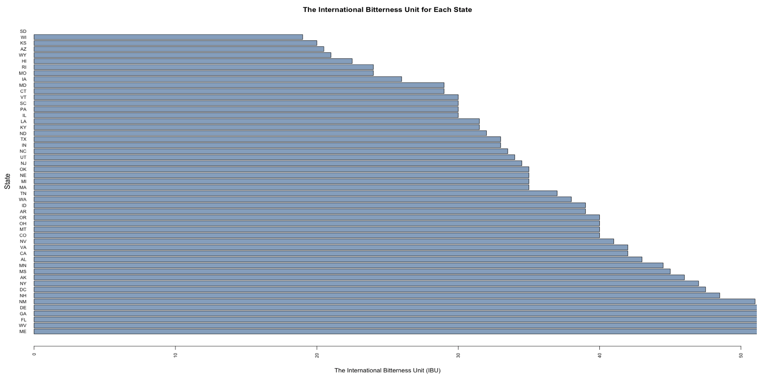
Q2: What are the median IBU values for each state?
States with the 5 highest median IBU values are: ME, WV, FL, GA & DE
Texas is close to the middle for median IBU values.

Slide 5
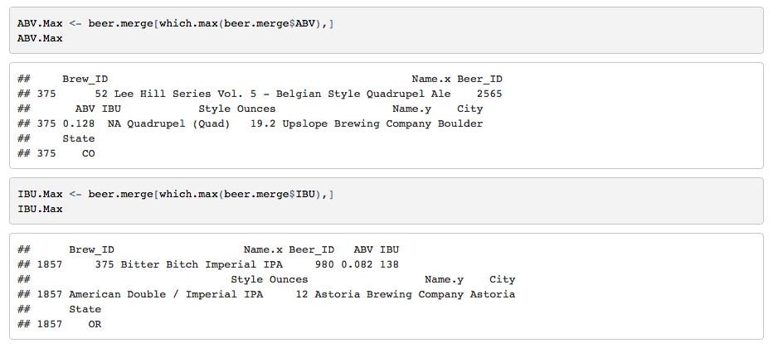
Q3: Which state has the maximum ABV or IBU beer?
The highest ABV is in a Belgian Style Quadrupel Ale made in Boulder, CO with an ABV of 12.8%
The highest IBU is found in a beer known as Bitter Bitch Imperial IPA from Astoria, OR with an IBU of 138

Slide 6
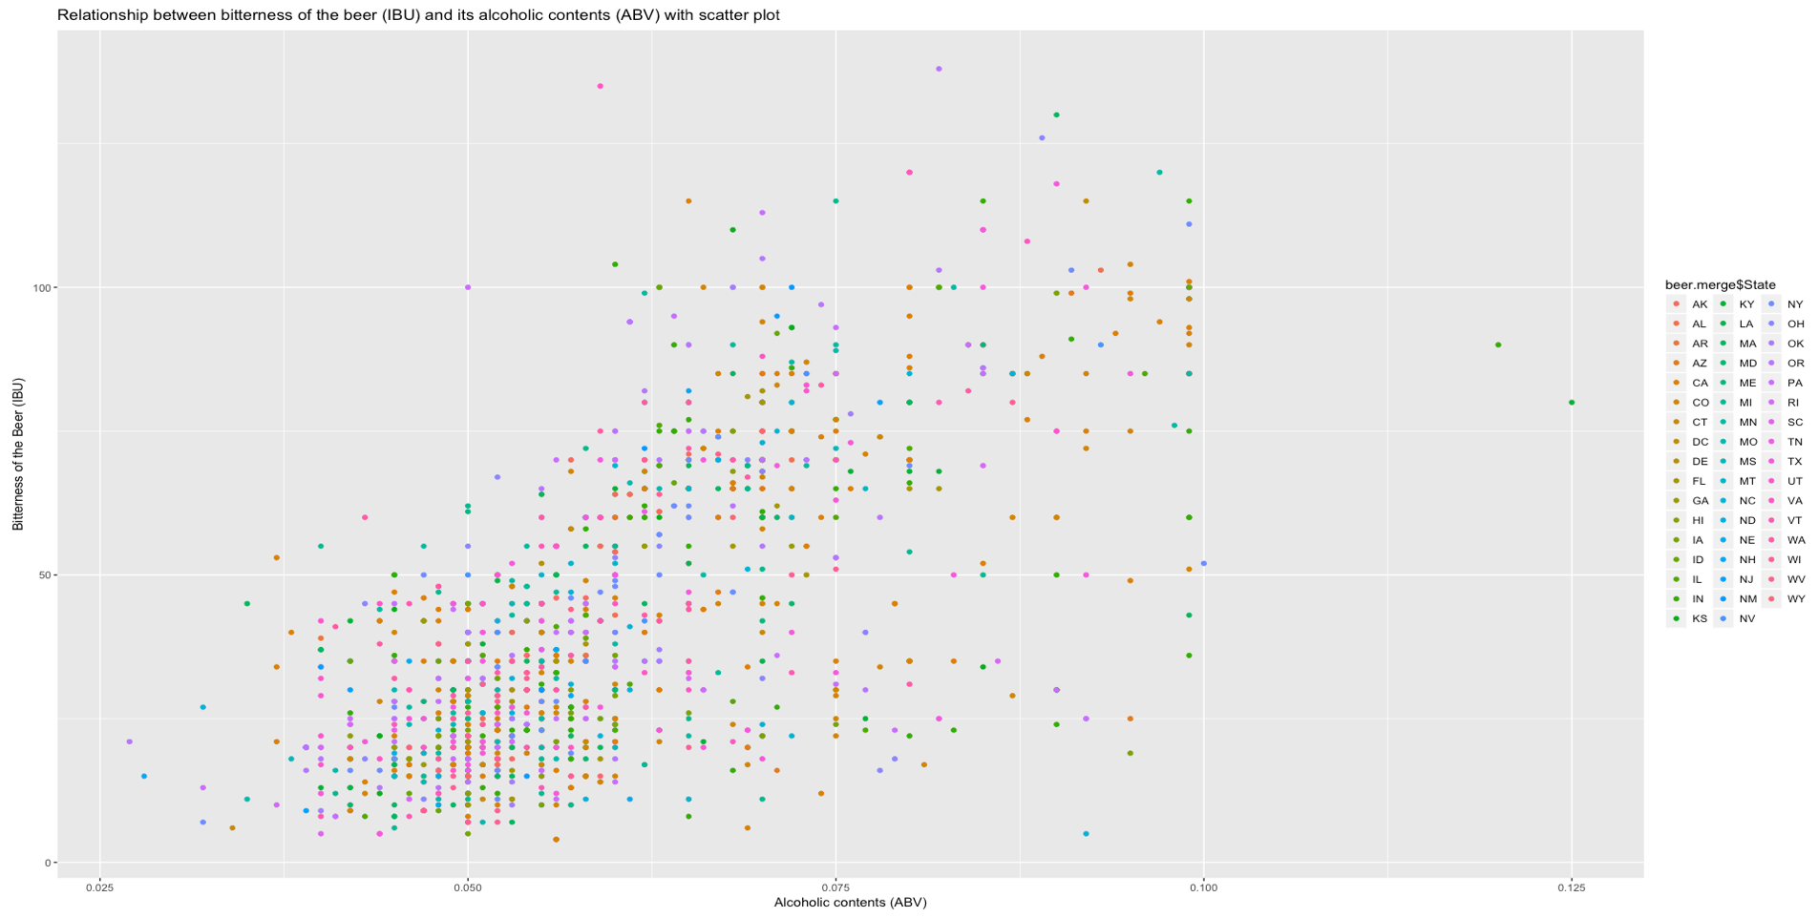
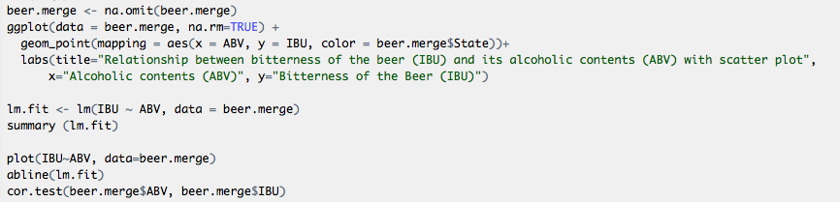
Q4: Is there an relationship between the ABV and IBU?

Slide 7
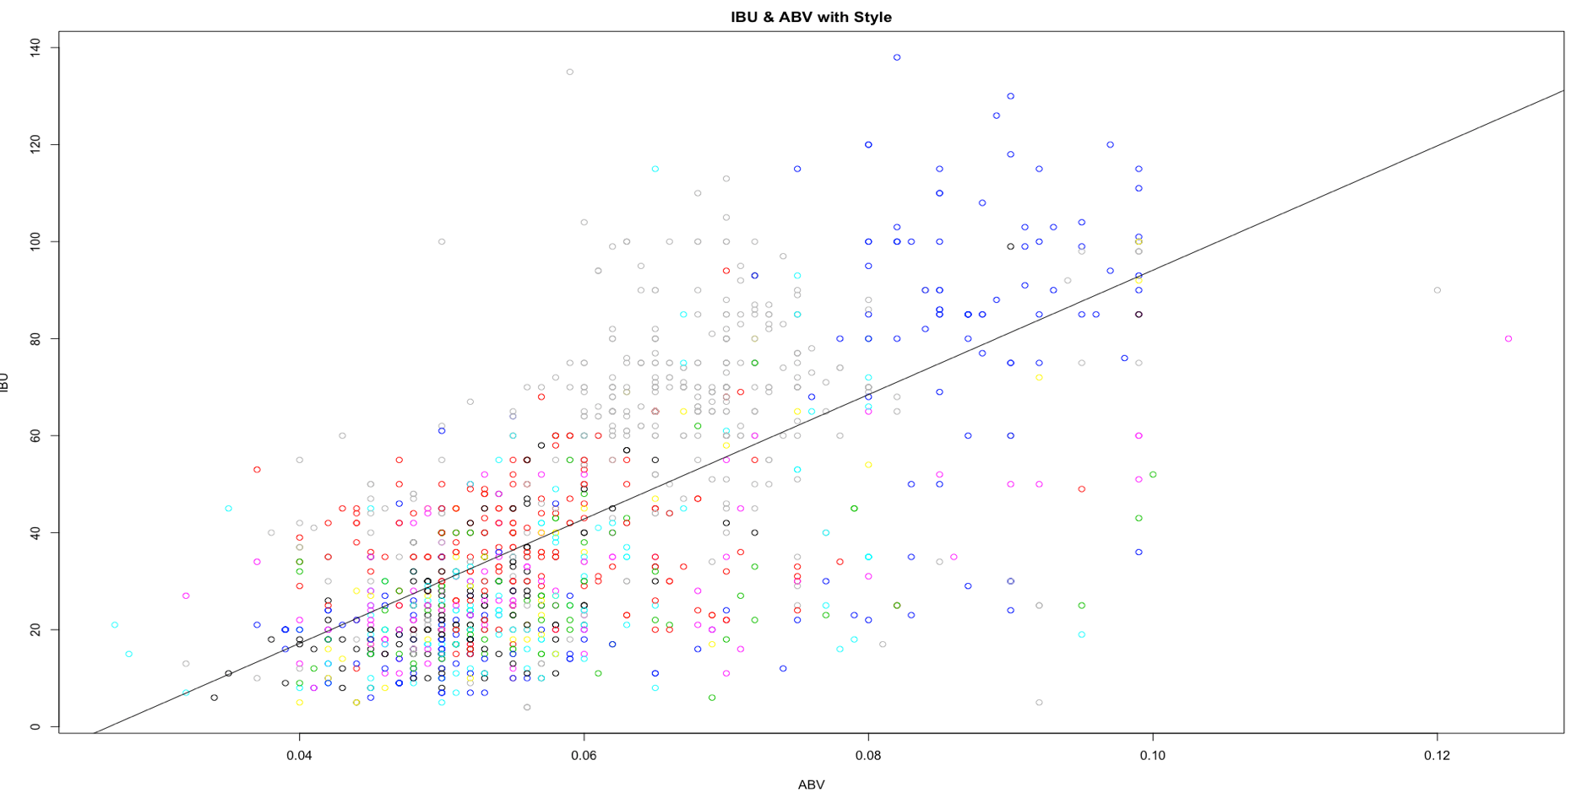
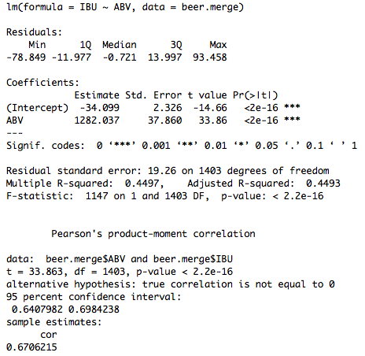
Q4: Is there an relationship between the ABV and IBU?

Slide 8
Cause or Correlation?
Styles that vary the most in ABV
 | Style | minABV | maxABV | meanABV | meanIBU | minIBU | maxIBU | DiffABV
16 | American IPA | 0.027 | 0.094 | 0.06452758 | 67.63455 | 30 | 135 | 0.067
91 | Schwarzbier | 0.040 | 0.099 | 0.05377778 | 31.00000 | 24 | 40 | 0.059
89 | Rye Beer | 0.045 | 0.104 | 0.06705556 | 52.00000 | 18 | 99 | 0.059
10 | American Brown Ale | 0.040 | 0.095 | 0.05792647 | 29.89474 | 10 | 65 | 0.055
100 | Witbier | 0.037 | 0.092 | 0.05355102 | 16.20833 | 10 | 27 | 0.055
“Alcohol is a byproduct of the fermentation process, which takes place when the yeast converts the sugars
derived from the grain. Knowing that, you can increase the alcohol by volume (ABV) by increasing the size
of the grain bill or increasing the amount of malt extract used. If all other factors remain the same, so a popular method for increasing the ABV of an existing beer recipe without bringing much change, is to simply add more sugar into the mix.” (https://learn.kegerator.com/raising-abv/)
When mixing your Brew, look first at the local preference profiles for IBU and ABV in order to hit the right marks.
ABV can always be increased by adding sugar, and IBU can hit a wide range even for a given Style of beer.

