Slide 1
SMU NLP Course (DS7337) -- Homework 02 submission (05-29-2019)
Shanqing Gu (Class 401)
Outline of HW2:
Data preparation with BeautifulSoup
Question 1: Create a scoring method with vocabulary size and normalize scores from 0 to 1
Question 2: Create a scoring method with vocabulary length and normalize scores from 0 to 1
Question 3: Create “text difficulty score” and apply to text examples in HW1.

Slide 2
Data preparation with BeautifulSoup
Obtain all the texts of different categories from this link (http://www.gutenberg.org/wiki/Children%27s_Instructional_Books_(Bookshelf).
In total, there are 104 texts with titles hyperlinked their corresponding urls to download from 10 categories (Misc., Graded Readers, Poetry Readers, Readers for English Speakers Learning Other Languages, Non-English Readers, About Readers, Science and Nature, History, Geography, Uncategorized).
The first step is to create BeautifulSoup object with base url and html.parser for getting urls and ebook titles, and obtain the plain text UTF-8 url links for all the category books with wget function. In this step, the pattern shared in hyperlinks help convert to the final following format example: http://www.gutenberg.org/cache/epub/11313/pg11313.txt.
The second step is to clean the data by removing the tagged Gutenberg license and other unrelated information. This step will help analyze text data more accurately on lexical diversity, long-word vocabulary size, and text difficult score

Slide 3
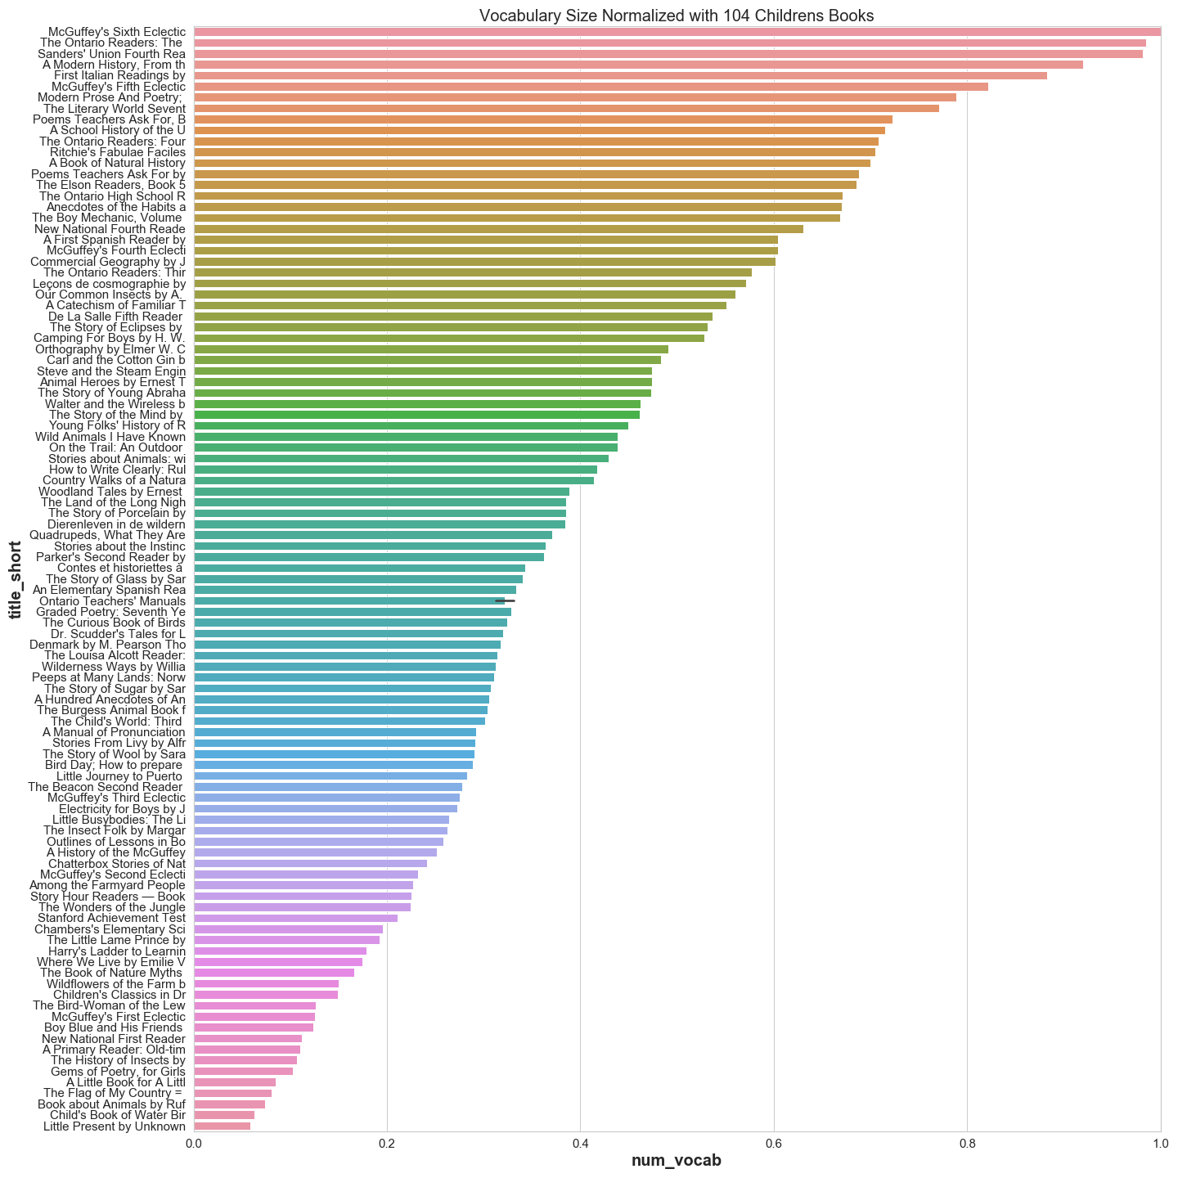
Question 1:
Create a scoring method with vocabulary size and normalize scores from 0 to 1.
The maximum vocabulary size 14,611 unique words in "McGuffey’s Sixth Eclectic Reader" was set to 1 and used to normalize other individual text scores.
For normalizing the score from 0 to 1, the vocabulary size normalization score for each text was calculated as the simple ratio of the vocabulary size of each text to the maximum vocabulary size.
From the score distributions for each, most books categories have normalized scores between 0.2 and 0.8. "McGuffey’s Sixth Eclectic Reader" is the highest at 1, and "Little Present by Unknown" is the lowest at 0.06.

Slide 4
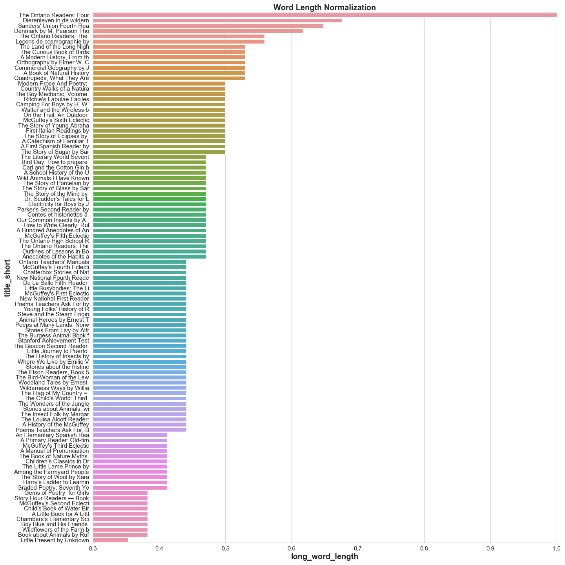
Question 2:
Create a scoring method with vocabulary length and normalize scores from 0 to 1.
The longest word identified with 34 characters..".
The long-word vocabulary is only a relatively accurate method for normalizing all words.
The vocabulary length normalization score for each text was calculated as the simple ratio of the vocabulary length of each text to the maximum vocabulary length (34).

Slide 5
Question 3:
Create “text difficulty score” and apply to text examples in HW1.
The text difficulty score (TDS) was calculated with the equal weight of normalized values of vocabulary size score, lexical diversity score, and vocabulary length score.
The TDS score meets expectation better than using single scoring methods ('vocab_nrml’, ‘lex_div_nrml’, 'word_length_nrml).
TDS score method is relatively more accurate to reflect the text difficulties for McGuffey readers after adjusting with equal weights.
There are still rooms to improve TDS scoring method, such as to choose different weights, further clean the texts, consider different languages.

