Slide 1
SMU NLP Course (DS7337) -- Homework 03 submission (06-10-2019)
Shanqing Gu (Class 401)
Outline of HW3:
Edit distance calculation
Remove stopwords
Compare Stemmers

Slide 2
Question 1. Remove Stopwords
Edit distance, also known as "levenshtein Edit Distance", is to measure how near or far a word is from the input word.
The Levenshtein distance between my given name “Shanqing" and nickname ”Shan" is 4, since the following 4 edits change one into the other, and there is no way to do it with fewer than three edits:
Shanqing → Shaning (deletion of ”q")
Shaning → Shanng (deletion of ”i")
Shanng → Shang (deletion of ”i")
Shang → Shan (deletion of ”i")
The sum of two string lengths (sum) is 8 + 4 =12
The Edit Distance (edit_dist) is 4 as shown above (or calculate edit_dist with levenshteinDistance())
The percentage for string match between nickname and given name is calculated as:
(sum-edit_dist)/sum = (12-4)/12 =0.67 (the same as the calculation from levenshteinDistance())

Slide 3
Question 2. Remove Stopwords
Stopwords are words that have little or no significance. They are usually removed from text during processing in order to retain words having maximum significance and context. Words like "from", "a", "the" and so on are stopwords. Each domain of language may have its own set of stopwords.
Remove stopwords from the first two sentences from book “The Lion King”:
"From the smallest ant to the largest elephant, every living thing has a place in the great Circle of Life. Mufasa’s place was as king of the lions.”
The cleaned tokens are:
['smallest', 'ant', 'largest', 'elephant', 'every', 'living', 'thing', 'place', 'great', 'circle', 'life', 'mufasa', 'place', 'king', 'lions’]
One can easily recognize the sentences are from book "The Lion King" by just reading the collected tokens.

Slide 4
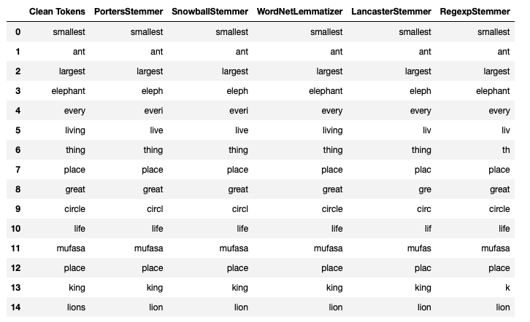
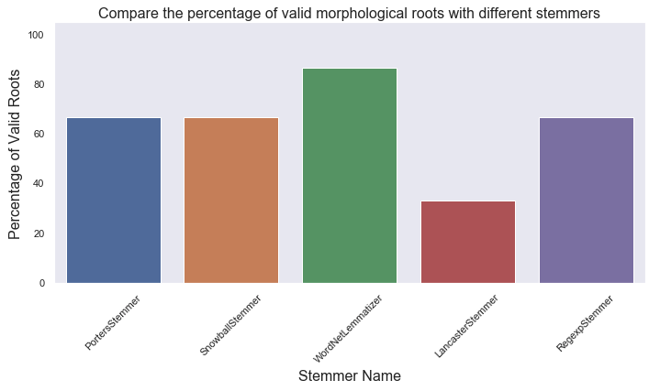
Question 3. Compare Stemmers
PorterStemmer is used most frequently. RegexpStemmer is based on user-defined rules, and SnowballStemmer supports stemming in 13 different languages besides English. The performance can be calculated from the percentage of valid morphological roots.
The performances for these 3 Stemmers are equally better than that of LancasterStemmer.
The process of lemmatization is very similar to stemming. The difference is that the root stem may not always be a lexicographically correct word, while the root word (lemma) will always be present in the dictionary. A robust lemmatization module that uses WordNet and the word’s syntax and semantics to get the root word or lemma.
WordNetLemmatizatier works better than other 4 Stemmers because one additional step is involved where a lemma is formed by removing the affix from the word if and only if the lemma is present in the dictionary.

