Slide 1
SMU NLP Course (DS7337) -- Homework 04 submission (06-24-2019)
Shanqing Gu (Class 401)
Outline of HW4:
POS tagging in NLTK library
POS tagging in spaCy library
Check 2 random sentences with 6 POS methods
(NLTK, spaCy, Pattern, Stanford, Unigram and manually tagging)

Slide 2
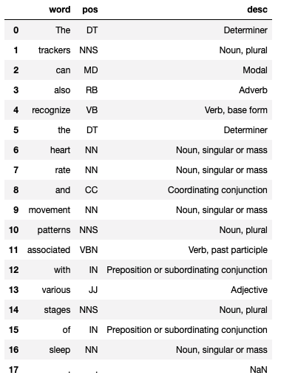
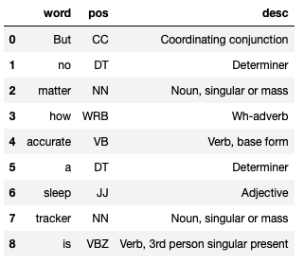
Q1a
Question 1. POS tagging in NLTK library
POS Tagging assigns each word with a likely part of speech, such as adjective, noun, verb. It is important for syntactic and semantic analysis.
A long sentence is tokenized and POS tagged in NLTK library which yields pretty accurate results (Q1a, right table). However, the pos_tag fails to tag 100 percent correctly to a short sentence (Q1b, below). For example, "4 accurate" is adjective (not verb), and "6 sleep" is a noun (not adjective).
Q1b

Slide 3
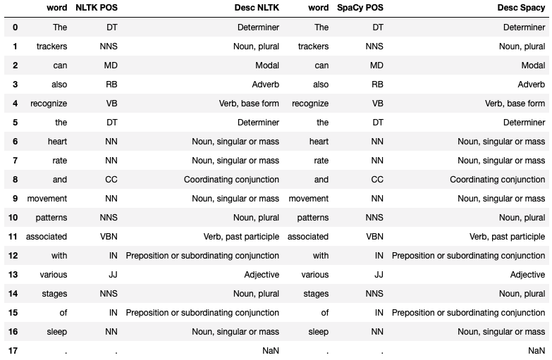
Question 2a. spaCy POS tagger with long sentence (identical tag list to NLTK POS tagger)

Slide 4
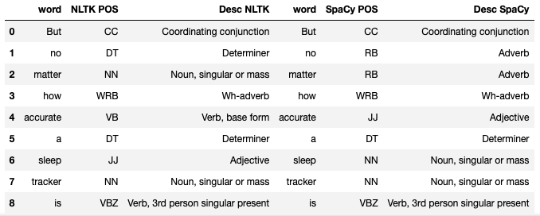
Question 2b. spaCy POS tagger with short sentence (better than NLTK POS tagger)
A spaCy document is created for performing POS tagging, and the tag_ attribute is to obtain fine-grained POS tags. For long sentence, the spaCy POS tagger yields identical tag list to NLTK POS tagger (Q2a). Comparatively for short sentence, spaCy POS tagger performs better than NLTK POS tagger (Q2b). For example, "4 accurate" is adjective (verb with NLTK POS tagger), and "6 sleep" is a noun (adjective with NLTK POS tagger). In addtion, spaCy treats "no matter" as adverb.
NLTK and spaCy are main competitors to each other, and both libraries can be used for the same tasks. Unlike NLTK, which is widely used for teaching and research, spaCy focuses on providing software for production usage.

Slide 5
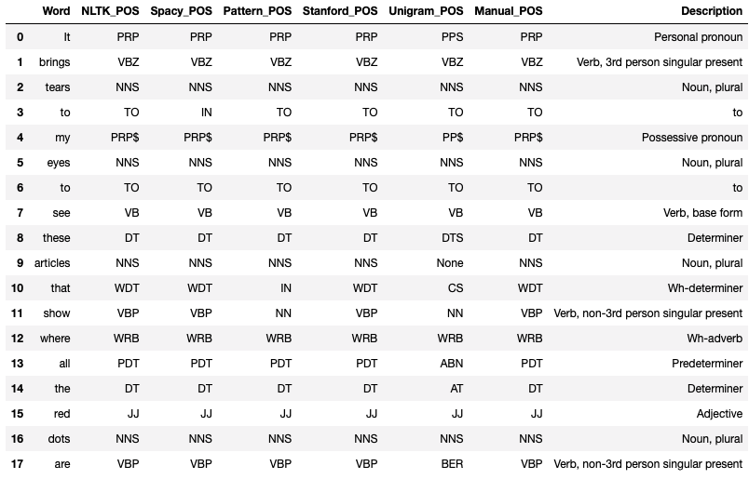
Question 3: Random sentence 1 with 6 POS tagging methods (basically identical except Unigram)
6 POS tagging methods are applied: NLTK, spaCY, Pattern, Stanford, Unigram, and manual POS tagging.
NLTK is a great toolkit for teaching and learning NLP, spaCy focuses more on efficiency and performance for production use, Pattern is a web mining module for the Python programming language, the Stanford PoS Tagger is an implementation of a log-linear POS tagger, Unigram POS tagger is a lookup tagger, it has been trained before being used to tag untagged corpora, and manual POS tagging takes time.
For random sentence 1, all 6 methods preform basically identically except Unigram POS. spaCy correctly identifies “3 to” as preposition – IN. Patterns fails to identify ”10 that” and ”11 show” correctly. Unigram POS tagger only agrees partially with others.

Slide 6
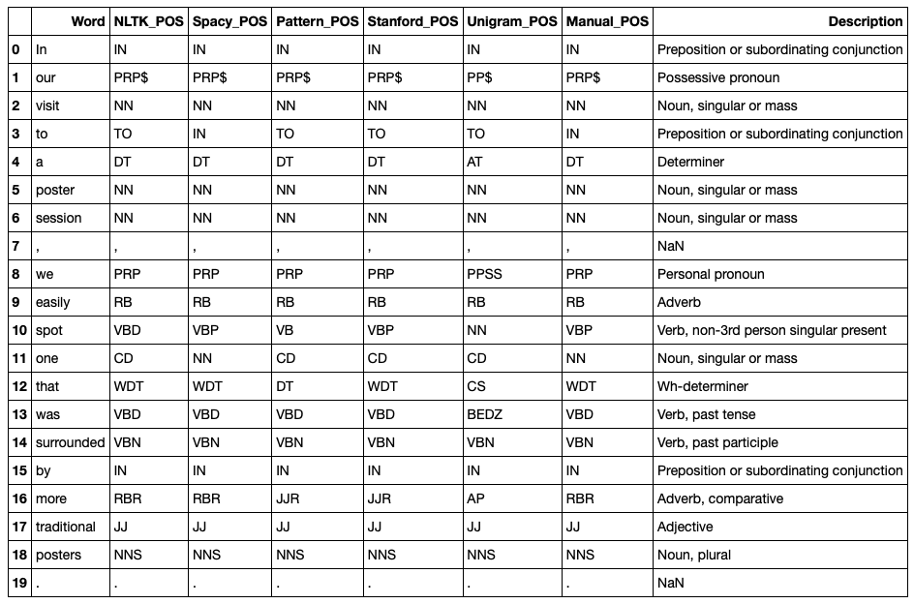
Question 3: Random sentence 2 with 6 POS tagging methods (spaCy performs the best)
For random sentence 2, "11 one" is cardinal number (CD) for NLTK and Pattern (noun - NN for spaCy and Manual POS tagging), "12 that" is DT for Pattern (Wh-determiner - WDT for other 3 methods), "16 more" is JJR for Pattern and Stanford (AP for Unigram and comparative adverb - RBR for other 3 methods).
spaCy performs the best in these examples because of its efficiency and performance.
All these 6 methods agree with each other mostly. Therefore, all the methods can be helpful in identifying some tags to be corrected either with functions or manually.

Slide 7
References
1. That Sleep Tracker Could Make Your Insomnia Worse. https://www.nytimes.com/2019/06/13/health/sleep-tracker-insomnia-orthosomnia.html
2. A Good Part-of-Speech Tagger in about 200 Lines of Python. https://explosion.ai/blog/part-of-speech-pos-tagger-in-python
3. Categorizing and Tagging Words. https://www.nltk.org/book/ch05.html
4. linguistic features. https://spacy.io/usage/linguistic-features
5. Pattern.en. https://www.clips.uantwerpen.be/pages/pattern-en
6. The Penn Discourse Treebank 2.0.http://compprag.christopherpotts.net/pdtb.html

