Slide 1
SMU NLP Course (DS7337) -- Homework 05 submission (07-01-2019)
Shanqing Gu (Class 401)
Outline of HW5:
Compile a list of permalinks to individual user movie reviews from IMDb
Extract NP chunks from movie reviews
Output all the chunks in a single list for each review.

Slide 2
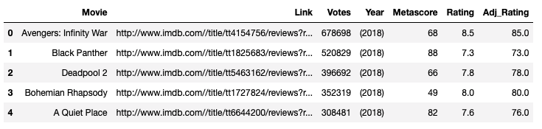
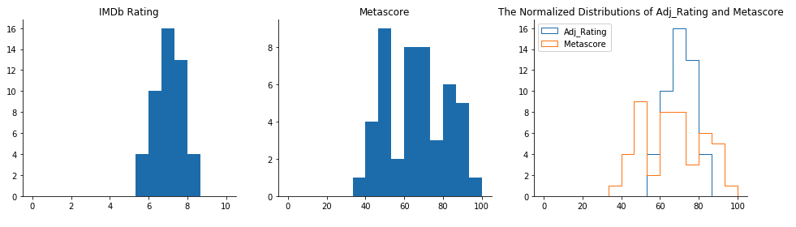
Question 1. Compile a list of permalinks to individual user movie reviews from IMDb
47 thriller movies from IMDb are extracted with BeautifulSoup web scraping.
Usually, "very good"(critical favorites) movies have metascore above 70, correponding to the IMDb rating score around 7.

Slide 3
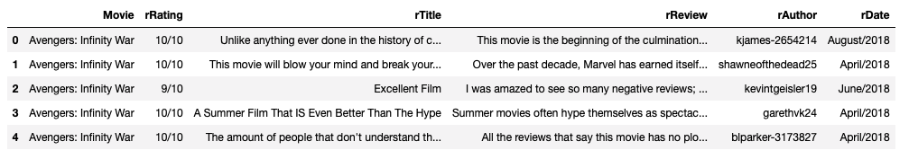
Question 1. Compile a list of permalinks to individual user movie reviews from IMDb
953 movie reviews from 47 thriller movies are extracted with BeautifulSoup web scraping

Slide 4
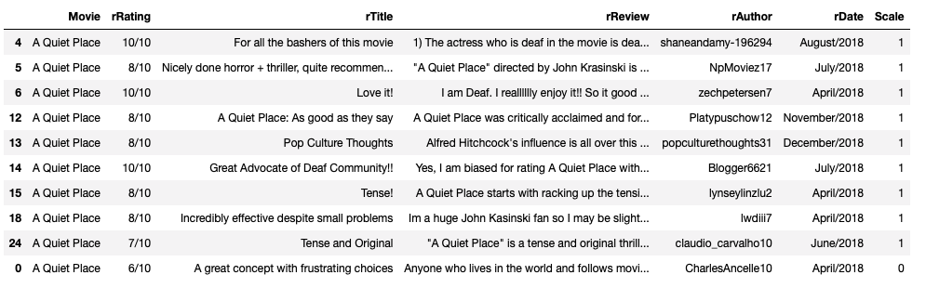
Question 2: Extract NP chunks from movie reviews
The 953 reviews are classified to two groups:
"1" for positive reviews with ratings higher than 7/10, and "0" for negative reviews with rating below 7/10.
In total, there are 428 reviews assigned to "1" and 525 reviews assigned to "0".

Slide 5
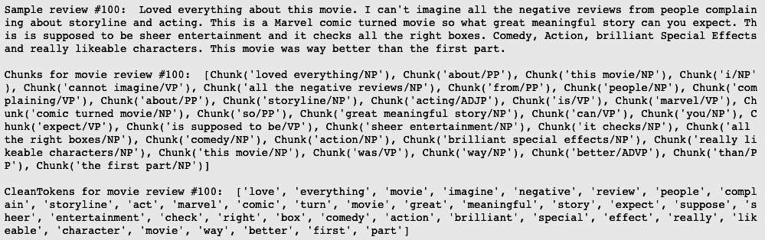
Question 2: Extract NP chunks from movie reviews
Sample presentation for the review #100, chunks, and the cleaned tokens:
After checking the sample chunked review and cleaned tokens for sample review #100, the NP chunks together with other forms of chunks are successfully parsed with parsetree from pattern library. In addition, parsetree from pattern library is more efficient than nltk.RegexpParser which takes much longer time to compute.

Slide 6
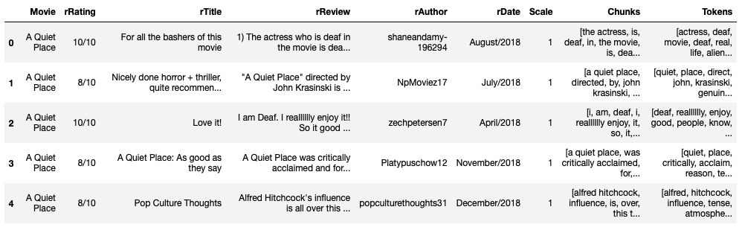
Question 2: Extract NP chunks from movie reviews
For noun phrase (NP) chunk extractions, the preprocessing procedures are needed to expand sentence contractions, remove word affixes and get a base form of the word, and remove_stopwords() to remove stopwords. The parsetree function from pattern library is used to chunk the collected reviews after cleaning and tokenization.
Get 953 reviews, chunks, and the cleaned tokens and compile to one file:

Slide 7
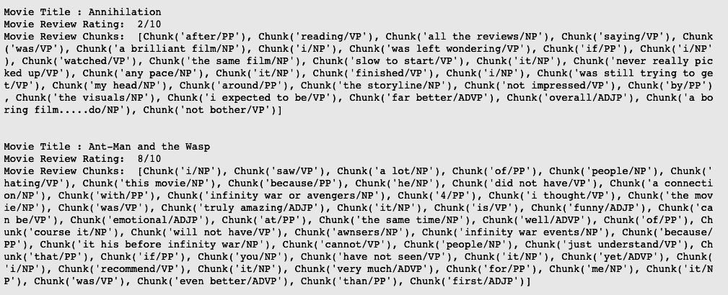
Question 3: Output all the chunks in a single list for each review
All the chunks in a single list for each review are saved in pickle file for future use.
Two sample chunk presentations for checking:

Slide 8
References
1. IMDB All U.S. Released Movies: 1972-2016 Analysis
http://thebigdatascience.com/2018/01/17/imdb-all-u-s-released-movies-1972-2016-analysis/
2. Tutorial: Web Scraping and BeautifulSoup
3. https://www.dataquest.io/blog/web-scraping-beautifulsoup/
4. https://stackoverflow.com/questions/48932995/webscraping-using-beautifulsoup
5. Which movie should I watch? https://medium.com/@nishantsahoo/which-movie-should-i-watch-5c83a3c0f5b1
6. IMDb. https://www.imdb.com/
7. Shallow Parsing for Entity Recognition with NLTK and Machine Learning https://nickcdryan.com/2017/02/13/shallow-parsing-for-entity-recognition-with-nltk-and-machine-learning/.
Implementation environments
Darwin-18.6.0-x86_64-i386-64bit
Python 3.6.8 |Anaconda, Inc.| (default, Dec 29 2018, 19:04:46) [GCC 4.2.1 Compatible Clang 4.0.1 (tags/RELEASE_401/final)]
Pandas 0.24.2
NumPy 1.16.4
Requests 2.22.0
Pickle 4.0 Re 2.2.1
nltk 3.4 Matplotlib 3.0.2
Pattern 3.6

