Slide 1
SMU NLP Course (DS7337) -- Homework 06 submission (07-15-2019)
Shanqing Gu (Class 401)
Outline of HW6:
Evaluate text similarity of Amazon book search results
Evaluate using a major search engine

Slide 2
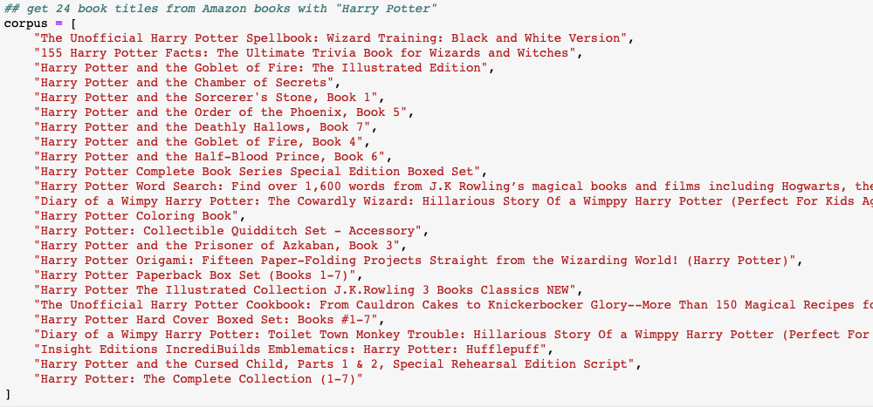
Question 1. Evaluate text similarity of Amazon book search results
#1a Manually copy the full book title of each of the top 24 books

Slide 3
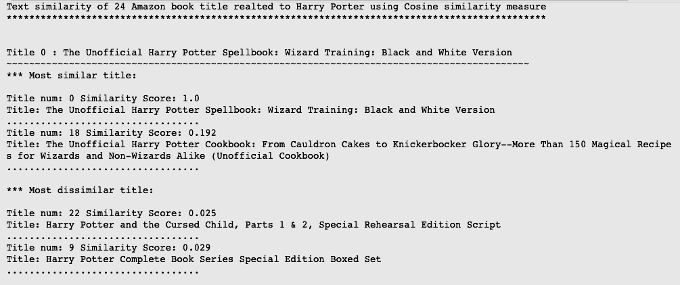
Question 1. Evaluate text similarity of Amazon book search results
#1b Pairwise compare the cosine similarity score for each of the book title (only list 2 of 24)

Slide 4
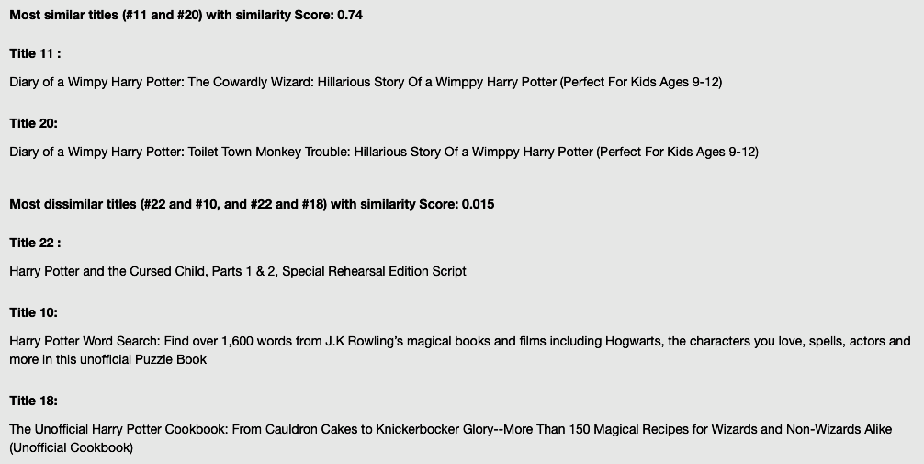
Question 1. Evaluate text similarity of Amazon book search results
#1c Most similar and dissimilar book titles

Slide 5
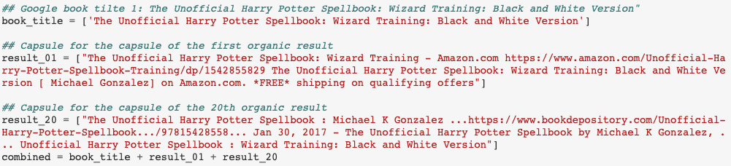
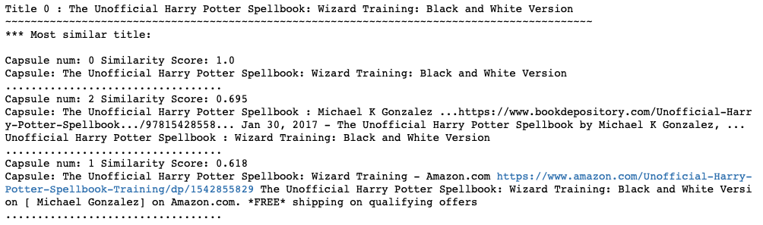
Question 2: Evaluate using a major search engine
#2a: Google book title #1 and copy two organic results (result_01 and result_20)
#2b: Run the same text similarity calculations in Q1b
#2c: Similarity scores are shown in #2b

Slide 6
Summary
In HW6, functions are defined to take in the vectorized corpus and the document corpus for computing similarities. The similarity scores are from the dot product operation and sorted them in reverse (forward) order to get the top (bottom) n documents with the highest (lowest) similarity score.
The top search for a book title from both Amazon and Google can get high cosine similarity score. We can conclude both amazon and google use similar distance measures to rank their items online.
In addition, Scikit-learn’s cosine_similarity() utility functioncan be found in the sklearn.metrics.pairwise module. It uses similar logic and much more optimized, especially performing well on large corpora of documents.

Slide 7
References
1. Sarkar D. Text analytics with Python, 2nd edition
Implementation environments
Darwin-18.6.0-x86_64-i386-64bit
Python 3.6.8 |Anaconda, Inc.| (default, Dec 29 2018, 19:04:46) [GCC 4.2.1 Compatible Clang 4.0.1 (tags/RELEASE_401/final)]
Pandas 0.24.2
NumPy 1.16.4
Requests 2.22.0
Pickle 4.0 Re 2.2.1
nltk 3.4 Matplotlib 3.0.2
Pattern 3.6

