Slide 1
SMU NLP Course (DS7337) -- Homework 08 submission (08-12-2019)
Shanqing Gu (Class 401)
Outline of HW 08:
Q1. Sentiment analysis with TextBlob and AFINN lexicons for individual movie review
Load IMDB review dataset from homework 7 with 4 KMeans clusters (km4_pws)
Sentiment Analysis with TextBlob/AFINN Lexicon for individual or entire movie reviews
Q2. Sentiment analysis with TextBlob lexicons for HW7 movie review clusters
Polarity and subjectivity for all the individual movie reviews
Polarity and subjectivity with KMeans clusters (km4_pws) or with two scales (0 or 1)
Summary
Q3. Sentiment analysis with movie review chunks
Run Each Chunk Individually through TextBlob Lexicon
Highest Negative-Sentiment-Scoring or Positive-Sentiment-Scoring chunks
Summary

Slide 2
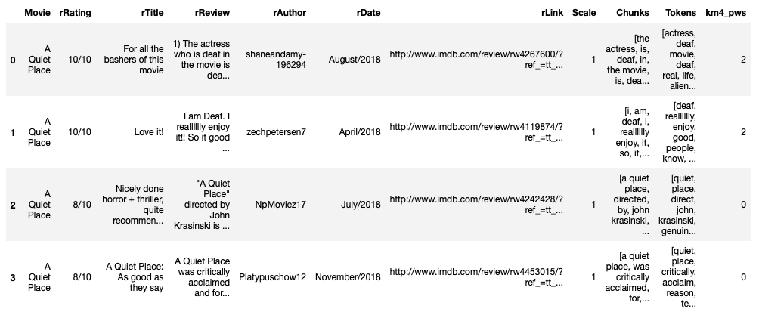
Q1. Sentiment analysis with TextBlob and AFINN lexicons for individual movie review
Q1.1 Load IMDB review dataset from homework 7 with 4 KMeans clusters (km4_pws)

Slide 3
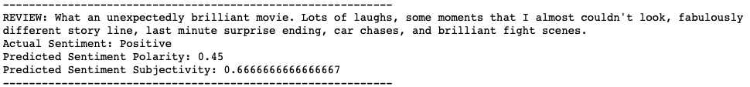
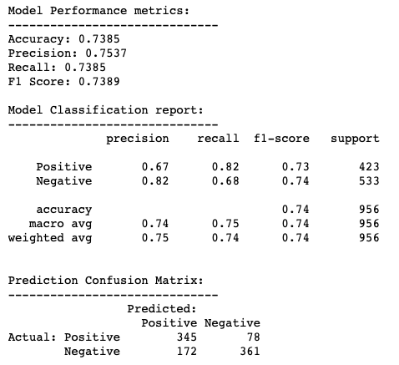
Q1.2 Sentiment analysis with TextBlob lexicon for individual or entire movie reviews
Individual
Entire movie reviews

Slide 4
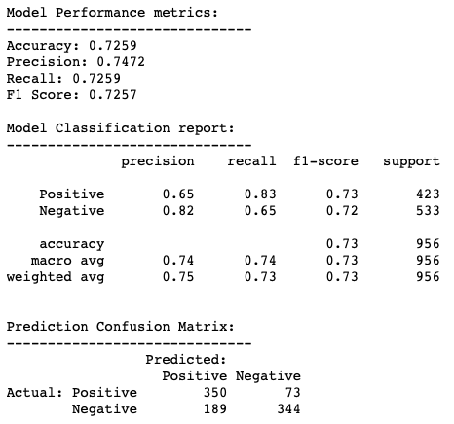
Q1.3 Sentiment Analysis with AFINN Lexicon for individual or entire movie reviews
Individual
Entire movie reviews

Slide 5
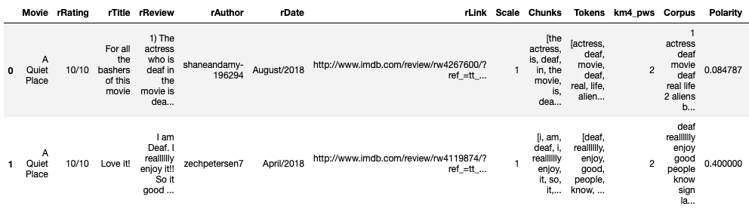
Q2. Sentiment analysis with TextBlob lexicons for 4 Kmeans clusters
Q2.1 Polarity and subjectivity for all the individual movie reviews

Slide 6
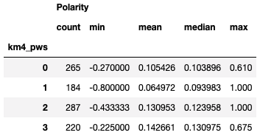
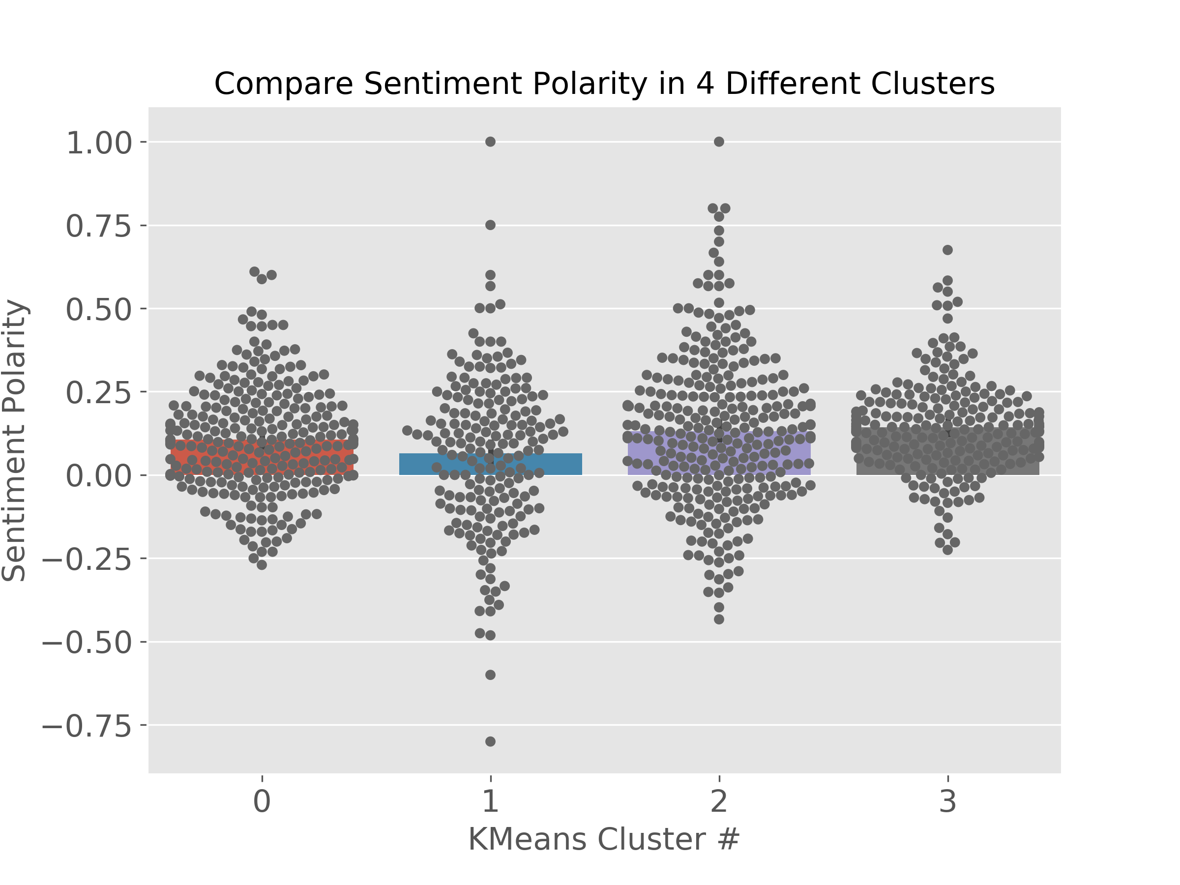
Q2.2 Polarity with KMeans clusters (km4_pws)
Polarity refers to the emotion expressed in the sentence (positive, neutral, and negative), and subjectivity refers to the opinions that describe personal views towards a specific subject or topic.
The 4 KMeans cluster sizes are similar (265, 184, 287, 220). Cluster 0 has higher polarity value (mean=0.105) than cluster 1 (mean=0.065), but lower than clusters 2 and 3 (mean = 0.131 and 0.143 separately). Clusters 2 and 3 are more positive in polarity than clusters 0 and 1.

Slide 7
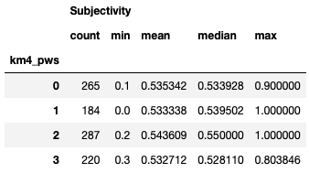
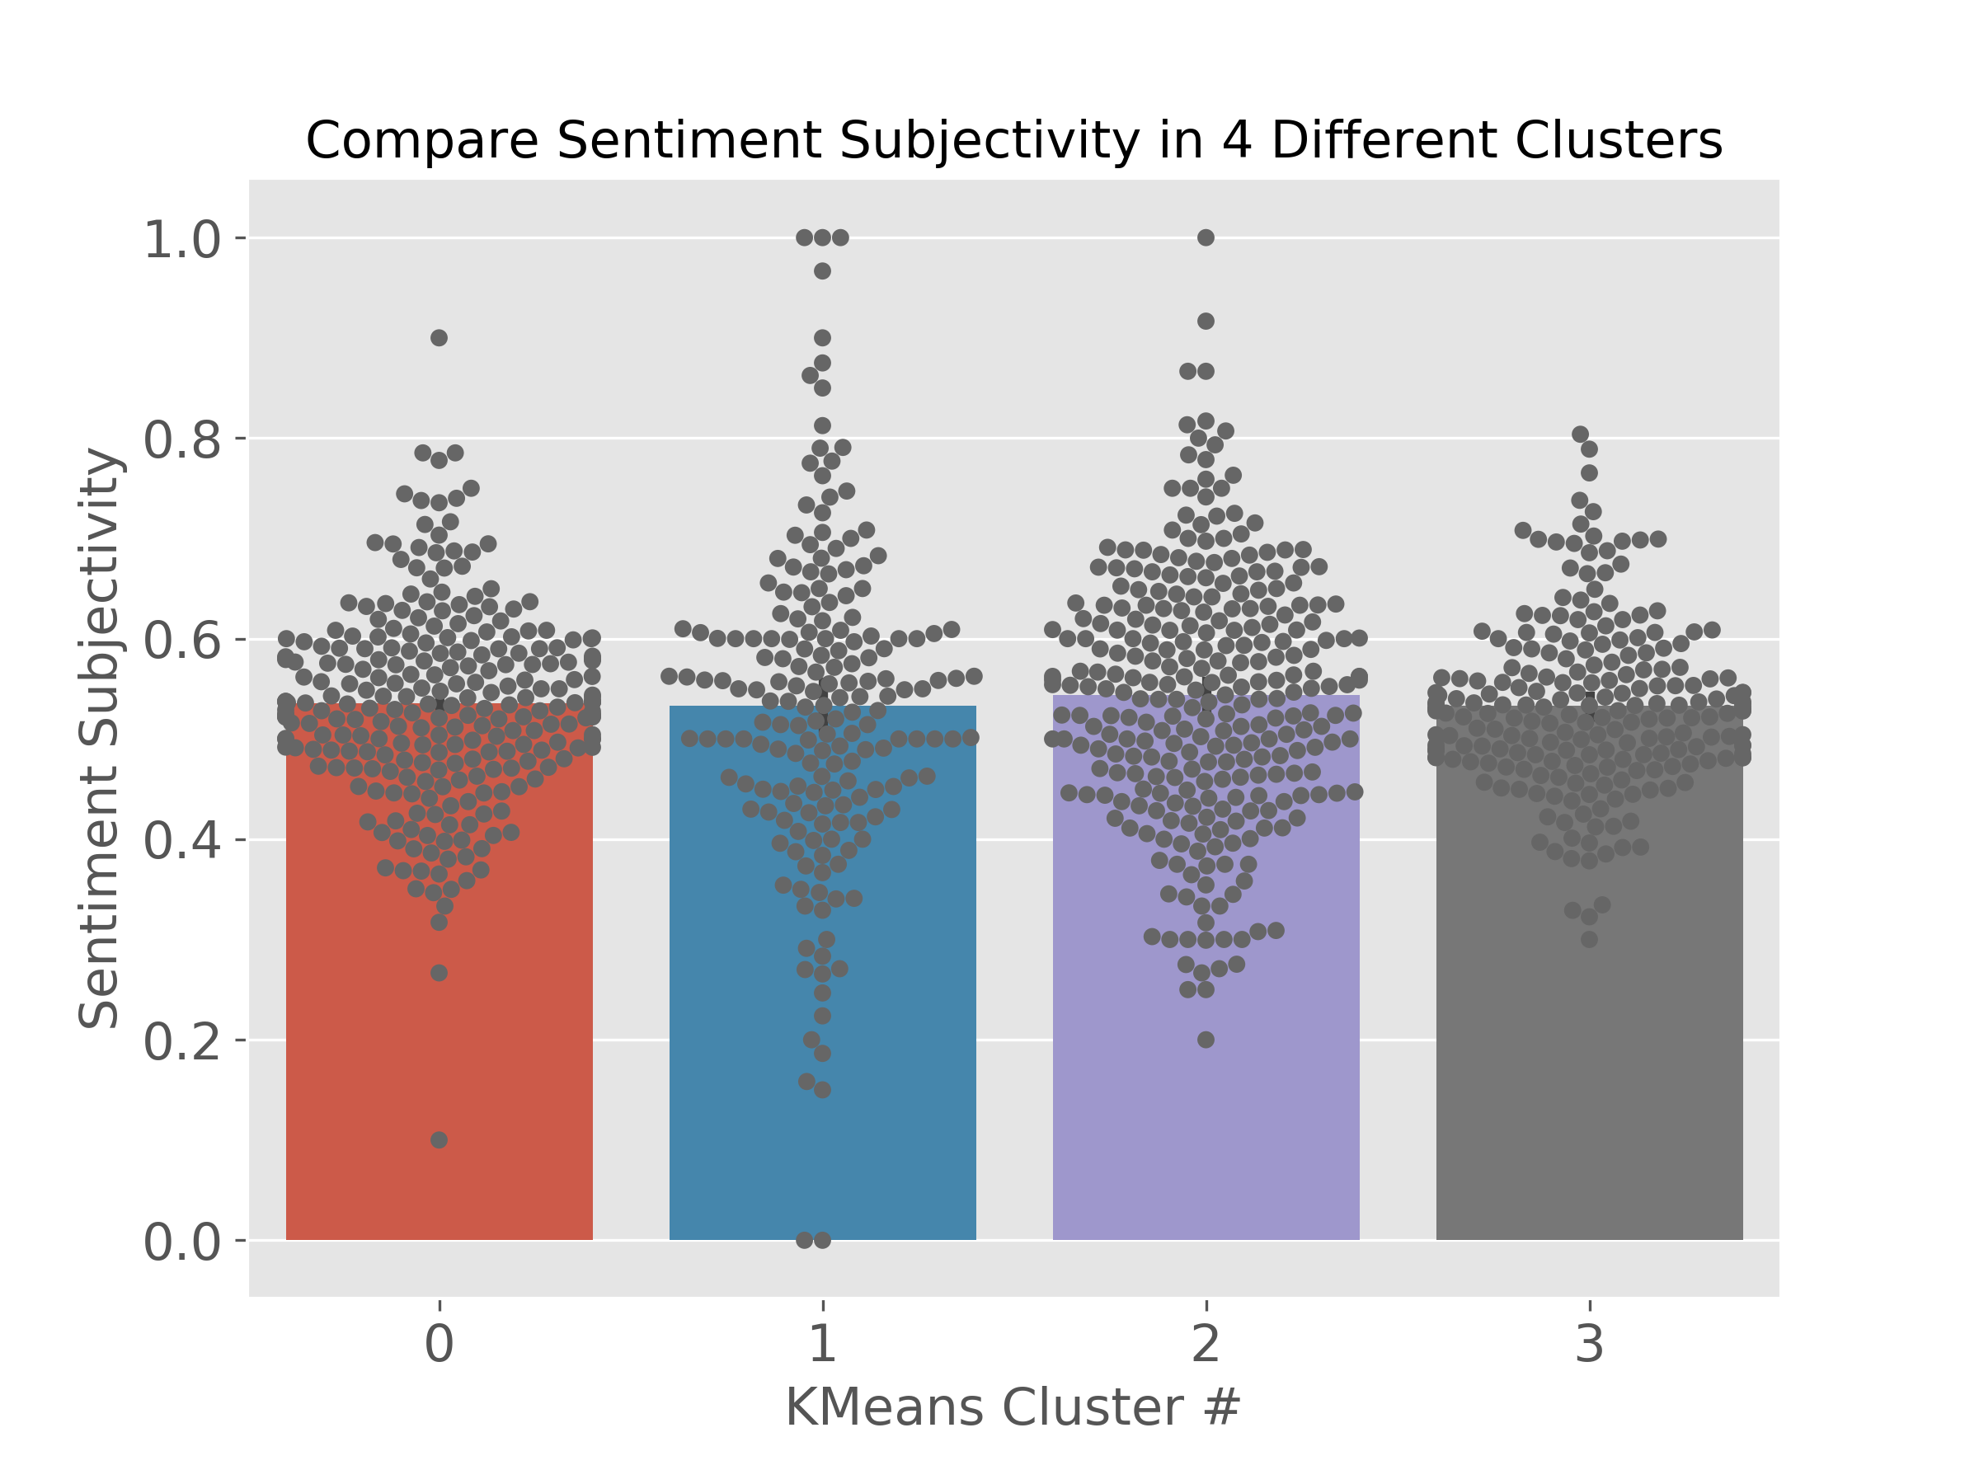
Q2.3 Subjectivity with KMeans clusters (km4_pws)
Comparatively, the values for sentiment subjectivity are very close (0.535, 0.533, 0.543, 0.533).

Slide 8
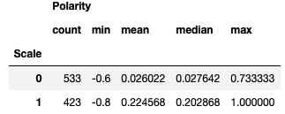
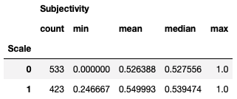
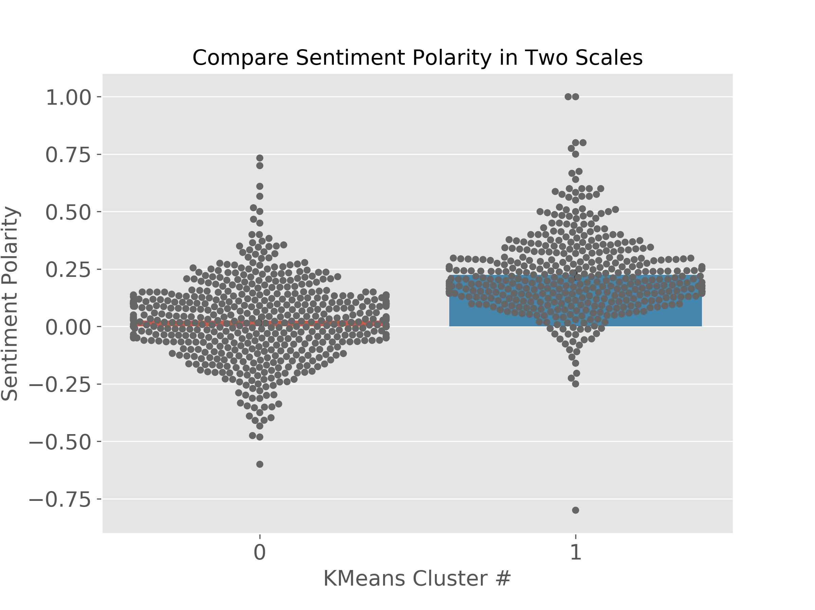
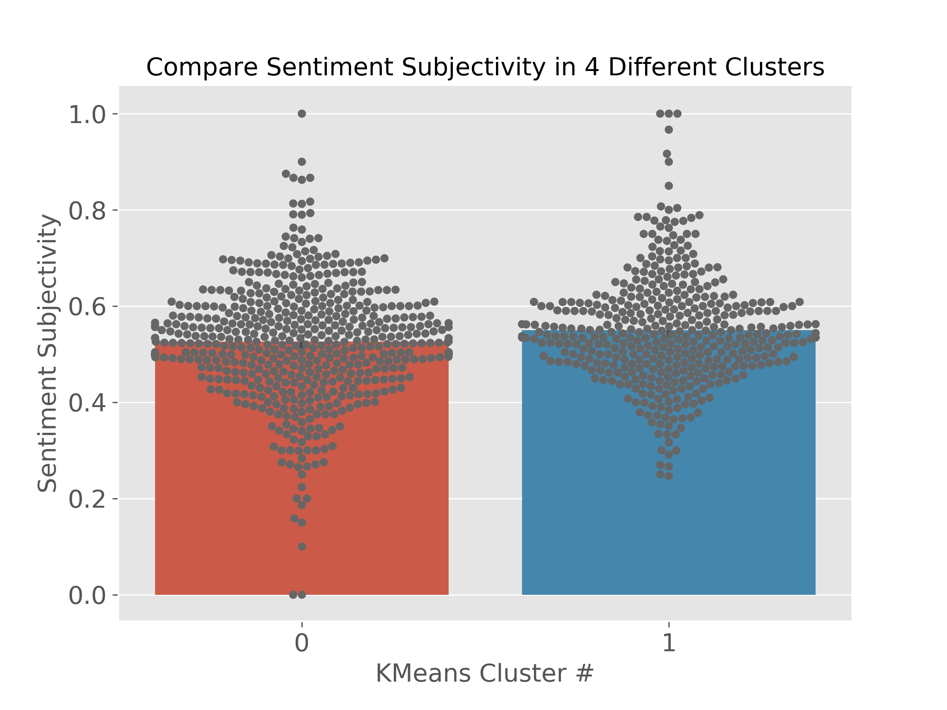
Q2.4 Polarity and subjectivity with two classes (scale 0 or 1)
The polarity values for class 0 (mean=0.026) are almost neutral, while class 1 is more positive with higher polarity value (mean=0.225).

Slide 9
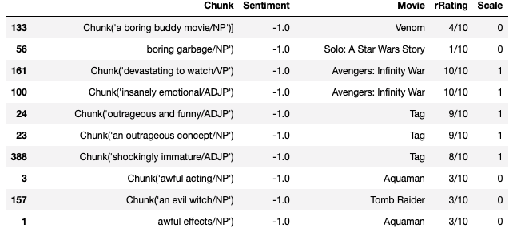
Question 3. Sentiment analysis with movie review chunks
There are 9588 non-neutral chunks in the total 115646 chunks which means only 8.3% chunks are used for sorting with positive or negative sentiment polarity. From the sorted tables, there are 337 highest positive-sentiment-scoring chunks (polarity =1) and 176 highest negative-sentiment-scoring chunks (polarity =-1).
The examples in 337 "Positive" chunks (polarity =1): 'an awesome thrill ride', 'the best coach', 'a masterful performance', 'best to thrill', 'a wonderful place' ... (for movie "A Quite Place"). All these chunks are positive in sentiment polarity.
The examples in 176 "Negative" chunks (polarity =-1): 'horrible mistakes', 'miserable life', 'terribly lazy', 'the worst movies', 'disgusting and unfathomable' ... (for movie "A Quite Place"). All the chunks are negative in sentiment polarity. .

Slide 10
References
Sarkar D. Text analytics with Python (1st and 2nd editions)
Summarising, Aggregating, and Grouping data in Python Pandas.
https://www.shanelynn.ie/summarising-aggregation-and-grouping-data-in-python-pandas/
Implementation environments
Darwin-18.6.0-x86_64-i386-64bit
Python 3.6.8 |Anaconda, Inc.| (default, Dec 29 2018, 19:04:46) [GCC 4.2.1 Compatible Clang 4.0.1 (tags/RELEASE_401/final)] Pandas 0.24.2
NumPy 1.16.4
Requests 2.22.0
Pickle 4.0
Re 2.2.1
nltk 3.4
Matplotlib 3.0.2
Sklearn 0.21.2
Scipy 1.2.1

