Slide 1
NLP Final Project: Topic Modeling Shanqing Gu (Class 401)
956 IMDb reviews from 47 thriller movies are extracted (423 positive reviews with polarity mean 0.22 and 533 negative reviews with polarity mean 0.03).
TF-IDF is a one of the most popular term-weighting schemes to reflect how important a word is to a document in a collection or corpus.
Topic modelling is a method of uncovering hidden structure in a collection of texts.
Non-negative matrix factorization (NMF) is one matrix decomposition technique similar to Singular Value Decomposition (SVD) but operates on non-negative matrices.
Latent Dirichlet Allocation (LDA) is to use a generative probabilistic model where each document consists of a combination of several topics and each term or word can be assigned to a specific topic.
pyLDAvis is to interpret the topics from a topic model that has been fit to a corpus of text data. The package extracts information from a fitted topic model to inform an interactive web-based visualization. Typically, dimension reduction techniques like MDS, PDA, and t-SNE are used to visualize the topics in a two-dimensional visual.
Pipeline
IMDb Movie Review Data
Text Preprocessing
Tokenization
POS tagging
Lemmatization
Text representation(TF-IDF)
Modeling (NMF, LDA)
Evaluation (Topics, pyLDAvis)

Slide 2
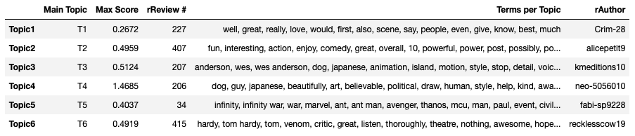
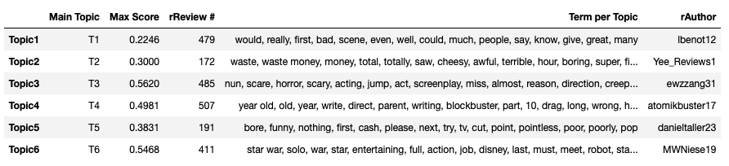
Use NMF Topic Model to Generate Positive or Negative Topics
View Each Positive Topic with Its Maximum Contribution
*
View Each Negative Topic with Maximum Contribution
*

Slide 3
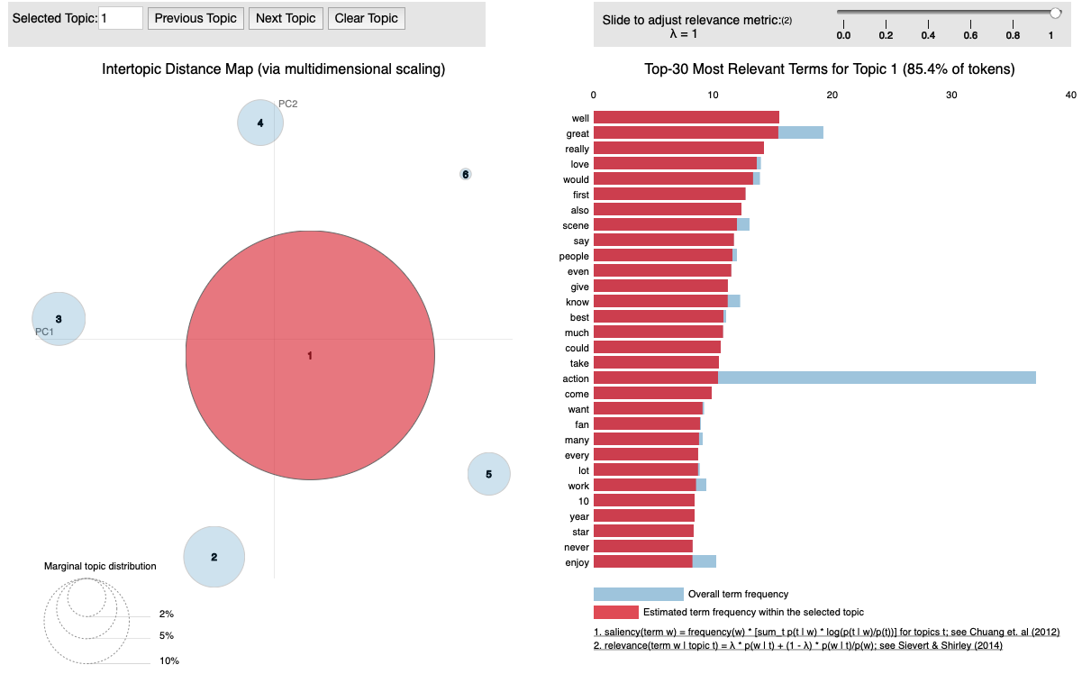
Visualize Positive Topics from NMF Model

Slide 4
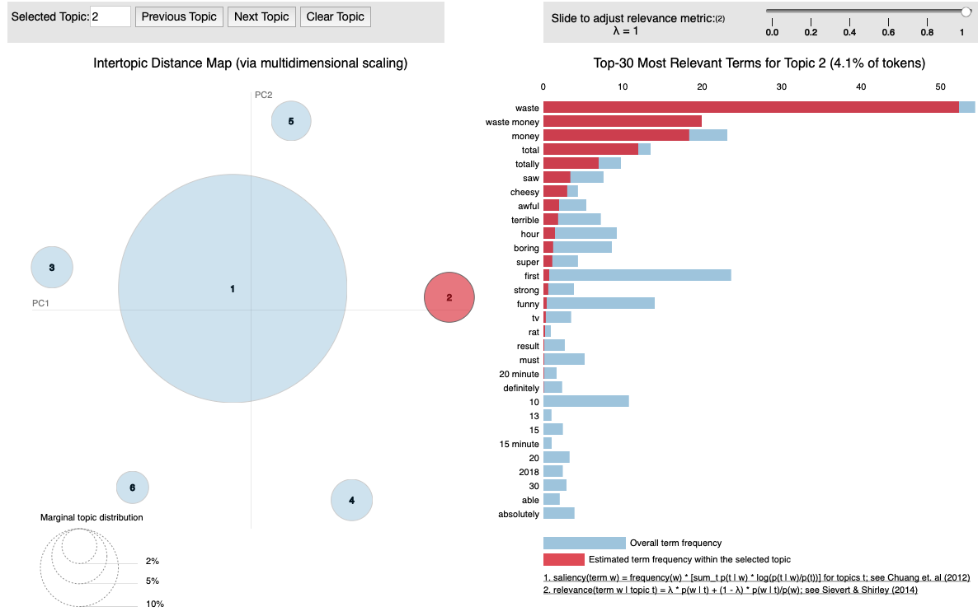
Visualize Negative Topics from NMF Model

Slide 5
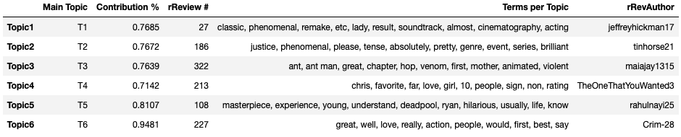
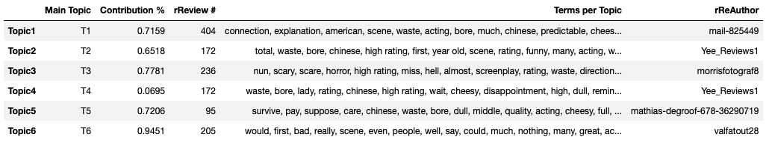
Use LDA Topic Model to Generate Positive or Negative Topics
View Each Positive Topic with Its Maximum Contribution
*
View Each Negative Topic with Maximum Contribution
*

Slide 6
Summary for Topic Modeling
NMF and LDA topic models can generate partially overlapping positive and negative movie review topics.
NMF topic modeling performs best for short text topic mining than popular LDA-based methods. The noisy and sparse short review texts lack sufficient information for LDA, while NMF contains much more priors such as TF-IDF encodings for texts (instead of the only TF in LDA).
Typically, dimension reduction techniques like MDS, PDA, and t-SNE are used to visualize the topics in a two-dimensional visualization. The pyLDAvis visualization is saved to a stand-alone HTML file for easy sharing. The function mds takes 'topic_term_dists' as an input and outputs a 'n_topics' by 2 distance matrix. The output approximates the distance between topics.
References
Sarkar D. Text analytics with Python (1st and 2nd editions)
pyLDAvis Documentation Release 2.1.2 https://buildmedia.readthedocs.org/media/pdf/pyldavis/latest/pyldavis.pdf
Source code for pyLDAvis._prepare https://pyldavis.readthedocs.io/en/latest/_modules/pyLDAvis/_prepare.html

