Slide 1


HISAB AI
Smart Ledger. Smarter Business. Powered by AI.
Smart digital credit & payment management
Guvvadi Manohar · D24R · 10000 Coders
Smart Ledger. Smarter Business. Powered by AI.
Notes:
Hisab AI is a proposed digital credit and payment management platform for small Indian retailers and kirana stores. The vision combines a digital khata with AI assistance and accessible voice interactions.

Slide 2



Problem and objective
A clearer view of customer credit for small retailers
Handwritten khata
Unclear dues
Limited visibility
Missing entries can obscure customer balances.
Outstanding payments become difficult to track.
Paper records limit financial visibility.
OBJECTIVE
OBJECTIVE
OBJECTIVE
Digital transaction records
Automatically calculated dues
Business summaries
02 Hisab AI · Proposed project
Notes:
Notebook-based credit records can lead to missing transactions, inaccurate balances and weak visibility into dues. Hisab AI aims to organize records and make outstanding credit easier to understand.

Slide 3
Data and tools used
Proposed architecture · Database choice remains open
Data sources
CSV statements, customer credit records and authorized payment data.
Application stack
HTML, CSS, JavaScript; Node.js, Express; MongoDB or PostgreSQL.
Intelligence and voice
Python, Pandas, open-source LLMs and speech services.
03 Hisab AI · Proposed project
Notes:
The architecture is proposed, and no specific dataset or completed integration has been confirmed. Data would come from credit records, CSV uploads and authorized payment sources, with Python and Pandas supporting analysis.

Slide 4
How Hisab AI works
Proposed workflow from transaction entry to business answers
1
2
3
4
Record
Organize
Analyze
Ask
Credit, repayments
and CSV uploads
Balances and
payment history
Payment patterns
and insights
Chatbot and
multilingual voice
Planned voice support: Telugu, Hindi and English
04 Hisab AI · Proposed project
Notes:
The intended workflow captures transactions, organizes customer balances and analyzes payment patterns. Shopkeepers could then ask about dues or summaries through chat or voice in Telugu, Hindi and English.

Slide 5
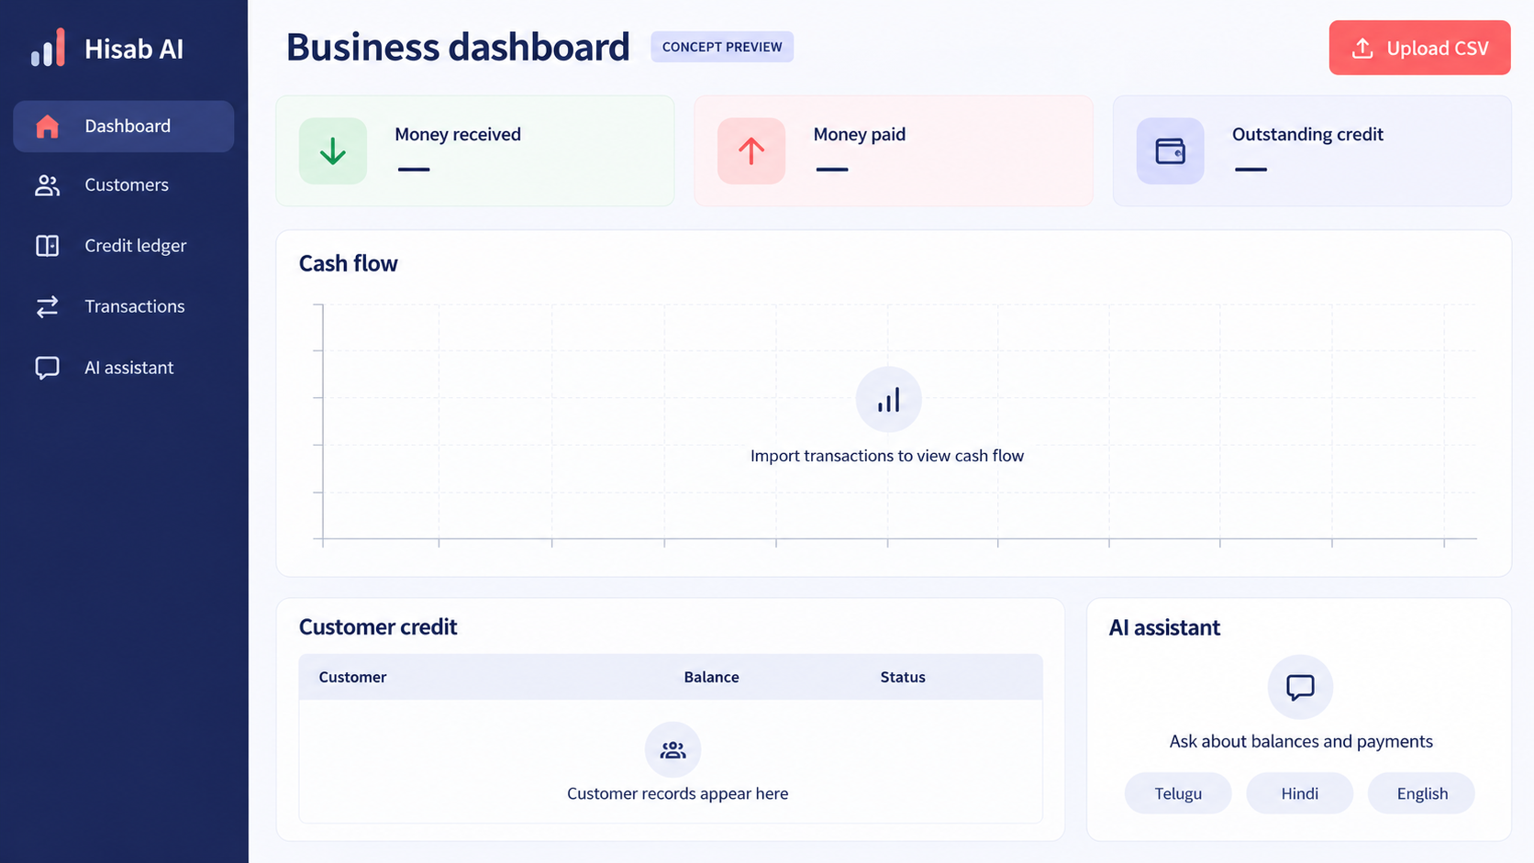
Dashboard and planned insights
AI-generated dashboard concept · No transaction data shown
Credit visibility
Track outstanding customer balances.
Cash flow
Compare daily and monthly movements.
Customer insights
Identify frequent and highest-paying customers.
05 Hisab AI · Proposed project
Notes:
This AI-generated dashboard concept shows planned features in an empty state, without real transactions or measured results. Explain how imported records would populate credit balances, cash flow and customer insights.

Slide 6

Challenges and learnings
Design considerations · Implementation learnings are not yet documented
Authorized payment access
Plan around supported providers and statement imports.
Regional language interaction
Design simple voice access with minimal typing.
Clear financial answers
Connect conversational summaries to customer transaction records.
06 Hisab AI
Notes:
These are planning considerations implied by the proposed integrations and accessibility goals, not claims about obstacles already solved. Replace them with firsthand implementation challenges and lessons once development has been verified.

Slide 7
Thank you
What's next
Android app and automated payment reminders
Regional language expansion and predictive credit insights
Accessible AI-powered financial tools for India's small businesses
Smart Ledger. Smarter Business. Powered by AI.
Notes:
Future scope includes an Android application, automated payment reminders, broader language support and predictive credit insights. The long-term vision is to make AI-powered financial tools accessible to small Indian businesses.

