Slide 1


Self-Supervised Learning of Smart Contract Representations
Shouliang Yang, Xiaodong Gu, Beijun Shen
May, 2022
Notes:
Hello everyone, I am very happy to present our paper here.
Its title is “Self-Supervised Learning of Smart Contract Representations ”.

Slide 2
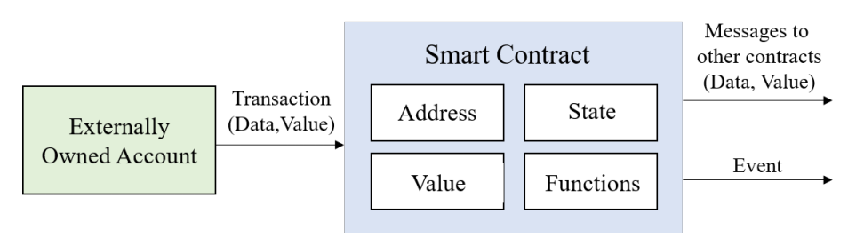
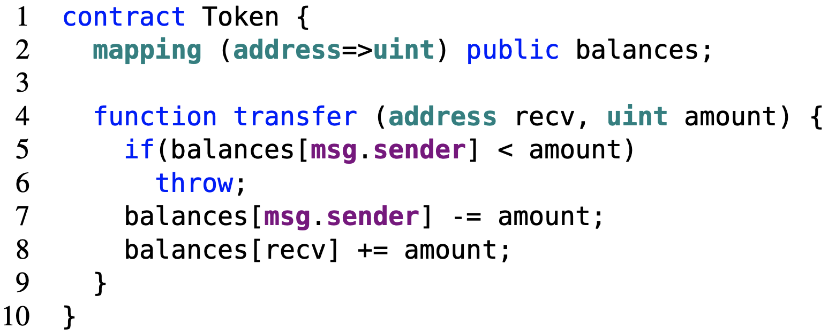
Learning Smart Contract Representations
Smart contracts are general-purpose computer programs that run on Ethereum that are written in high level languages such as Solidity.
Learning smart contract representation can greatly facilitate the development of smart contracts in many tasks, such as Bug Detection, Clone Detection, Code Clustering, Code Search.
Notes:
Smart contracts are general-purpose computer programs that run on Ethereum and have been widely used in many business domains to enable efficient and trustful transactions. Smart contracts are mainly written in high level languages such as Solidity.
Since a bug in a smart contract may lead to a substantial loss. Learning smart contract representations can greatly facilitate the development of smart contracts in many tasks such as bug detection and clone detection.

Slide 3
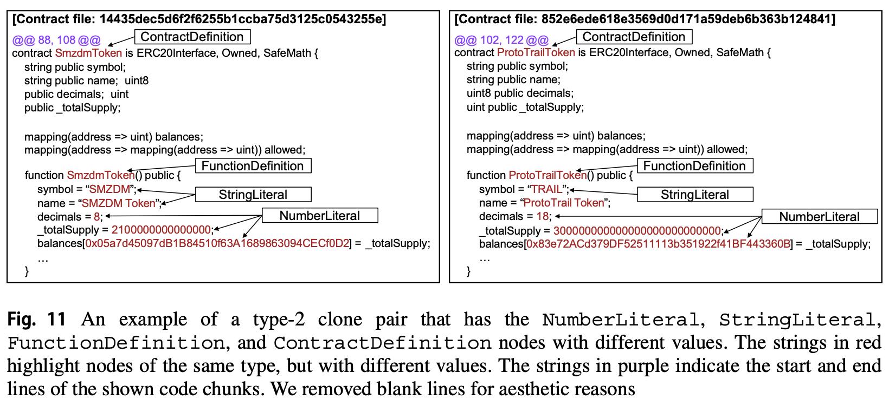
The Low-Resource Challenges
Lacking of sufficient labeled data
Smart contracts are highly homogeneous and redundant
Notes:
However, learning smart contract representations faces many challenges.
The main challenge of learning code representations is how to incorporate structural information in source code.
Second, code reuse in smart contract is quite frequent, which make they are highly homogeneous and redundant.
Third, unlike general programming languages, there is often a scarce availability of large and labeled datasets for training deep smart contract representation models.

Slide 4
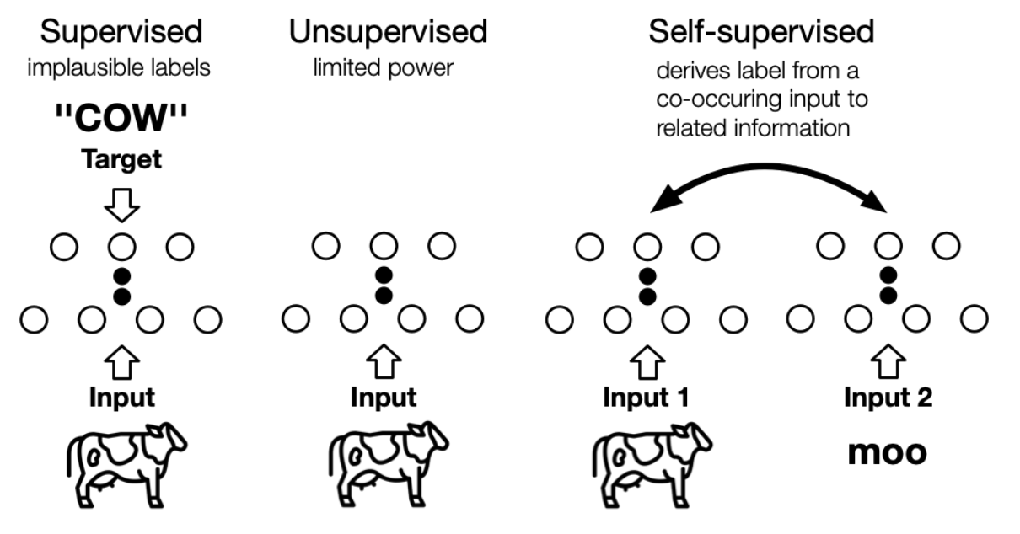
Self-Supervised Learning
Obtain labels from data in a “semi-automatic” manner
Predicting part of the data from other parts

Slide 5
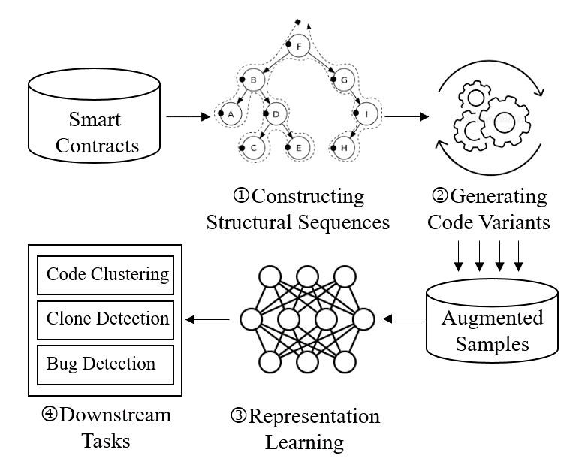
SRCL – Self-Supervised Learning of Smart Contract Representations
Construct learning objectives from smart contracts themselves.
Automatic data augmentation.
Overall Workflow
Notes:
To this end, we propose SRCL for learning smart contract representations.
The pipeline involves three phases, namely, constructing structural sequences, generating code variants, and representation learning, addressing the aforementioned three challenges respectively.
The generated code vectors are then used to assist downstream tasks for smart contracts.
Next, I'll go through these three phases in detail.

Slide 6
Step1: Constructing Structural Sequences
Convert each smart contract into two sequences by traversing its modified AST.
Type sequence retains structural information
Value sequence retains semantic information
ContractDefinition
shapeCalculator
AST
1 pragma solidity ^0.4.0;
2
3 contract shapeCalculator {
function rectangle(uint w, uint h)
returns(uint s, uint p){
5 s = w * h;
6 p = 2 * (w + h);
7 }
8 }
FunctionDefinition
rectangle
…
Block
BlockValue
ParameterList
ParameterListValue
…
ExpressionStatement
ExpressionStatementValue
Source Code
Parameter
w
Parameter
h
…
BinaryOperation
=
Preorder traverse
Structural sequences
Type sequence: ContractDefinition → FunctionDefinition → Block → ExpressionStatement, …
Value sequence: shapeCalculator → rectangle → BlockValue → ExpressionStatementValue, …
Notes:
Given a smart contract, we first convert each smart contract into two sequences, namely, type sequence and value sequence by traversing its modified AST.
The type sequence involves structural information while the value sequence retains semantic information
Such sequential representations of structural data can be easily processed by sequence learning models such as the Transformer

Slide 7
Step2: Generating Code Variants
To increase code diversity, we propose three code variants:
Type Replacement (TR): randomly replace a token from the type sequence with another random type token.
Value Replacement (VR): randomly replace a token 𝑣𝑖 from the value sequence with another value token 𝑣𝑗 with the same type.
Pair Insertion (PI): find a random < 𝑡𝑖, 𝑣𝑗 > pair and insert it into a random position of the sample
Notes:
Then, we propose three simple code variants generation operations, including type replacement, value replacement and pair insertion.
These operations increase both the amount and diversity of smart contracts in our dataset without explicitly collecting more data.

Slide 8
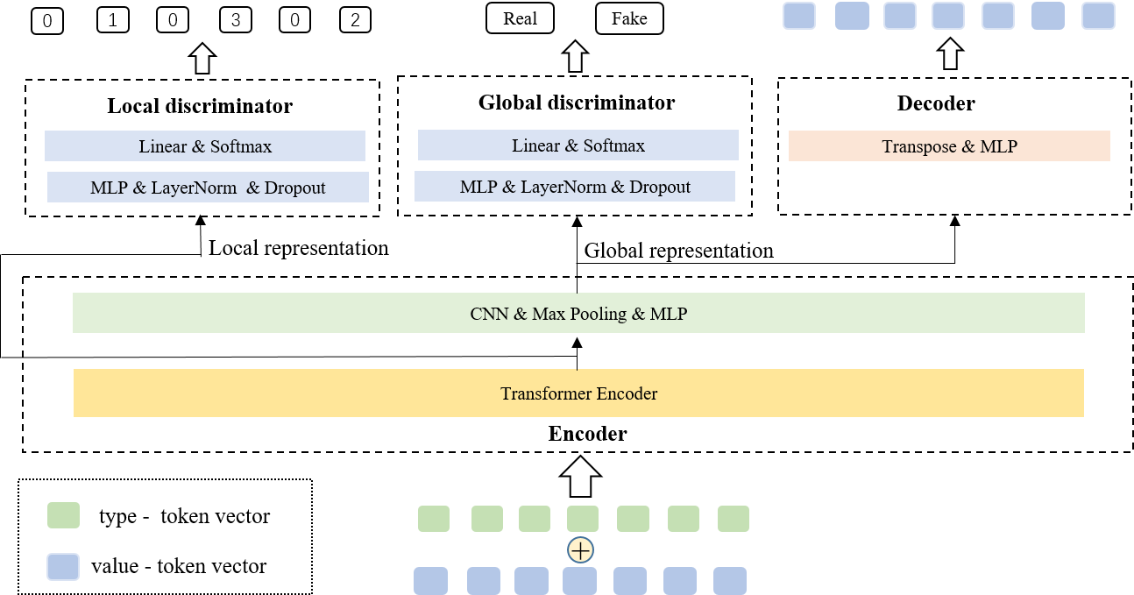
Step 3: Representation Learning
Detect whether a token has been modified
Detect whether the whole sequence has been modified
Decoding the sequences from vectors
Encoding sequences into vectors
Notes:
Finally, the augmented samples are used to train a model based on self-supervised learning.
The model mainly consists of four components, namely, encoder, local discriminator, global discriminator, and decoder.
First, the encoder takes as input the structural sequences of a smart contract and generates the local representation using the Transformer encoder. The local representation is then aggregated into a global representation using a convolutional neural network.
Second, local and global discriminators are applied to the local and global representation respectively, so as to learn the local and global features of a smart contract.
Third, the decoder takes as input the global representation and learns to reconstruct the original value sequence.
The trained encoder can be used to generate code vectors for smart contracts.

Slide 9
Evaluation
RQ1: How effectively does SRCL perform compared with the state-of-the-art methods?
RQ2: How do internal components or techniques contribute to the effectiveness of SRCL?

Slide 10
Experiments
Downstream Tasks
Bug Detection
Clone Detection
Code Clustering
Metrics
Precision, Recall and F1
Adjusted Rand Index
Baselines
SmartEmbed
code2vec
code2seq
9
Notes:
In order to evaluate the performance of our SRCL, we conduct a series of experiments on three downstream tasks, namely, bug detection, code clone detection, and code clustering.
We compare our approach with three state-of-the-art methods on code representations learning: smartEmbed, code2vec and code2seq.

Slide 11
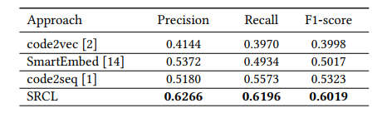
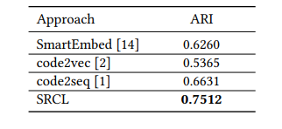
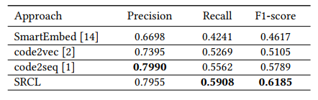
Overall Performance (RQ1)
Effectiveness in Bug Detection
Effectiveness in Code Clustering
Effectiveness in Clone Detection
SRCL achieves the best performance compared to baseline models in all three studied tasks.
Notes:
In this experiment, we compare the performance of SRCL and baselines.
These three tables shows the results in the bug detection, clone detection and code clustering tasks, respectively.
We can observe that SRCL achieves the best performance compared to baseline models in all three studied tasks.

Slide 12
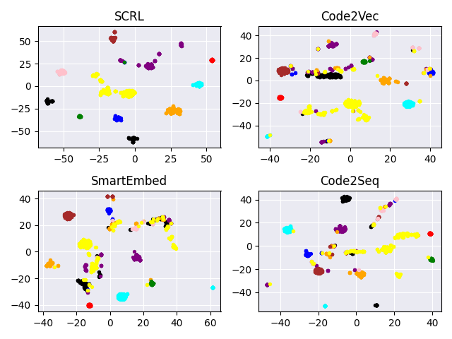
Visualization Analysis
Vectors generated by SRCL has clear boundaries than those generated by other methods
Notes:
To further show the effectiveness of SRCL, we visualize the code vectors produced by all four methods.
From the figure, we can observe that vectors generated by SRCL has clear boundaries than those generated by other methods. This facilitates the K-Means algorithm to cluster contracts.
What’s more, vectors of some classes (e.g. red) are close to each other, nearly clustered as a point. This confirms our initial finding that code reuse is a common phenomenon in smart contracts.

Slide 13
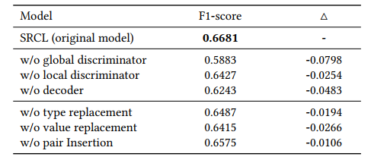
Ablation Study (RQ2)
All the studied components contribute to the effectiveness of SRCL
Notes:
In RQ2 experiment, ,we perform an in-depth ablation study on SRCL.
From the result, we can find that all the studied components and operations contribute to the effectiveness of SRCL.
Among them, the global discriminator contributes the most in terms of F1-score.

Slide 14
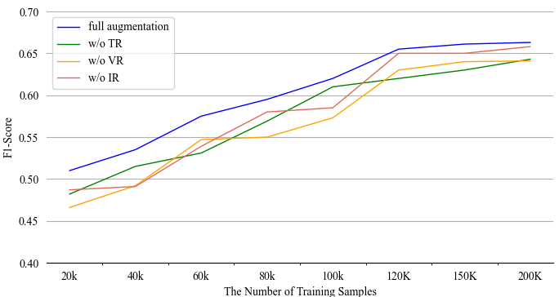
Hyperparameter Robustness (RQ2)
Impacts of different code variant generation techniques in the bug detection task.
Generating code variants also enhances the performance of SRCL, especially when the scale of training data is small
Notes:
What’s more, we conduct an experiment on various fractions of the training data.
We can see that the generation of code variants is more effective on smaller training sets.
This is because small datasets are more likely to overfit training data than larger datasets.

Slide 15
Thanks for listening!
Contact me：ysl0108@sjtu.edu.cn
Notes:
That is all my talk. Thanks for your listening!

