Slide 1
Deep API Learning
Xiaodong GU Sunghun Kim
The Hong Kong University of Science and Technology
Hongyu Zhang Dongmei Zhang
Microsoft Research
Notes:
Quality of API sequences such as API bugs. -> language model learn the probability from large-scale data, so they are just noises. DeepAPI only produce commonly used API sequences. Second, this is a threat to validity. Our future work will explore better training data
The augment of the loss function will affect the original conditional probabilities? => It is just a regularization.
The motivation example “convert int to string” is not convincing as google can distinguish?
How the model distinguish words with different forms? For example, “write an image”->”writing an image”? An word embedding mechanism to identify similar words..
In real world, developers want API graph, instead of a sequence. =>No need for graph, sequences indicates difference usages, developers can synthesize their own graphical structure of APIs.

Slide 2

Programming is hard
Unfamiliar problems
Unfamiliar APIs [Robillard,2009]
“how to parse XML files?”
DocumentBuilderFactory.newInstance
↓
DocumentBuilderFactory.newDocumentBuilder
↓
DocumentBuilder.parse

Slide 3
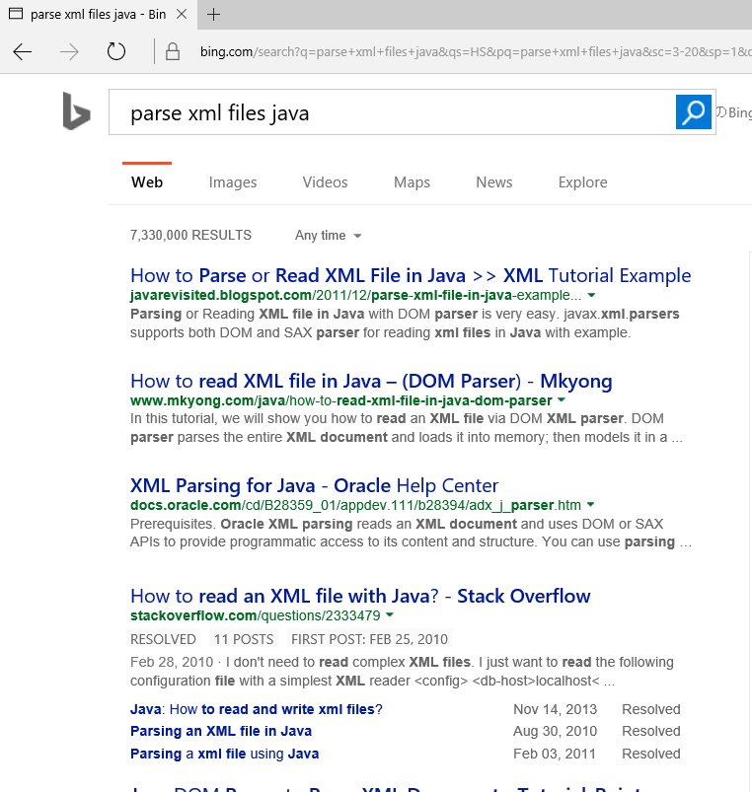


Obtaining API usage sequences based on a query
Notes:
General search engines are not designed for source code and could have many unrelated results such as discussions and programming experience. Besides, developers need to brows many web pages to check the results.

Slide 4



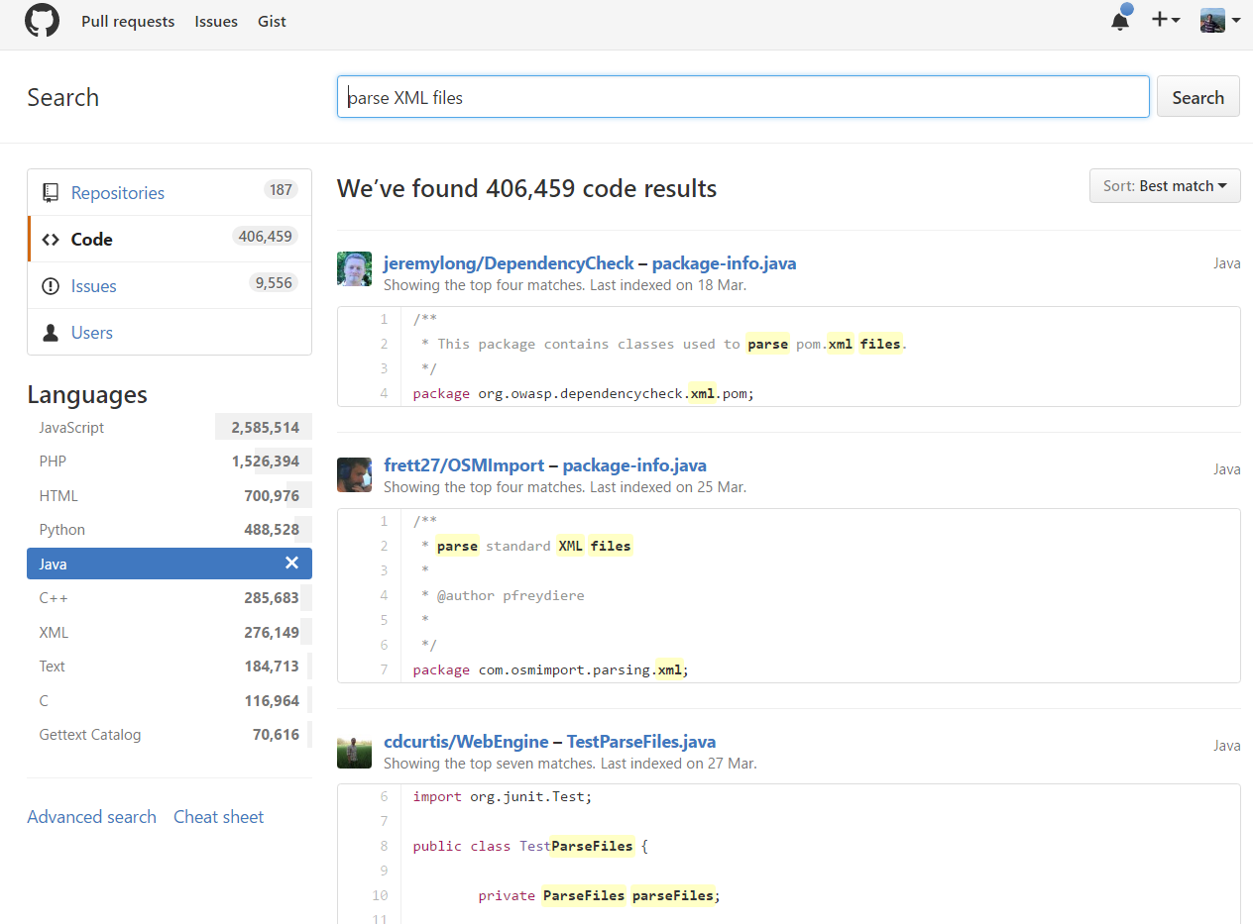
Obtaining API usage sequences based on a query
The
Problem?
Bag-of-words Assumption!
Lack a deep understanding of the semantics of the query

Slide 5



Limitations of IR-based Approaches
“how to convert string to int”
static public Integer str2Int(String str) {
Integer result = null;
try {
result = Integer.parseInt(str);
} catch (Exception e) {
String negativeMode = "";
if(str.indexOf('-') != -1) negativeMode = "-";
str = str.replaceAll("-", "" );
result = Integer.parseInt(negativeMode + str);
}
return result;
}
“how to convert int to string”
“how to convert string to number”
Limit #1
Cannot identify semantically related words
Limit #2
Cannot distinguish word ordering

Slide 6
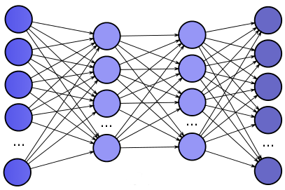

DeepAPI – Learning The Semantics
DocumentBuilderFactory:newInstance DocumentBuilderFactory:newDocumentBuilder
DocumentBuilder:parse
“how to parse XML files”
$$\left[\begin{matrix}1.1 \\ \begin{matrix}2.3 \\ 0.4 \\ ⋮\end{matrix} \\ 5.0\end{matrix}\right]$$
DNN – Embedding Model
DNN – Language Model
Better query understanding (recognize semantically related words and word ordering)

Slide 7


Background – RNN
Recurrent Neural Network
Output Layer
Hidden Layer
h₁
h₂
h₃
w₁
w₂
w₃
Input Layer
parse
xml
file
$h_{t}=f\left(h_{t−1},x_{t}\right)$
Hidden layers are recurrently used for computation
This creates an internal state of the network to record dynamic temporal behavior

Slide 8
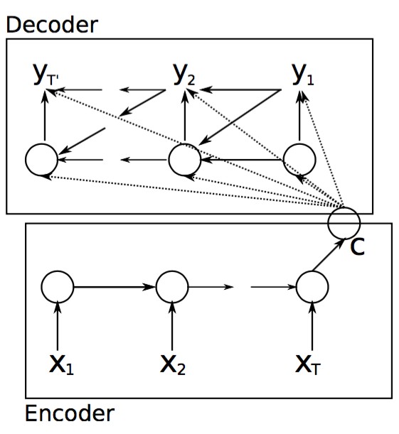
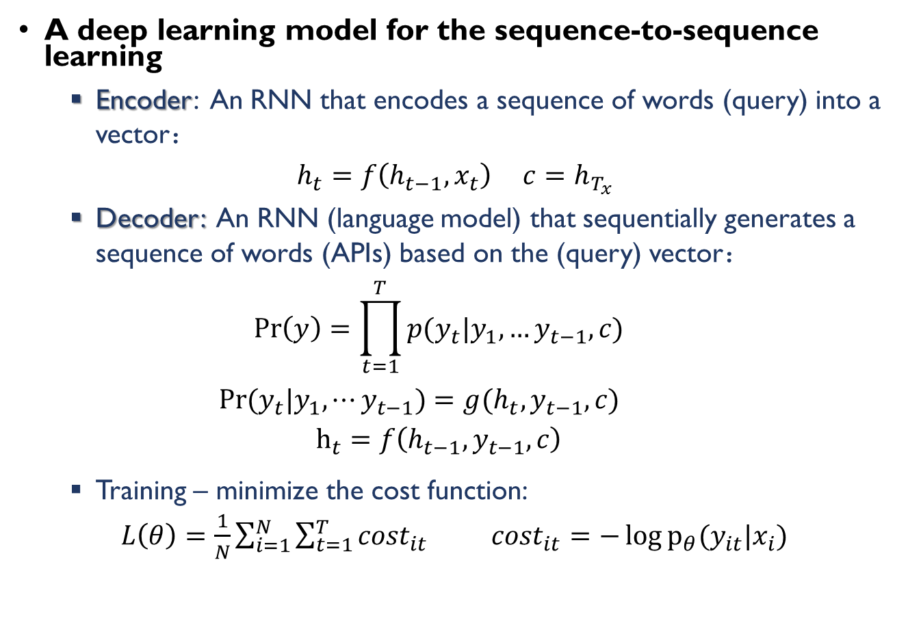
Background – RNN Encoder-Decoder
A deep learning model for the sequence-to-sequence learning
Encoder: An RNN that encodes a sequence of words (query) into a vector：
$h_{t}=f\left(h_{t−1},x_{t}\right)$ $c=h_{T_{x}}$
Decoder: An RNN (language model) that sequentially generates a sequence of words (APIs) based on the (query) vector：
$$\operatorname{Pr}\left(y\right)=\prod_{t=1}^{T}{p(y_{t}|y_{1},…y_{t−1},c)}$$
${Pr⁡(y}_{t}|y_{1},⋯y_{t−1})=g(h_{t},y_{t−1},c)$
$$h_{t}=f\left(h_{t−1},y_{t−1},c\right)$$
Training – minimize the cost function:
$L\left(θ\right)=\frac{1}{N}\sum_{i=1}^{N}{\sum_{t=1}^{T}{{cost}_{it}}}$ ${cost}_{it}=−\log{p_{θ}(y_{it}|x_{i})}$

Slide 9
RNN Encoder-Decoder Model for API Sequence Generation
Encoder RNN
Decoder RNN
FileReader
.new
BuffereReader
.new
BuffereReader
.read
BuffereReader
.close
<EOS>
Output
y₁
y₂
y₃
y₄
y₅
c
Hidden
h₁
h₂
h₃
h₁
h₂
h₃
h₄
h₅
Input
x₁
x₂
x₃
y₁
y₂
y₃
y₄
Read
Text
File
<START>
FileReader
.new
BuffereReader
.new
BuffereReader
.read
BuffereReader
.close

Slide 10
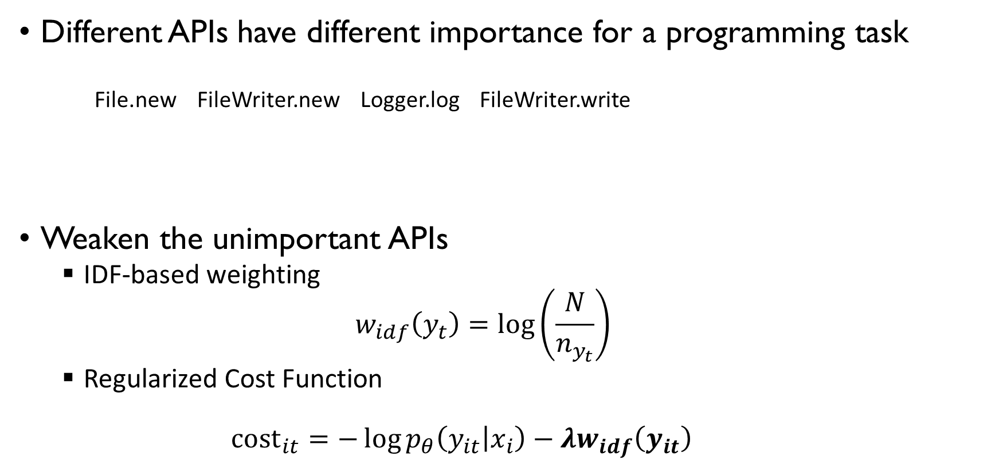
Enhancing RNN Encoder-Decoder Model with API importance
Different APIs have different importance for a programming task
File.new FileWriter.new Logger.log FileWriter.write
Weaken the unimportant APIs
IDF-based weighting
$$w_{idf}\left(y_{t}\right)=\log\left(\frac{N}{n_{y_{t}}}\right)$$
Regularized Cost Function
$${cost}_{it}=−\log{p_{θ}\left(y_{it} | x_{i}\right)}−λw_{idf}\left(y_{it}\right)$$

Slide 11




System Overview
Offline Training
API-related User Query
Natural Language Annotations
Training
Instances
Code Corpus
RNN Encoder-Decoder
Training
API sequences
Suggested API sequences

Slide 12
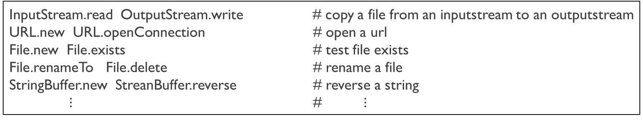
Step1 – Preparing a Parallel Corpus
<API Sequence, Annotation> pairs
InputStream.read OutputStream.write # copy a file from an inputstream to an outputstream
URL.new URL.openConnection # open a url
File.new File.exists # test file exists
File.renameTo File.delete # rename a file
StringBuffer.new StreanBuffer.reverse # reverse a string
$⋮$ # $⋮$
API Sequences (Java)
Annotations(English)
Collect 442,928 Java projects from GitHub (2008-2014)
Parse source files into ASTs using Eclipse JDT
Extract an API sequence and an annotation for each method body (when Javadoc comment exists)

Slide 13
Extracting API Usage Sequences
Post-order traverse on each AST tree:
Constructor invocation:
new C() => C.new
Method call:
o.m() => C.m
Parameters:
o₁.m₁(o₂.m₂(),o₃.m₃())=> C₂.m₂-C₃.m₃-C₁.m₁
A sequence of statements:
stmt₁;stmt₂;,,,stmt_{t};=>s₁-s₂-…-s_{t}
Conditional statement:
if(stmt₁){stmt₂;} else{stmt₃;} =>s₁-s₂-s₃
Loop statements:
while(stmt₁){stmt₂;}=>s₁-s₂
1 …
2 BufferedReader reader = new BufferedReader(…);
4 while((line=reader.readLine())!=null)
5 …
6 reader.close;
Body
Statement
While Statement
…
Variable Declaration
Constructor Invocation
Method Invocation
Block Statement
Type
Variable
Variable
readLine
BufferedReader
reader
reader
BufferedReader.new BufferedReader.readLine
BufferedReader.close

Slide 14
Extracting Natural Language Annotations
The first sentence of a documentation comment
MethodDefinition
/***
* Copies bytes from a large (over 2GB) InputStream to an OutputStream.
* This method uses the provided buffer, so there is no need to use a
* BufferedInputStream.
* @param input the InputStream to read from
* . . .
* @since 2.2
*/
public static long copyLarge(final InputStream input,
final OutputStream output, final byte[] buffer) throws IOException {
long count = 0;
int n;
while (EOF != (n = input.read(buffer))) {
output.write(buffer, 0, n);
count += n;
}
return count;
}
Javadoc Comment
Body
…
…
API sequence: InputStream.read OutputStream.write
Annotation: copies bytes from a large inputstream
to an outputstream.

Slide 15
Step2 – Training RNN Encoder-Decoder Model
Data
7,519,907 <API Sequence, Annotation> pairs
Neural Network
Bi-GRU, 2 hidden layers, 1,000 hidden unites
Word Embedding: 120
Training Algorithm
SGD+Adadelta
Batch size: 200
Hardware:
Nvidia K20 GPU
Notes:
Q: Bi-GRU will affect API sequence? Why reverse API sequences? => we just use Bi-GRU for the query. For API sequence, we use traditional GRU.

Slide 16
Evaluation
RQ1: How accurate is DeepAPI for generating API usage sequences?
RQ2: How accurate is DeepAPI under different parameter settings?
RQ3: Do the enhanced RNN Encoder-Decoder models improve the accuracy of DeepAPI?

Slide 17
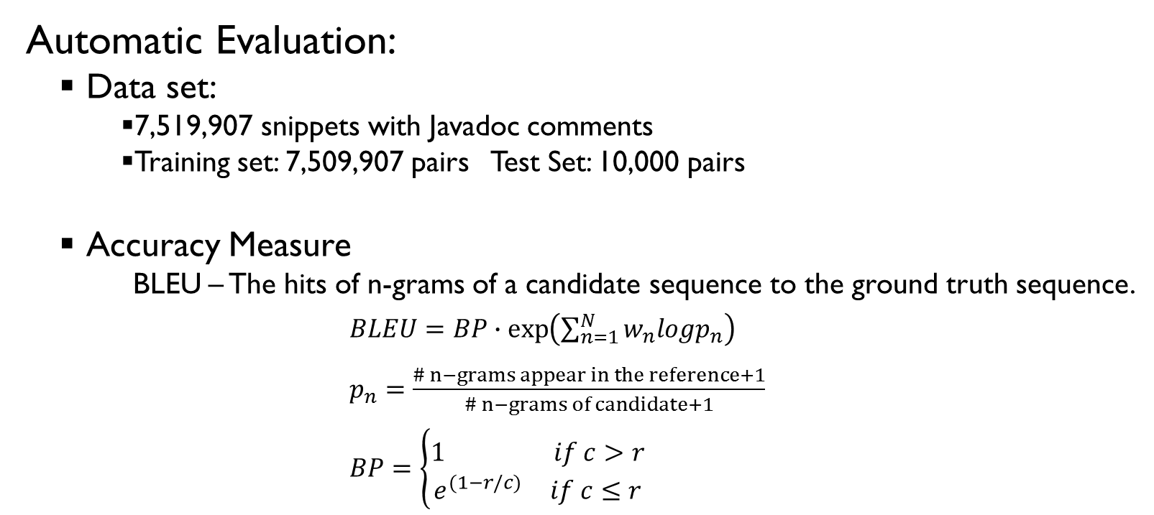
RQ1: How accurate is DeepAPI for generating API usage sequences?
Automatic Evaluation:
Data set:
7,519,907 snippets with Javadoc comments
Training set: 7,509,907 pairs Test Set: 10,000 pairs
Accuracy Measure
BLEU – The hits of n-grams of a candidate sequence to the ground truth sequence.
$BLEU=BP∙\exp\left(\sum_{n=1}^{N}{w_{n}logp_{n}}\right)$
$p_{n}=\frac{\# n−grams appear in the reference+1}{\# n−grams of candidate+1}$
$BP=\left\{\begin{matrix}\begin{matrix}1 & if c>r\end{matrix} \\ \begin{matrix}e^{(1−r/c)} & if c≤r\end{matrix}\end{matrix}\right.$

Slide 18
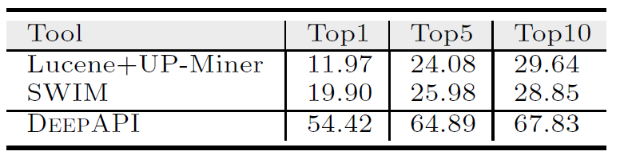
RQ1: How accurate is DeepAPI for generating API usage sequences?
Comparison Methods
Code Search with Pattern Mining
Code Search – Lucene
Summarizing API patterns – UP-Miner [Wang, MSR’13]
SWIM [Raghothaman, ICSE’16]
Query-to-API Mapping – Statistical Word Alignment
Search API sequence using the bag of APIs – Information retrieval

Slide 19
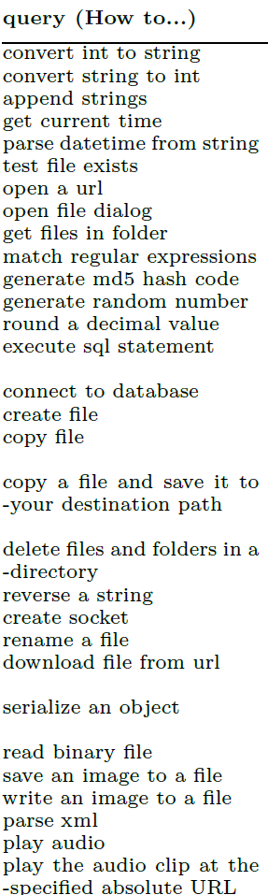
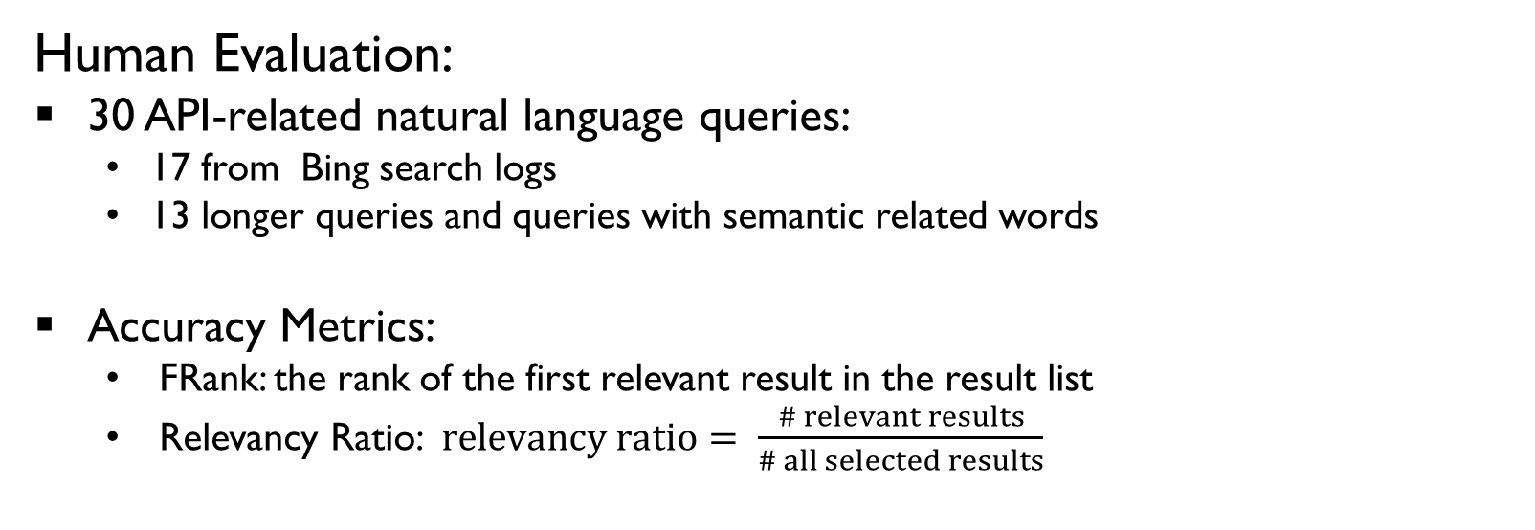
RQ1: How accurate is DeepAPI for generating API usage sequences?
Human Evaluation:
30 API-related natural language queries:
17 from Bing search logs
13 longer queries and queries with semantic related words
Accuracy Metrics:
FRank: the rank of the first relevant result in the result list
Relevancy Ratio:$relevancy ratio= \frac{\# relevant results}{\# all selected results}$

Slide 20
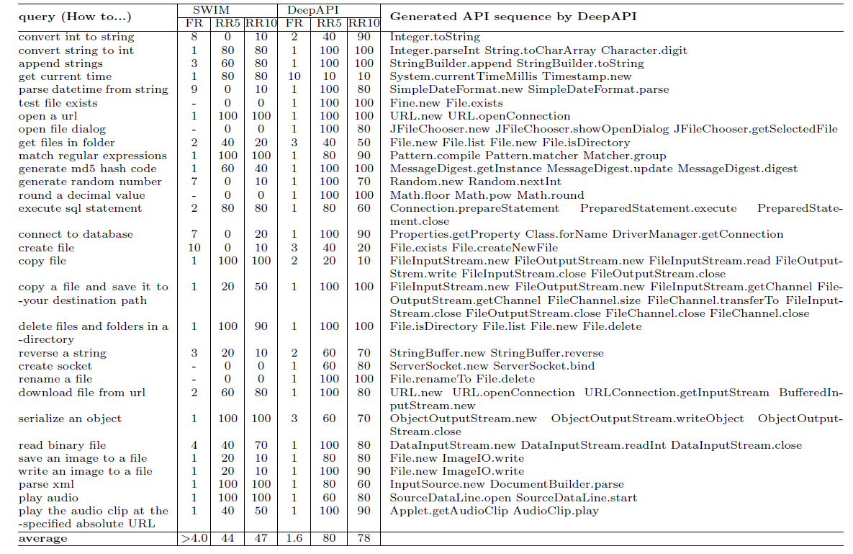

Slide 21
RQ1: How accurate is DeepAPI for generating API usage sequences?
Examples
DeepAPI
Distinguishing word ordering
convert int to string => Integer.toString
convert string to int => Integer.parseInt
Identify Semantically related words
save an image to a file => File.new ImageIO.write
write an image to a file=> File.new ImageIO.write
Understand longer queries
copy a file and save it to your destination path
play the audio clip at the specified absolute URL
SWIM
Partially matched sequences
generate md5 hashcode=> Object.hashCode
Project-specific results
test file exists => File.new, File.exists, File.getName, File.new, File.delete, FileInputStream.new,…
Hard to understand longer queries
copy a file and save it to your destination path

Slide 22
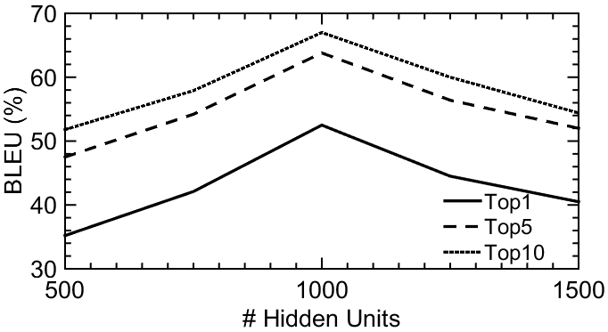
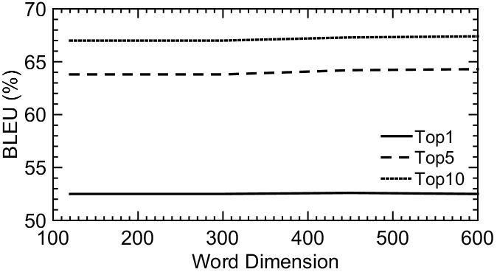
RQ2 – Accuracy Under Different Parameter Settings
BLEU scores under different number of hidden units and word dimensions

Slide 23
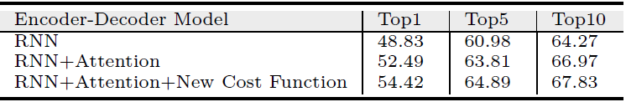
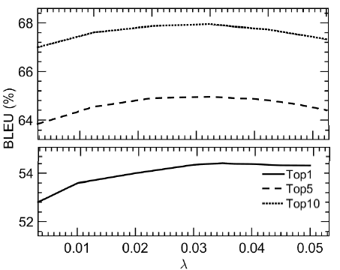
RQ3 – Performance of the Enhanced RNN Encoder-Decoder Models
BLEU scores of different Models(%)
BLEU scores under different λ

Slide 24
Conclusion
Apply RNN Encoder-Decoder for generating API usage sequences for a given natural language query
Recognize semantically related words
Recognize word ordering
Future Work
Explore the applications of this model to other problems.
Investigate the synthesis of sample code from the generated API sequences.

Slide 25

Thanks!

