Slide 1


DeepAM: Migrate APIs with Multi-modal Sequence to Sequence Learning
Xiaodong GU Sunghun Kim
The Hong Kong University of Science and Technology
Hongyu Zhang
The University of NewCasttle
Dongmei Zhang
Microsoft Research

Slide 2

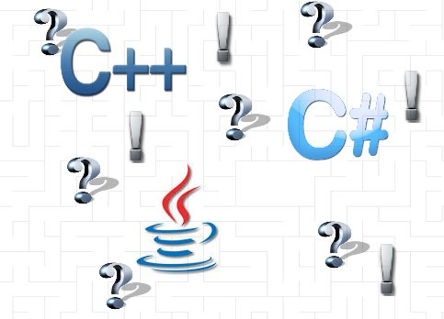

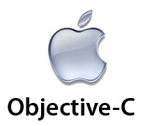

Programming Language Migration
Notes:
Programming Language Migration is a very common task in software development. A software product is often required to support a variety of devices and environments. This requires developing the software product in one language and manually porting it to other languages.
This procedure is rather tedious and time-consuming. So, many automatic code migration tools have been developed.

Slide 3
API Migration
BufferedWriter bw=new BufferedWriter();
bw.write();
bw.close();
StreamWriter sw=new StreamWriter();
sw.Write();
sw.Close();
JAVA
BufferedWriter.new->BufferedWriter.write->BufferedWriter.close
C#
StreamWriter.new->StreamWriter.Write->StreamWriter.Close
Notes:
However, current language migration tools, such as Java2CSharp, require users to manually define the mappings between the corresponding APIs

Slide 4

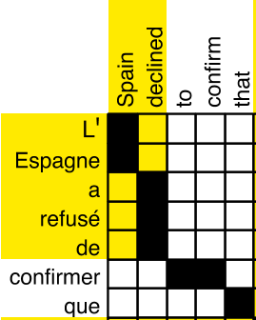
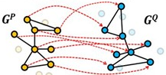
Existing Techniques
J
C#
fun1 {
}
foo1 {
}
…
…
Collect bilingual projects
J
C#
foo {
}
fun1 {
}
Match equivalent functions with similar signatures
Build API transformation graphs
Statistical machine translation
[Zhong et al. 2010]
[Nguyen et al. 2014]

Slide 5
Limitation1: Limited Bilingual Projects
Analyzed 11k Java projects in Github from 2008-2014
Only 15 projects have been manually ported from Java to C#

Slide 6
Limitation 2: Aligning Functions with Text Similarity
public static long readFile(final InputStream input,
final OutputStream output, final byte[] buffer) {
long count = 0;
int n;
while (EOF != (n = input.read(buffer))) {
output.write(buffer, 0, n);
count += n;
}
return count;
}
public static string ReadTextFile(String sFilename) {
if (File.Exists(sFilename)) {
StreamReader myFile
= new StreamReader(sFilename);
sContent = myFile.ReadToEnd();
myFile.Close();
}
return sContent;
}
Notes:
Incomplete function names, bag-of-words assumptions.

Slide 7
DeepAM
Big Code Data – Enables the construction of large-scale bilingual API sequences from big code corpus rather than limited bilingual projects.
Deep Model – Learns API semantic representations using deep neural network
Notes:
First: DEEPAM enables the construction of large-scale bilingual API sequences from big code corpus rather than limited bilingual projects.

Slide 8
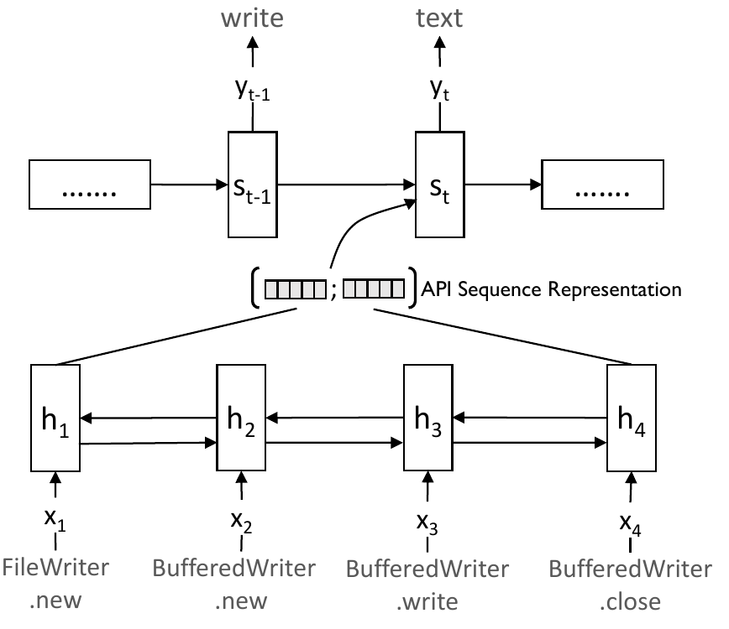


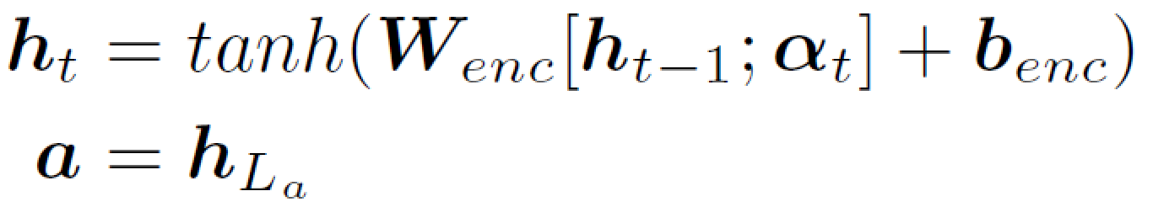
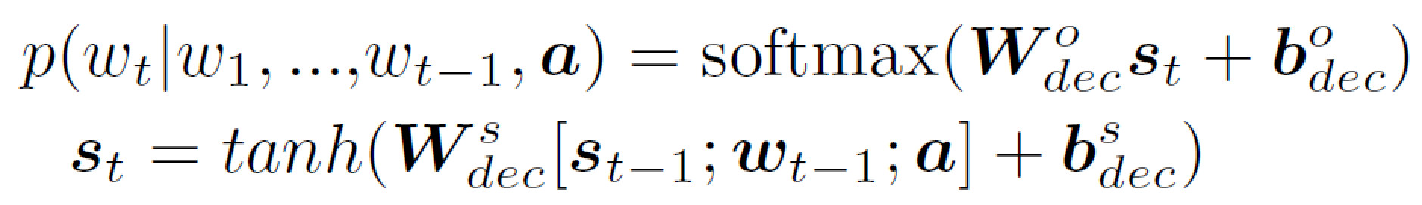

Embedding API sequences with Seq2Seq
Deep learning the semantic representation of API sequences
$$\left[\begin{matrix}1.1 \\ … \\ 5.0\end{matrix}\right]$$
d=[ ]
Encoder: embeds API sequences
Decoder: generates NL descriptions with API vectors
Notes:
The key idea is: For each API sequence a, we will collect a corresponding natural language description d. And we learn a vector for the API sequence that reflects the developer’s high-level intent in the description. Then, with the vectors, we can find equivalent API sequences in the other language.

Slide 9
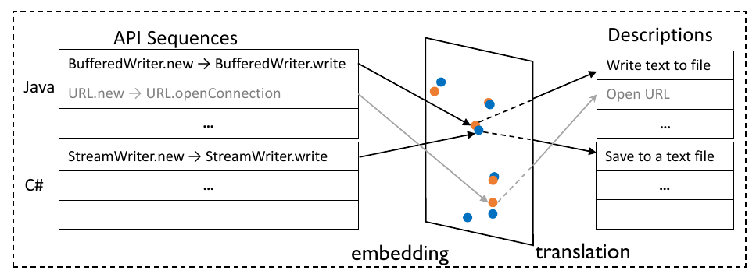
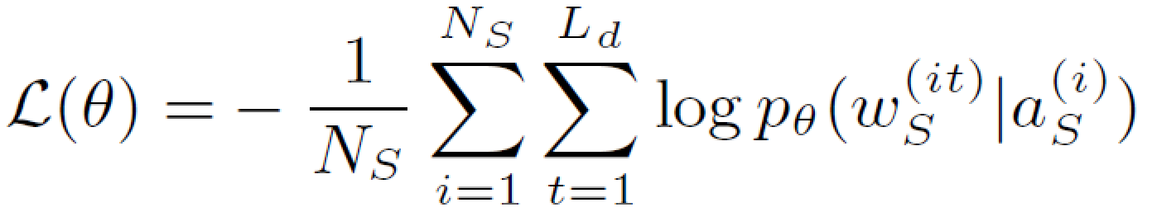
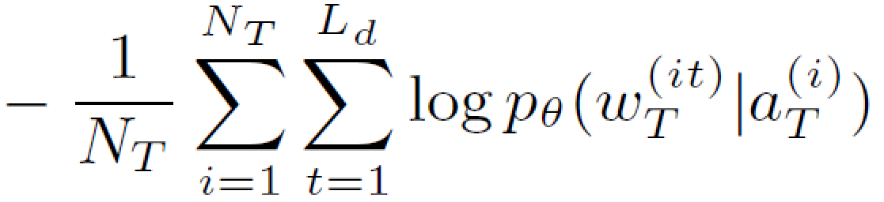
Multi-modal Sequence-to-Sequence Learning

Slide 10
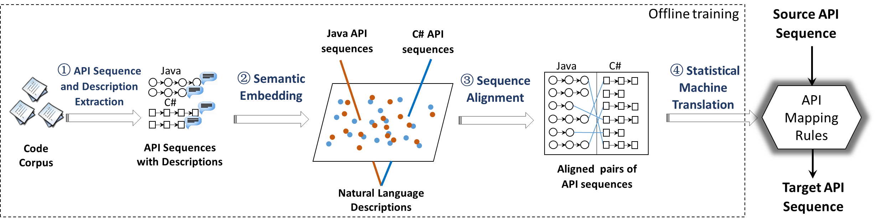
Workflow

Slide 11
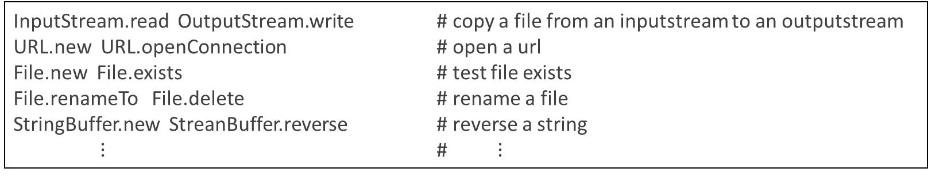
Collecting a Parallel Corpus
<API Sequence, Description> pairs
InputStream.read OutputStream.write # copy a file from an inputstream to an outputstream
URL.new URL.openConnection # open a url
File.new File.exists # test file exists
File.renameTo File.delete # rename a file
StringBuffer.new StreanBuffer.reverse # reverse a string
$⋮$ # $⋮$
API Sequences (Java/c#)
Descriptions(English)
Download 442,928 Java and 182,313 C# projects from GitHub (2008-2014)
Parse source files into ASTs using Eclipse JDT and VS Roslyn
Extract an API sequence and a NL description for each method body (when doc comment exists)

Slide 12
Collecting a Parallel Corpus
/// <summary>
/// Get the content of the file.
/// </summary>
/// <param name="sFilename">File path and name.</param>
///
public static string ReadFile(String sFilename) {
StreamReader myFile
= new StreamReader(sFilename, System.Text.Encoding.Default);
string sContent = myFile.ReadToEnd();
myFile.Close();
return sContent;
}
MethodDefinition
doc Comment
Body
…
…
API sequence: StreamReader.new StreamReader.ReadToEnd StreamReader.Close
Description: get the content of the file.

Slide 13
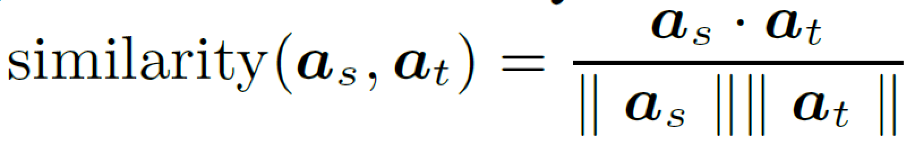
API Sequence Alignment
Build pairs of equivalent Java and C# API sequences according to their semantic vectors
For each Java API sequence, we select a equivalent C# API sequence as with the most similar vector representation
Similarity measure

Slide 14
Extracting General API Mappings
The aligned pairs of API sequences may be project-specific. However, automated code migration tools (e.g., Java2C#) require commonly used API mappings
We further summarize common mappings from the aligned pairs using Statistical Machine Translation (i.e., phrase-based model [Koehn et al., 2003])

Slide 15
Experiment
Dataset
Training: 9,880,169 <API sequence, description> pairs (5,271,526 Java 4,608,643 C#)
Test: 640 API Mapping Rules from Java2CSharp
Baselines
StaMiner [Tien et al. 2014]
TMAP [Pandita et al. 2015]
Metric
Precision, Recall, F-score

Slide 16
Experiment
Neural Network
Bi-GRU, 2 hidden layers, 1,000 hidden unites
Word Embedding: 120
Training Algorithm
Adadelta
Batch size: 200
Hardware:
Nvidia K20 GPU
Notes:
Q: Bi-GRU will affect API sequence? Why reverse API sequences? => we just use Bi-GRU for the query. For API sequence, we use traditional GRU.

Slide 17
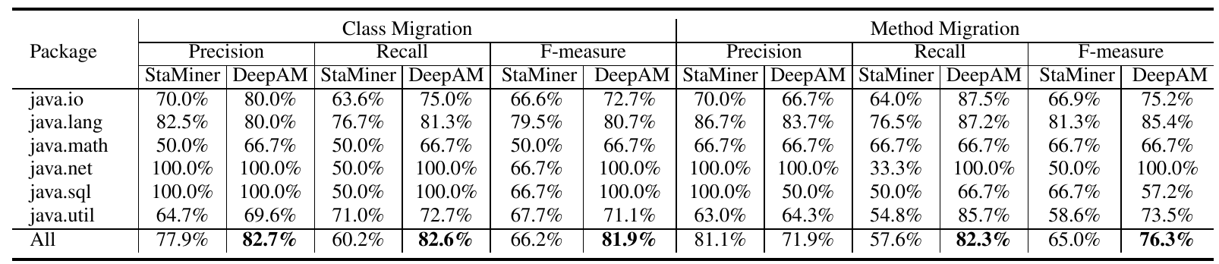
Results – Accuracy
Accuracy of 1-to-1 API mappings mined by DEEPAM and StaMiner (%)

Slide 18
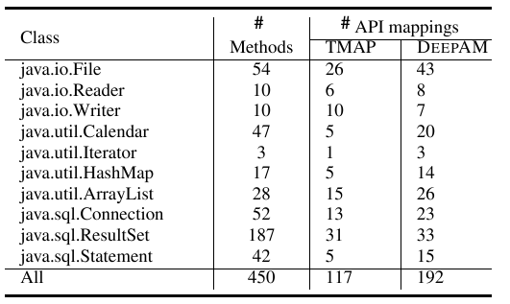
Results – Accuracy
Number of correct API mappings mined by DEEPAM and TMAP

Slide 19
Examples of Mined API Mappings
parse datetime from string
SimpleDateFormat.new SimpleDateFormat.parse | DateTimeFormatInfo.new DateTime.parseExact DateTime.parse
open a url
URL.new URL.openConnection | WebRequest.create Uri.new HttpWebRequest.getRequestStream
get files in folder
File.new File.list File.new File.isDirectory | DirectoryInfo.new DirectoryInfo.getDirectories
create a directory
File.new File.exists File.createNewFile | FileInfo.new Directory.exists Directory.createDirectory

Slide 20
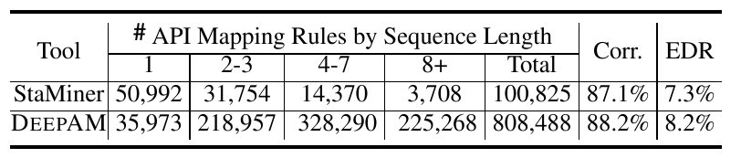
Results – Scale
Number of API Mappings Mined by DEEPAM and StaMiner

Slide 21
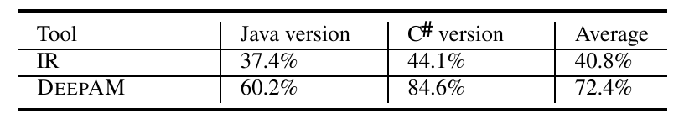
Results – Effectiveness of API Sequence Embedding
Accuracy of API pair alignment by DEEPAM and IR-based technique

Slide 22
Conclusion
Multimodal Sequence-to-sequence learning to migrate APIs
Jointly embedding source and target API sequences to the same NL space
Aligning equivalent API sequences with vector similarities
Future Work
Extend to more language pairs
Consider more complicated API mappings, e.g., structures.

Slide 23
Thanks！

