Slide 1
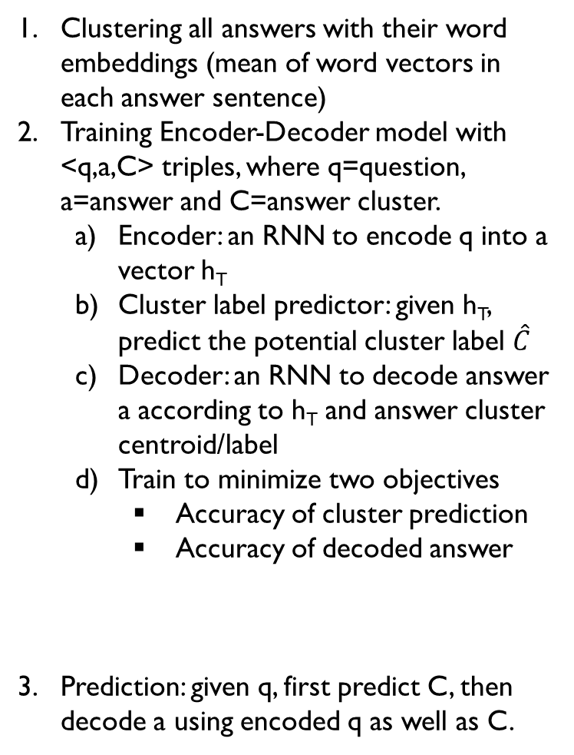




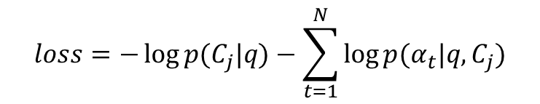

Clustering all answers with their word embeddings (mean of word vectors in each answer sentence)
Training Encoder-Decoder model with <q,a,C> triples, where q=question, a=answer and C=answer cluster.
Encoder: an RNN to encode q into a vector h_{T}
Cluster label predictor: given h_{T}, predict the potential cluster label $\hat{C}$
Decoder: an RNN to decode answer a according to h_{T} and answer cluster centroid/label
Train to minimize two objectives
Accuracy of cluster prediction
Accuracy of decoded answer
Prediction: given q, first predict C, then decode a using encoded q as well as C.
Encoder
Decoder
$$q=[w_{1},…,w_{T}]$$
$$a=[α_{1},…,α_{T}]$$
h_{T}
…
S_{t-1}
S_{t}
…
$$[α_{t−1};\hat{C}]$$
$$p\left(C_{j} | q\right)={softmax(h}_{T}W)$$
$$\hat{C}$$
$$loss=−\log{p(C_{j}|q)}−\sum_{t=1}^{N}{\log{p(α_{t}|q,C_{j})}}$$
Answer Centroids
Deep Metric Learning

