Slide 1
R-Seq2Seq: Relational Sequence to Sequence Learning for Question Answering
Xiaodong Gu
2017.08.30

Slide 2
Quick Summary of Internship
2 Implementations
Chatbot-retrieval [keras]
Variational Seq2Seq [pytorch]
3 ideas
DivQA (failed)
Relational Seq2Seq (ongoing)
Conditional Seq2Seq (ongoing by UROP)

Slide 3
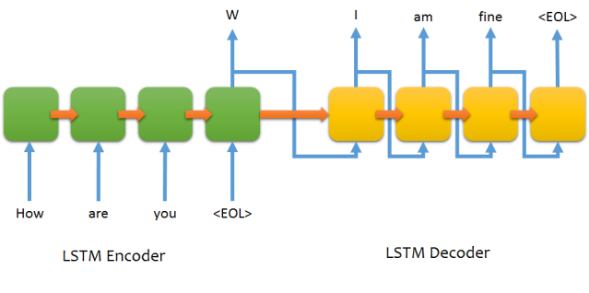
Sequence to Sequence Learning

Slide 4
Consider Relations between Q and A
question
answer
What’s the weather tomorrow?
Good
I don’t know
How are you?
Why not ask John?
What’s the weather tomorrow?
What’s the weather tomorrow?
Good
Good
I don’t know
I don’t know
Why not ask John
Why not ask John
How are you?
How are you?

Slide 5
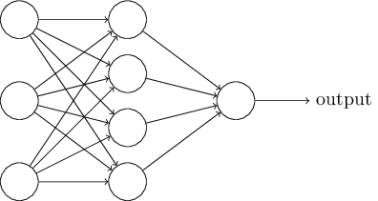
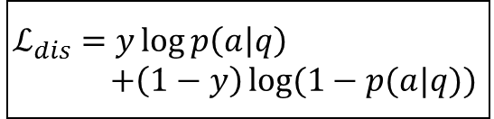




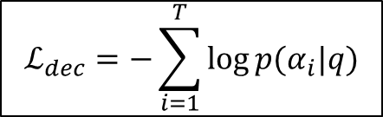
Proposed Model
Encoder
$$q=[w_{1},…,w_{T}]$$
$$a=[α_{1},…,α_{T}]$$
$$\tilde{a}=[α_{1},…,α_{T}]$$
p(q,a)
Discriminator
Decoder
$$ℒ_{dis}=y\log{p\left(a | q\right)}$$
$$+\left(1−y\right)\log{(1−p(a|q))}$$
$$ℒ_{dec}=−\sum_{i=1}^{T}{\log{p(α_{i}|q)}}$$
$$ℒ={(1−λ)ℒ}_{dec}+λℒ_{dis}$$

Slide 6
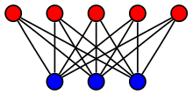
Relation Summarization
questions
answers
Encoder
Question Vectors
Answer Vectors
0.3
0.2
0.7
Q-A relations

Slide 7
Answer Sampling
Answers
Question

Slide 8
Datasets
Opensub
Ubuntu Dialog Corpus
Cornell Movie Dialogs Corpus
Twitter Chat log

Slide 9

Training
Optimizers:
Embedder: Adam
Encoder: Adam
Discriminator: Adadelta
Decoder: Adam
Hyper Parameters
Batch Size: 128
$λ$: 0.9
RNN Hidden Size: 512
Word Embedding Size: 100
Learning rate=0.001

Slide 10
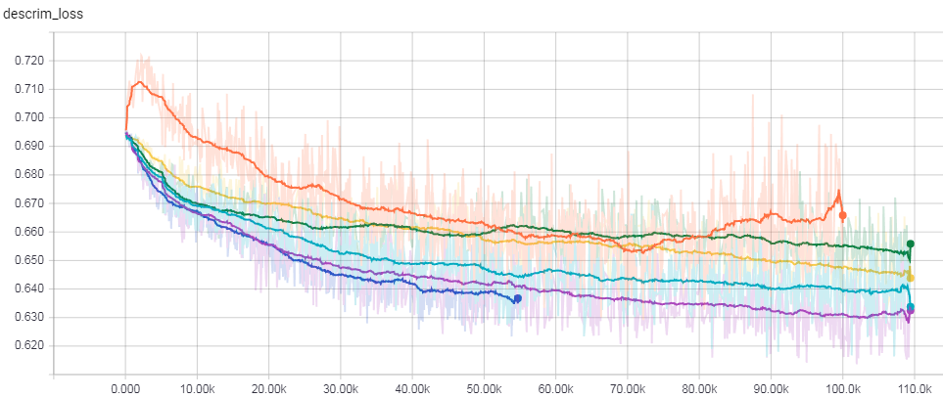

Training
Optimizer=adam
RNN hid size=1024
default
2-layer highway
Batch size=256
$$λ=0.95$$

Slide 11
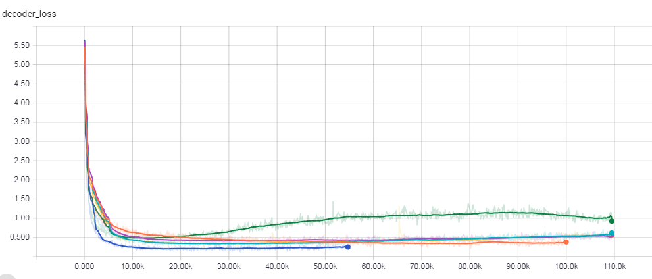
Training

Slide 12
Training – Clustering
Cluster Table
ID | Center Vector | instances
0 | [0.1,0.5,…0.8] | 33,58,99
1
…
n
ID | Center Vector | instances
0 | [0.8,0.5,…0.7] | 12,45,27
1 |  | 55,1004
…
n
Minibatch K-Means
N_clusters: 10000
batch_size: 10001
Question Clusters
Answer Clusters
Instance Table
ID | Vector | clus
0 | [0.2,0.5,…0.8] | 0
1 |  | 12
…
n
ID | Vector | clus
0 | [0.1,0.4,…0.8] | 11
1 |  | 7
…
n
Prob
0.23
0.45
…
0.77
Relation Table
Q_clus | A_clus | Prob
0 | 15 | 0.9
0 | 21 | 0.75
0 | 53 | 0.6
1 | ..
1 | ..
1 | …
…
Questions
Answers
probs
Q-A relations

Slide 13
Challenges & Future Plan
Think of better loss term for Discriminator Training
Try to separate decoder (store the encoded vector for each answer)
Introduce Random Noise to the Decoder (Variational Auto-Encoder)
Applying to Source Code (API sequence) Generation

Slide 14
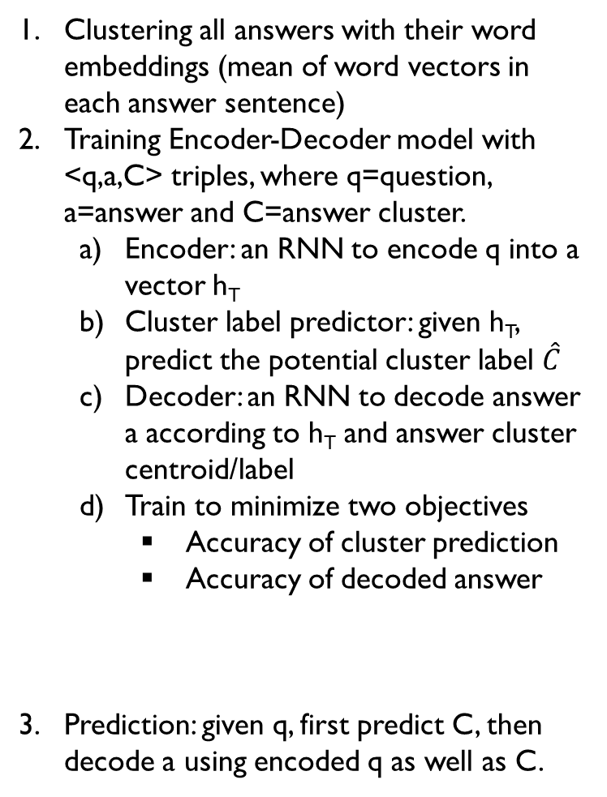




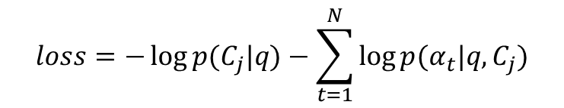

Conditional Sequence to Sequence
Clustering all answers with their word embeddings (mean of word vectors in each answer sentence)
Training Encoder-Decoder model with <q,a,C> triples, where q=question, a=answer and C=answer cluster.
Encoder: an RNN to encode q into a vector h_{T}
Cluster label predictor: given h_{T}, predict the potential cluster label $\hat{C}$
Decoder: an RNN to decode answer a according to h_{T} and answer cluster centroid/label
Train to minimize two objectives
Accuracy of cluster prediction
Accuracy of decoded answer
Prediction: given q, first predict C, then decode a using encoded q as well as C.
Encoder
Decoder
$$q=[w_{1},…,w_{T}]$$
$$a=[α_{1},…,α_{T}]$$
h_{T}
…
S_{t-1}
S_{t}
…
$$[α_{t−1};\hat{C}]$$
$$p\left(C_{j} | q\right)={softmax(h}_{T}W)$$
$$\hat{C}$$
$$loss=−\log{p(C_{j}|q)}−\sum_{t=1}^{N}{\log{p(α_{t}|q,C_{j})}}$$
Answer Centroids
Deep Metric Learning

Slide 15
Q & A

