Slide 1

Self-Supervised Query Reformulation for Code Search
Yuetian Mao¹, Chengcheng Wan², Yuze Jiang¹, Xiaodong Gu¹
¹School of Software, Shanghai Jiao Tong University
²Software Engineering Institute, East China Normal University
Notes:
Hello everyone, My name is XiaoDong Gu, from Shanghai Jiao Tong University. Today I am gonna present our work “Self-Supervised Query Reformulation for Code Search”
目前测试时长：13分钟

Slide 2




Outline
Background
SSQR
Evaluation
Summary
Notes:
I’ll first introduce the background.

Slide 3





Code Search
Search through a vast repository of source code
An essential step in software development
Query
Code
19%
how to sort arrays?
public void sort(int[] para) {
int ret = Array.sort(para);
}
Search Engine
Developers spend 19% of time on code search
Code Corpus
Indexing/Training
GitHub
Notes:
In the past decades, code search has been an indispensable activity throughout the software development process.
A previous study has shown that developers spend 19% of time on code search.
在过去的数十年间，涌现出了大量的开发框架和API库，代码复用成了软件开发过程中必不可少的步骤。然而面对海量的代码库，开发者往往需要使用代码搜索引擎来找到需要的信息。因此，如何快速地搜索到目标代码已经成为影响软件开发效率的重要问题。

Slide 4
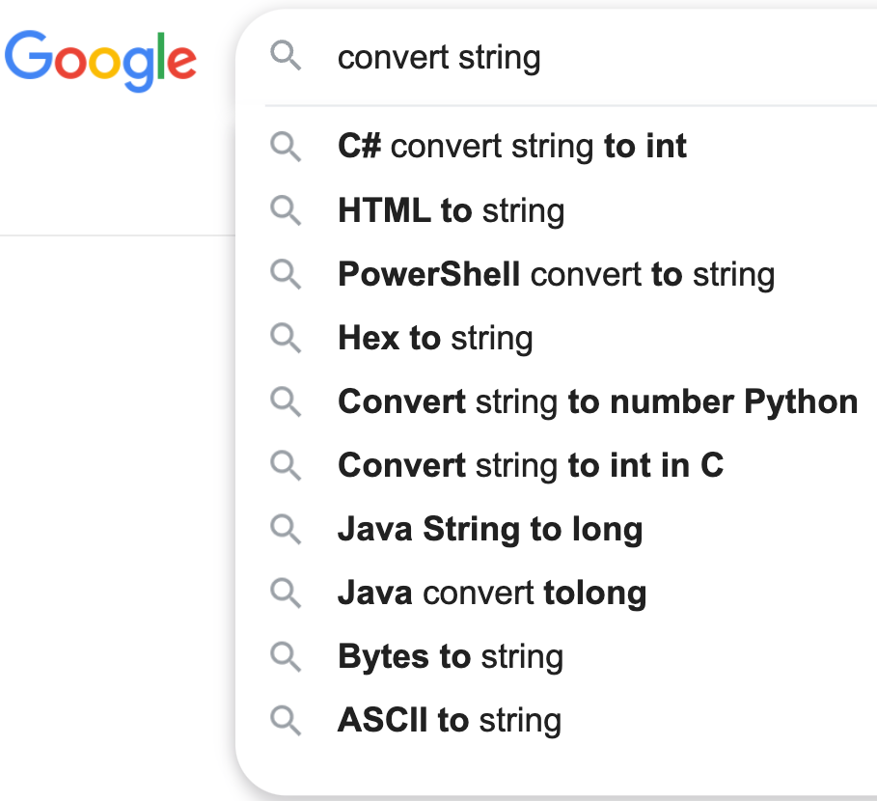

On the Ambiguity of Code Queries
24%
24% queries in Stack Overflow have undergone reformulation
Notes:
One of the challenges for acquire reliable results is how to write precise and comprehensive code queries.
Studies have shown that in Stack Overflow, approximately 24.62% of queries on Stack Overflow have undergone reformulation.

Slide 5



Query Reformulation
Rephrase a code query into a more comprehensive alternative
83%
Query Expansion
Convert Integer to String
in JAVA
Query Revision
Sort an array in desk desc order
13%
Query Pruning
Create a hashmap named hmap
4%
Notes:
So query reformulation has been an cricital research topic. Query reformulation aims to rephrase a code query into a more comprehensive alternative. Typically, there are three types of reformulation.
Query expansion. It will add more content, such as synonyms and related entities, to reduce ambiguity. For example, appending “in java” to query “convert integer to String”.
Query revision. It will replace the incorrect spellings or rare words, such that the query could match more results.
Query pruning. It will remove ambiguous or overly specialized phrases, to reduce interference. For example, we do not care variable name when searching how to create a hashmap.
We conduct an empirical study on CodeSearchNet dataset, and find more than 80% query reformulations are expansion, which means adding extra keywords into original query. Therefore, our study will focus on query expansion.
接下来通过具体例子说明语句重构大约是怎样的任务。语句重构一般可以根据对原始语句所做的变化分为三类，第一类是语句扩展，也就是将更多的内容，例如同义词和共现词，加入原始语句，令语句变得更具体。比如“将整数转换为字符串”和“用java语言将整数转换为字符串”
第二类是语句修改，一般是将原始语句中的错别字或生僻字换成正确的、常见的关键词。比如把拼写错误的“倒序”修改正确
第三类是语句删减，一般是将原始语句中模棱两可或过于特化的表达删去，提高语句清晰度。比如“创建名叫hmap的哈希图”和“创建哈希图”
我们针对代码搜索领域常用的公开大型数据集：CodeSearchNet进行了经验研究分析。我们发现超过80%的变换都为扩展，即需要将额外的关键词添加到原始语句中。

Slide 6

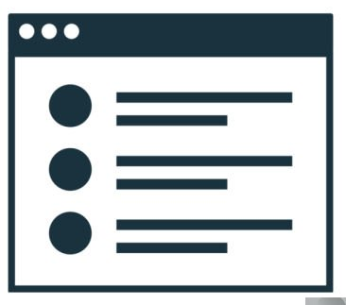

Existing Works
Knowledge-Based Approach
Feedback-Based Approach
Deep Learning-Based Approach
convert int …
convert int to str
convert int to str
Look up a dictionary
seq2seq
Search Engine
convert int
search
results
feedback
convert integer .
Rely on large parallel queries which is invisible to other researchers
Word-level expansion
Too expensive to maintain the knowledge base
Fail to capture semantic correlation of queries
Reformulations may not reflect user’s intent
Notes:
There are three types of query reformulation techniques.
The knowledge-based approaches aim to expand or revise the initial query based on external knowledge such as WordNet. However, they fail to capture semantic correlation of queries. It is also too expensive to maintain the knowledge base.
Feedback-based approaches identify the possible intentions of the user from the initial search results and use them to update the original query. They also fail to caputre sematic correlations. In addition, the reformulated queries are likely not reflecting user intention.
Recently, deep learning has advanced query reformulation significantly. But they rely on high quality query-pair dataset, which is not available to researchers.
.
现有的代码搜索语句重构方法主要可以分为三类，
第一种是基于知识的语句重构方法，它利用词库和知识图谱等外部知识，为原始语句中的关键词找到近义词和相关词等，并用这些词重构语句。这类方法的缺点是，对于找到的这些词，仅仅利用了统计学上的共现关系，却没有评估其与原始语句的语义相关性，而且词库的构建及维护成本非常高昂。
第二种是基于反馈的语句重构方法，它将原始语句的搜索结果视为一种反馈，并从这些搜索结果中利用TF-IDF等权重评估算法找到一些重要的关键词用于重构语句，这类方法的缺点是，基于初始不完整语句的搜索结果并不一定与原始语句，或者说用户意图相关，而且找到的关键词也没有在语义上评估它与原始语句的相关性。
第三种是基于深度学习的语句重构方法，它们一般将语句重构任务视为机器翻译任务，直接利用成对的重构前后语句训练出序列到序列模型。虽然这类方法的性能一般要比前两种方法好，但是它最大的缺点是平行语料的数据集极其匮乏，至今没有公开的大规模数据集。

Slide 7

Existing Work
Knowledge-Based Approach
Fail to capture semantic correlation of queries
Too expensive to maintain the knowledge base
Our goal: A self-supervised query reformulation method that does not rely on any parallel queries while achieving competitive performance to supervised approaches
Feedback-Based Approach
Fail to capture semantic correlation of queries
Reformulated queries do not reflect user intention
Deep-Learning-Based Approach
Rely on high quality query-pair dataset
Notes:
Therefore, we aim to propose a self-supervised query reformulation method that achieves competitive performance to the state-of-the-art supervised approaches.
基于当前各类研究的缺点，我们的研究目标是：提出一种基于自监督学习的代码搜索语句的自动重构技术，性能媲美甚至超越有监督的语句重构技术。

Slide 8
Outline
Background
SSQR
Evaluation
Summary
Notes:
Next, I’ll introduce our self-supervised solution SSQR, which primely focus on query expansion
.

Slide 9
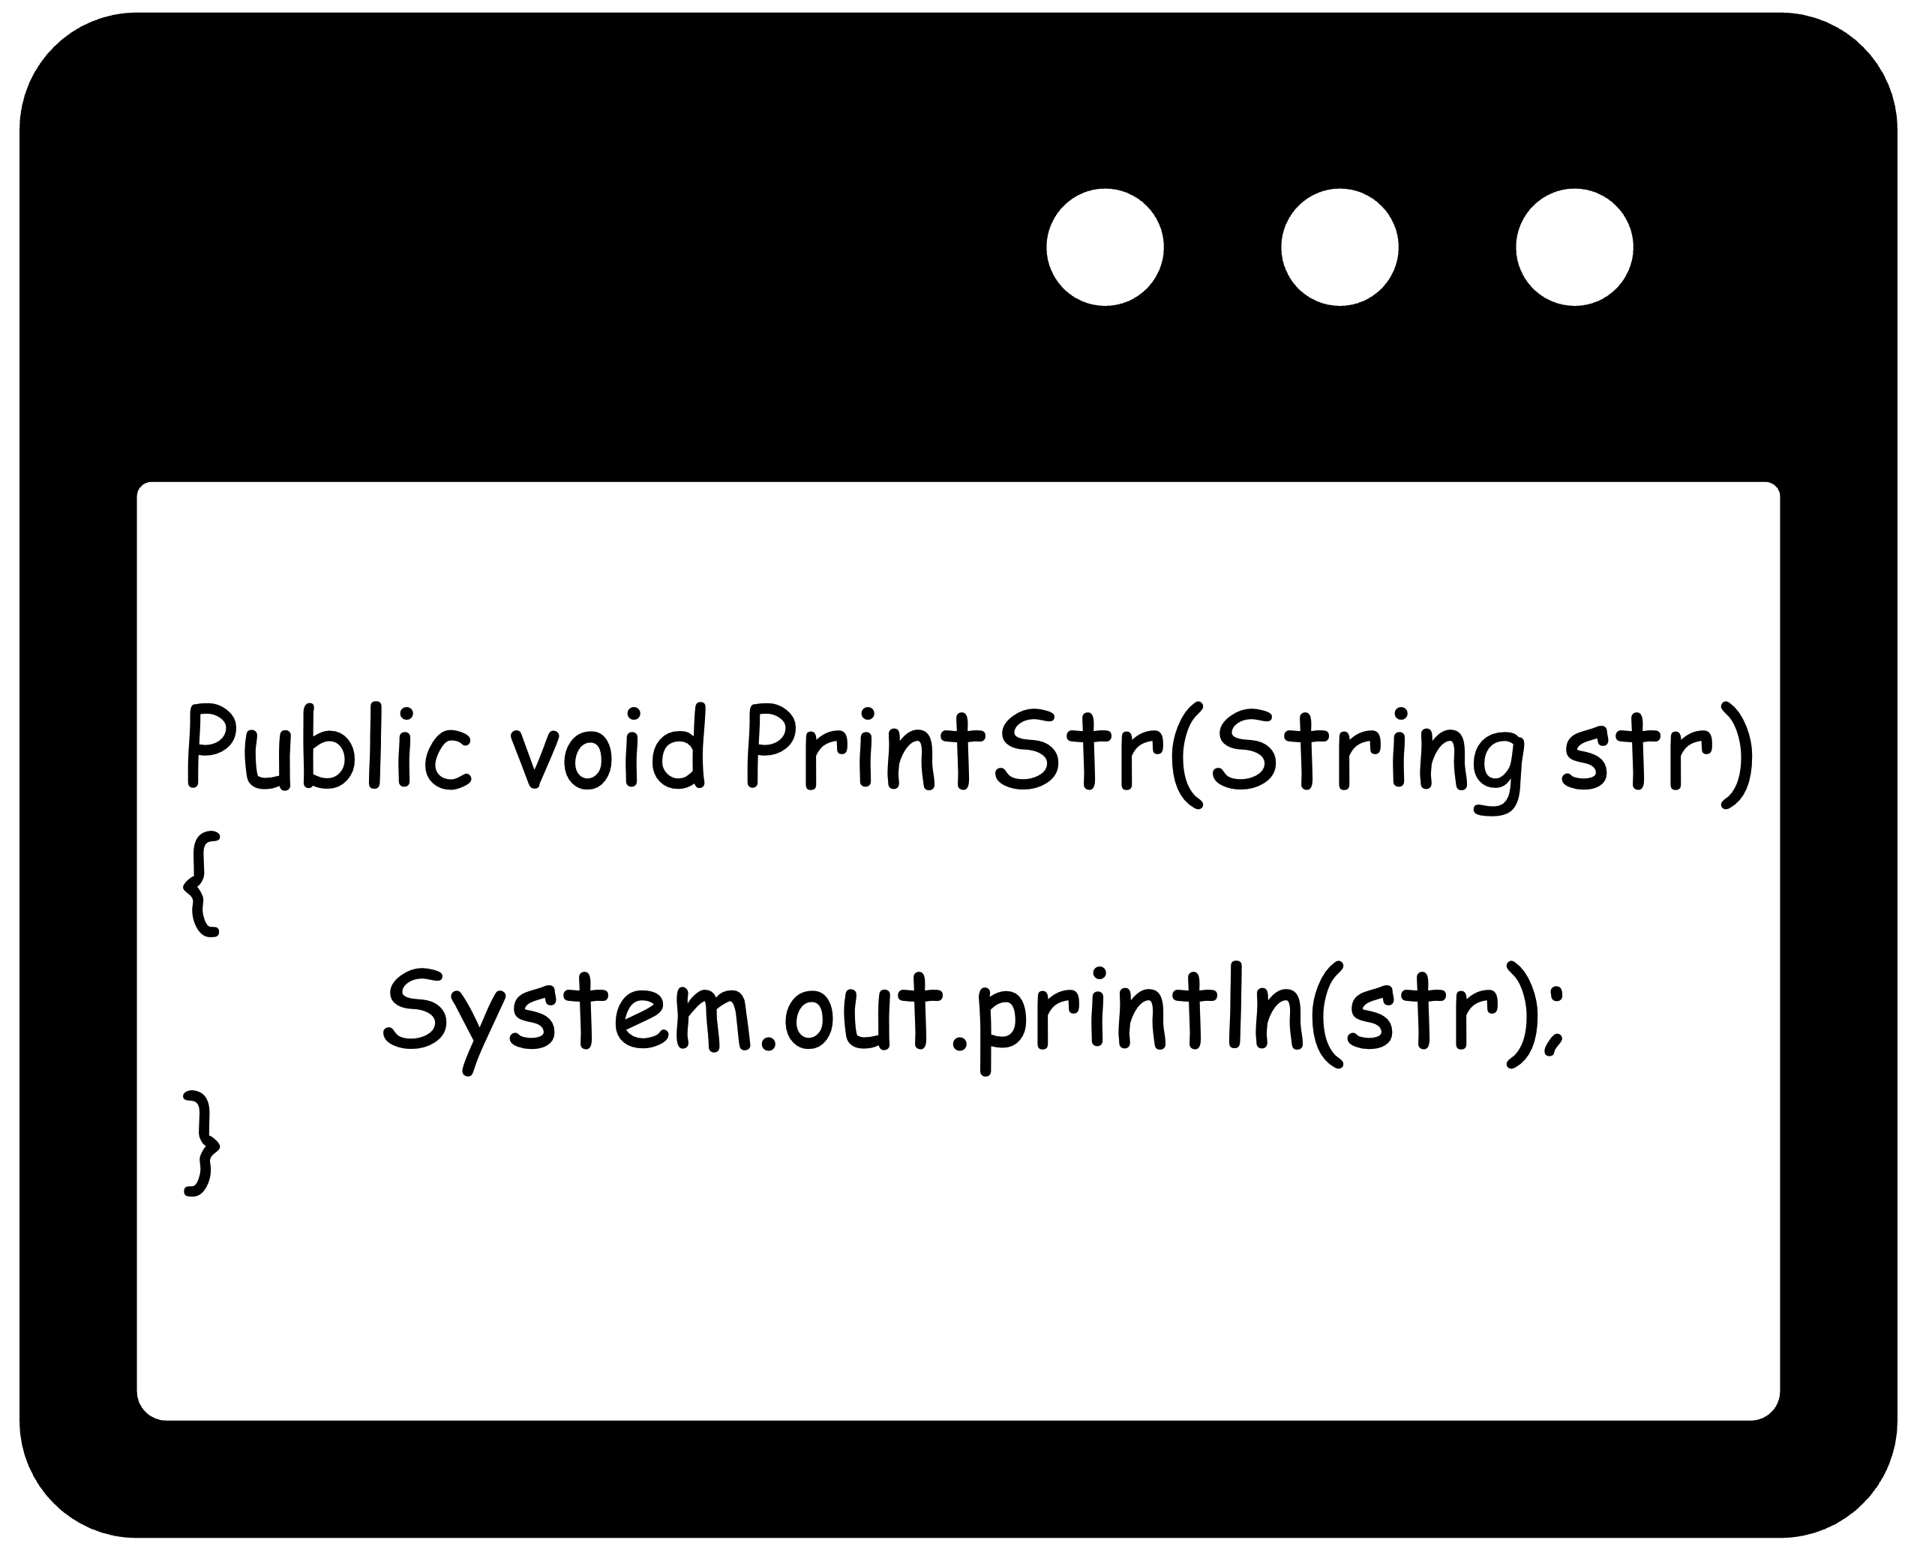




SSQR: Self-Supervised Query Reformulation
1. Pre-train T5
offline
Search Results
?
4.Code Search
x _ x x x
Reformulated Query
Code Query
Corpus
Pre-training
(Corrupted Query Completion)
“print string in console”
T5
3. Select Expansion Position
Incomplete Queries
Expanded Queries
Initial Query
“<MASK> print string”
“android print string”
…
IG=-1.2
“print string”
“print <MASK> string”
“print Java string”
…
IG=-0.3
“print string <MASK>”
“print string in console”
IG=-0.1
T5
…
2. Expand Candidate Spans
Notes:
This figure shows the overall workflow of SSQR. It involves two main phases: an offline pre-training phase and an online expansion phase. During the pre-training phase, SSQR continually pre-trains a language model with a newly designed corrupted query completion task. During the runtime of SSQR, when a user presents a query for code search, SSQR employs a two-step process for query expansion. It enumerates candidate positions within the query and utilizes the pre-trained T5 model to generate content that fills these positions. It then selects the one that offer the highest information gain after the expansion. Finally, users conduct code search by selecting the most relevant reformulation that aligns with their intended query.
于是，基于上述思路和经验研究的结论，本文针对语句扩展这一代码搜索语句重构需求，基于预训练语言模型的深度学习方法，设计了一种先定位后扩展的语句重构方法，也就是将语句重构任务转化为预训练任务的形式，规避了微调阶段对大量成对有标签数据的依赖，高效地利用了预训练阶段学到的知识。SSQR的整个流程主要分为三个步骤，首先是基于缺失语句补全任务来模拟扩展任务，采用无标签的代码搜索语句数据集对T5模型进行继续预训练，让模型学习到代码搜索领域中通用的语法结构和语义信息。第二步是扩展位置预测，给定一句原始代码搜索语句，利用T5预测出最有可能存在信息缺失的位置作为候选语句，在此处插入MASK位。第三步则是再次利用T5为待扩展语句的MASK位填充上实际内容，完成语句扩展，最终即可用于代码搜索任务。
接下来我将详细介绍这三个步骤。

Slide 10
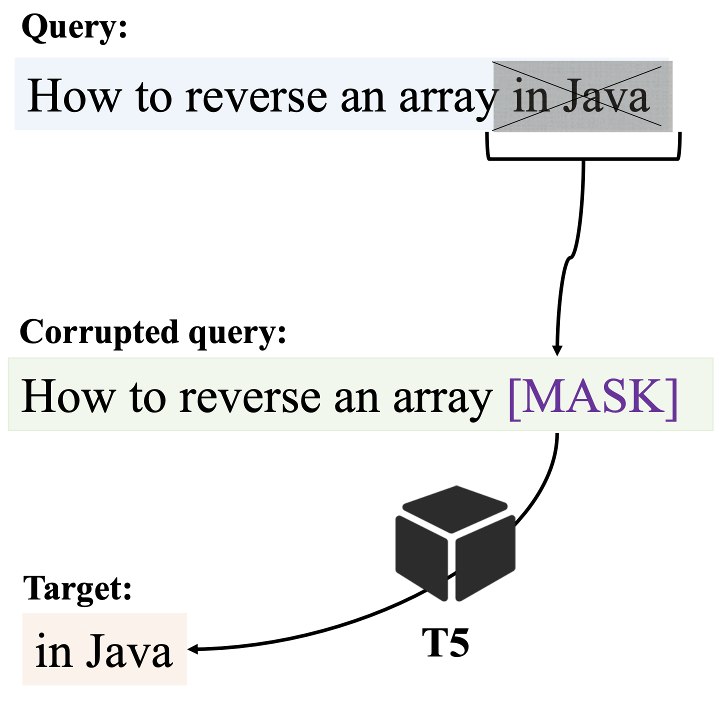
Step 1. Pre-Training Language Model
1. Pre-train T5
offline
?
x _ x x x
Code Query
Corpus
Pre-training
(Corrupted Query Completion)
corrupt
T5
Model:
T5
Pretraining Objective:
corrupted query completion (CQC)
completion
Notes:
Next, I’ll introduce SSQR step by step. Step 1. Pre-Training Language Model
We take the state-of-the-art T5 model as the backbone model since it is suitable for generative task, particularly masked span task, which is related to query expansion task.
To enable T5 to learn how to express a query more comprehensively, we design a new pre-training objective called corrupted query completion. Similar to the masked language modeling objective, it randomly masks a span of words in the query and asks the model to predict the masked span. The main difference is that here, one mask is associated to a sequence of tokens.
We use the teacher-forcing strategy and Code comments from CODEnn dataset for pre-training.
这里我们采用T5模型作为预训练语言模型，并在这个基础上进行微调。这主要出于两个原因：一方面它采用序列到序列的模型架构，天然适合处理生成式的任务；另一方面它擅长处理掩码任务，与搜索语句扩展相关。
为了使T5学会如何撰写一句内容完整、语义清晰的代码搜索语句，这里用到的预训练任务是缺失语句补全（CQC），它与掩码语言模型任务形式类似，不同的是，缺失语句补全任务中一个MASK位代表的是一连串单词，因为在补全信息时，我们并不知道具体应该加几个词，模型被要求还原出一个MASK位上的原始单词序列，还原的过程就与补全语句的任务形式十分类似了。
在训练过程中，我们采用teacher-forcing策略，并随机选择15%的连续单词进行打码，并要求T5进行补全。
在这一步中使用的数据集是来自CODEnn数据集中的代码注释。

Slide 11
Step 2. Expand Candidate Spans
Use the pretrained T5 to expand potential expansions
Incomplete Queries
Expanded Queries
Initial Query
“<MASK> print string”
“android print string”
“print string”
“print <MASK> string”
“print Java string”
“print string <MASK>”
“print string in console”
T5
Best First Search
Enumerate all possible expansion positions
Insert a <MASK> token
Ask T5 to perform CQC
Notes:
Finally, the pre-trained T5 model is leveraged to expand the top-k candidate expansion position by performing corrupted query completion task. In this example, SSQR reformulates the original query to “convert string to list in Java” and “convert string to integer list”.
这一步的任务形式完全契合T5在预训练阶段的任务形式，将上一步中得到的待填充语句输入T5，T5为其生成实际的填充内容，最后原始语句就被重构为了一条信息更为丰富的语句，可用于后续的代码搜索。
针对这两个拓展位置，我们将搜索语句拓展为“使用JAVA语言将字符串转换为列表”和“将字符串转换为整数列表”。

Slide 12

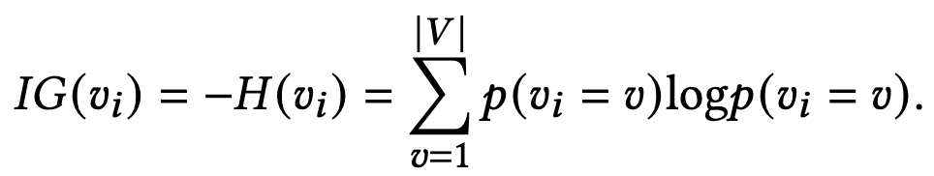
Step 3. Select Expansion Positions
Select positions that most likely miss information
Expanded Queries
Search Results
“android print string”
…
IG=-1.2
Reformulated Query
Code Search
“print Java string”
…
IG=-0.3
“print string in console”
“print string in console”
…
IG=-0.1
Selection Criteria
Information Gain: The negative entropy over the predicted probability distribution of the generated words
The lower the entropy, the higher confidence of the position
Notes:
Step 3. Select expansion positions
Given a query, SSQR tries to find the position that is most likely to contain missing information.

Slide 13
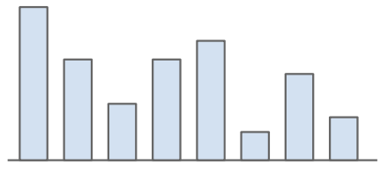
Step 3. Select Expansion Positions
Example
Candidate Position
convert string to list [MASK]
w₁
w₂
…
w_{n}
p(w₁)
p(w₂)
…
p(w_{n})
Reformulated Query
convert string to list
Information Gain
p(w_{i}) = T5 (query, ~w_{i})
IG(w_{i}) = -H(w_{i}) = ∑_{wi∈V} p(w_{i}) · log p(w_{i})
IG(s) = 1/n · ∑_{w~S} IG(w)
Notes:
Let’s look into the concrete example. For this candidate position, T5 model predicts the span and obtain the probability distribution of each word. We then get the information gain of one word by calculating negative entropy. Finally, their average value is the information gain of the entire span.
让我们进一步看一下信息熵的计算过程。对于这个拓展位置，T5模型尝试进行补全，生成了由n个单词的组成的填充内容。
对于每一个单词位置，T5模型都会预测词汇表中所有词汇的出现概率。我们使用这些概率来计算信息熵并取负数，从而获得T5对这个单词位的自信度。
而单词位自信度的平均值就是这个拓展位置的自信度。

Slide 14
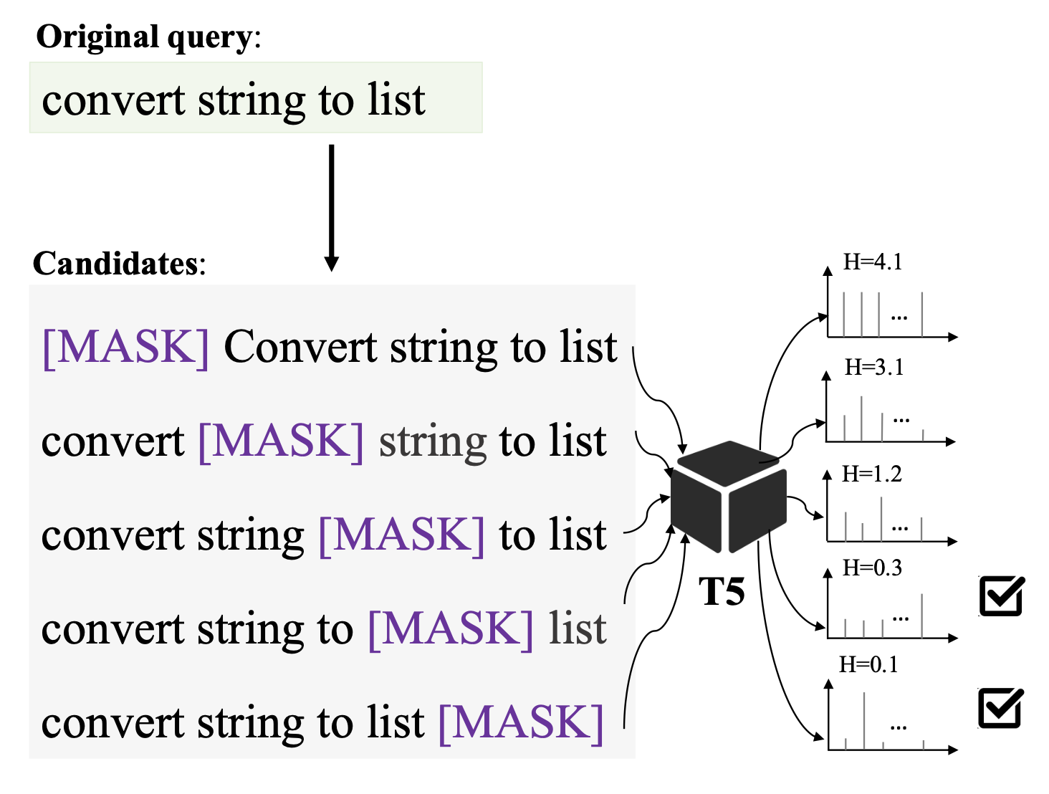
Step 3. Select Expansion Positions
Notes:
As shown in the right figure, a query with k words has k+1 candidate positions for expansion, but not all of them are necessary for expansion.
Hence, we must determine which positions are the most proper to be expanded. SSQR selects the top-k candidate queries that have the most missing information in the masked span.
We define information gain as the ranking criteria. It is the negative entropy over the predicted probability distribution of the generated words. Therefore, the lower the entropy, the higher confidence of the expand position.
在这一步中，采用的是最佳优先搜索策略，即枚举出所有可能的语句扩展位置，在其中分别插入MASK位形成待填充语句，再让模型为这些待填充位置计算出生成填充内容的词表概率分布，然后选取其中生成自信度最高的前k个位置作为实际扩展位置。
那么关键的问题是如何计算生成自信度，这里用到的衡量标准是信息熵，即取生成时在词表上的概率分布，基于此计算信息熵，如果信息熵越低，则意味着整个词表上少数几个单词的生成概率显著高于其他单词，所以对应的模型生成时的自信度越高。
右边这张图显示了一个具体的位置预测例子：这里的搜索语句是“将字符串转换为列表”，我们尝试在所有可能的位置增加拓展，也就这五个候选。在其中，最后两个位置拥有比较低的信息熵，于是我们将这两个位置传递到下一步

Slide 15
Outline
Background
SSQR
Evaluation
Summary
Notes:
Next, I’ll introduce our evaluation result.

Slide 16
Research Questions
RQ1: How effective is SSQR in query reformulation for code search?
RQ2: Whether the queries reformulated by SSQR are more contentful and easy to understand?
RQ3: How do different configurations impact the performance of SSQR?
Notes:
We evaluate SSQR by addressing the following three research questions:
1. How effective is SSQR in query reformulation for code search?
2. Whether the queries reformulated by SSQR are more contentful and easy to understand?
3. How do different configurations impact the performance of SSQR?

Slide 17
Experiment Settings
Dataset
Pretraining: CODEnn
Code search: CODEXGLUE
Baselines
SEQUER: the SOTA supervised learning approach
NLP2API: A feedback based approach using recommended APIs
LuSearch: A knowledge-based approach using synonyms in WordNet
GooglePS: The Google online query prediction service
Notes:
Experiment settings.
We pre-train T5 using code comments from the large-scale CODEnn dataset. We use the code search dataset CodeXGLUE to evaluate code search performance. These two datasets do not have overlaps.
We compare our method with the state-of-the-art query reformulation approaches, including: SEQUER, the SOTA supervised learning approach for query reformulation; NLP2API, a feedback based approach using recommended APIs; LuSearch, a knowledge-based approach using synonyms in WordNet; and GooglePS, the Google online query prediction service.
实验设置。在预训练阶段，我们采用的数据集为CODEnn，在代码搜索阶段，则采用CodeXGLUE代码搜索数据集来验证重构语句的效果，这两个数据集之间没有重合。
用于对比的基准方法有四种，SEQUER是当前最先进的有监督学习语句重构方法，也就是基于机器翻译序列到序列模型。NLP2API是一个基于反馈推荐API的语句扩展方法。LuSearch是一个基于知识的语句重构方法，为原始语句在WordNet中找到近义词。GooglePS是谷歌官方提供的搜索语句实时重构推荐服务。

Slide 18
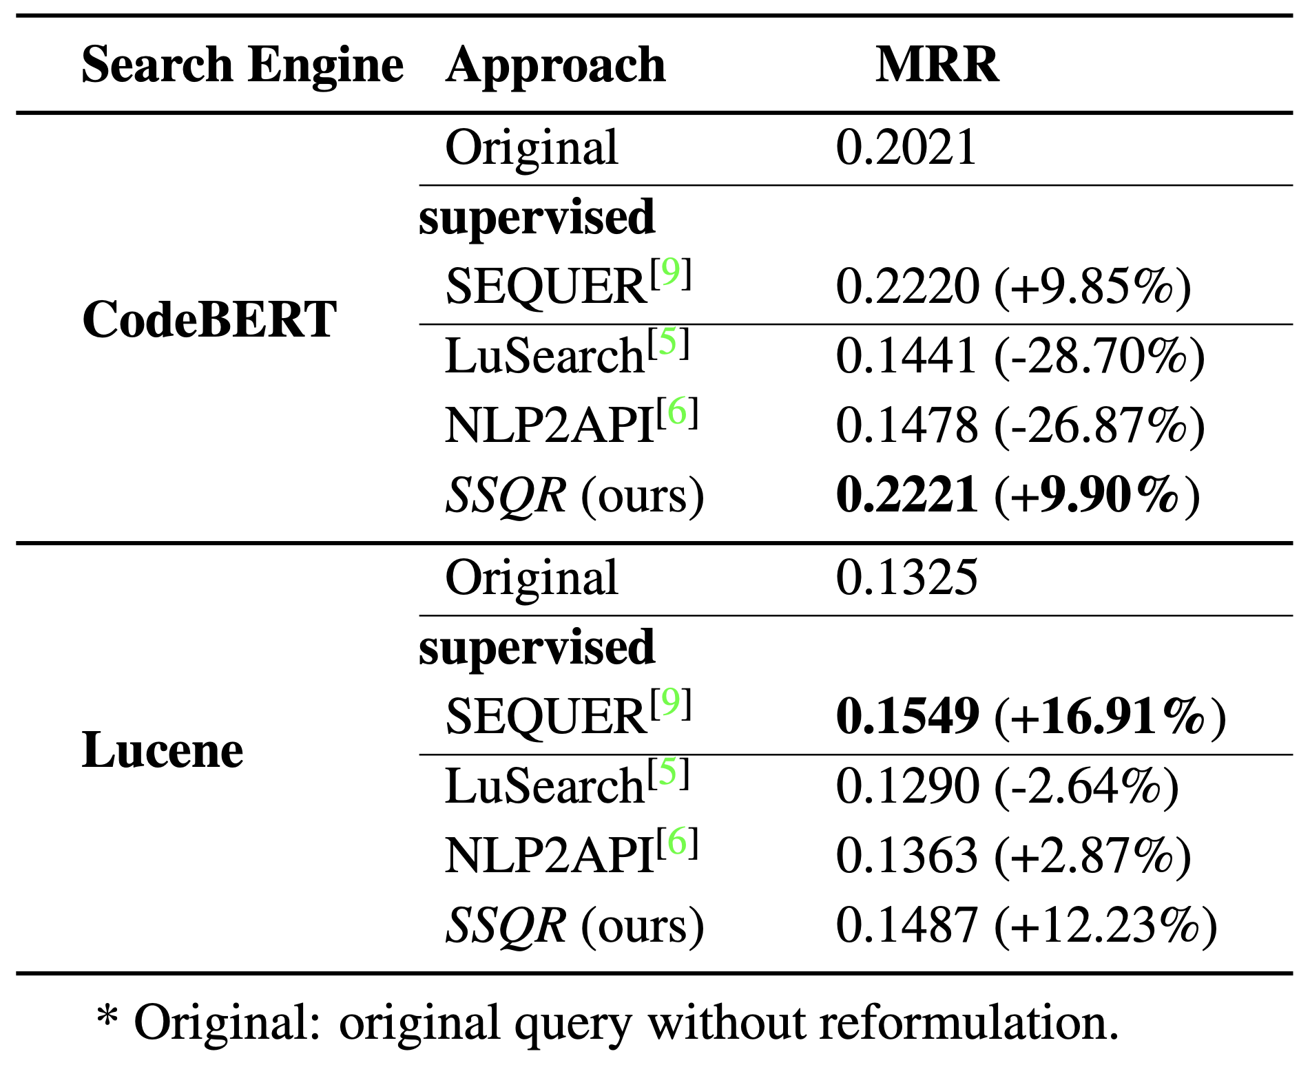
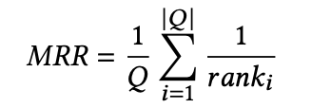

RQ1: Performance on Code Search
SSQR outperforms other unsupervised approaches, achieving competitive performance to supervised approaches
Notes:
As the ultimate goal of query reformulation, we evaluate whether the reformulated queries by SSQR lead to better code search performance. We experiment under two search engines and compare the improvement of mean reciprocal rank scores. As shown in the table, SSQR enhances the MRR by 9.90% and 12.23% on the two search engines, respectively. SSQR achieves competitive results to the supervised counterpart though it is not given with any labelled training data. This indicates that our self-supervised approach can assist developers to write high-quality queries, which ultimately leads to better code search results.
为了更好地评估各个方法的能力，我们把这些重构后的语句发送到代码搜索引擎，评估它们的检索效果。
在代码搜索实验中，我们对比了经各种基准方法重构后的代码搜索语句实，际用于代码搜索时的效果，这里用到的评估指标是MRR，也就是平均倒数排名（mean reciprocal rank），来检验预期搜索结果的排名是否靠前。这里同时用到了两种搜索引擎，CodeBERT和Lucene来执行代码搜索工作。从实验结果上可以看到，我们的SSQR在两种搜索引擎上的性能都大幅超越了以NLP2API和LuSearch为代表的基于知识和基于反馈的方法，并媲美最先进的有监督方法SEQUER。
尽管在个别情况中，SSQR的语句重构性能略低于SEQUER，但 SEQUER 依赖于一个闭源的平行搜索语句数据集。相比之下是SSQR不需要收集用户真实语句重构行为，仅需要利用 Github 等中 的庞大代码库，从中获取更多的代码注释 。我们提供了一种可行的、 廉价的替代方法。

Slide 19
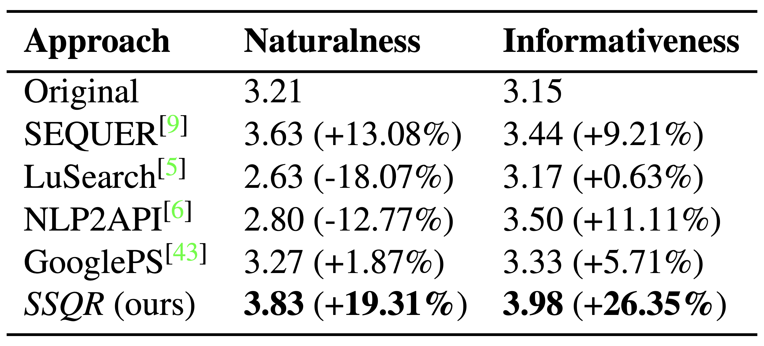
RQ2: Qualitative Evaluation
SSQR improves 26% informativeness and 19% naturalness.
Notes:
To evaluate the intrinsic quality of the reformulated queries, we perform an user study with programmers. We invite four developers with more than 4 years coding experiences. They are given 100 search queries and are required to score the informativeness and naturalness of reformulated queries, on a scale of 1 to 5. As shown in the table, SSQR outperforms the baselines. It achieves 19% improvement of naturalness and 26% of informativeness.
除了客观指标，我们也进行了人工评估实验，收集开发者的使用体验。我们邀请了四位开发经验超过四年的参与者，直接对经过各种重构方法重构后的语句本身的质量进行评估，要求他们对一百句搜索语句的语句流畅度和信息丰富度分别进行打分，分数为取值都为1到5之间的整数。从这张表格中可以看到，经过SSQR重构后的语句在两个指标上都取得了最好的效果，相比于原始语句在信息丰富度和语句流畅度上分别取得了26%和19%的提升。

Slide 20
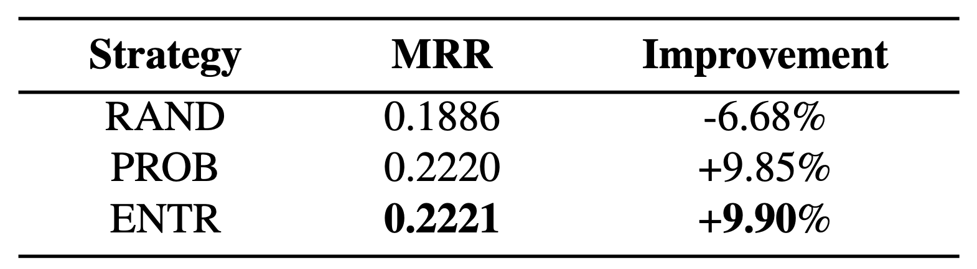
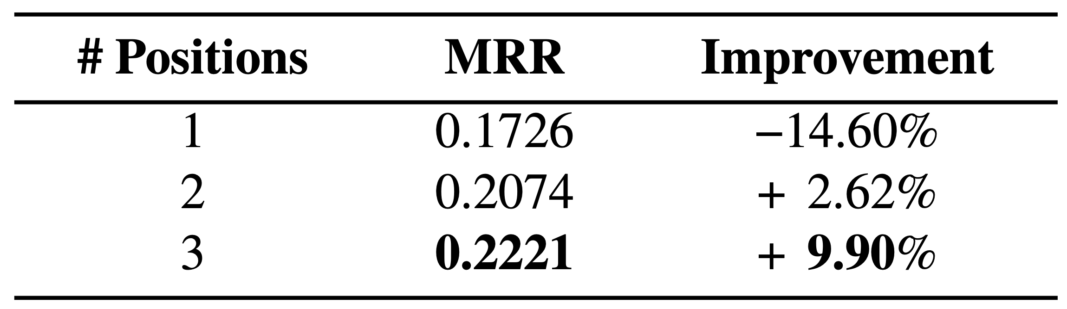
RQ3: Performance under Different Configurations
SSQR under Different Positioning Strategies
Positioning Strategy
Selecting the top-k positions with entropy (ENTR) achieves highest performance
Candidate Position Numbers
Three candidates are sufficient for most code search queries.
SSQR under Different Candidate Position Numbers
Notes:
We also evaluate the performance of SSQR in code search under different configurations. We vary the positioning strategy and the number of candidate positions in order to search for the optimal configuration.
For the positioning strategy, selecting the top-k positions with entropy (ENTR) achieves highest performance. This indicates that information gain correctly quantify the missing information at various positions.
For the candidate position numbers, three candidates are sufficient for most code search queries. A larger number of candidate positions can hit more user intents and hence leads to better search accuracy.
我们接着进行了消融实验。
我们探究了基于信息熵的位置选择策略对于语句重构效果的影响，实验发现，相较于随机选择策略和基于词表最大生成概率的选择策略，我们的基于生成时的信息熵选择扩展位置策略可以获得最好的重构效果。
我们也探究了选择前k个扩展位置中k的数量选择为多少时能覆盖大多数的用户搜索意图，从而达到最佳的代码搜索效果。结果表明，当候选位置数量设置为3时，就足以扩展大多数代码搜索语句。

Slide 21
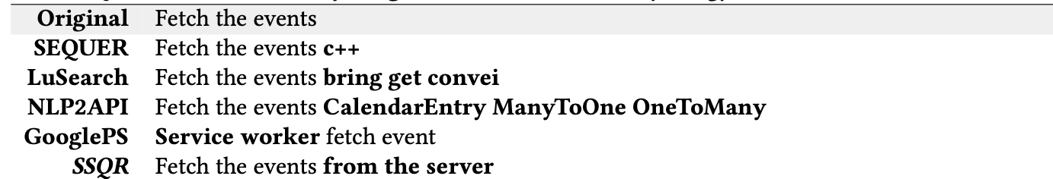
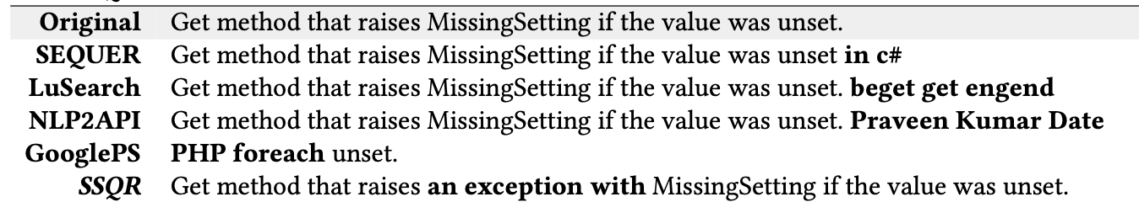
Case Study
Notes:
Now let’s see some case studies.
In the first case, we have a query“fetch the events”to be expanded. As can be seen, the first three baseline methods fail to provide meaningful expansion: SEQUER adds programming language information, which is less related; the other two baselines only provide unrelated information. Comparatively, GooglePS and our method adds useful information of server and worker, greatly improves the query informativeness.
In the second case, the original query is a long sentence describing exceptions. Again, all baselines fail to insert meaningful information. GooglePS even provides completely wrong result. In contrast, our SSQR successfully expands query and adds keyword “exception”, further increasing the probability of retrieving the correct result without changing the query semantics.
我们首先展示几个搜索语句重构的样例。
这里的原始语句是“获取事件”，前三个基准方法都没能给出有意义的拓展：SEQUER补充了价值不大的编程语言信息，而LuSearch和NLP2API提供的信息与原始语句无关。相应的，GooglePS服务和我们的方法从不同角度为搜索语句增加了服务器的信息，从而丰富了搜索语料。
这是另一个例子，原始搜索语句是“如果某个值未被设置，抛出MIssingSetting”。在这个例子中，在前三个基准方法仍旧表现不佳的同时，GooglePS服务也未能完成任务，这可能是由复杂长句造成的。形成对比的是，我们的SSQR再一次成功补全了信息，将异常这个关键词加入了搜索语句，在不改变语义的同时，进一步增加了检索到正确结果的概率。

Slide 22
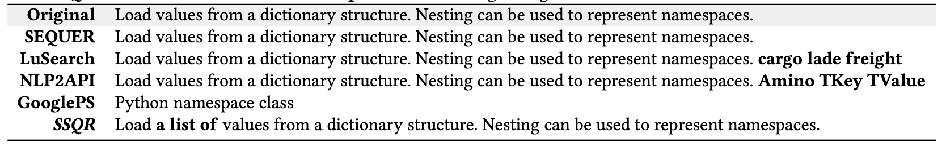
Case Study
Notes:
在这个例子中，输入的语句是“从字典结构中加载数值。同时使用嵌套来代表命名空间”。基准方法再一次无法重构长句，而我们的方法找到了一个扩展位置，强调了从字典结构中获得的数值要保存在列表中。这些例子都表明，SSQR采用的信息熵和拓展位置预测方法，可以在各类场景中有效地补全查询语句中遗漏的信息

Slide 23
Outline
Background
SSQR
Evaluation
Summary

Slide 24




Summary
SSQR: A self-supervised query reformulation for code search
Open Source: https://github.com/RedSmallPanda/SSQR
Achieve comparable performance to SOTA supervised approach
Notes:
In summary, we propose SSQR, a self-supervised query reformulation method for code search without the availability of parallel queries.
SSQR automatically acquires the supervision of query expansion through self-supervised training on a large-scale corpus of code comments.
The evaluation result shows that SSQR achieves comparable performance as SOTA supervised approach.
We have also open-sourced our tool in GitHub.
我们研究了代码搜索领域的搜索语句重构技术，帮助开发者修改代码查询语句，来从海量的代码数据中找到最符合要求的代码片段。
我们提出了自监督代码搜索语句重构技术SSQR，它使用代码大模型理解查询意义，并将语句重构视为缺失语句补全任务，使用信息熵对重构语句进行排序。同时，它的训练数据不需要进行标注，因此可以低成本地进行扩大训练数据，从而应用在更丰富的场景中。
实验评估表明，它的性能接近最佳的有监督方法，满足开发者的搜索需求。
这里是我们的工具开源地址，欢迎大家和我们一起解决代码搜索的问题。

Slide 25
Thank You!
Q&A
Notes:
That’s all of my presentations. Thanks for listening and welcome to ask any questions.

