Slide 1






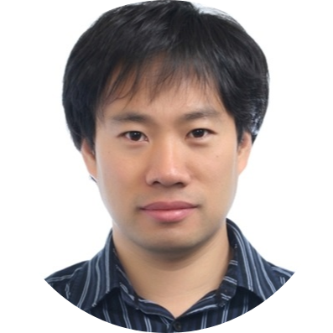
CodeKernel: A Graph Kernel Based Approach to the Selection of API Usage Examples
Xiaodong Gu
Hongyu Zhang
Sunghun Kim
Notes:
Hi, my name is Xiaodong Gu. From Hong Kong UST, the paper I am gonna present is CodeKernel: A graph kernel based approach to the selection of API usage examples. This is also a collaboration work with Hongyu Zhang from the university of NewCastle and Sung Kim from Naver Corporation.

Slide 2



Programming by Examples
void read(String fname) {
new FileReader(fname).
read(); //
}
Notes:
As we know programming is sometimes hard, because developers often need to learn the usages about programming libraries. So it would be very helpful if we can provide them with intuitive and comprehensive API examples.

Slide 3
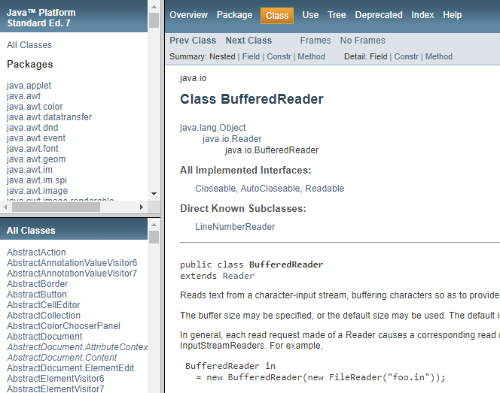

Obtaining API Examples
API Documentations
Manually Written!
Too simple or incomplete
Notes:
So, how do developers obtain API examples? The first option can be the API documentation. But, these documentations are usually manually written. They are often too simple or incomplete due to the large amount of human resources required.

Slide 4





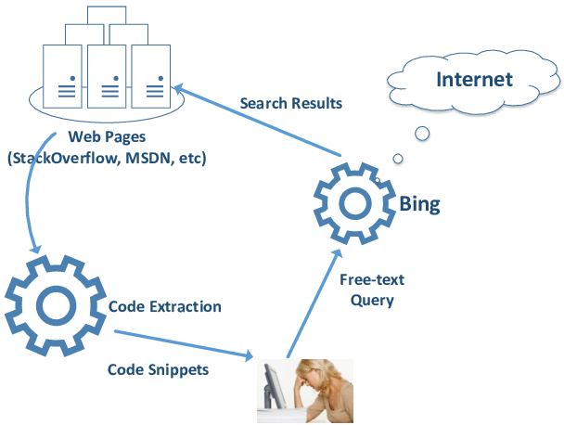
Mining for Sample Code
A General Recipe
– cluster similar code snippets and select the most representative of each cluster.
void read(String fname) {
new FileReader(fname).
read();
}
FileReader.read
Internet
③ Selection/Synthesis
void foo ()
{
a = map();
a.put(‘’”);
}
void read ()
{
a = map();
a.put(‘’”);
}
void read ()
{
a = map();
a.put(1,‘’);
}
void foo ()
{
a = map();
a.put(‘’”);
}
void foo ()
{
a = map();
a.put(‘’”);
}
void read ()
{
a = list();
a.read();
}
void read ()
{
a = map();
a.put(‘’”);
}
void read ()
{
a = map();
a.put(‘’”);
}
① Gathering
② Clustering
void read ()
{
a= array();
a.add(‘’”);
}
void read ()
{
a = map();
a.put(‘’”);
}
void foo ()
{
a = map();
a.put(‘’”);
}
void foo ()
{
a = map();
a.put(‘’”);
}
void foo ()
{
a = map();
a.put(‘’”);
}
void foo ()
{
a = map();
a.put(‘’”);
}
void foo ()
{
a = list();
a.append(‘’);
}
void load ()
{
a= array();
a.load(1);
}
void read ()
{
a = map();
a.put(1,‘’);
}
Codebase
The key problem:
How to cluster similar code?
Notes:
So, mining code examples from big codebase in the internet has been a well-studied research.
A general recipe of such technique is: given an API query, we retrieve relevant code snippets, then we cluster the code snippets according to some similarity measures and eventually select the most representative of each cluster.
As we can see, the most challenging step here is how to cluster similar code snippets? So our focus in this paper is mainly on the code clustering techniques.

Slide 5
Code Clustering: Related Work
Category | Related Works
Clone-detection based approach | MUSE [Moreno et al. ICSE’15]
Extracting feature vectors | ExoaDocs [Kim et al. AAAI’10]
Similarity heuristics e.g., method call sequences | MAPO [Xie and Pei, MSR’06] UP-Miner [Wang et al. MSR’13]
Notes:
There have been many related works that are mainly designed for code clustering, including clone detection based approach, extracting feature vectors and clustering with similarity heuristics such as method call sequences.

Slide 6
Category1: Code Clustering by Clone Detection
MUSE [Moreno et al. ICSE’15]
void read(String fname) {
new FileReader(fname).
read();
}
FileReader.read
④ selection by popularity
①Gathering
void foo ()
{
a = map();
a.put(‘’”);
}
void read ()
{
a = map();
a.put(‘’”);
}
void read ()
{
a = map();
a.put(1,‘’);
}
void foo ()
{
a = map();
a.put(‘’”);
}
void foo ()
{
a = map();
a.put(‘’”);
}
void read ()
{
a = map();
a.put(‘’”);
}
③ Clone Detection
void read ()
{
a = list();
a.append(‘’);
}
② Slicing
void read ()
{
a = map();
a.put(‘’”);
}
void read ()
{
a= array();
a.add(‘’”);
}
void read ()
{
a = map();
a.put(‘’”);
}
void foo ()
{
a = map();
a.put(‘’”);
}
void foo ()
{
a = map();
a.put(‘’”);
}
void foo ()
{
a = map();
a.put(‘’”);
}
void foo ()
{
a = map();
a.put(‘’”);
}
void read ()
{
a = list();
a.append(‘’);
}
void read ()
{
a= array();
a.add(‘’”);
}
void read2 ()
{
a = map();
a.read();
}
Client Projects
Shortcoming: sensitive to local context, yielding redundant examples.
Moreno, et al. "How can I use this method?." ICSE 2015.
Notes:
The first category I would mention is code clustering based on clone detection. Such approach first gathers relevant code snippets by retrieving and program slicing. Then snippets that are detected as clones are clustered together. However, clones over raw code especially the type-1 and type-2 clones contain too much information that is specific to local context. This could cause a large amount of redundant examples.

Slide 7
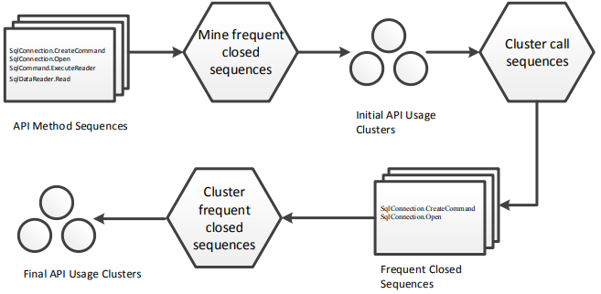
Category2: Clustering Call Sequences
MAPO [Zhong et al. ECOOP’09] UP-Miner [Wang et al. MSR’13]
SqlConnection.CreateCommand
↓
SqlConnection.Open
↓
SqlCommand.ExecuteReader
↓
SqlDataReader.Read
Shortcomings
Incomplete representation with a partial order
Hard to recover raw code
Relies on feature extraction (n-gram, etc.)
Zhong, Hao, et al. "MAPO: Mining and recommending API usage patterns." ECOOP 2009.
Wang et al. "Mining succinct and high-coverage API usage patterns from source code." MSR 2013.
Notes:
The second category of related work is clustering call sequences. Such approach abstract source code as function call sequences and run clustering.

Slide 8
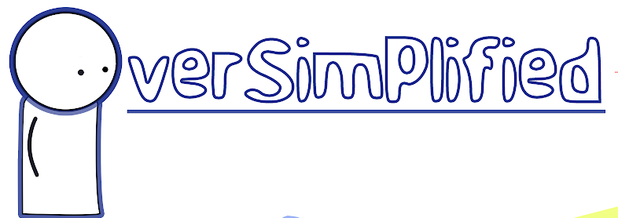
Category3: Extracting Feature Vectors from Code (AST)
ExoaDocs (Kim et al. AAAI’10)
AST feature vector
int sum (int x, n){
int s = 0;
for(int i = x; i<n; i++)
s = s + i;
return s;
}
4
1
0
4
# type declarations
vectorization
# for statements
# if statements
# identifiers
OverSimplified
Similarity Measure
int power (int x, n){
int p = 1;
for(int i = x; i<n; i++)
p = p * x;
return p;
}
4
1
0
4
# type declarations
vectorization
# for statements
# if statements
# identifiers
Kim, Jinhan, Sanghoon Lee, Seung-won Hwang, and Sunghun Kim. “Towards an intelligent code search engine.” AAAI 2010.
Notes:
There is also a category of approaches that clusters source code by extracting feature vectors from code snippets.

Slide 9


CodeKernel – A Kernel Method to Cluster Source Code Directly
Code clustering with kernel methods
Offline Processing
API List
FileReader.read
void foo ()
{
a = map();
a.put(‘’”);
}
void foo ()
{
a = map();
a.put(‘’”);
}
void read ()
{
a = list();
a.append(‘’);
}
Code Example Repository
void foo ()
{
a = map();
a.put(‘’”);
}
void foo ()
{
a = map();
a.put(‘’”);
}
void foo ()
{
a = map();
a.put(‘’”);
}
void foo ()
{
a = map();
a.put(‘’”);
}
void foo ()
{
a= array();
a.add(‘’”);
}
void foo ()
{
a = map();
a.put(1,‘’);
}
Code Snippets for Each API
void read(String fname) {
new FileReader(fname).
read();
}
CodeKernel
Code Repository
Notes:
In this paper, we propose CodeKernel, instead of extracting features or relying on similarity heuristics, our approach employs the Kernel method which enables direct clustering of source code.

Slide 10
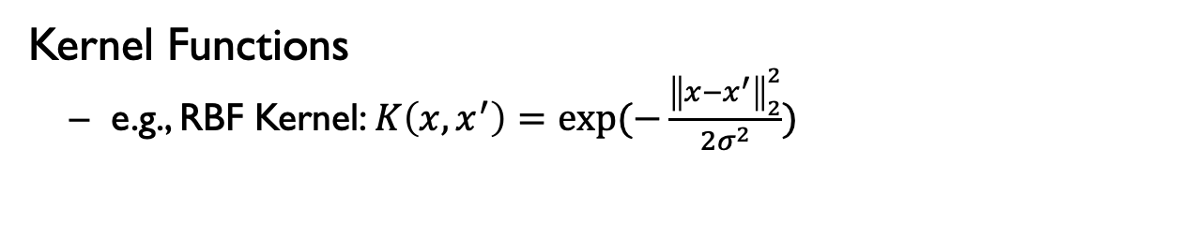
Kernel Method
We have data that is hard to compute, e.g., measuring similarities
non-linear for classification
non-vectorial (requires feature engineering)
X
F
kernel trick"
Inner products in the new space can be computed via a kernel function in the original space! This is often computationally cheaper than the explicit computation.
Φ
Φ(X)
X
X
Φ(X)
Φ(X)
O
O
Φ(O)
X
Φ(O)
Φ(X)
O
X
O
Φ(O)
Φ(O)
Solution: map the data into a vector space where linear relations exist among the data, then apply a linear algorithm in this space.
Kernel Functions
e.g., RBF Kernel: $K\left(x,x^{′}\right)=exp⁡(−\frac{{\left\|x−x^{′}\right\|}_{2}^{2}}{2σ^{2}})$
Notes:
So first let’s see what is kernel method? Suppose we have data that is hard to compute, for example, they are non-linear for classification, or they are non-vector at all so that we need to extract features. similarity is hard to measure. What we want to do is to map the data into a vector space where linear relations exists. So we can apply simple linear algorithm for to the transformed data. However, the transformation is hard to define. Fortunately, we have the kernel trick, which means…. With the kernel trick, we do not need any feature extraction at all, all we need to do is to define a function called kernel function. There are many widely used kernel functions, For example, the RBF kernel is defined as a normalized distance between two vectors.

Slide 11
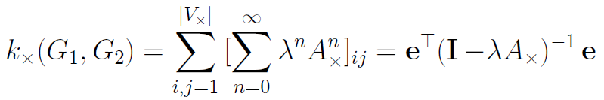
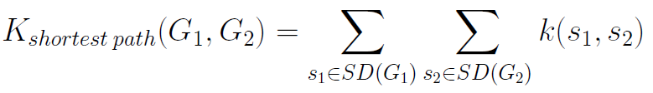
Graph Kernel – Kernel Method for Graphs
graph computation (e.g., Isomorphism) is usually NP hard.
graph clustering in the embedding space with pairwise inner products
Φ(·)
Φ(·)
Φ(·)
Φ(·)
Original Space
Continuous Space
Widely used graph kernels
random walk kernel
shortest path kernel – considers only shortest paths
……
11
Notes:
What is graph kernel? Graph kernel means kernel methods for graphs. As we know, graph computation is complicated, it is usually NP hard. Even we can simplify the problem by feature extraction (e.g., n-gram), it suffers from information loss, resulting in inaccurate results. What we want to do is to embed the graphs into a vector space. Then we can easily do clustering based on the vectors.

Slide 12
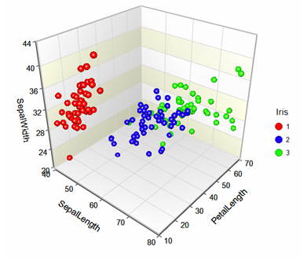
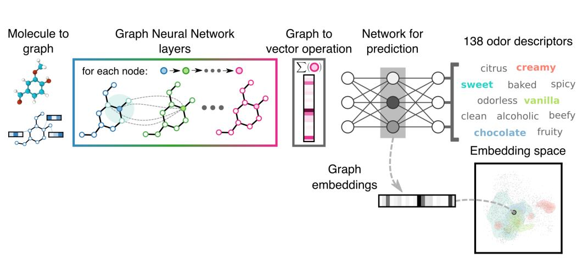
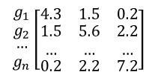
Overall Workflow of CodeKernel
Represent code snippets as graphs and then cluster the graphs with graph kernel:
01 | graph representation for source code
02 | embedding graphs into a new continuous space
03 | graph clustering in the new space
04 | example selection
① Graph Construction
② Graph Embedding
③ Clustering
④ Example Selection
void foo ()
{
a = map();
a.put(‘’”);
}
void foo ()
{
a = map();
a.put(‘’”);
}
void foo ()
{
a = map();
a.put(‘’”);
}
int power ( int x, n){
int p = 0;
for( int i = x; i<n; i++)
p = p * x;
return p;
void foo ()
{
a = map();
a.put(‘’”);
}
$$\begin{matrix}\begin{matrix}g_{1} \\ g_{2}\end{matrix} \\ … \\ g_{n}\end{matrix}\left[\begin{matrix}4.3 & 1.5 & 0.2 \\ \begin{aligned}1.5 \\ …\end{aligned} & \begin{aligned}5.6 \\ …\end{aligned} & \begin{aligned}2.2 \\ …\end{aligned} \\ 0.2 & 2.2 & 7.2\end{matrix}\right]$$
String print( int x, n){
String s = “Hello Word”;
for( int i = x; i<n; i++)
s = s + i +“number”;
return s;
Code Snippets
Graphs
Inner-product Matrix
Graph Clusters
Code Examples
Notes:
So, in our approach, we propose the CodeKernel method. The idea is to represent code …. The approach contains four steps: first,

Slide 13

Step1: Graph Representation for Source Code
Represent code as object usage graph [Nguyen et al. FSE’09]
Groum = CFG + DFG
1 StringBuffer sb = new StringBuffer();
2 BufferedReader reader = new BufferedReader(new FileReader(“ ”));
3 String line=“”;
4 while((line=reader.readLine())!=null)
5 sb.append(line+“\n”);
6 reader.close;
StringBuffer.new
StringBuffer
$$\left[\begin{matrix}\begin{matrix}\begin{matrix}0 & 2 \\ 0 & 0\end{matrix} & \begin{matrix}1 & 0 \\ 0 & 0\end{matrix} \\ \begin{matrix}0 & 0 \\ 0 & 0\end{matrix} & \begin{matrix}0 & 2 \\ 0 & 0\end{matrix}\end{matrix} & \begin{matrix}\begin{matrix}0 & 0 \\ 0 & 0\end{matrix} & \begin{matrix}0 & \begin{matrix}0 & 0 & 0\end{matrix} \\ 0 & \begin{matrix}0 & 2 & 0\end{matrix}\end{matrix} \\ \begin{matrix}1 & 0 \\ 2 & 0\end{matrix} & \begin{matrix}0 & \begin{matrix}0 & 0 & 0\end{matrix} \\ 0 & \begin{matrix}0 & 0 & 0\end{matrix}\end{matrix}\end{matrix} \\ \begin{matrix}\begin{matrix}0 & 0 \\ 0 & 0\end{matrix} & \begin{matrix}0 & 0 \\ 0 & 0\end{matrix} \\ \begin{matrix}0 & 0 \\ \begin{matrix}0 \\ 0 \\ 0\end{matrix} & \begin{matrix}0 \\ 0 \\ 0\end{matrix}\end{matrix} & \begin{matrix}0 & 0 \\ \begin{matrix}0 \\ 0 \\ 0\end{matrix} & \begin{matrix}0 \\ 0 \\ 0\end{matrix}\end{matrix}\end{matrix} & \begin{matrix}\begin{matrix}0 & 2 \\ 0 & 0\end{matrix} & \begin{matrix}1 & \begin{matrix}0 & 0 & 0\end{matrix} \\ 2 & \begin{matrix}0 & 0 & 2\end{matrix}\end{matrix} \\ \begin{matrix}0 & 0 \\ \begin{matrix}0 \\ 0 \\ 0\end{matrix} & \begin{matrix}0 \\ 0 \\ 0\end{matrix}\end{matrix} & \begin{matrix}0 & \begin{matrix}1 & 0 & 0\end{matrix} \\ \begin{matrix}0 \\ 0 \\ 0\end{matrix} & \begin{matrix}\begin{matrix}0 \\ 0 \\ 0\end{matrix} & \begin{matrix}1 \\ 0 \\ 0\end{matrix} & \begin{matrix}0 \\ 1 \\ 0\end{matrix}\end{matrix}\end{matrix}\end{matrix}\end{matrix}\right]$$
FileReader.new
FileReader
BufferedReader.new
BufferedReader
BufferedReader.read
while
+
[0 1 2 3 4 5 6 7 8 9]
StringBuffer.append
BufferedReader.close
…..
Notes:
the whole picture of usages (more information of code)

Slide 14
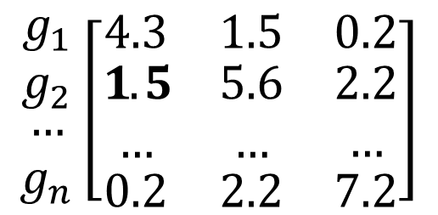

Step2: Graph Embedding with Graph Kernel
$$K_{ij}=K(G_{i}, G_{j})$$
$$\begin{matrix}\begin{matrix}g_{1} \\ g_{2}\end{matrix} \\ … \\ g_{n}\end{matrix}\left[\begin{matrix}4.3 & 1.5 & 0.2 \\ \begin{aligned}1.5 \\ …\end{aligned} & \begin{aligned}5.6 \\ …\end{aligned} & \begin{aligned}2.2 \\ …\end{aligned} \\ 0.2 & 2.2 & 7.2\end{matrix}\right]$$
inner-product (similarity) matrix
graphs

Slide 15
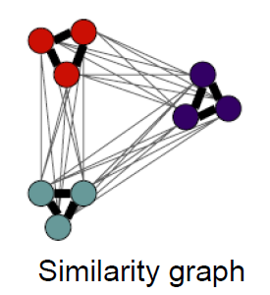

Step3: Graph Clustering on The Kernel Matrix
Difficulty
inputs are non-vectorial !
K-means, GMM, EM, Bayesian ×
Spectral Clustering
Takes as input similarity (inner product) pairs!
Faster and more accurate in many tasks
$$\left[\begin{matrix}4.3 & 1.5 & 0.2 \\ \begin{aligned}1.5 \\ …\end{aligned} & \begin{aligned}5.6 \\ …\end{aligned} & \begin{aligned}2.2 \\ …\end{aligned} \\ 0.2 & 2.2 & 7.2\end{matrix}\right]$$
kernel matrix
graph partition
Notes:
OK, now we can easily measure the graph similarities, our next step is to cluster these graphs.

Slide 16






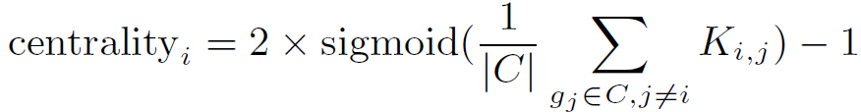
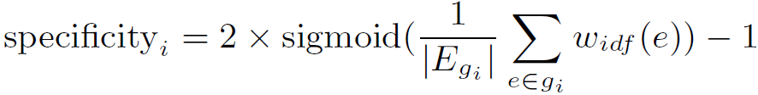
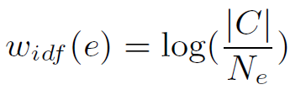
Step4: Code Example Selection (Ranking)
void read(String fname) {
new AudioReader(fname).
read();
}
void read(String fname) {
new TextReader(fname).
readLine();
}
void read(String fname) {
new FileReader(fname).
read();
}
String read(String fname) {
new BuffReader(fname).
read();
}
void read(String fname) {
new FileReader(fname).
read();
}
Rank Metric
Notes:
Having these clusters, we rank examples in each cluster and select the most typical example of each cluster.
We define a ranking score as a regularized centrality, where centrality is calculated as the average distance from a graph to other graphs in the cluster. Since large graphs are more likely to be similar to others, we penalize large graphs by defining a specificity which counts the quantity of rare weights in the graph.

Slide 17
Evaluation
Research Questions
RQ1: How accurate are the code examples selected by
CodeKernel ?
RQ2: How useful is CodeKernel for selecting API usage
examples ?
RQ3: Does graph kernel help improve the graph
clustering performance ?
Notes:
We evaluate our tool by answering three research questions.

Slide 18
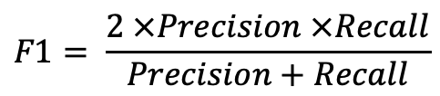
Accuracy of Code Clustering (RQ1)
Data
473 code snippets that are relevant to 14 randomly selected Java APIs
Metrics
Precision: ratio of correct decisions that pairs of graphs are correctly clustered into the same or different clusters
Recall: ratio of correct decisions that a pair of graphs should be clustered into the same or different clusters.
Baseline
MUSE – clustering code snippets by program slicing and clone detection
ExoaDocs – clustering code snippets with similarity heuristics between AST element vectors
$$F1= \frac{2 ×Precision ×Recall}{Precision+Recall}$$

Slide 19
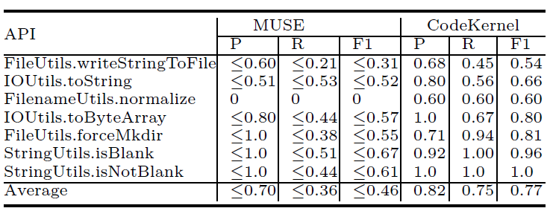
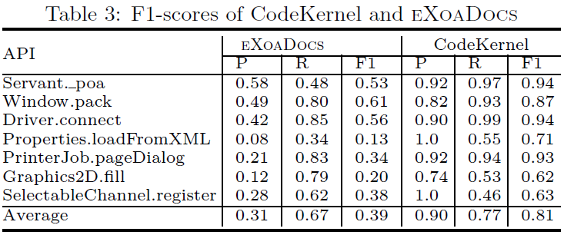
Accuracy of Code Clustering (RQ1)
A Comparison between CodeKernel and Baselines
Approach | Precision | Recall | F1
MUSE | ≤0.70 | ≤0.36 | ≤0.46
EXOADOCS | 0.31 | 0.67 | 0.39
CodeKernel | 0.86 | 0.76 | 0.79
Our approach outperforms the two baselines in terms of F1-score.

Slide 20
An Example
Example 1 [from 6 instances]
Centrality↓:0.8085 Specificity↑:0.4202
Repo.add( final String name, final String content){ final File dir = new File(this.path); final File file = new File(dir, name); FileUtils.writeStringToFile(file, content); this.git.exec(dir, "add”, name); }
Instance 1
Centrality↓:0.8085 Specificity↑:0.4202
Repo.add( final String name, final String content){ final File dir = new File(this.path); final File file = new File(dir, name); FileUtils.writeStringToFile(file, content); this.git.exec(dir, "add”, name); }
Instance 2
Centrality↓:0.7777 Specificity↑:0.5648
GSISSHAbstractCluster.submitBatchJob(JobDescriptor jobDescriptor){ int number = new SecureRandom().nextInt(); number = (number < 0 ? -number : number); tempPBSFile = new File(Integer.toString(number) + jobManagerConfiguration.getScriptExtension()); FileUtils.writeStringToFile(tempPBSFile, scriptContent); }
Instance 3
Centrality↓:0.7739 Specificity↑:0.6023
ConfigGenerator.generateConfig(FileInfo template, FileInfo filter,
String outputBasePath, StrSubstitutor strSub, Map<String,Set<String>> missPropertiesByFilename, boolean missingPropertyFound ) {
String rawTempl = FileUtils.readFileToString(template.getFile()); Properties properties = readFilterIntoProperties(filter); String processedTemplate = StrSub.replace(rawTempl, properties); FileUtils.writeStringToFile(new File(outputFilename), processedTemplate); }
……
Notes:
Here is an excerpt of code example selected by CodeKernel. These results come from a cluster consisting of 6 instances. The Example 1 at the top is the selected representative of the cluster. The code snippets below (Instances 1 to 3) are instances in that cluster. The first instance is selected as an example as it has high similarities to other instances and does not contain many project-specific nodes.
all the instances we consider to be the same are clustered together by CodeKernel, which means CodeKernel can provide less redundant API usage examples to developers. In addition, the representative graph selected by CodeKernel contains less context-specific information, which means our examples are more readable.

Slide 21
Usefulness (RQ2)
A user study involving 25 developers in a multinational company, with each developer having more than 2 years of programming experience
very useful
not useful
totally not useful
Questionnaire
Overall, are the selected examples useful for understanding API usages?
useful
neither
Tool comparison
Which tool produces better example?
Notes:
25 developers in a multinational company, all having more than 2 years of programming experiences.

Slide 22

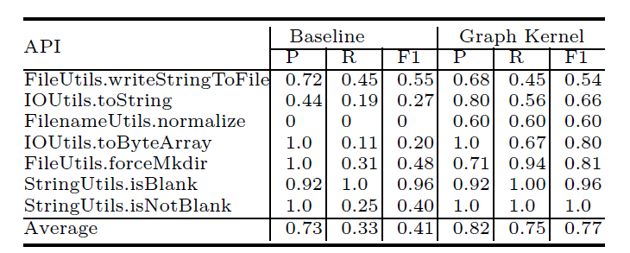
The Effects of Graph Kernel (RQ3)
Replace the graph kernel component in CodeKernel with a traditional similarity measure:
Graph Kernel is effective in code clustering.

Slide 23
Conclusion
CodeKernel – a graph kernel based approach for clustering and selecting code examples
graph representation of code snippets
graph kernel for code graph embedding and clustering
Future Work
Other tasks that require code similarity measure
e.g., code search, code clone detection, etc.
Deep learning to further improve the completeness and readability of the code examples.
Notes:
In conclusion, we propose a graph kernel based approach for clustering and selecting API code examples. CodeKernel uses graphs to represent code snippets and employs the graph kernel algorithm for code graph embedding.
The kernel-based graph embedding could also be applied to other tasks that require feature extraction on source code, such as code retrieval and code clone detection, which will be our future work. In the future, we will also investigate deep learning based techniques to further improve the completeness and readability of the code examples.

Slide 24

Thank you!
Q&A
Paper

