Slide 1





Deep Code Search
Xiaodong Gu
Hong Kong University of Science and Technology
Hongyu Zhang
The University of Newcastle
Sunghun Kim
Hong Kong University of Science and Technology

Slide 2

Programming is hard
Lack of experience
Unfamiliar libraries
Notes:
As we know programming is sometimes hard, either because programmers have little experience on the task or are unfamiliar with the programming libraries.

Slide 3

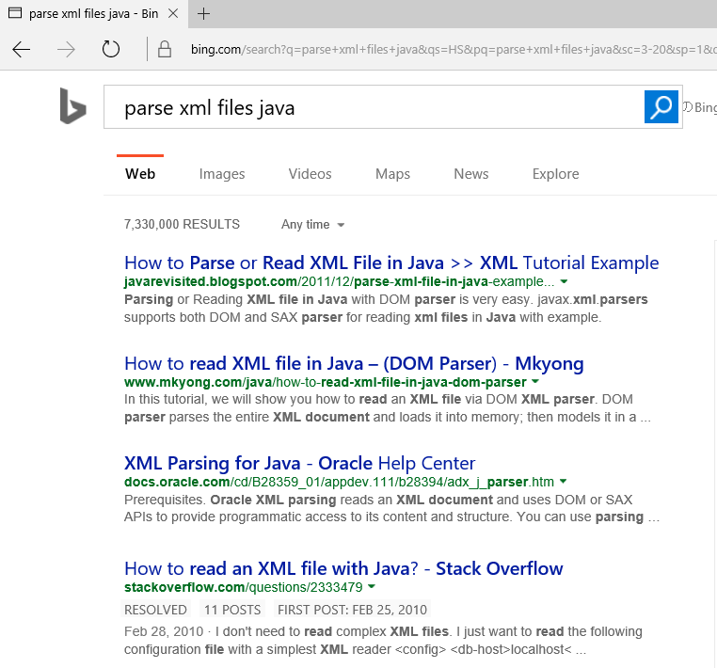

Why Not Search for It?
Not designed for source code
Notes:
So, what do they do when they have difficulty with a programming task? The first idea comes in their mind could be search for it. They can ask general search engines such as Google. However, as we know, general search engines are not designed for source code and could have many irrelevant results such as discussions and programming experience. Besides, developers have to brows many web pages to check the results.

Slide 4


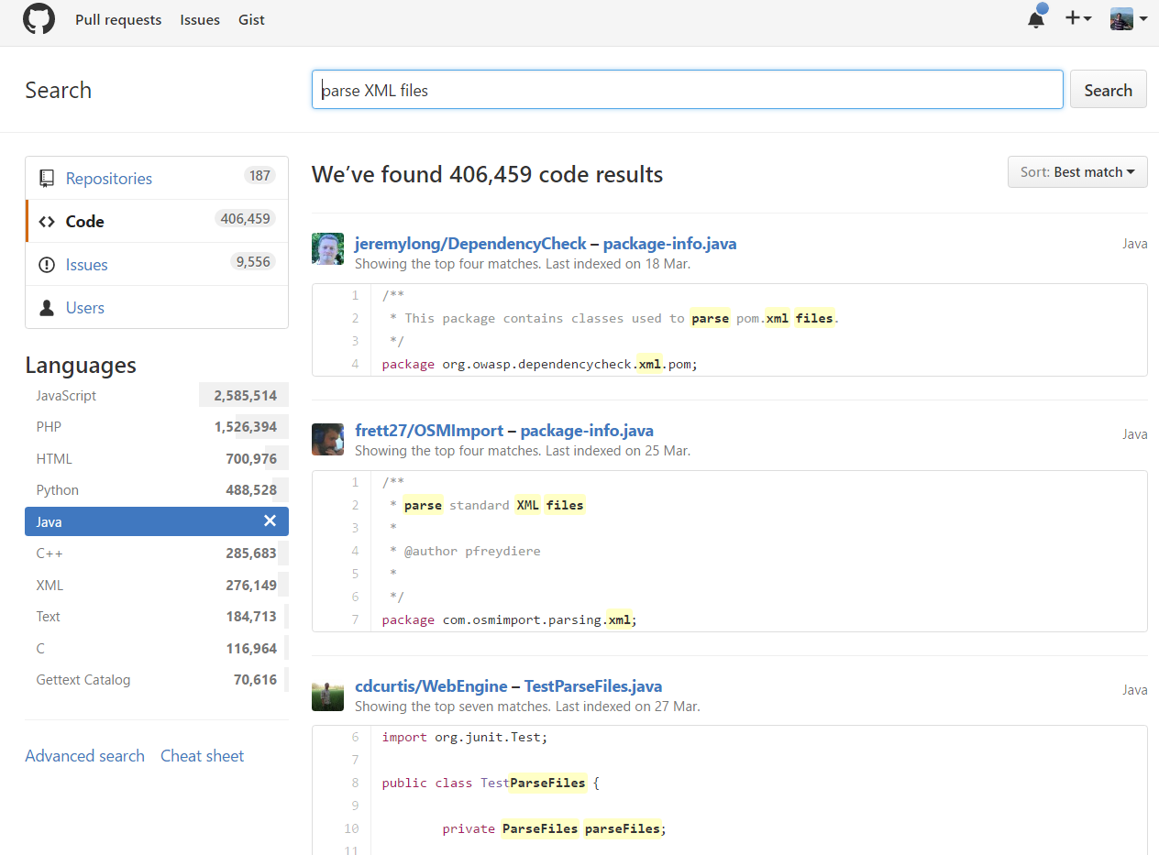
Code Search Engines
Keyword Matching!
Hard to represent complicated tasks
Notes:
Another way to obtain code examples is from code search engines such as Github Search. However, Existing code search engines are basic keyword matching and are difficult to represent complicated tasks.

Slide 5
Information Retrieval – Related Work
Consider source code as plain text and apply IR techniques (e.g., Lucene)
Augment IR approaches by considering properties of source code and NL queries
Typical Techniques
Sourcerer [Linstead DMKD’09]: augments Lucene by considering method names and code popularity
Portforlio [McMillan, ICSE’11]: considers relationships between functions
[Lu et al. SANER’15]: query expansion with WordNet
CodeHow [Lv et al. ASE’15]: API matching
Notes:
So, code search has always been an active research. And most of the ideas are based on Information Retrieval

Slide 6
A fundamental problem of IR based code search
Source code and natural language have heterogeneous representations
Query: “how to read an object from an xml”
public static <S> S deserialize(Class c, File xml) {
try {
JAXBContext context = JAXBContext.newInstance(c);
Unmarshaller unmarshaller = context.createUnmarshaller();
S deserialized = (S) unmarshaller.unmarshal(xml);
return deserialized;
} catch (JAXBException ex) {
log.error("Error-deserializing-object-from-XML", ex);
return null;
}
}
Mismatch between the high-level intent reflected in the queries and the low-level implementation details in the source code
Notes:
Natural language queries and code snippets are heterogeneous and cannot be easily matched through lexical tokens.

Slide 7
Proposed Approach
Joint Embedding of both Code and Natural Language into a unified vector representation
public void readText(String textFile) {
BufferedReader br = new BufferedReader(
new FileInputStream(helpFile));
String line = null;
while ((line = br.readLine()) != null) {
System.out.println(line);
}
••••••
br.close();
}
Query/Description
Embedding
Code
Embedding
“read a text file line by line”
public static < S > S deserialize(Class c, File xml) {
try {
JAXBContext context = JAXBContext.newInstance(c);
Unmarshaller unmarshaller =context.createUnmarshaller();
S deserialized = (S) unmarshaller.unmarshal(xml);
return deserialized;
} catch (JAXBException ex) {
log.error("Error-deserializing-object-from-XML", ex);
return null;
}
}
“read an object from an xml file”
Notes:
So our idea is, can we learn to represent source code and natural language in the same vector space, so that for a given natural language query, we can directly find relevant code snippets through their vector similarities?

Slide 8
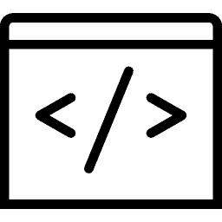

CODEnn (Code-Description Embedding Neural Network)
Code Vector
Description Vector
Cosine Similarity
Code Embedding Network (CoNN)
Description Embedding Network (DeNN)
Similarity Module
Code Embedding Network (CoNN)
Description Embedding
Network(DeNN)
Code
Description
Notes:
Based on this idea, we propose a deep neural network named CODEnn (Code-Description Embedding Neural Network). CODEnn is trained to embed source code and natural language description with deep neural networks.
The neural network consists of three modules: a code embedding network (CEN) to embed source code into vectors; a description embedding network (DeNN) to embed natural language descriptions into vectors; and a similarity module that measures the similarity between code and descriptions.

Slide 9
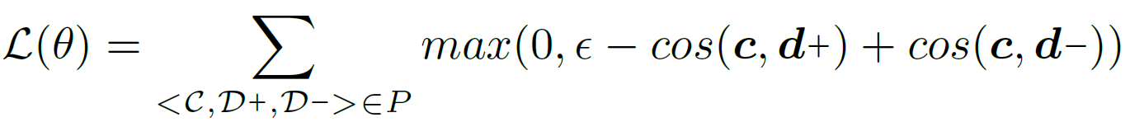





code vector [$\vec{c}$]
description vector [$\vec{d}$]
Cosine Similarity
Fusion
$$\vec{m}$$
$$\vec{a}$$
$$\vec{t}$$
max pooling
max pooling
max pooling
max pooling
MLP
MLP
MLP
RNN
RNN
RNN
RNN
RNN
RNN
RNN
RNN
RNN
text
reader
Scanner.new
Scanner.next
Scanner.close
str
buff
close
read
a
text
file
method name [M]
API sequence [A]
Tokens [Γ]
[D]
Code
Description
Training with Ranking Loss:

Slide 10

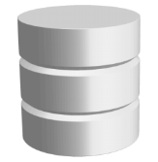




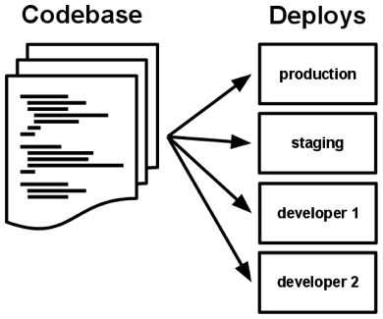


DeepCS – Deep Learning based Code Search
Offline Training
Query
Recommended Code
Training
Instances
CODEnn Model
Training
embedding
Similarity Lookup
0101010
aspect extraction
Query Vector
aspect extraction
embedding
code snippets
(Java methods)
natural language descriptions
code snippets
(Java methods)
Commented Code Snippets
Code Vectors
Search Codebase
Offline Embedding

Slide 11
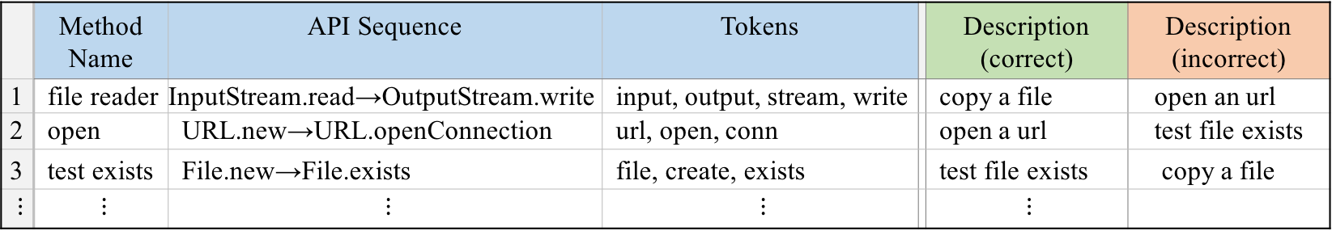
Step1 – Prepare a Training Corpus
Training Instances
<C,D+,D-> (<method name, api seq, tokens, correct desc, incorrect desc>)
 | Method Name | API Sequence | Tokens |  | Description (correct) | Description (incorrect)
1 | file reader | InputStream.read→OutputStream.write | input, output, stream, write |  | copy a file | open an url
2 | open | URL.new→URL.openConnection | url, open, conn |  | open a url | test file exists
3 | test exists | File.new→File.exists | file, create, exists |  | test file exists | copy a file
$⋮$ | $⋮$ | $⋮$ | $⋮$ |  | $⋮$
Collect Java projects from GitHub
Parse source files into ASTs using Eclipse JDT
Extract an API sequence, method name, tokens and a description for each method body (when Javadoc comment exists)
Notes:
At training time, we construct each training instance as a triple ⟨C,D+,D-⟩: for each code snippet C, there is a positive description D+ (a correct description of C) as well as a negative description (an incorrect description of C) D- randomly chosen from the pool of all D+’s. When trained on the set of ⟨C,D+,D-⟩ triples, the CODEnn predicts the cosine similarities of both ⟨C,D+⟩ and ⟨C,D-⟩ pairs and minimizes the ranking loss.

Slide 12
Description:
/**
* read a text file line by line.
* @param: path
*/
public void readContent(String path){
…
BufferedReader reader = new BufferedReader(…);
while((line=reader.readLine())!=null)
…
reader.close();
}
read a text file line by line.
Method name:
read context
Tokens:
{read, context, string, buffer, reader, line, close}
MethodDefinition
Body
Javadoc Comment
Statement
While Statement
…
API Sequence:
Variable Declaration
Constructor Invocation
Method Invocation
Block Statement
BufferedReader.new BufferedReader.readLine
BufferedReader.close
Type
Variable
Variable
readLine
BufferedReader
reader
reader

Slide 13
Step2 – Training CODEnn Model
Neural Network
Bi-LSTM, 200 hidden units
MLP: 100 hidden units for embedding and 400 for fusing
Word Embedding: 100
Training Algorithm
Adadelta
Batch size: 128
Vocabulary size: 10,000

Slide 14
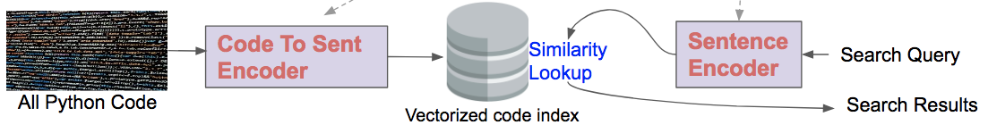
Step3 – Searching Code Snippets
Code Embedding
Query Embedding
All Java Code

Slide 15
Evaluation
Search Codebase
Java repositories from GitHub
Query Subjects
Top 50 Java-tagged Questions from Stack Overflow
Baselines
CodeHow [Lv et al. ASE’15]: combines multiple code aspects such as method name and APIs using an extended boolean model
Lucene: a conventional search engine behind many existing code search tools such as Sourcerer [Linstead et al. DMKD’09]
Notes:
To evaluate our approach, we apply DeepCS for Github code search. We collect Java repositories from Github as the search codebase, and perform code search with the top 50 Java-tagged questions from Stack Overflow.
We compare DeepCS with two baselines. CodeHow, which is a state-of-the-art tool for general code search. It combines multiple code aspects such as method name and APIs using an extended Boolean model.
The other is Lucene, which is ….

Slide 16
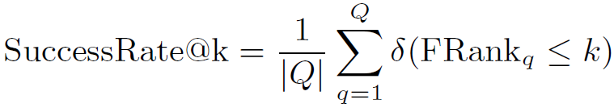
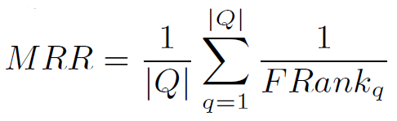
Evaluation
Metrics
FRank – the rank of the first hit result in the result list
Notes:
We use four metric to measure the performance. MRR is the average reciprocal Frank.

Slide 17
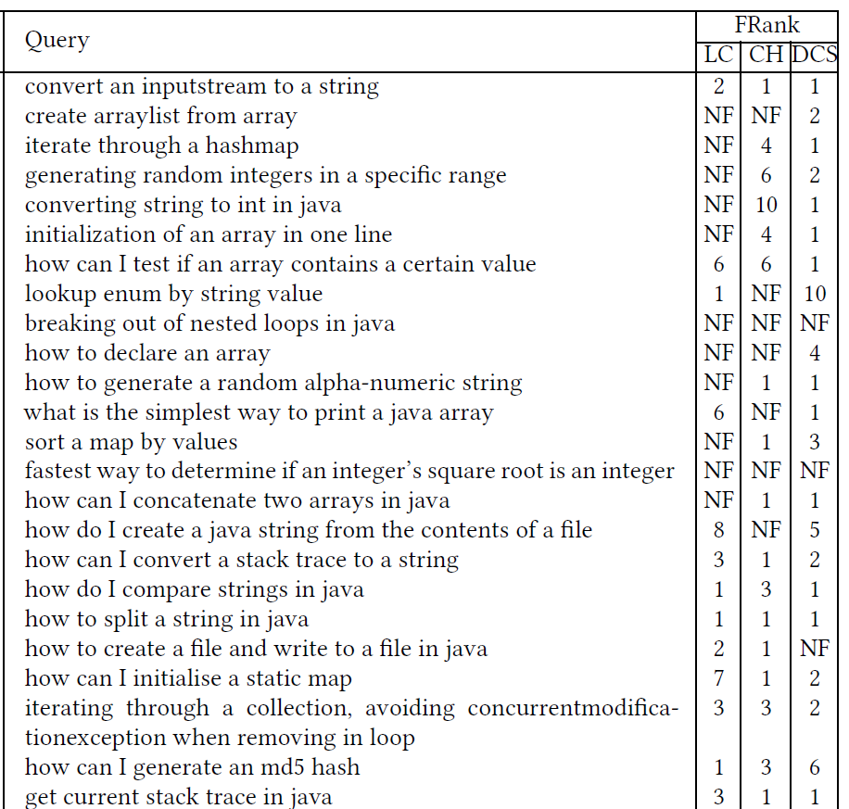
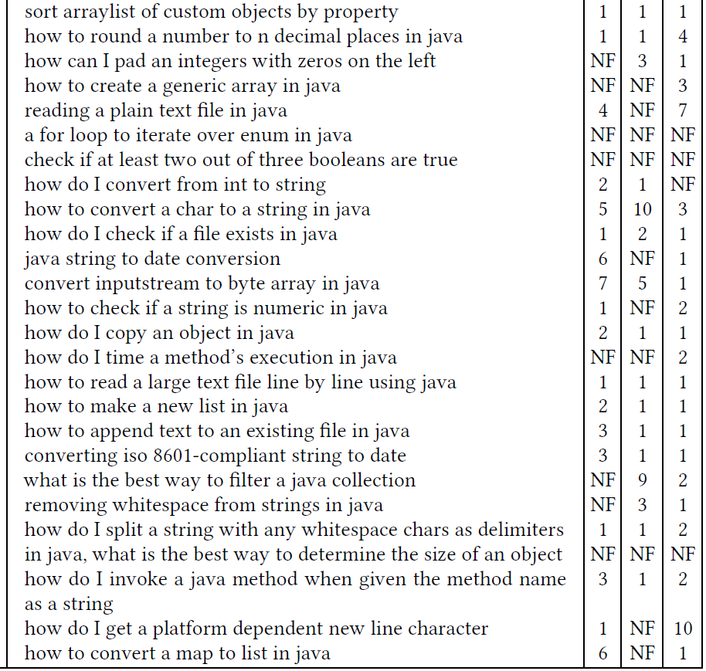
Results
Notes:
Here are the results for the 50 Stack Overflow questions.

Slide 18
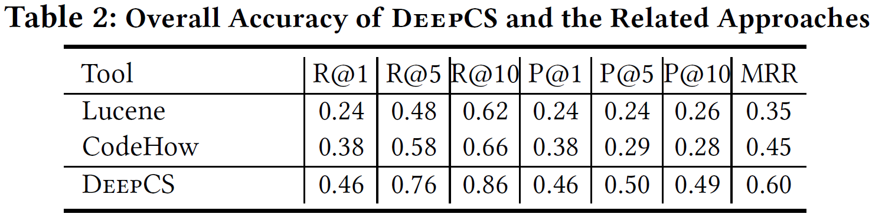
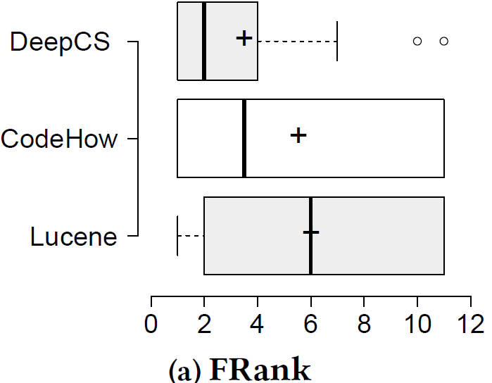
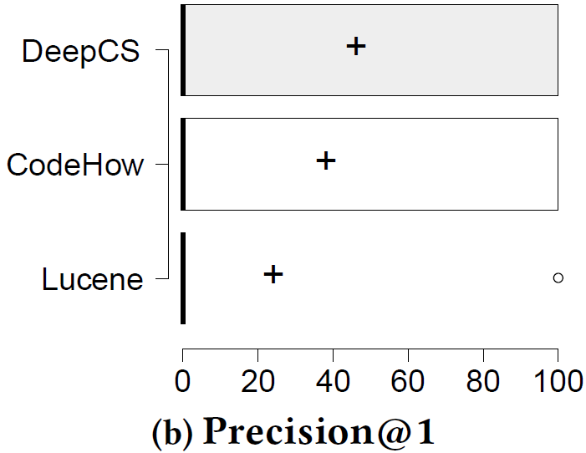
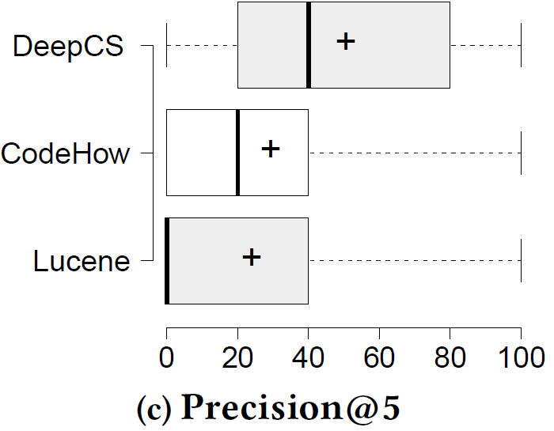
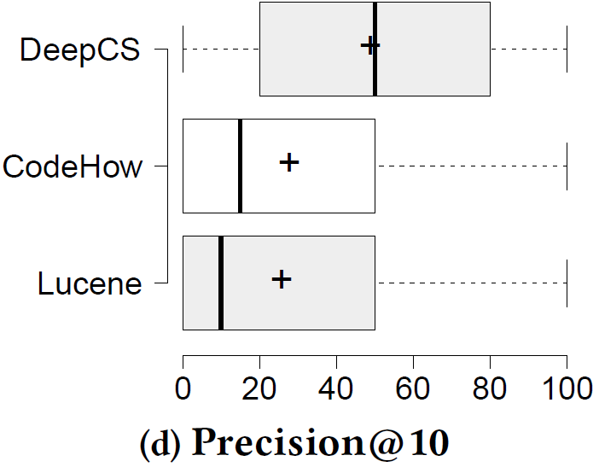
Results

Slide 19
Example – Associative Search
Query: “read an object from an xml”
public static <S> S deserialize(Class c, File xml) {
try {
JAXBContext context = JAXBContext.newInstance(c);
Unmarshaller unmarshaller = context.createUnmarshaller();
S deserialized = (S) unmarshaller.unmarshal(xml);
return deserialized;
} catch (JAXBException ex) {
log.error("Error-deserializing-object-from-XML", ex);
return null;
}
}

Slide 20
Example – Query Understanding
Query: “queue an event to be run on a thread”
Query: “run an event on a thread queue”
public boolean enqueue(EventHandler
handler, Event event) {
synchronized(monitor) {
••••••
handlers[tail] = handler;
events[tail] = event;
tail++;
if (handlers.length <= tail)
tail = 0;
monitor.notify();
}
return true;
}
public void run() {
while (!stop) {
DynamicModelEvent evt;
while ((evt = eventQueue.poll())!= null)
{
for (DynamicModelListener l:
listeners.toArray(
new DynamicModelListener[0]))
l.dynamicModelChanged(evt);
}
••••••
}
}

Slide 21
Conclusion
DeepCS –Deep Learning based Code Search
Learns the representation of source code and NL with deep neural networks
Jointly embeds source code and natural language into a unified vector space
Future Work
Code embedding with more aspects (e.g., structures)
https://github.com/guxd/deep-code-search

