Slide 1





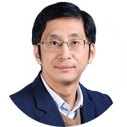
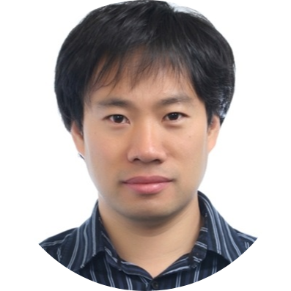
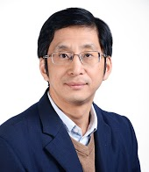
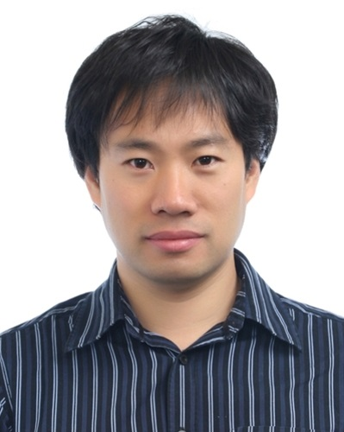
CodeKernel: A Graph Kernel Based Approach to the Selection of API Usage Examples
Xiaodong Gu
Hongyu Zhang
Sunghun Kim
Notes:
Hi, my name is Xiaodong Gu. From Hong Kong UST, the paper I am gonna present is deep code search, which means deep learning based code search.

Slide 2



Programming by Examples
void read(String fname) {
new FileReader(fname).
read(); //
}
Notes:
As we know programming is sometimes hard, either because programmers have little experience on the task or because they are unfamiliar with the programming libraries.

Slide 3
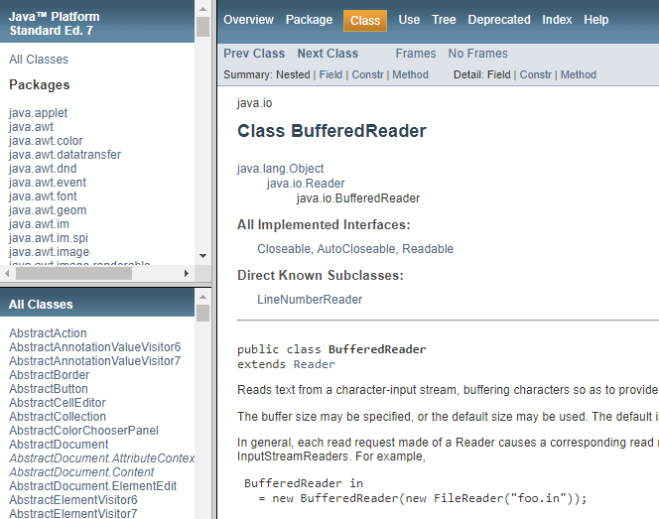

Obtaining API Examples
API Documentations
Manually Written!
Simple and Incomplete
Notes:
So , how developers obtain these code examples? The first choice should be the API documentation. However, these usage patterns are often not well documented.

Slide 4





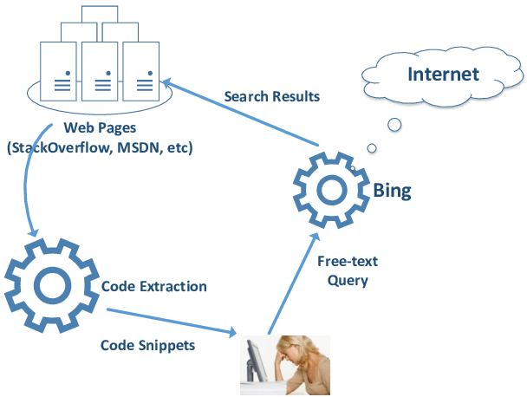
Mining for Sample Code
A General Recipe
– clustering similar code snippets and select the most representative ones
void read(String fname) {
new FileReader(fname).
read();
}
FileReader.read
Internet
③ Selection/Synthesis
void foo ()
{
a = map();
a.put(‘’”);
}
void foo ()
{
a = map();
a.put(‘’”);
}
void foo ()
{
a = map();
a.put(1,‘’);
}
void foo ()
{
a = map();
a.put(‘’”);
}
void foo ()
{
a = map();
a.put(‘’”);
}
void foo ()
{
a = list();
a.append(‘’);
}
void foo ()
{
a = map();
a.put(‘’”);
}
void foo ()
{
a = map();
a.put(‘’”);
}
① Gathering
② Clustering
void foo ()
{
a= array();
a.add(‘’”);
}
void foo ()
{
a = map();
a.put(‘’”);
}
void foo ()
{
a = map();
a.put(‘’”);
}
void foo ()
{
a = map();
a.put(‘’”);
}
void foo ()
{
a = map();
a.put(‘’”);
}
void foo ()
{
a = map();
a.put(‘’”);
}
void foo ()
{
a = list();
a.append(‘’);
}
void foo ()
{
a= array();
a.add(‘’”);
}
void foo ()
{
a = map();
a.put(1,‘’);
}
Codebase
Key problem:
How to cluster similar code?
Notes:
Another way to obtain code examples is from code search engines such as Github Search. However, …

Slide 5
Code Clustering: Related Work
Category | Related Works
Clone-detection | MUSE [Moreno et al. ICSE’15]
Extracting feature vectors | ExoaDocs [Kim et al. AAAI’10]
Clustering method call sequences | MAPO [Xie and Pei, MSR’06] UP-Miner [Wang et al. MSR’13]
Graph-based frequent pattern mining | GrouMiner
Notes:
Following this idea, there have been many techniques proposed for code example selection. Basically, there are three categories of techniques,…

Slide 6
Code Clustering by Clone Detection
MUSE [Moreno et al. ICSE’15]
void read(String fname) {
new FileReader(fname).
read();
}
FileReader.read
④ selection by popularity
①Gathering
void foo ()
{
a = map();
a.put(‘’”);
}
void foo ()
{
a = map();
a.put(‘’”);
}
void foo ()
{
a = map();
a.put(1,‘’);
}
void foo ()
{
a = map();
a.put(‘’”);
}
void foo ()
{
a = map();
a.put(‘’”);
}
void foo ()
{
a = map();
a.put(‘’”);
}
③ Clone Detection
void foo ()
{
a = list();
a.append(‘’);
}
② Slicing
void foo ()
{
a = map();
a.put(‘’”);
}
void foo ()
{
a= array();
a.add(‘’”);
}
void foo ()
{
a = map();
a.put(‘’”);
}
void foo ()
{
a = map();
a.put(‘’”);
}
void foo ()
{
a = map();
a.put(‘’”);
}
void foo ()
{
a = map();
a.put(‘’”);
}
void foo ()
{
a = map();
a.put(‘’”);
}
void foo ()
{
a = list();
a.append(‘’);
}
void foo ()
{
a= array();
a.add(‘’”);
}
void foo ()
{
a = map();
a.put(1,‘’);
}
Client Projects
Shortcoming: clone-detection-based approach is context-sensitive for code clustering
Moreno, Laura, Gabriele Bavota, Massimiliano Di Penta, Rocco Oliveto, and Andrian Marcus. "How can I use this method?." In Proceedings of the 37th International Conference on Software Engineering-Volume 1, pp. 880-890. IEEE Press, 2015.

Slide 7
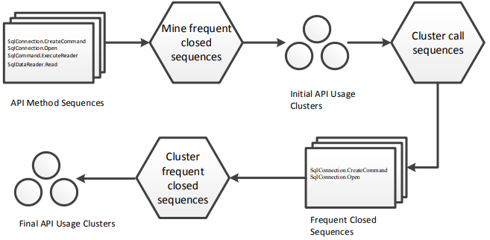
Clustering Call Sequences
MAPO [Xie and Pei, MSR’06] UP-Miner [Wang et al. MSR’13]
SqlConnection.CreateCommand
↓
SqlConnection.Open
↓
SqlCommand.ExecuteReader
↓
SqlDataReader.Read
Shortcomings
Incomplete representation with a partial order
Hard to recover raw code
Relies on feature extraction (n-gram, etc.)
Wang, Jue, Yingnong Dang, Hongyu Zhang, Kai Chen, Tao Xie, and Dongmei Zhang. "Mining succinct and high-coverage API usage patterns from source code." In Proceedings of the 10th Working Conference on Mining Software Repositories (MSR 2013).
Notes:
Let’s look at some typical techniques for code clustering

Slide 8
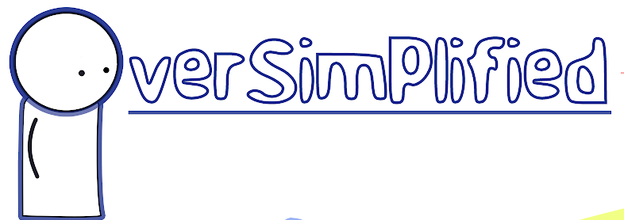
Extracting Feature Vectors from Code (AST)
ExoaDocs (Kim et al. AAAI’10)
AST feature vector
int sum (int x, n){
int s = 0;
for(int i = x; i<n; i++)
s = s + i;
return s;
}
4
1
0
4
# type declarations
vectorization
# for statements
# if statements
# identifiers
OverSimplified
Similarity Measure
int power (int x, n){
int p = 1;
for(int i = x; i<n; i++)
p = p * x;
return p;
}
4
1
0
4
# type declarations
vectorization
# for statements
# if statements
# identifiers
Kim, Jinhan, Sanghoon Lee, Seung-won Hwang, and Sunghun Kim. "Towards an intelligent code search engine." In Twenty-Fourth AAAI Conference on Artificial Intelligence. 2010.
Notes:
Similarity heuristics

Slide 9
Graph-based Frequent Pattern Mining
GrouMiner (Nguyen et al. FSE’09)
Pattern 27
if (StringUtils.isBlank(pattern))
if (m.find()) {
…
namedRegex = StringUtils.replace(namedRegex, "%{"
+ group.get("name")+"}", "(?<name"+index +">"
+ grokPatternDef.get(group.get("pattern"))+")");
index++;
}
if (namedRegex.isEmpty()) {
throw new GrokException("Pattern not fount");
}
Pattern 12
Computational expensive
Prefer small patterns
Hard clustering

Slide 10


CodeKernel – A Kernel Method to Cluster Source Code Directly
Clustering code with kernel methods
Offline Processing
API List
FileReader.read
void foo ()
{
a = map();
a.put(‘’”);
}
void foo ()
{
a = map();
a.put(‘’”);
}
void foo ()
{
a = list();
a.append(‘’);
}
Code Example Repository
void foo ()
{
a = map();
a.put(‘’”);
}
void foo ()
{
a = map();
a.put(‘’”);
}
void foo ()
{
a = map();
a.put(‘’”);
}
void foo ()
{
a = map();
a.put(‘’”);
}
void foo ()
{
a= array();
a.add(‘’”);
}
void foo ()
{
a = map();
a.put(1,‘’);
}
Code Snippets for Each API
void read(String fname) {
new FileReader(fname).
read();
}
CodeKernel
Code Repository

Slide 11
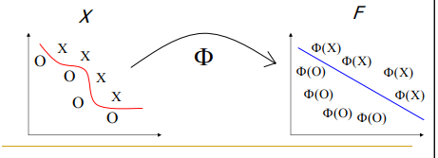
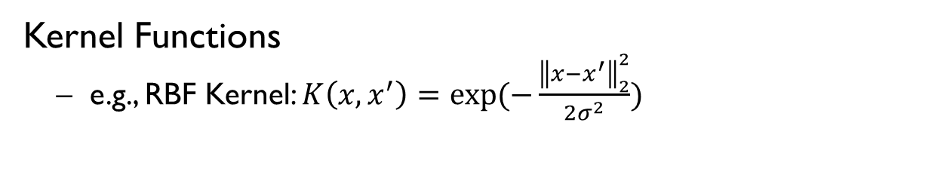
Kernel Method
We have data that is hard to compute, e.g., measuring similarities
non-linear for classification
non-vector at all (needs feature engineering)
X
F
kernel trick"
Inner products in the new space can be computed via a kernel function in the original space! This is often computationally cheaper than the explicit computation.
Φ
Φ(X)
X
X
Φ(X)
Φ(X)
O
O
Φ(O)
X
Φ(O)
Φ(X)
O
X
O
Φ(O)
Φ(O)
Solution: map the data into a vector space where linear relations exist among the data, then apply a linear algorithm in this space.
Kernel Functions
e.g., RBF Kernel: $K\left(x,x^{′}\right)=exp⁡(−\frac{{\left\|x−x^{′}\right\|}_{2}^{2}}{2σ^{2}})$
Notes:
So first let’s see what is kernel method? Suppose we have data that is hard to compute, for example, they are non-linear for classification, or they are non-vector at all so that we need to extract features. similarity is hard to measure. What we want to do is to map the data into a vector space where linear relations exists. So we can apply simple linear algorithm for to the transformed data. How to do that? All we need to do is to define a function called kernel function. Now with a simple function, we do not need any feature selection and transformation. Everything we need is a predefined function. Perfect! A kernel function is a function that satisfies mercer’s condition. For example, an RBF kernel is defined as a normalized distance between two vectors.
A graph kernel,…

Slide 12
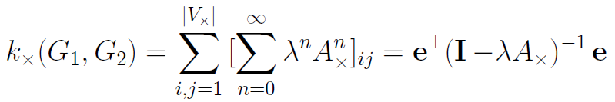
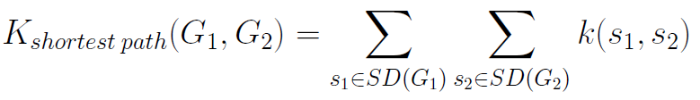
Graph Kernel
Kernel method for graphs
graph computation (e.g., comparison) is NP hard.
graph clustering in the embedding space with pairwise inner products
Φ(·)
Φ(·)
Φ(·)
Φ(·)
Original Space
Continuous Space
Widely used graph kernels
random walk kernel
shortest path kernel – consider only shortest paths
……
12
Notes:
Graph computation especially comparing graphs is an NP hard problem. Even we can simplify the problem by feature extraction (e.g., n-gram), it suffers from information loss, resulting in inaccurate results.
Graph kernel, …

Slide 13
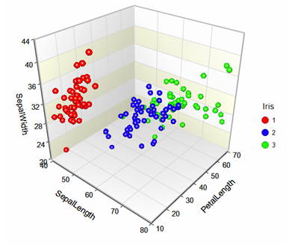
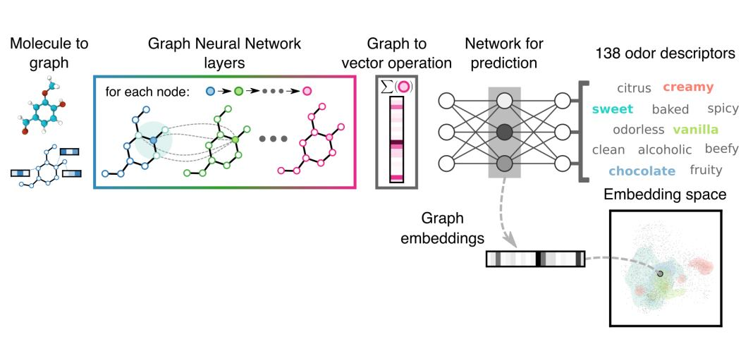
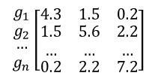
Overall Workflow of CodeKernel
Represent code snippets as graphs and then cluster the graphs with graph kernel:
01 | graph representation for source code
02 | embedding graphs into a new continuous space
03 | graph clustering in the new space
04 | example selection
① Graph Construction
② Graph Embedding
③ Clustering
④ Example Selection
void foo ()
{
a = map();
a.put(‘’”);
}
void foo ()
{
a = map();
a.put(‘’”);
}
void foo ()
{
a = map();
a.put(‘’”);
}
int power ( int x, n){
int p = 0;
for( int i = x; i<n; i++)
p = p * x;
return p;
void foo ()
{
a = map();
a.put(‘’”);
}
$$\begin{matrix}\begin{matrix}g_{1} \\ g_{2}\end{matrix} \\ … \\ g_{n}\end{matrix}\left[\begin{matrix}4.3 & 1.5 & 0.2 \\ \begin{aligned}1.5 \\ …\end{aligned} & \begin{aligned}5.6 \\ …\end{aligned} & \begin{aligned}2.2 \\ …\end{aligned} \\ 0.2 & 2.2 & 7.2\end{matrix}\right]$$
String print( int x, n){
String s = “Hello Word”;
for( int i = x; i<n; i++)
s = s + i +“number”;
return s;
Code Snippets
Graphs
Inner-product Matrix
Graph Clusters
Code Examples
Notes:
So, we propose CodeKernel, which tries to better

Slide 14

Step1: Graph Representation for Source Code
Represent code as object usage graph [Nguyen et al. FSE’09]
Groum = CFG + DFG
1 StringBuffer sb = new StringBuffer();
2 BufferedReader reader = new BufferedReader(new FileReader(“ ”));
3 String line=“”;
4 while((line=reader.readLine())!=null)
5 sb.append(line+“\n”);
6 reader.close;
StringBuffer.new
StringBuffer
$$\left[\begin{matrix}\begin{matrix}\begin{matrix}0 & 2 \\ 0 & 0\end{matrix} & \begin{matrix}1 & 0 \\ 0 & 0\end{matrix} \\ \begin{matrix}0 & 0 \\ 0 & 0\end{matrix} & \begin{matrix}0 & 2 \\ 0 & 0\end{matrix}\end{matrix} & \begin{matrix}\begin{matrix}0 & 0 \\ 0 & 0\end{matrix} & \begin{matrix}0 & \begin{matrix}0 & 0 & 0\end{matrix} \\ 0 & \begin{matrix}0 & 2 & 0\end{matrix}\end{matrix} \\ \begin{matrix}1 & 0 \\ 2 & 0\end{matrix} & \begin{matrix}0 & \begin{matrix}0 & 0 & 0\end{matrix} \\ 0 & \begin{matrix}0 & 0 & 0\end{matrix}\end{matrix}\end{matrix} \\ \begin{matrix}\begin{matrix}0 & 0 \\ 0 & 0\end{matrix} & \begin{matrix}0 & 0 \\ 0 & 0\end{matrix} \\ \begin{matrix}0 & 0 \\ \begin{matrix}0 \\ 0 \\ 0\end{matrix} & \begin{matrix}0 \\ 0 \\ 0\end{matrix}\end{matrix} & \begin{matrix}0 & 0 \\ \begin{matrix}0 \\ 0 \\ 0\end{matrix} & \begin{matrix}0 \\ 0 \\ 0\end{matrix}\end{matrix}\end{matrix} & \begin{matrix}\begin{matrix}0 & 2 \\ 0 & 0\end{matrix} & \begin{matrix}1 & \begin{matrix}0 & 0 & 0\end{matrix} \\ 2 & \begin{matrix}0 & 0 & 2\end{matrix}\end{matrix} \\ \begin{matrix}0 & 0 \\ \begin{matrix}0 \\ 0 \\ 0\end{matrix} & \begin{matrix}0 \\ 0 \\ 0\end{matrix}\end{matrix} & \begin{matrix}0 & \begin{matrix}1 & 0 & 0\end{matrix} \\ \begin{matrix}0 \\ 0 \\ 0\end{matrix} & \begin{matrix}\begin{matrix}0 \\ 0 \\ 0\end{matrix} & \begin{matrix}1 \\ 0 \\ 0\end{matrix} & \begin{matrix}0 \\ 1 \\ 0\end{matrix}\end{matrix}\end{matrix}\end{matrix}\end{matrix}\right]$$
FileReader.new
FileReader
BufferedReader.new
BufferedReader
BufferedReader.read
while
+
[0 1 2 3 4 5 6 7 8 9]
StringBuffer.append
BufferedReader.close
…..
Notes:
the whole picture of usages (more information of code)

Slide 15
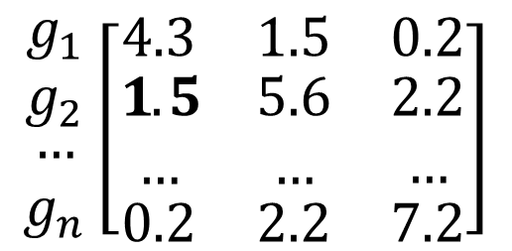

Step2: Graph Embedding with Graph Kernel
$$K_{ij}=K(G_{i}, G_{j})$$
$$\begin{matrix}\begin{matrix}g_{1} \\ g_{2}\end{matrix} \\ … \\ g_{n}\end{matrix}\left[\begin{matrix}4.3 & 1.5 & 0.2 \\ \begin{aligned}1.5 \\ …\end{aligned} & \begin{aligned}5.6 \\ …\end{aligned} & \begin{aligned}2.2 \\ …\end{aligned} \\ 0.2 & 2.2 & 7.2\end{matrix}\right]$$
inner-product (similarity) matrix
graphs

Slide 16
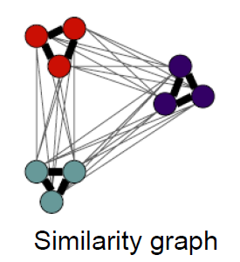

Step3: Graph Clustering on Kernel Matrix
Difficulty – inputs are non-vectorial !
K-means, GMM, EM ,Bayesian ×
Spectral clustering
Based on inner product pairs!
Faster and more accurate
$$\left[\begin{matrix}4.3 & 1.5 & 0.2 \\ \begin{aligned}1.5 \\ …\end{aligned} & \begin{aligned}5.6 \\ …\end{aligned} & \begin{aligned}2.2 \\ …\end{aligned} \\ 0.2 & 2.2 & 7.2\end{matrix}\right]$$
kernel matrix
graph partition
Notes:
OK, now we can easily measure the graph similarities, our next step is to cluster these graphs.

Slide 17






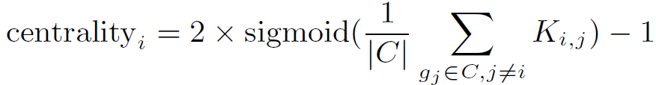
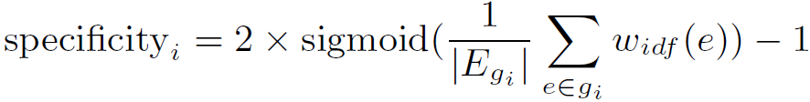
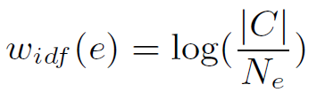
Step4: Code Example Selection (Ranking)
void read(String fname) {
new AudioReader(fname).
read();
}
void read(String fname) {
new TextReader(fname).
readLine();
}
void read(String fname) {
new FileReader(fname).
read();
}
String read(String fname) {
new BuffReader(fname).
read();
}
void read(String fname) {
new FileReader(fname).
read();
}
Rank Metric
Notes:
Having these clusters, we rank examples in each cluster and select the most typical example from each cluster.

Slide 18
Evaluation
Research Questions
RQ1: How accurate are the code examples selected by
CodeKernel ?
RQ2: How useful is CodeKernel for selecting API usage
examples ?
RQ3: Does graph kernel help improve the graph
clustering performance ?

Slide 19

Accuracy (RQ1)
Dataset
44 Java API examples
Metrics
Baseline
MUSE – clustering code snippets by program slicing and clone detection
ExoaDocs – clustering code snippets with similarity heuristics between AST element vectors
$$F1= \frac{2 ×P ×R}{P+R}$$
Notes:
[1] Cai, Deng, Xiaofei He, and Jiawei Han. "Document clustering using locality preserving indexing." Knowledge and Data Engineering, IEEE Transactions on17.12 (2005): 1624-1637.

Slide 20
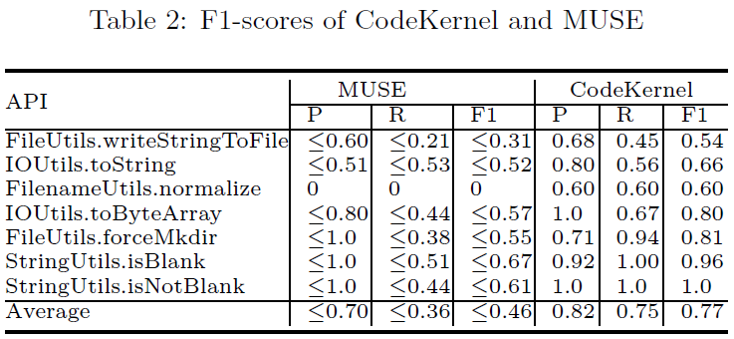
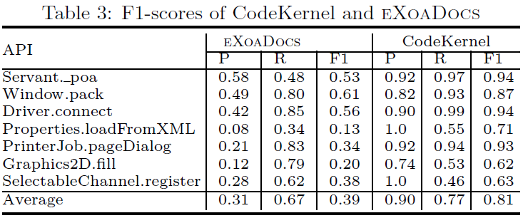
Accuracy (RQ1)

Slide 21
Usefulness (RQ2)
very useful
not useful
totally not useful
Questionnaire
Overall, are the selected examples useful for understanding API usages?
useful
neither
Tool comparison
Which tool produces better example?

Slide 22

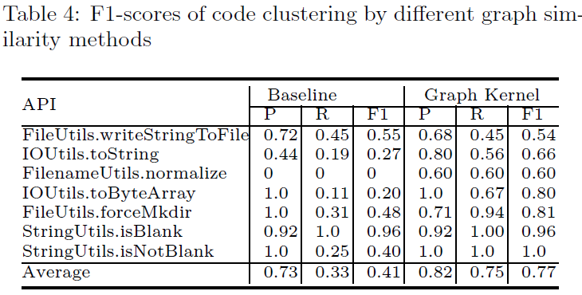
Effectiveness of GraphKernel (RQ3)
Replace the graph kernel component in CodeKernel with a traditional similarity measure

Slide 23
Conclusion
CodeKernel – summarize and select code examples
graph representation of code snippets
graph embedding and clustering by graph kernel
Future Work
Other tasks that require code similarity measure
e.g., code search, code clone detection, etc.
Deep learning to further improve the completeness and readability of the code examples.
Notes:
Graph embedding could also be applied to other tasks that require feature extraction on source code, such as code retrieval and code clone detection, which will be our future work. In the future, we will also investigate deep learning based techniques to further improve the completeness and readability of the code examples.

Slide 24

Thank you!
Q&A
Paper

