Slide 1
CVPR 2020: Online Knowledge Distillation via Collaborative Learning
AAAI 2020 : Improved Knowledge Distillation via Teacher Assistant
NIPS 2018 : Knowledge distillation by on-the-fly native ensemble.
CVPR 2018: Deep mutual learning
ICML 2018 : Born-Again Neural Networks
ECCV 2020 Knowledge Distillation Meets Self-Supervision

Slide 2
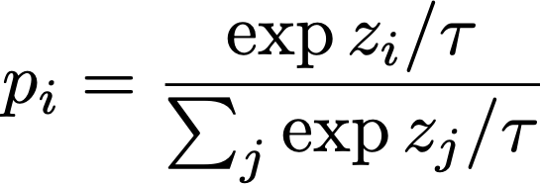
Knowledge Distillation with Soft Targets
损失函数：
Avoid
Wrong
guidance
Student output
Soft teacher output
Soft teacher output
label

Slide 3
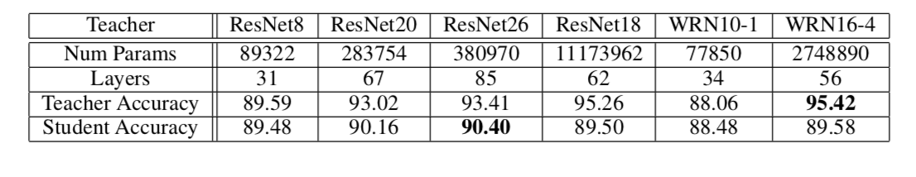
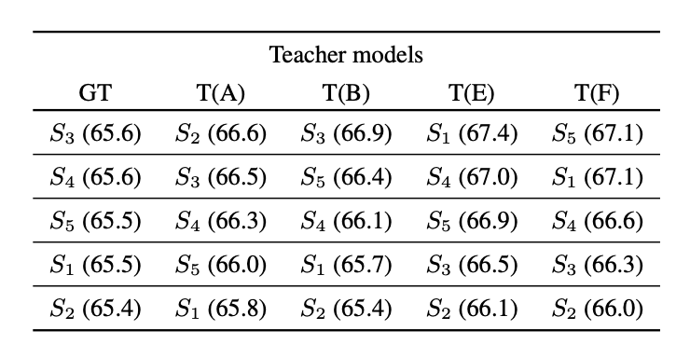
How To Choose the Teacher?
Resnet8 在不同老师情况下在Cifar 10上的accuracy
5个搜索出来的子网络在teacher A,B,E,F指导下imagenet 的结果

Slide 4
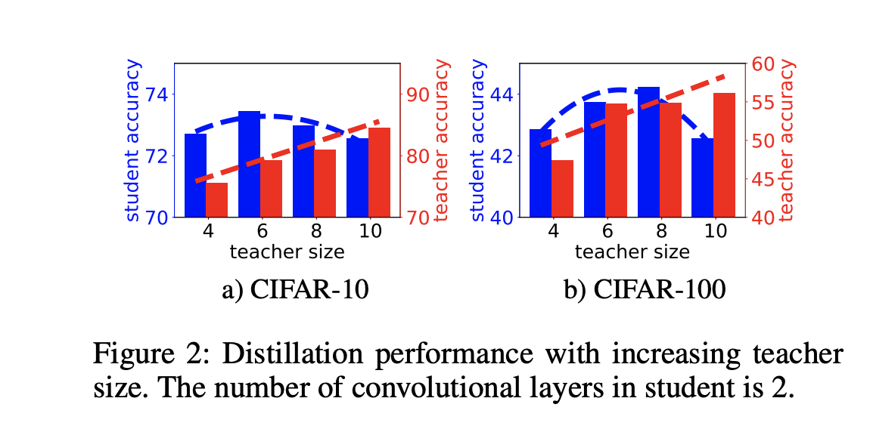
AAAI 2020 : Improved Knowledge Distillation via Teacher Assistant
The student network performance degrades when the gap between student and teacher is large

Slide 5
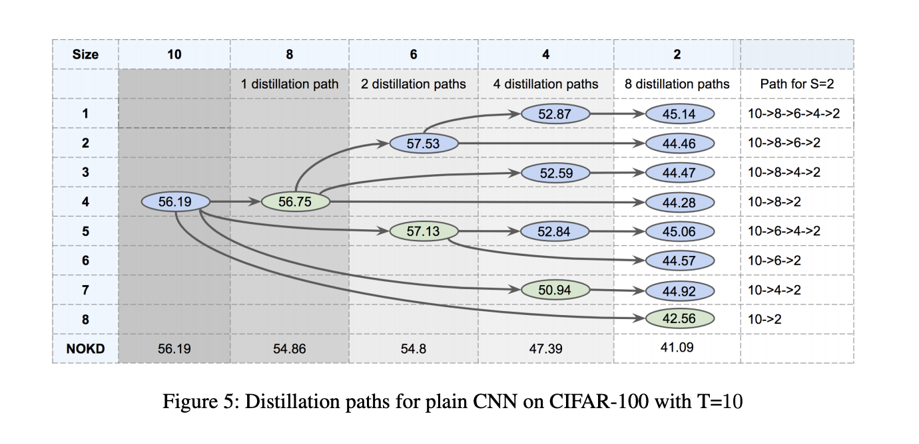
AAAI 2020 : Improved Knowledge Distillation via Teacher Assistant
Teacher Assistant Knowledge Distillation (TAKD)

Slide 6
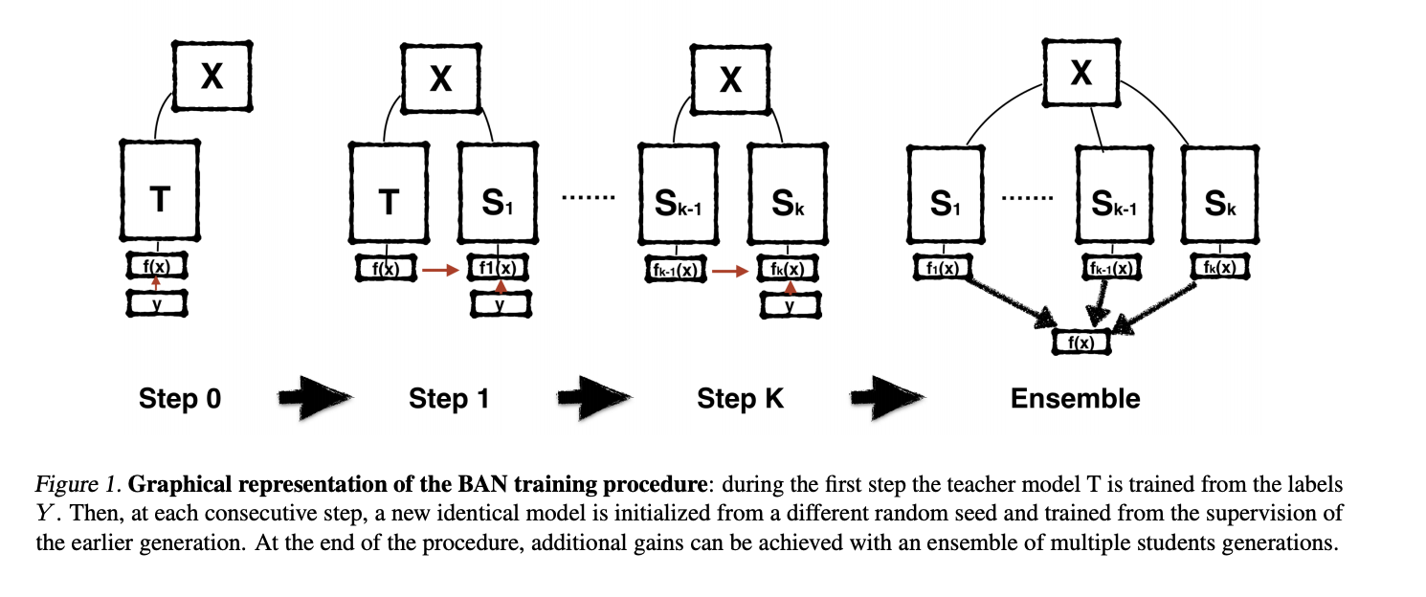
ICML 2018 : Born-Again Neural Networks
TAKD: The student network performance degrades when the gap between student and teacher is large
Guidance from itself

Slide 7
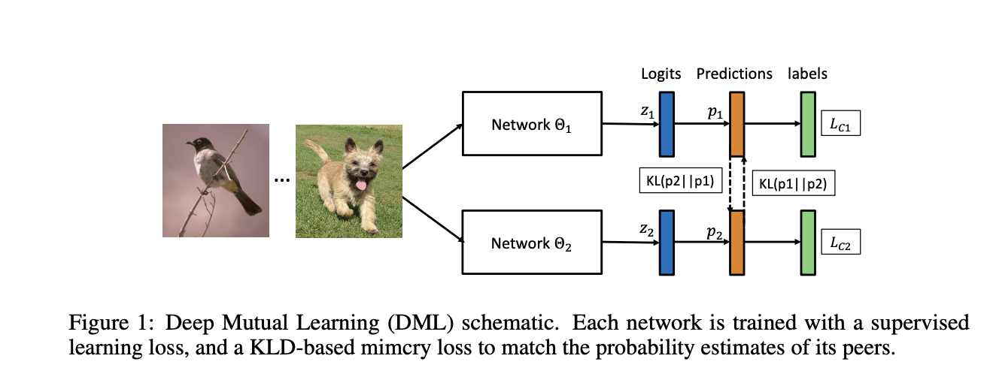
CVPR 2018: Deep mutual learning

Slide 8
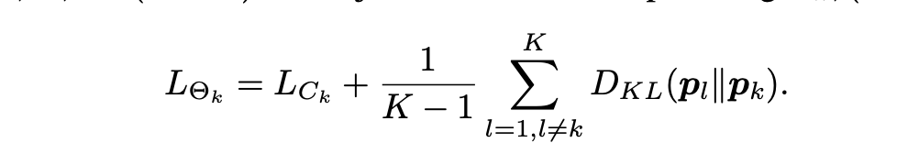
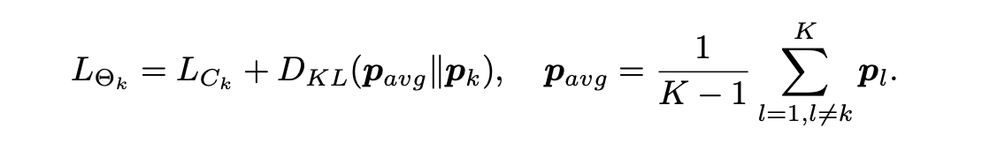
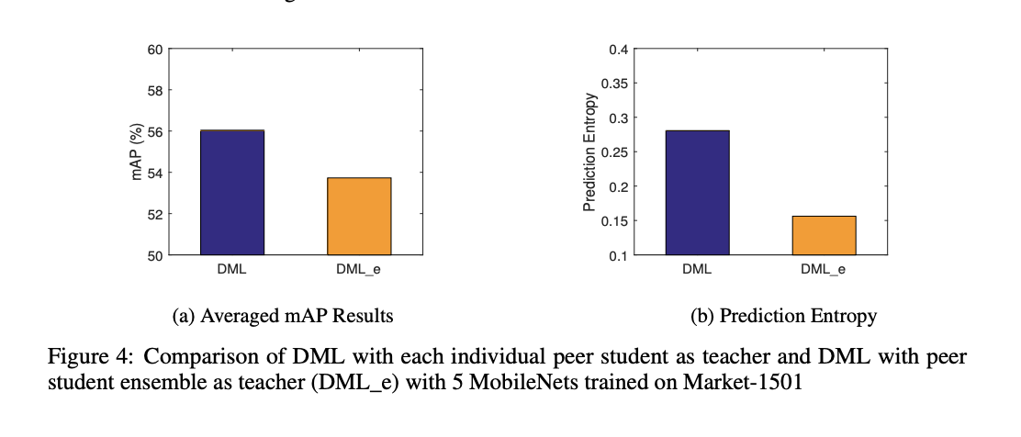
CVPR 2018: Deep mutual learning
DML with more than two networks
DML:
DML_e

Slide 9
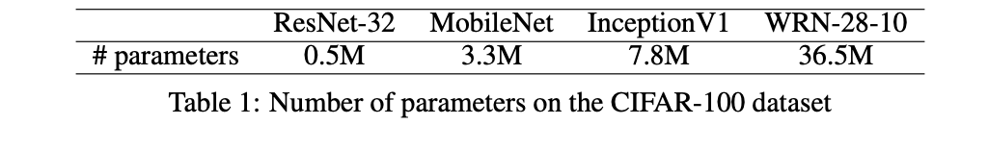
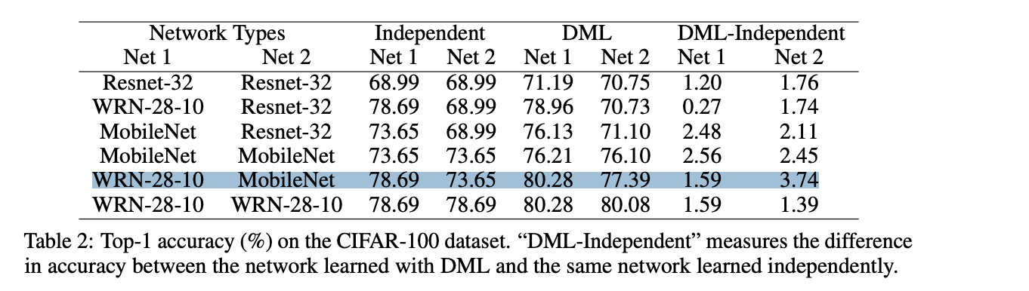
CVPR 2018: Deep mutual learning

Slide 10
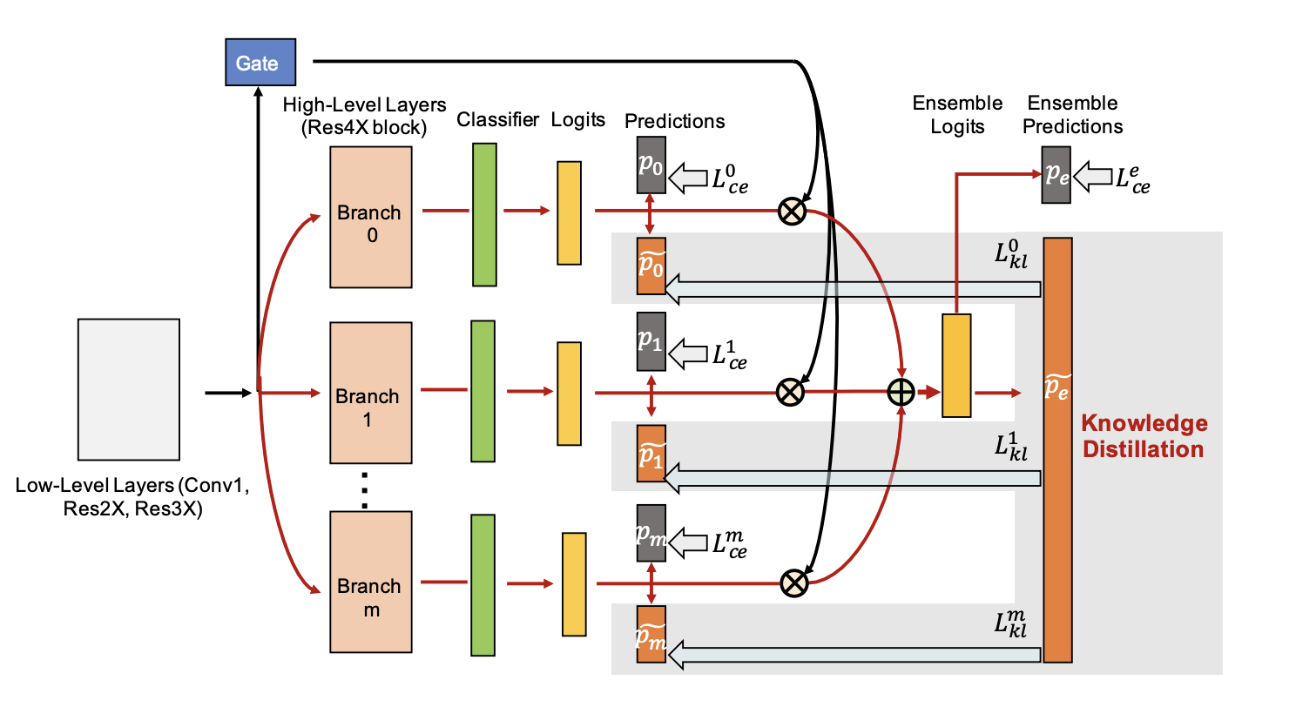
NIPS 2018 : Knowledge distillation by on-the-fly native ensemble.

Slide 11

NIPS 2018 : Knowledge distillation by on-the-fly native ensemble.
ONE: Ensemble importance is learnable
DML_e ： average

Slide 12
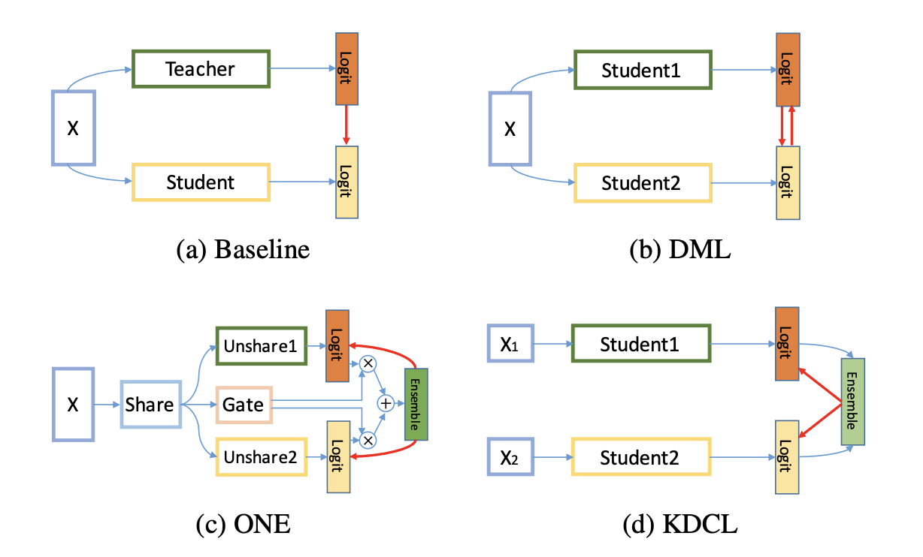
CVPR 2020: Online Knowledge Distillation via Collaborative Learning

Slide 13
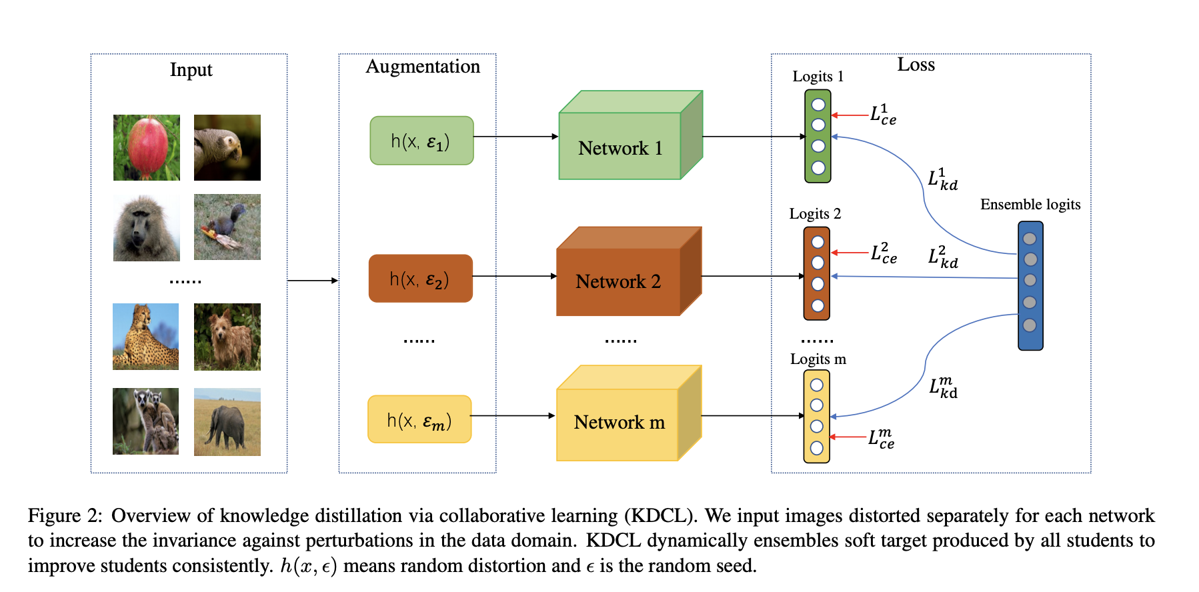
CVPR 2020: Online Knowledge Distillation via Collaborative Learning

Slide 14
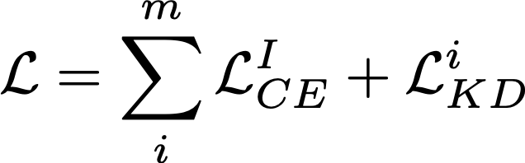

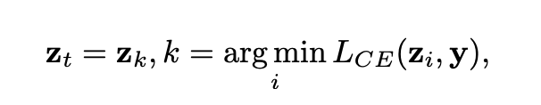
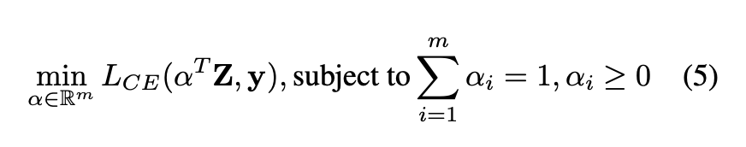
CVPR 2020: Online Knowledge Distillation via Collaborative Learning
LOSS:
Teacher Logit:
Naive
Linear
MinLogit :

Slide 15
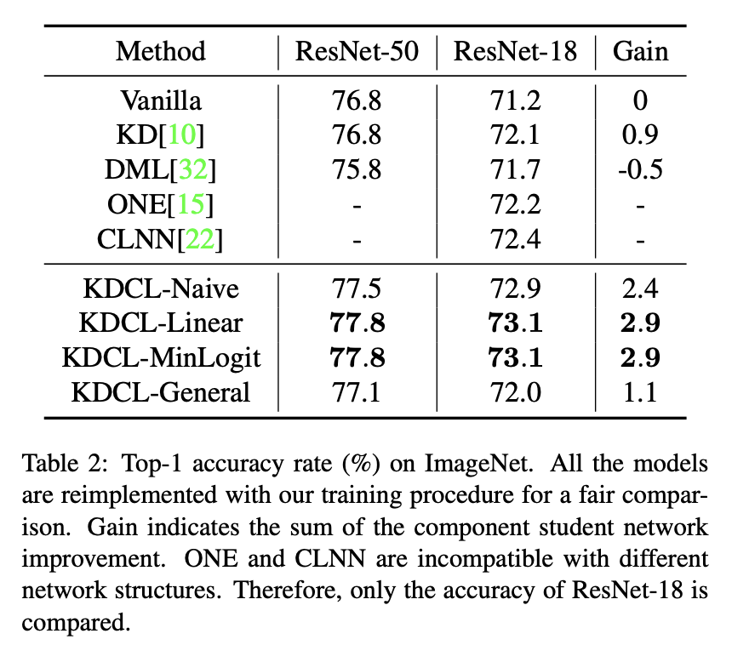
CVPR 2020: Online Knowledge Distillation via Collaborative Learning

Slide 16
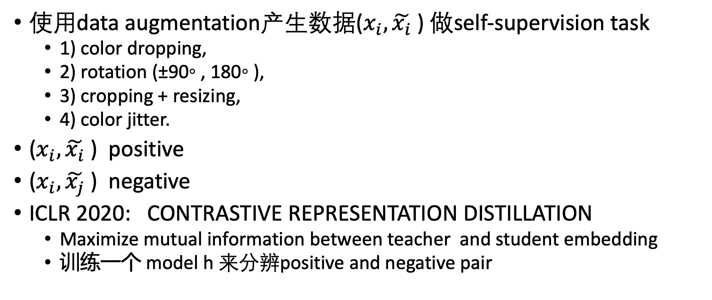
ECCV 2020 Knowledge Distillation Meets Self-Supervision
使用data augmentation产生数据($x_{i},\tilde{x_{i}}$) 做self-supervision task
1) color dropping,
2) rotation (±90◦ , 180◦ ),
3) cropping + resizing,
4) color jitter.
($x_{i},\tilde{x_{i}}$) positive
($x_{i},\tilde{x_{j}}$) negative
ICLR 2020: CONTRASTIVE REPRESENTATION DISTILLATION
Maximize mutual information between teacher and student embedding
训练一个 model h 来分辨positive and negative pair

Slide 17
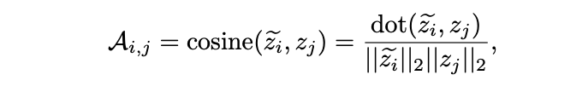
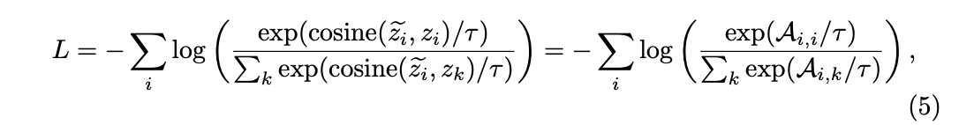
ECCV 2020 Knowledge Distillation Meets Self-Supervision
Maximize the similarity between positive pairs and minimize the similarity between negative pairs
Loss

Slide 18
ECCV 2020 Knowledge Distillation Meets Self-Supervision
Train Teacher
Fix Teacher Parameters
Add a 2-layer MLP module and using the contrastive prediction loss to train
Train Student
Add a 2-layer MLP module
Minimize the KL Div between teacher similarity matrix and student
同时对于aug data， student classifier mimic teacher classifier

Slide 19
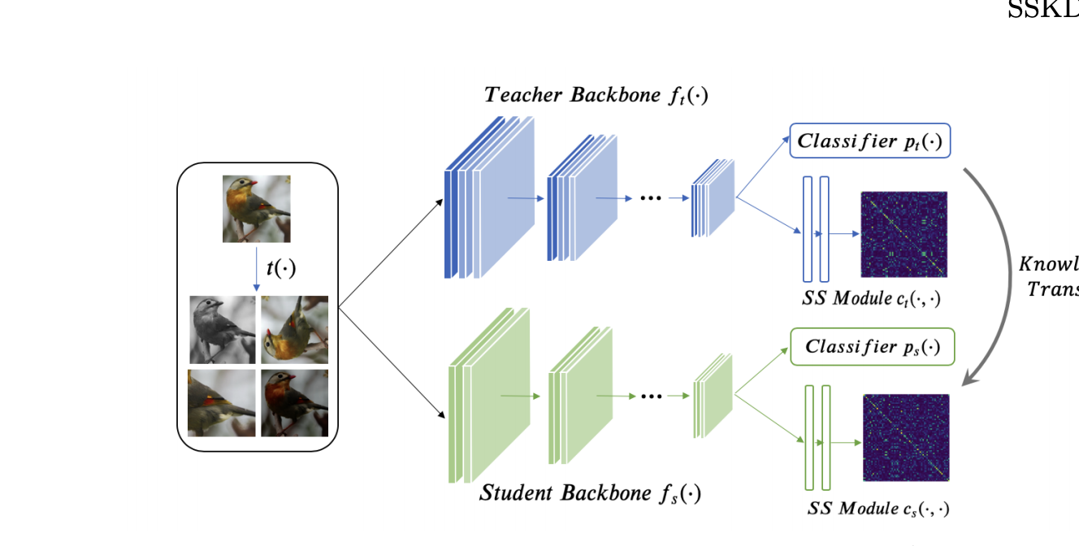
ECCV 2020 Knowledge Distillation Meets Self-Supervision

Slide 20
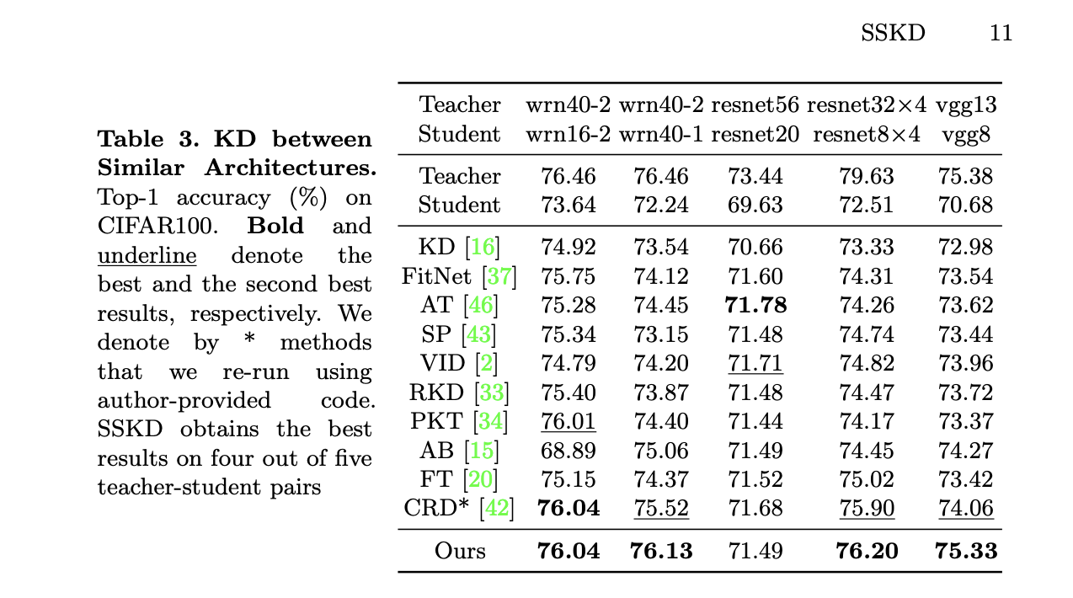
ECCV 2020 Knowledge Distillation Meets Self-Supervision

