Slide 1
Deep Learning in the Presence of Noisy Labels
Minqing Zhang
2020/07/10

Slide 2
Outline
A Brief Introduction to the Noisy Label Issue
A Brief Introduction to Several Previous Works Including a CVPR-2020 Paper

Slide 3
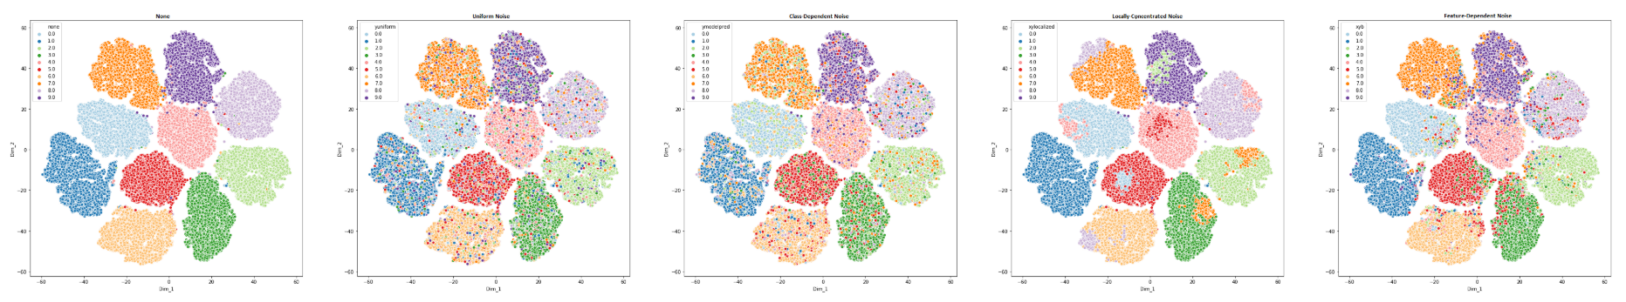
A Brief Introduction to the Noisy Label Issue

Slide 4
Noisy Label Issue for DNN
Deep neural network (DNN) models have to reach excellent performance to be applied in practice.
Well-performed models usually require excessive amount of labeled data for supervised learning.
The labeling process of such vast data can be extremely costly.
Assistances like crowdsourcing decrease the cost of labeling notably, but they meanwhile introduce label noise.
DNN models have the capacity to overfit training data including noisy-labeled data, which results in the deterioration of the models’ generalization.

Slide 5


Preliminaries
Classical supervised learning consists of an input dataset
drawn according to an unknown distribution
for any classifier f, expected risk is defined as follows
as an approximation, the empirical risk is used

Slide 6





Preliminaries
Model parameters can be obtained by minimizing the empirical risk
In the presence of the noise, dataset turns into
drawn according to a noisy distribution
Then, risk minimization results in
The parameters by minimizing over are different from the desired optimal parameters
Notes:
关键就是让第二个theta逼近第一个

Slide 7
Noisy Label Taxonomy
Random Noise: totally random and does not depend on either instance features nor its true class.
Y-dependent noise: independent of image features but depends on its class.
XY-dependent noise: depends on both image features and its class.
Notes:
Y: 手写7容易看成1，与图像无关，每个7的样本有同样的概率被标记成1；XY：在Y的基础上不同图像的表现特征对分错类也有影响，不同7的样本可能有不同的概率被标记成1

Slide 8
Noisy Label Algorithm Taxonomy
According to their need for a noise-free subset of data or not.
According to the noise type they are dealing with.
According to their need for explicit modeling of the noise structure or not.
Noise model based methods aim to model the noise structure so that this information can be used during training to come through noisy labels.
Noise model free methods aim to come up with inherently noise robust methods without explicit modeling of the noise structure.

Slide 9
Noisy Model Based Methods (NMBM)
Noisy Channel
Label Noise Cleansing
Dataset Pruning
Sample Choosing
Sample Weighting

Slide 10



NMBM – Noisy Channel
Form the mapping from network predictions to given noisy labels as
If Q adapts the noise structure , then network will be forced to learn true mapping
A common problem in noisy channel estimation is scalability.

Slide 11

NMBM - Label Noise Cleansing
The idea is to identify and correct suspicious labels. Cleaning the whole dataset manually can be costly, therefore some works propose to pick only suspicious samples.
Including the cleansing algorithm, the empirical risk takes the following form, where G represents the noise cleansing algorithm.
It is not scalable as well.

Slide 12
NMBM - Dataset Pruning
Instead of correcting noisy labels, an alternative approach is to remove them.
This would result in loss of information, and there is a risk of removing too many samples.
Therefore, it is crucial to remove as few samples as possible to prevent unnecessary data loss.
Notes:
只丢label保留数据，然后当无监督做

Slide 13

NMBM - Sample Choosing
Guiding the network with choosing the right instances to feed can help classifier finding its way easier in the presence of noisy labels.
If V=1 for all data, then it turns out to be classical risk minimization.
If V is a static function, then it turns out to be dataset pruning.
Notes:
动态的V

Slide 14


NMBM - Sample Weighting
Assigning weights to instances according to their estimated noise level.
where is a non-binary dynamic function to determines the instance dependent weight.

Slide 15
Noisy Model Free Methods (NMFM)
Robust Losses
Regularizers
Resemble
Notes:
Noisy data 被认为是outlier 因此使用 类似避免overfit的技术尝试解决问题

Slide 16
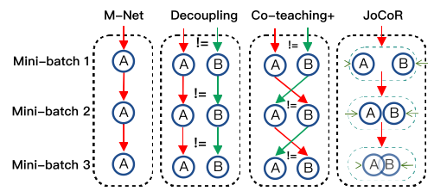
A Brief Introduction to Several Previous Works

Slide 17
MentorNet: Learning Data-Driven Curriculum for Very Deep Neural Networks on Corrupted Labels
ICML 2018
Lu Jiang¹, Zhengyuan Zhou², Thomas Leung¹, Li-Jia Li¹, Li Fei-Fei¹ ²
¹Google Inc., Mountain View, United States
²Stanford University, Stanford, United States

Slide 18
Motivation
DNNs are capable of memorizing the entire data even the noisy-labeled data.
This phenomenon leads to very poor generalization performance.
Small-loss instances can be seen as clean data and thus learned first.
Curriculum Learning: model should be learned gradually using samples ordered in a meaningful sequence.

Slide 19
Contribution
To overcome the overfitting on corrupted labels, we propose a curriculum learning based training framework: MentorNet& StudentNet.
MentorNet learns a data-driven curriculum dynamically with StudentNet to guide the training of StudentNet.
We prove the curriculum learning can work as the sample choosing manner to alleviate the noisy label issue.

Slide 20
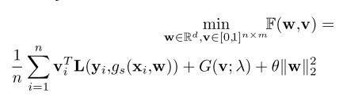

Method
Let denote the StudentNet, which is parameterized by w;
denotes the curriculum parameterized by .
The object can be formulated as
The curriculum can be computed as

Slide 21
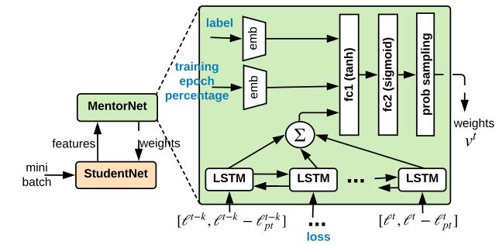
Method

Slide 22
Co-teaching: Robust Training of Deep Neural Networks with Extremely Noisy Labels
NIPS 2018
Bo Han¹ ², Quanming Yao³, Xingrui Yu¹, Gang Niu²,
Miao Xu², Weihua Hu⁴, Ivor W. Tsang¹, Masashi Sugiyama² ⁵
¹Centre for Artificial Intelligence, University of Technology Sydney;
²RIKEN; ³4Paradigm Inc.; ⁴Stanford University; ⁵University of Tokyo

Slide 23
Motivation
Memorization effects: DNNs would first memorize training data of clean labels and then those of noisy labels.
Self-paced Learning like MentorNet inherits the same inferiority of accumulated error caused by the sample-selection bias.
Self-check is hard, but dual classifiers with different learning abilities provide double-check to the label noise.

Slide 24
Contribution
We propose a dual-model learning framework Co-teaching.
In Co-teaching, the two classifiers can filter different types of label error.
We prove the dual-model learning framework can effectively alleviate the negative effects of noisy label.

Slide 25
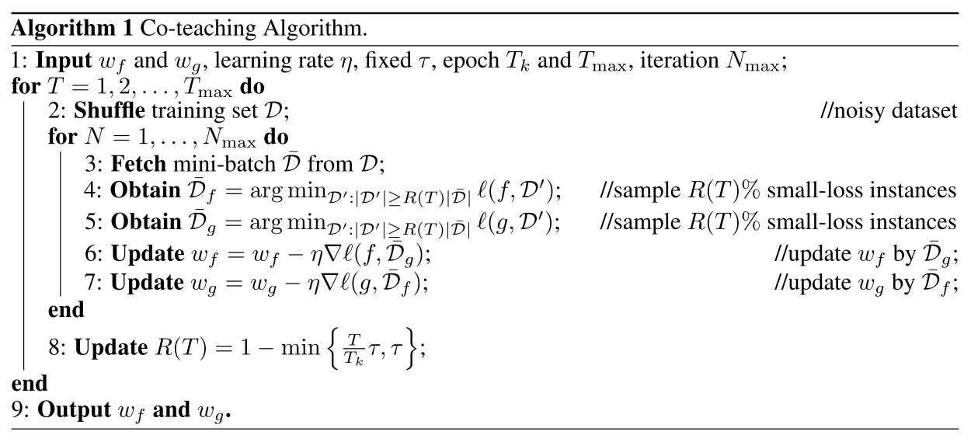
Method
Notes:
用对方的small-loss instance 来训练网络。 R(T)递减，刚开始需要多一些样本，逐渐变严格

Slide 26
Decoupling “when to update” from “how to update”
NIPS 2017
Eran Malach, Shai Shalev-Shwartz
School of Computer Science The Hebrew University, Israel

Slide 27
Motivation
In the regular training process clean data could be learned first to improve the classifier.
In the advanced stage of the training process, the classifier may give correct predictions, but will still have to update due to wrong labeling. Therefore the classifier deteriorates.
The disagreement from two models tends to be label noise.

Slide 28
Contribution
We propose a dual-model based learning framework and a disagreement update rule to alleviate the noisy label issue.
We prove the disagreement between two different networks can help identify label error.

Slide 29
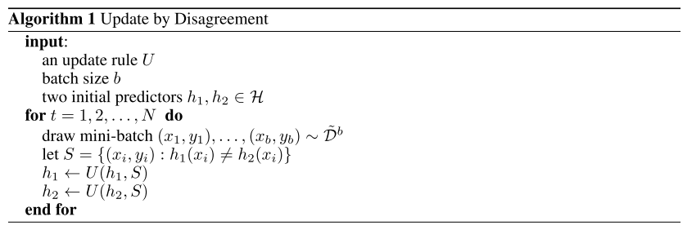
Method

Slide 30
How does Disagreement Help Generalization against Label Corruption?
ICML 2019
Xingrui Yu¹, Bo Han², Jiangchao Yao³,
Gang Niu², Ivor W. Tsang¹, Masashi Sugiyama² ⁴
¹Centre for Artificial Intelligence, University of Technology Sydney;
²RIKEN-AIP; ³Alibaba Damo Academy; ⁴University of Tokyo

Slide 31
Motivation
Co-teaching performs well in the noisy label issue by cross-training two DNNs using the small-loss trick. However, with the increase of epochs, two models converge to a consensus and Co-teaching reduces to the self-training MentorNet.
“Update by Disagreement” strategy can tackle this problem.

Slide 32
Contribution
We introduce the “Disagreement” strategy to solve the problem where two models converge with epoch increasing in Co-teaching.
We prove that the “Disagreement” strategy can keep two networks diverged, which significantly boosts the performance of Co-teaching.

Slide 33
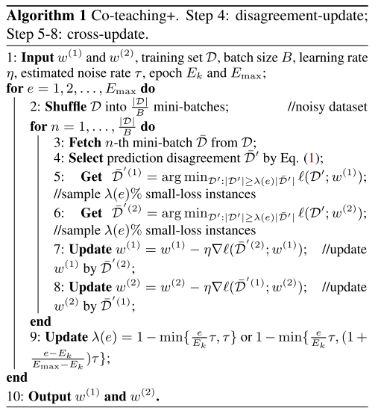
Method
Notes:
先disagreement再small-loss

Slide 34
Combating Noisy Labels by Agreement: A Joint Training Method with Co-Regularization
CVPR 2020
Hongxin Wei¹, Lei Feng¹, Xiangyu Chen², Bo An¹
¹School of Computer Science and Engineering, Nanyang Technological University, Singapore;
²Open FIESTA Center, Tsinghua University, China

Slide 35
Motivation
The state-of-the-art methods “Decoupling" and “Co-teaching+" argue the “disagreement" strategy is crucial for noisy label issue.
However, there are only a part of training examples that can be selected by the “Disagreement", and these examples cannot be guaranteed to have ground-truth labels.
Our intuition is that different models would agree on the labels of most examples, and it is unlikely for compatible classifiers to agree on an incorrect label.

Slide 36
Contribution
We propose a joint-training framework which stems from the idea that models tend to agree on clean labels.
We prove the ‘Agreement’ can be a alternative to alleviate noisy label issue, and this ‘Agreement’-based method achieved comparable performance to the ‘Disagreement’-based ones.

Slide 37
Method
We encourage two different classifiers to make predictions closer to each other by explicit regularization method instead of hard sampling employed by the “Disagreement” strategy.
This method trains two base classifiers by one loss function, which includes a regularization term to reduce divergence between the two classifiers.

Slide 38
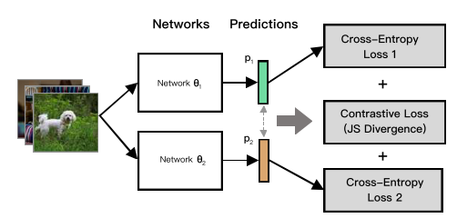


Method
“Joint Training“: The parameters of the two models are different but updated simultaneously by a joint loss

Slide 39
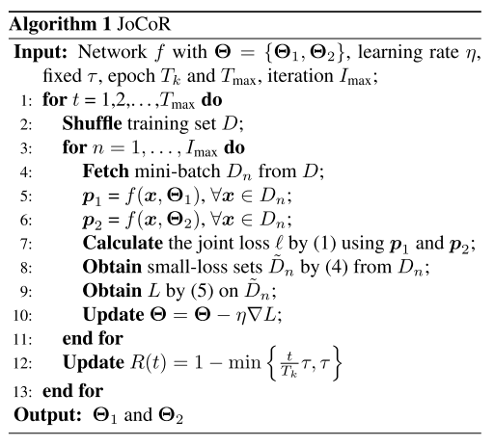
Method
Notes:
先用l计算loss，再找出small-loss instances，再在这些instances上重新计算loss（把大loss的丢掉）

Slide 40
Comparison over these methods
 | MentorNet | Co-teaching | Decoupling | Co-teaching+ | JoCoR
Small-loss | √ | √ |  | √ | √
Dual-model |  | √ | √ | √ | √
Cross-update |  | √ |  | √
Disagreement |  |  | √ | √
Agreement |  |  |  |  | √
Joint-training |  |  |  |  | √
Notes:
总结就是这些思路和trick被证明有效，具体哪个更好，可能还要看不同的任务。

Slide 41
Thanks

