Slide 1
ECCV2020 NAS Works
Zixun Zhang
2020/07/17

Slide 2
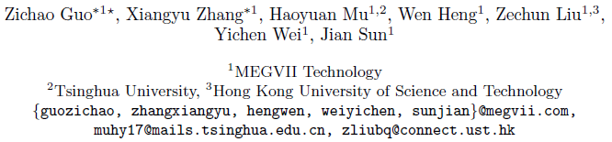
Single Path One-Shot Neural Architecture Search with Uniform Sampling

Slide 3
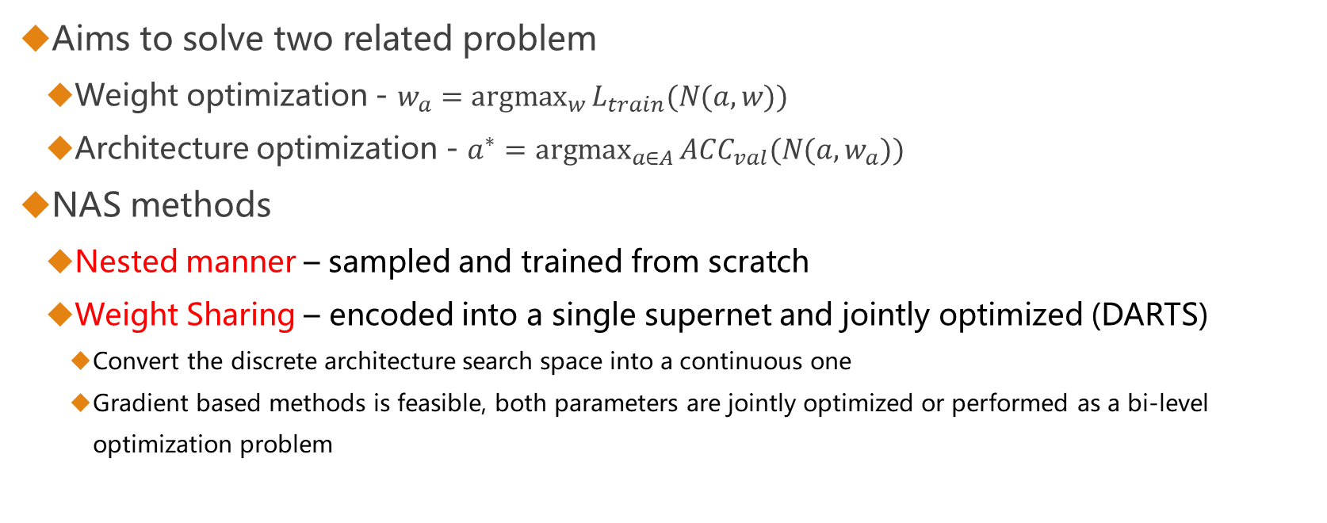
Neural Architecture Search
Aims to solve two related problem
Weight optimization - $w_{a}=\underset{w}{argmax}{L_{train}(N(a, w))}$
Architecture optimization - $a^{∗}=\underset{a∈A}{argmax}{ACC_{val}(N(a,w_{a}))}$
NAS methods
Nested manner – sampled and trained from scratch
Weight Sharing – encoded into a single supernet and jointly optimized (DARTS)
Convert the discrete architecture search space into a continuous one
Gradient based methods is feasible, both parameters are jointly optimized or performed as a bi-level optimization problem

Slide 4
Issues in previous methods
Nested methods
Training is expensive. Only small dataset and small search space are affordable
Weight sharing
Weights of the nodes depend on each other, become deeply coupled during training
Joint optimization of architecture param and weight param introduces further complexity (in analogy to the E&E dilemma in RL)
Tasks always have additional requirements on energy consumption

Slide 5
Single Path One Shot
Alleviate the joint optimization problem – decouple the weight training and architecture search
One-shot method
The weights of nodes are still coupled in supernet training
Reduce the co-adaptation of the node weights during training
Previous approach uses a “path dropout” strategy during weight training

Slide 6
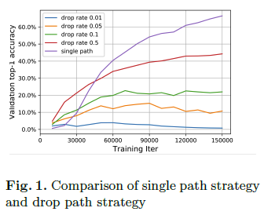
Single Path One Shot

Slide 7
Single Path One Shot
Rethink the fundamental principle behind the idea of weight sharing
The weights of supernet should be optimized in a way that all architectures in the search space are optimized simultaneously
Stochastic supernet
Single path and Uniform sampling are good enough

Slide 8
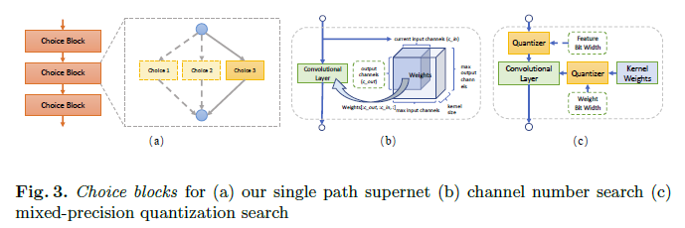
Search space

Slide 9
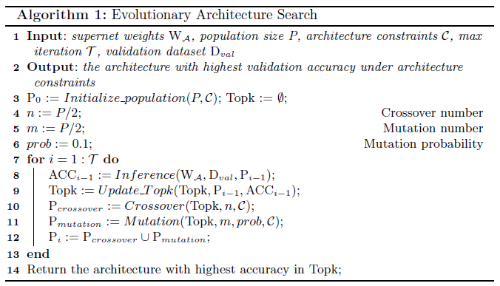
Architecture search

Slide 10
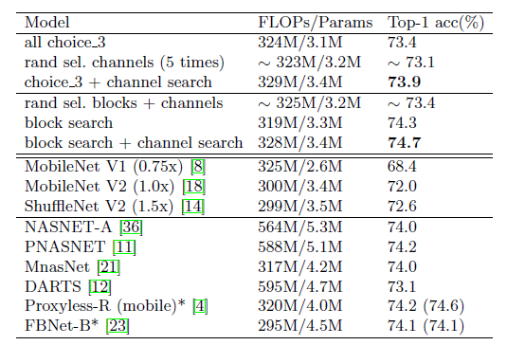
Experiments - ImageNet

Slide 11
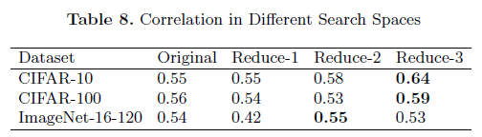
Correlation Analysis

Slide 12
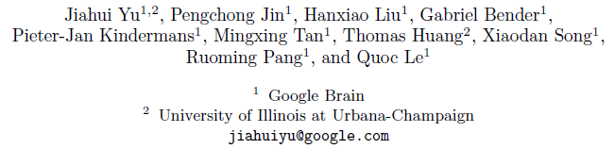
BigNAS: Scaling Up Neural Architecture Search with Big Single-Stage Models

Slide 13
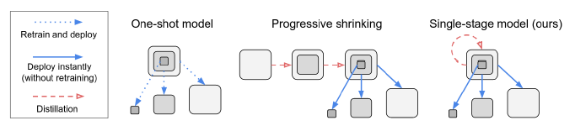
Deployment workflow of NAS

Slide 14
NAS with single-stage models
BigNAS consists of two steps
Train a big single-stage model from which we can directly sample or slice different architectures as child models for deployment
Architecture selection using a simple coarse-to-fine selection method to find the most accurate model under the given resource constraints

Slide 15
Training single-stage model
1. Sandwich rule (proposed in universal slimmable networks)
Sample the smallest, biggest and random N child models
Aggregate the gradients before updating
2. Inplace Distillation (proposed in universal slimmable networks)
Take the soft labels predicted by the biggest model to supervise all other child models
Crop from the same patch

Slide 16
Training single-stage model
3. Initialization
Initialize the output of each residual block to an all-zero tensor by setting the learnable scaling gamma to 0
4. Convergence behavior
In practice, big child converge faster than small model
Dilemma – at step t, big child models are overfitting while small models are not fully-trained
Exponentially decaying with constant ending LR schedule

Slide 17
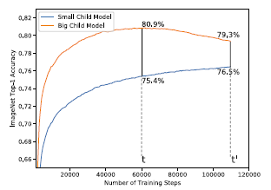
Training single-stage model
5. Regularization
Regularize only the biggest child model, to both weight decay and dropout
6. BN Calibration
Re-calibrate the batch norm statistics while inference

Slide 18
Coarse-to-fine selection
First try to find a rough skeleton of promising network candidates in general
Define a limited factor set
Obtain the benchmark for all child in this space
Then pick the best skeleton network, randomly search for fine-grained network
Randomly sample for network-wise resolution, stage-wise depth, number of channels and kernel sizes to further discover better network architectures

Slide 19
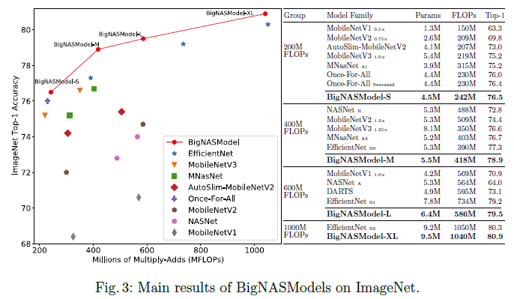
Experiments

Slide 20
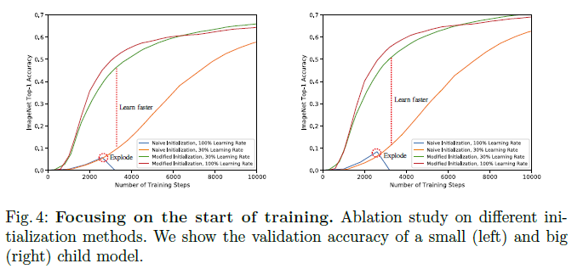
Ablation – Initialization

Slide 21
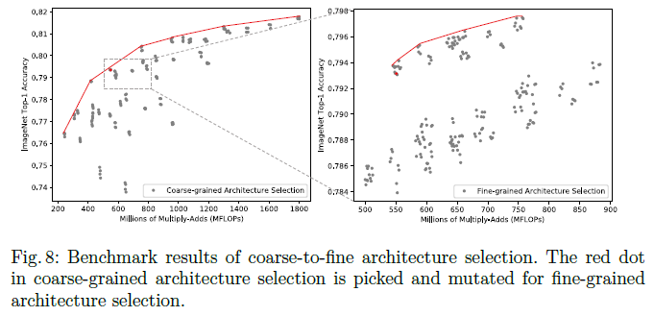
Ablation – CtoF selection

Slide 22
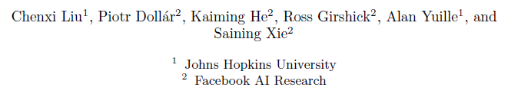
Are Labels Necessary for Neural Architecture Search?

Slide 23
Unsupervised NAS
NAS
UnNAS
Search
Pre-defined search space
Estimate the accuracy with labels
Evaluation
Retrain the target architecture
Evaluate on validation dataset
Search
Pre-defined search space
No human annotated labels
Evaluation
Retrain the target architecture
Evaluate on validation dataset

Slide 24
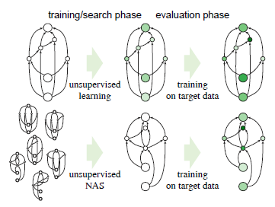
Related to unsupervised learning

Slide 25
Statistical experiments setting
Pretext tasks
Rotation prediction
Colorization
Solving jigsaw puzzles
Search space
DARTS search space
NAS-Bench-101 search space
Studies
Rank correlation
All architectures sampled from a whole search space
Random experiment
Top K architectures in a random experiment

Slide 26
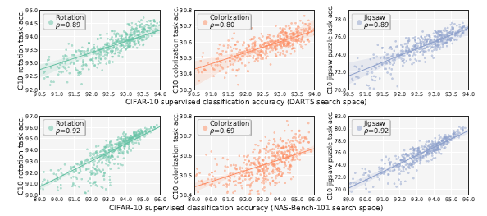
Rank correlation on same dataset

Slide 27
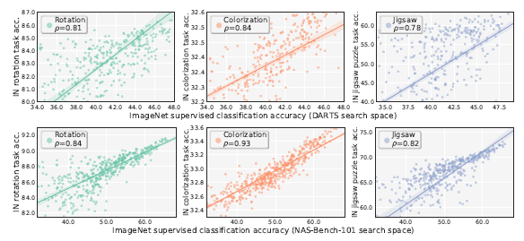
Rank correlation on same dataset
Rank correlation is typically higher than 0.8, regardless of the dataset, search space and pretext task.

Slide 28
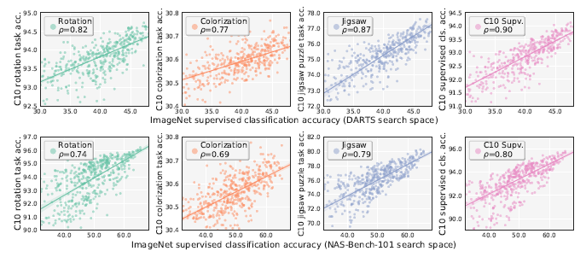
Rank correlation across dataset
The relative ranking of an architecture is likely to be similar
CIFAR-10 supv. is a commonly used proxy task in existing NAS methods

Slide 29
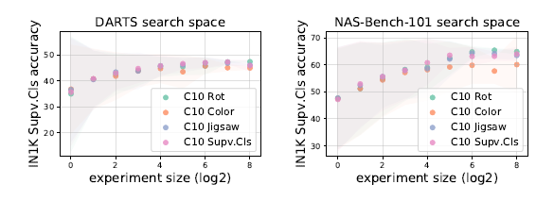
Rank correlation across dataset
The architecture rankings produced w/wo labels are not only correlated across the entire search space, but also towards the top of the search space
Better pretext accuracy translates to better supv. accuracy

Slide 30
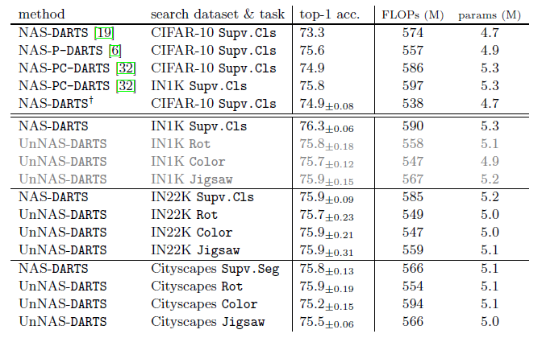
Search-based experiments

Slide 31
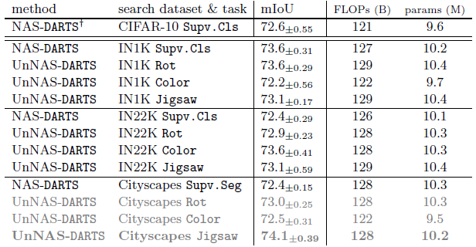
Search-based experiments
UnNAS architectures perform competitively to supervised counterparts
NAS and UnNAS results are robust across a large variety of datasets and tasks

Slide 32
Thanks

