Slide 1
Report
Deyu Zhou
2020.07.17

Slide 2
Self Introduction
Name
Deyu Zhou
Age
22
Native Place
Guangdong Shantou
School
South China University of Technology (SCUT)
Intern Experiences:
Huawei: CV (virtual make-up, blur detection)
Tencent: NLP (sentiment analysis, machine translation)

Slide 3
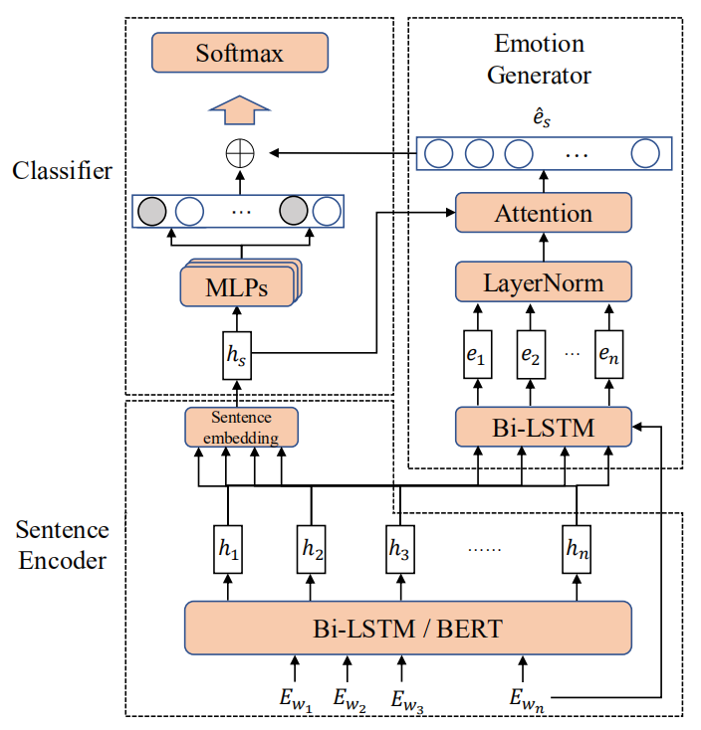
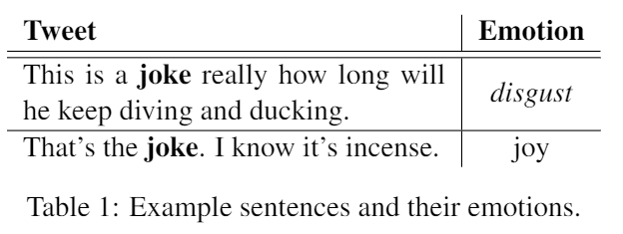
Previous Idea I
Task
Multi-label sentence emotion classification
Emotion Class
Happy, sad, anger, positive (11)
Motivation
Domain mismatch problem of emotion lexicons
Find emotions of every word in different context

Slide 4
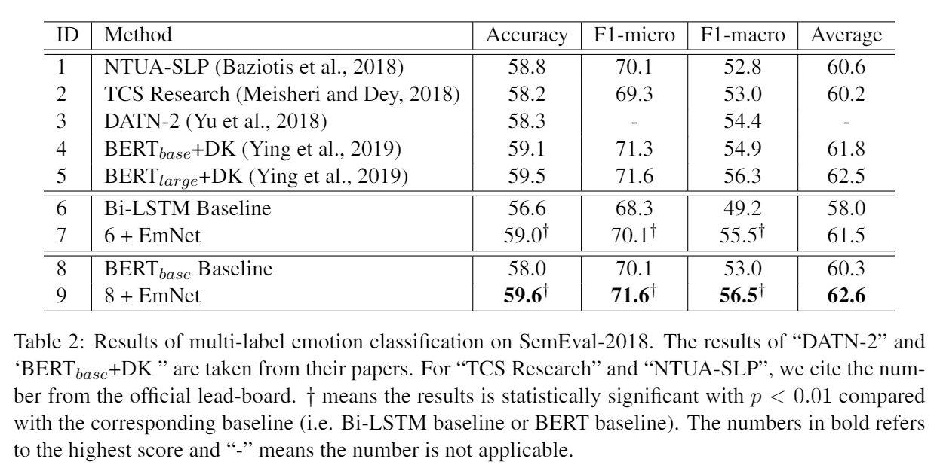
Previous Idea I
Performance

Slide 5
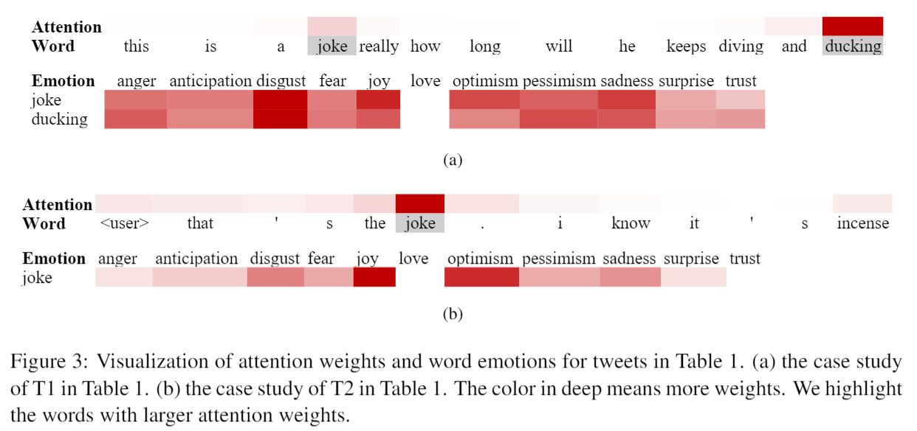
Previous Idea I
Case Study

Slide 6
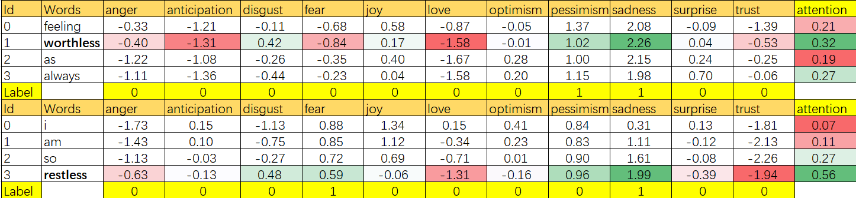
Previous Idea I
Generated Emotions

Slide 7
My Idea
Motivation
Idea I
Task
Semantic Segmentation/Object Detection/Image Classification
Dataset
Image Classification Dataset (ImageNet and so on.)

Slide 8
My Idea
Method
Set input of LSTM as image patch (3x3)
Output Image patch class
Patch/pixel classification by only image labels

Slide 9
Previous Idea II
Task
Neural Machine Translation
Ensemble
Conventional Ensemble (sentence-level, word-level)
Transductive Ensemble Learning
Translate the dev/test dataset using 4 models
Utilize the generated data to finetune an existing model
Motivation
One source sentence, optimized to multiple targets
Learn more from better teacher
Data Selection/Data Weighting/Noisy Label/Curriculum Learning

Slide 10
Previous Idea II
Idea Validation
Utilize 4 models to translate dev/test data
Use label to assign weights for generated data
4 translations of a sample in dev/test
[TA, TB, TC, TD]
4 BLEU values
[BLEU_TA, BLEU_TB, BLEU_TC, BLEU_TD)
4 weights
softmax(BLEU_TA*c, BLEU_TB*c, BLEU_TC*c, BLEU_TD*c)
[W_TA, W_TB, W_TC, W_TD] (0.8+, 0.1+, 0.0, 0.0)
Sentence-level weighted loss
Improve TEL by 5+ BLEU (hard to reach without label/reference)

Slide 11
Previous Idea II
Existing Translation Quality Esitimation Solution
4 models forward translate the dev/test set
Use another back-translation model to backtranslate the generated data
Compute BLEU with souce sentences in dev/test set as weights
Proxy
best-translation accuracy in the generated data of 2 models
[[TA1, TB1], [TA2, TB2], ... , [TAn, TBn]]
80% is able to improve TEL by 0.5+ BLEU

Slide 12
Thanks

