Slide 1

Medical Image in CVPR2020
Qin Wang
http://www.qinwang.blog

Slide 2
CPR-GCN: Conditional Partial-Residual Graph Convolutional Network in Automated Anatomical Labeling of Coronary Arteries
﻿Han Yang1,∗, Xingjian Zhen2,∗, Ying Chi1,
﻿﻿DAMO Academy, Alibaba Group

Slide 3
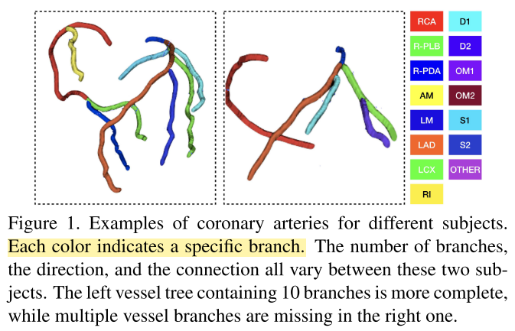
Task
Coronary branch labeling
Input: coronary centerline
Difficult: Not all cases has completed branches.
﻿Previous work only utilize position information from vessel centerline and leaves the full information in the CCTA images aside.

Slide 4
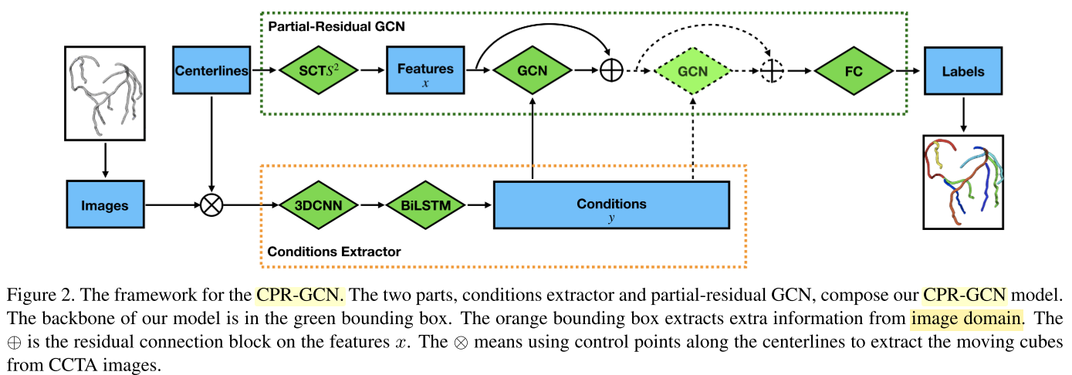
Method
Using GCN to combine voxel information and topology feature together to do precise labeling.
Using 3D CNN and BiLSTM to extract voxel features

Slide 5
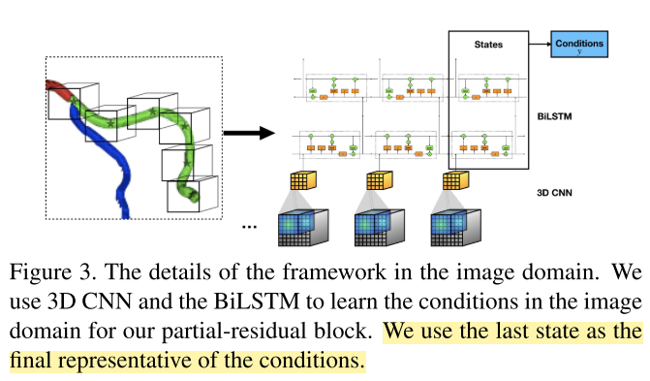
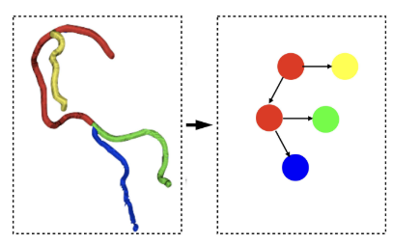
Method

Slide 6
LT-Net: Label Transfer by Learning Reversible Voxel-wise Correspondence for One-shot Medical Image Segmentation
﻿Shuxin Wang∗ 1,2, Shilei Ca∗ 2, Dong Wei∗ 2
﻿1 Xiamen University ﻿Jarvis Lab, Tencent

Slide 7
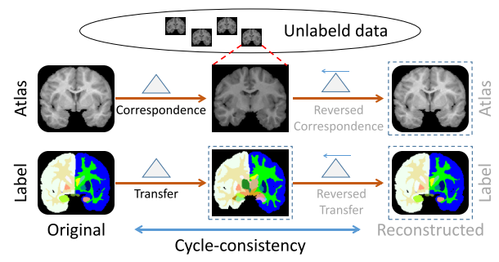
Task
One-shot segmentation
Only one case has ground truth
﻿Atlas-based segmentation
Template based

Slide 8
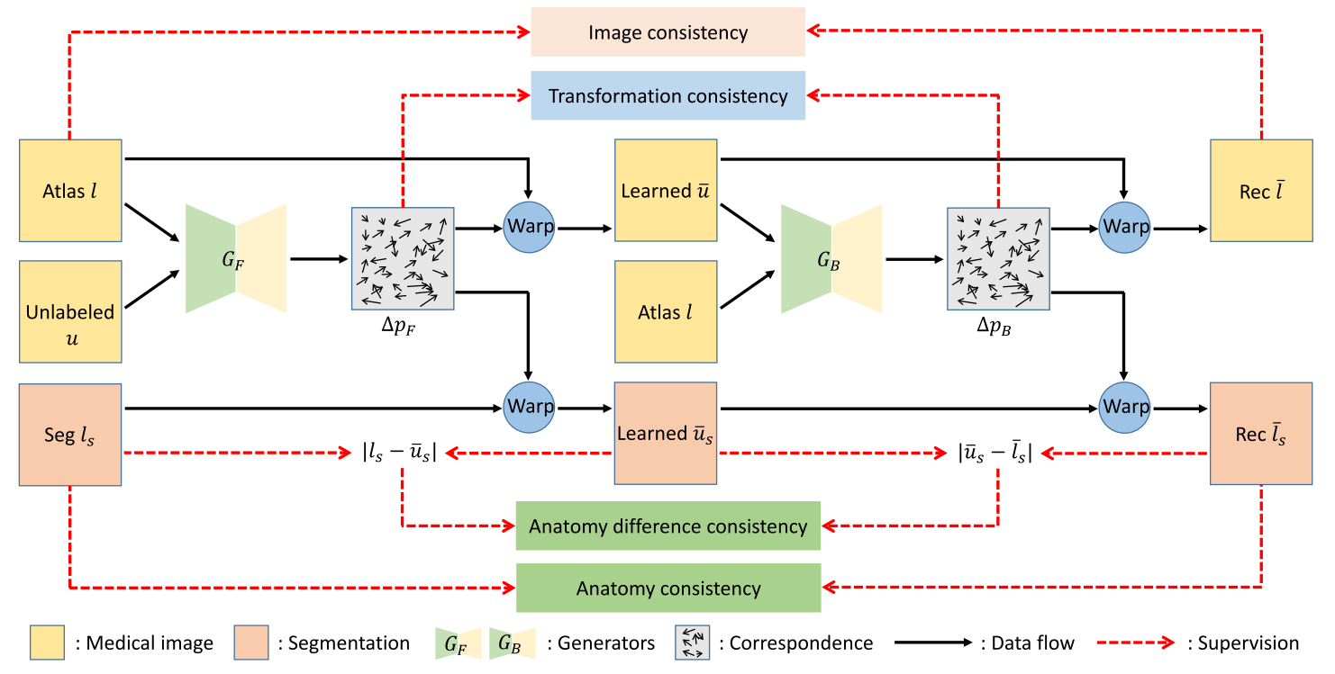
Method
﻿Correspondence
Vector field(Optical flow, tracking, ﻿patch matching ﻿and registration)
Adding supervises as many as possible

Slide 9
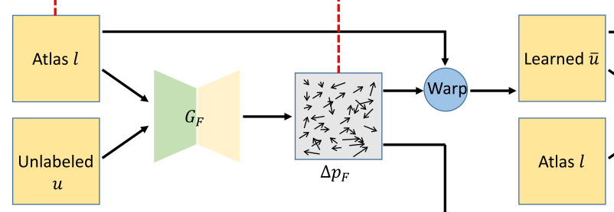
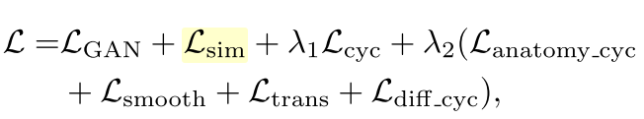


Method
﻿A GAN loss is exploit to distinguish \hat{u} and u
Loss Function

Slide 10
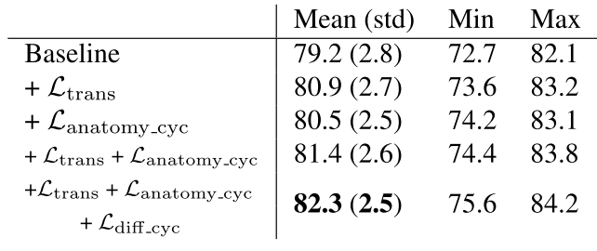
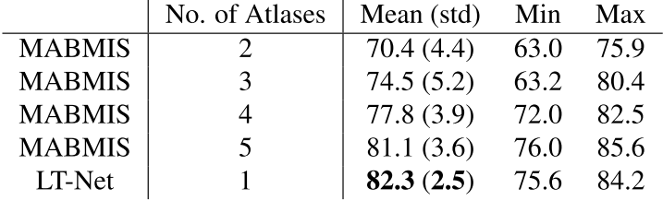
Experiment
Ablation study
Comparison

Slide 11
Synthetic Learning: Learn From Distributed Asynchronized Discriminator GAN Without Sharing Medical Image Data
Qi Chang1∗, Hui Qu1∗, Yikai Zhang Stony Brook University 4Hong Kong University of Science and Technology

Slide 12
Task
Utilize synthetic image solely to train the segmentation model.
The privacy policies and challenges in medical intelligence
the largest set of medical image data available to public is 32 thousand CT images, only 0.02% of the annual acquired images in the United States. In contrast, the ImageNet project, which is the large visual dataset designed for use in visual object recognition research, has more than 14 million images that have been annotated in more than 20,000 categories.
Achieves
Could learn the real image’s distribution from multiple datasets without sharing the patient’s raw data.
Is more efficient and requires lower bandwidth than other distributed deep learning methods
Achieves higher performance compared to the model trained by one real dataset,
Has provable guaran- tees that the generator could learn the distributed distribu- tion in an all important fashion thus is unbiased
https://github.com/tommy- qichang/AsynDGAN

Slide 13
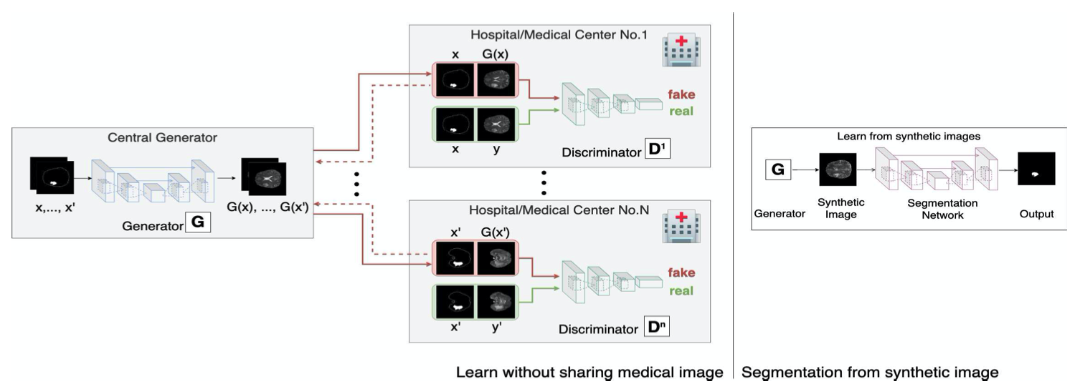
Method
One central generator and multiple distributed discriminators
Naturally capable of avoiding such limitation of real images in each medical center may not be accessed from outside.
Only synthetic images, masks, and gradients are needed to be transferred between the central generator and the medical entities.

Slide 14
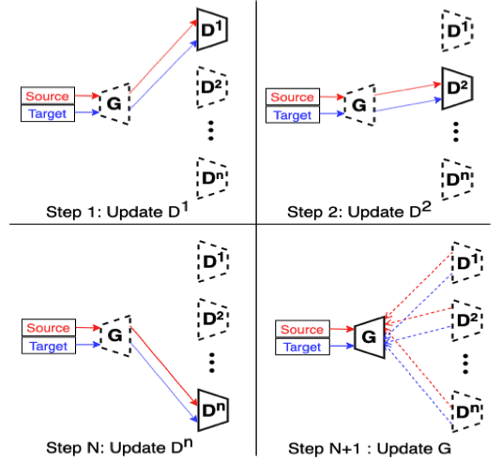
Method
Iteratively training

Slide 15
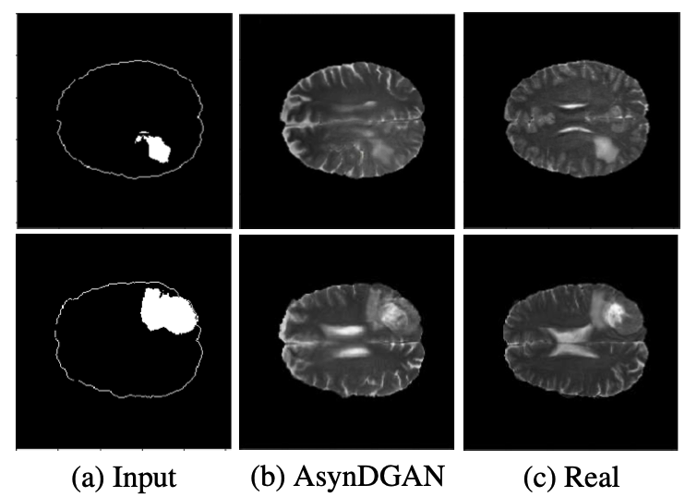
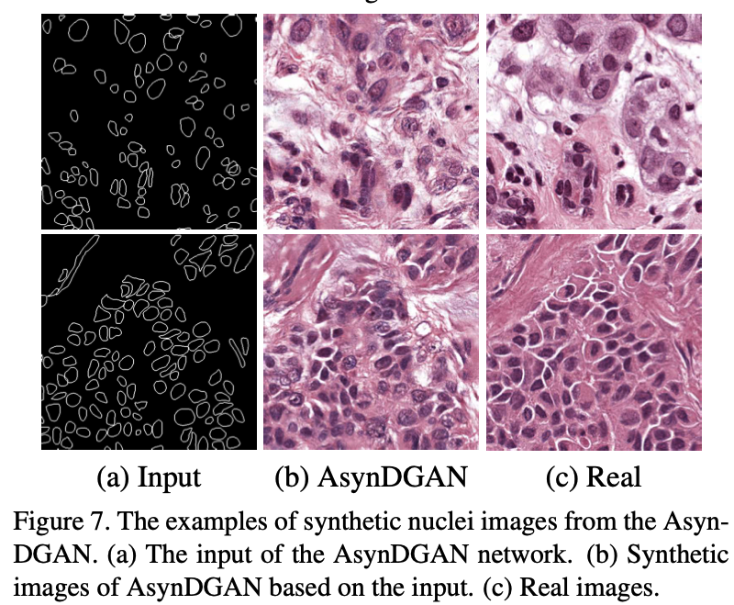
Experiment

Slide 16
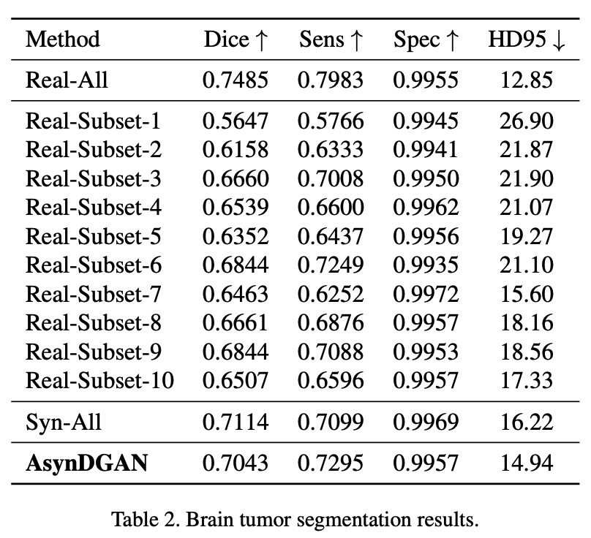
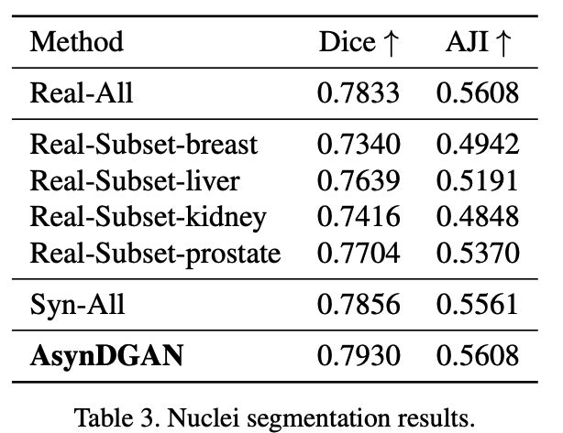
Experiment

Slide 17
Organ at Risk Segmentation for Head and Neck Cancer using Stratified Learning and Neural Architecture Search
Dazhou Guo1 Dakai Jin1 Zhuotun Zhu
PAII Inc. Ping An Technology

Slide 18
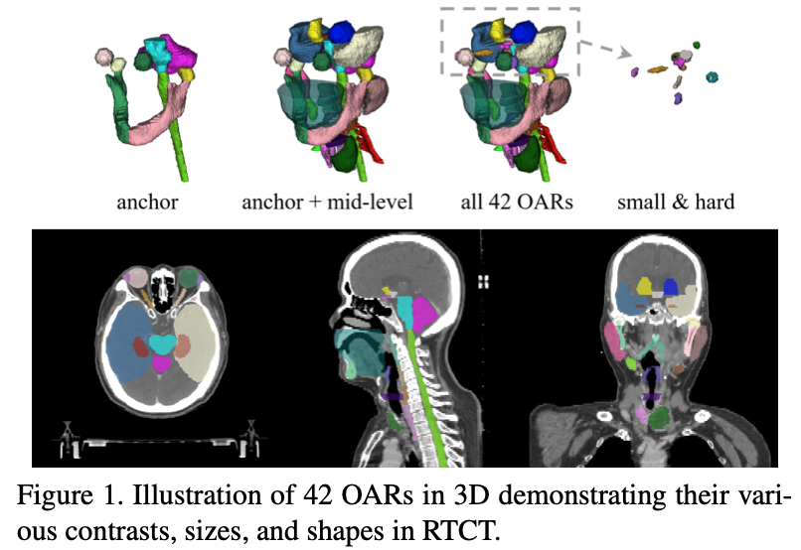
Task
Organ at Risk Segmentation(42 Organs)

Slide 19
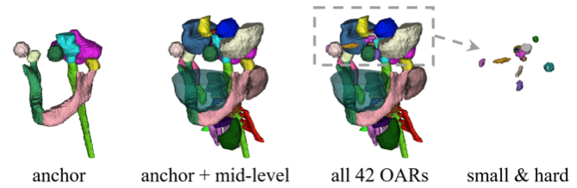
Method
Dividing 42 organs into 3 categories according to clinician recommendations: ﻿anchor, mid-level, and small & hard (S&H)
Stratified Learning: previous layer’s prediction can help letter task
Adopt NAS to search their own architecture to segment 3 kinds of organs
Localized region can be cropped to segment small hard organs

Slide 20
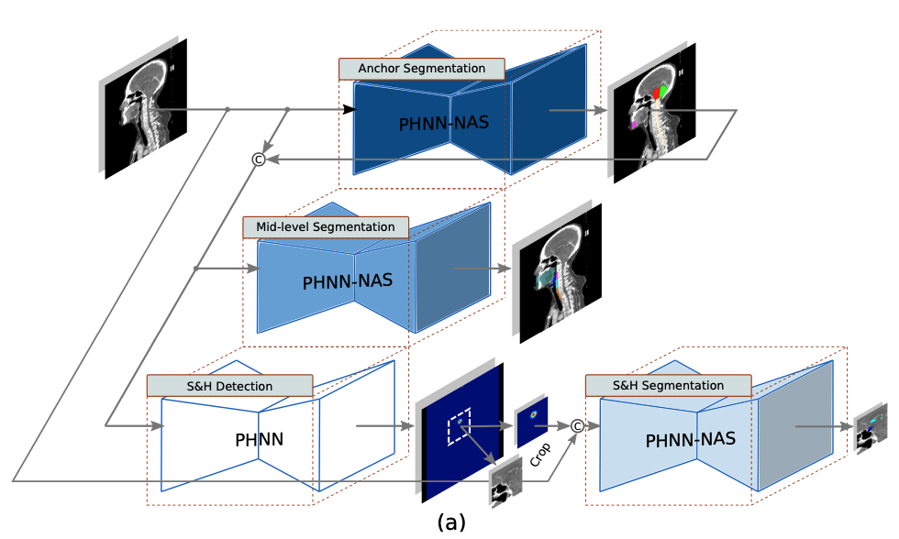
Method

Slide 21
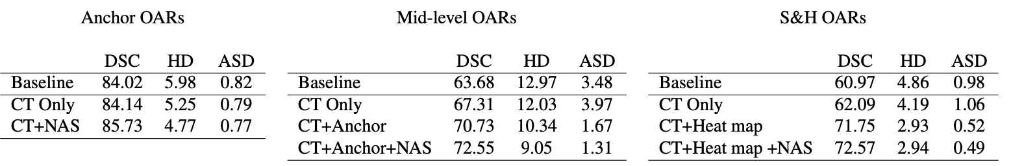
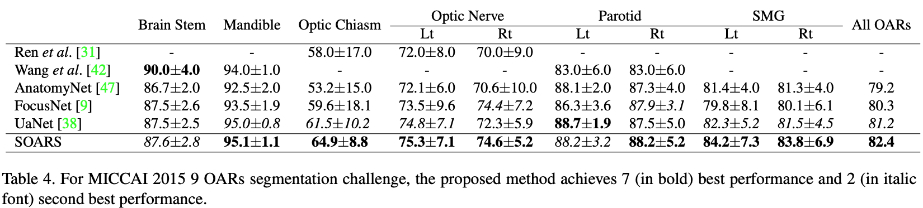
Experiment
H&N 42 OARs dataset(self collected 142 cases)
MICCAI2015 dataset(33 training cases and 15 test cases with 9 OARs annotated)

Slide 22
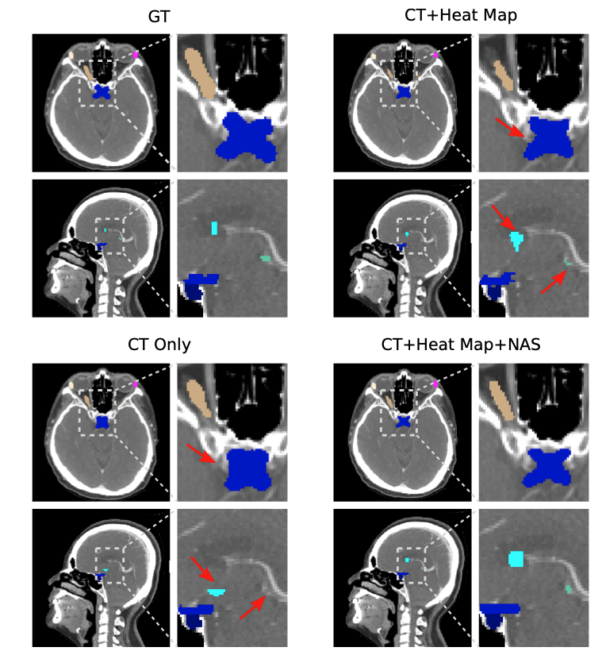

Slide 23
Thanks

