Slide 1
Low Resource Neural Machine Translation and Knowledge Distillation in NAT
Wending Zhou
2020/10/13

Slide 2
Paper List
Understanding Knowledge Distillation in Non-autoregressive Machine Translation
Universal Neural Machine Translation for Extremely Low Resource Languages

Slide 3
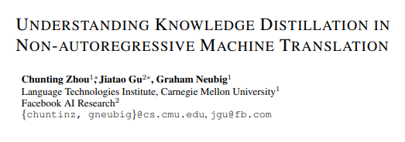

Slide 4

Knowledge Distillation
Knowledge distillation was originally proposed for training a weaker student classifier on the targets predicted from a stronger teacher model.
Using the label probabilities produced by the teacher as “soft targets”

Slide 5
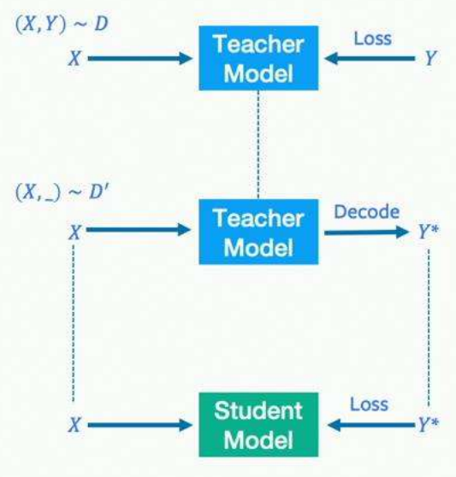
Sequence-level Knowledge Distillation

Slide 6
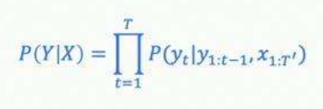

AT model & NAT model
Autoregressive model(Standard NMT)
In theory can model any arbitrary distribution of seq but slow
Non-autoregressive model
Predict all target tokens in parallel but assume output tokens are independent

Slide 7
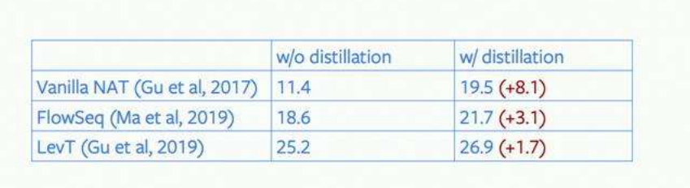
Example
Test on WMT14 English-German
All distilled from the same AT Transformer with BLEU score of 27.13 on WMT En-De.
How does distillation improve NAT?

Slide 8

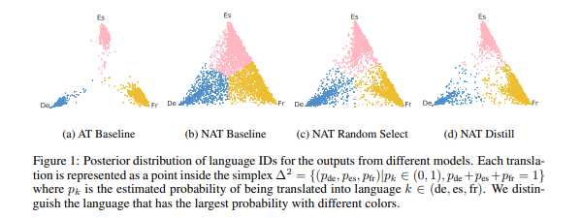
Multi-modality Problem
Dataset: Create a multi-target En-De/Es/Fr corpus without specifying language id
Visualization: Visualize the estimated probability distribution of language classes as

Slide 9
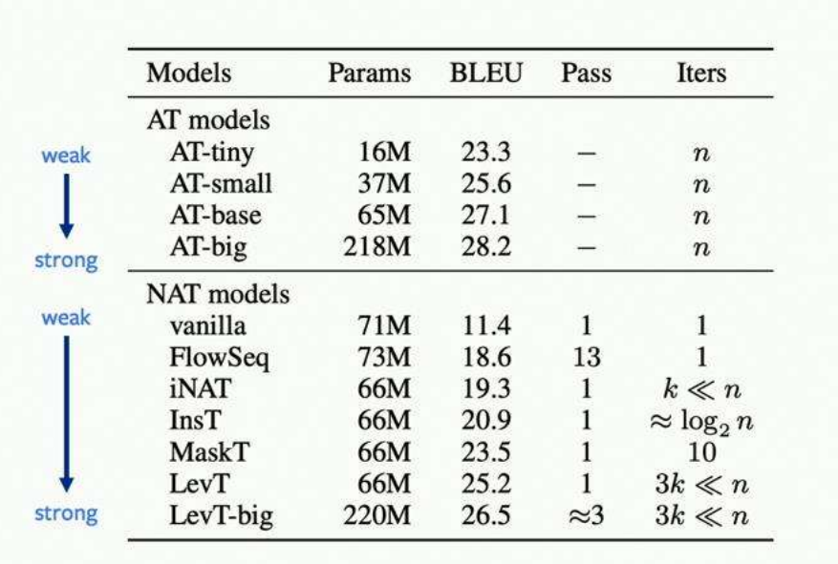
Empirical study

Slide 10
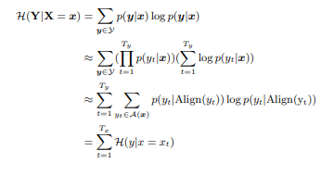
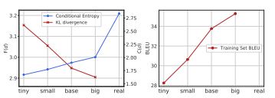

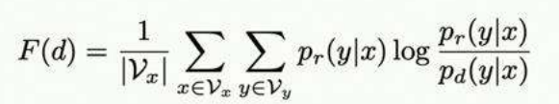
Complexity and Faithfulness of Distilled Data
Complexity: conditional entropy
Faithfulness: KL-divergence

Slide 11
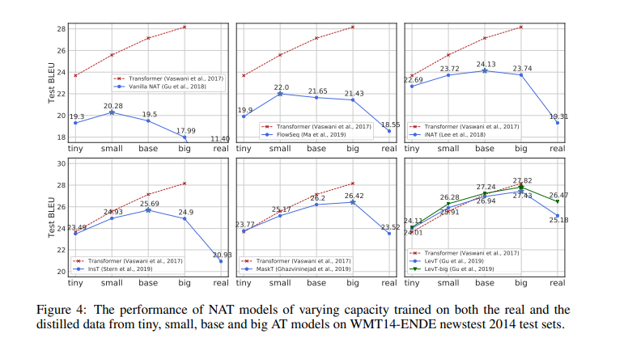
Analysis of the NAT Models

Slide 12
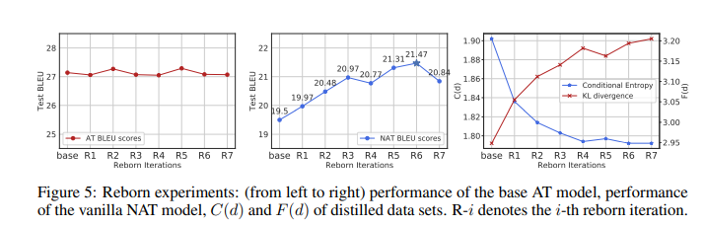
Improvements for distillation
Born-Again Networks (BAN):
Repeatedly distill the teacher model by its own output for multiple iterations and use the final output to train the student model.

Slide 13
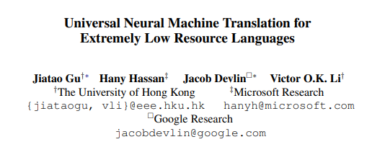


Slide 14
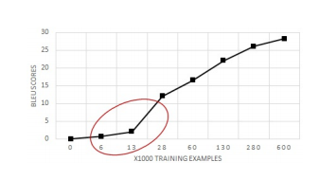
Motivation
Neural machine translation system cannot achieve reasonable translation quality when the number of the parallel examples is extremely small
Multi-lingual NMT utilizes the training examples of multiple languages to regularize the models avoiding over-fitting to the limited data of the smaller languages.

Slide 15
Challenges:
Lexical-level Sharing: The multi-lingual words do not practically share the same embedding space since each word has its own representation
Sentence-level Sharing: It is also crucial for low resource languages to share source sentence representation with other similar languages.

Slide 16




Universal Lexical Representation
Each word from any language is represented as a probabilistic mixture of universal-space word embedding.
The source word can be represented as:
The mapping that projects the multilingual words into the universal space:
The distance between universal token and source word:
Interpolated Embedding for frequent words:

Slide 17


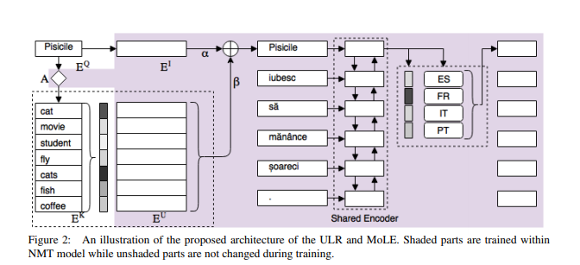
Mixture of Language Experts
Model the sentence-level universal encoder
Output: Objective:

Slide 18
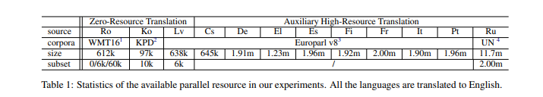
Experiments

Slide 19
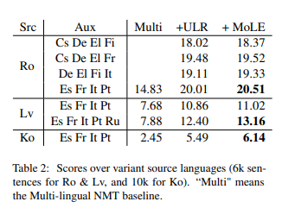
Result

Slide 20
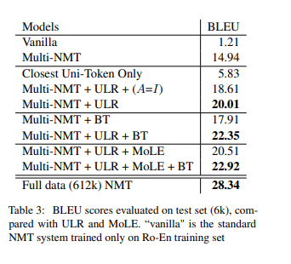
Ablation Study

Slide 21
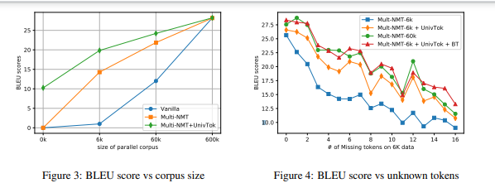
Ablation Study

Slide 22
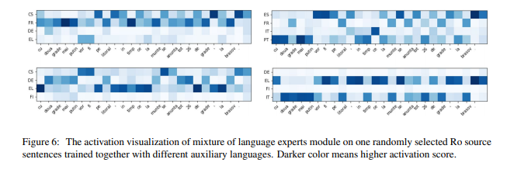
Visualization of MoLE

Slide 23
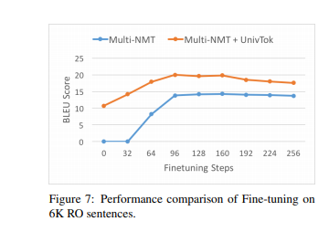
Fine-tuning a Pretrained Model
Train a Multi-NMT model (with ULR) on {Es, Fr, It, Pt}-En languages only to create a zero-shot setting for Ro-En translation. Then, fine-tuning the model with 6k parallel corpora of Ro-En, with and without ULR.

