Slide 1
NAS & Filter Grafting
Zixun zhang
2020-05-14

Slide 2
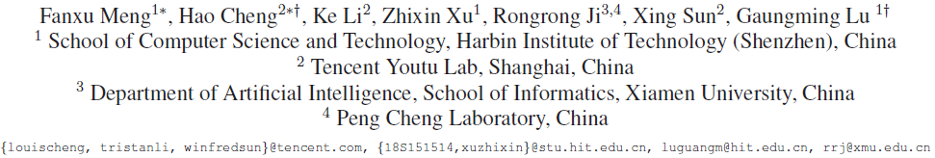
Filter Grafting for Deep Neural Networks

Slide 3
Elegantly deal with redundancy
As we all know, DNNs have many unimportant components
However, whether directly removing such filters and components is the best choice
Whether such invalid filters are indeed useful in certain senses
Ensemble learning like boosting

Slide 4
Previous filter enhancement
Dense-sparse-dense
Init dense training: learns the connection weights and importance via normal network training
Sparse training: prunes the low-weight connections and trains a sparse network
Final dense training: recovers the pruned connections (0), making the network dense again
RePr
Similar to DSD, reinitialize the filters to be orthogonal to its value before being dropped and the current value of non-pruned filters

Slide 5
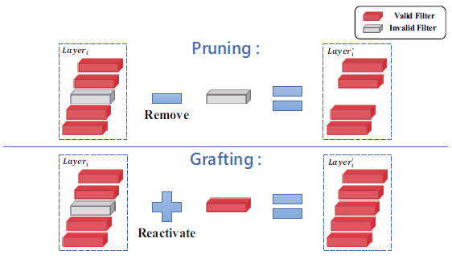
Filter grafting

Slide 6
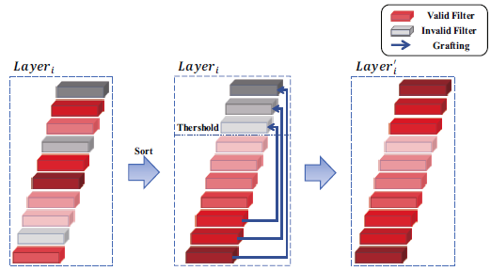
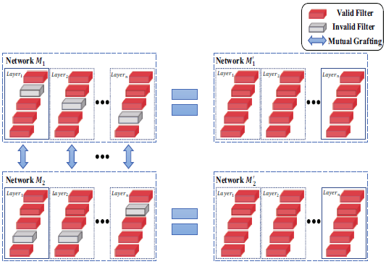

Information source
Noise
Graft Gaussian noise into invalid filters
Internal filters
Add the weights of other filters into invalid filters
External filters
Select external filters from other networks
${W_{i}^{M_{2}}}^{′}=αW_{i}^{M_{2}}+(1−α)W_{i}^{M_{1}}$

Slide 7

Information measurement
L1 norm
A common used metric
Entropy
Convert continuous distribution to discrete distribution
$H\left(W_{i,j}\right)=−\sum_{k=1}^{B}{p_{k}log}p_{k}$
$H\left(W_{i}\right)=\sum_{j=1}^{c}{H_{i,j}}$
To keep layer consistency
$H\left(W_{i}\right)=−\sum_{k=1}^{B}{p_{k}log}p_{k}$

Slide 8
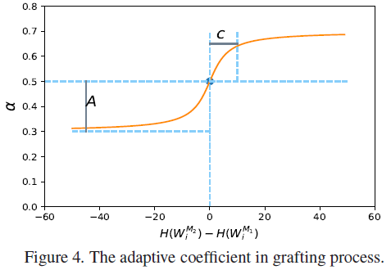

Adaptive Grafting
Hyper-parameter $α$
$α$ should be 0.5 if $H\left(W_{1}\right)=H(W_{2})$ and larger than 0.5 if $H\left(W_{1}\right)>H(W_{2})$
Each network should contain part of self information even though $H(W_{1})≫H(W_{2})$
$α=A×\left(arctan(c×(H\left(W_{i}^{M_{2}}\right)−H(W_{i}^{M_{1}})))\right)+0.5$

Slide 9
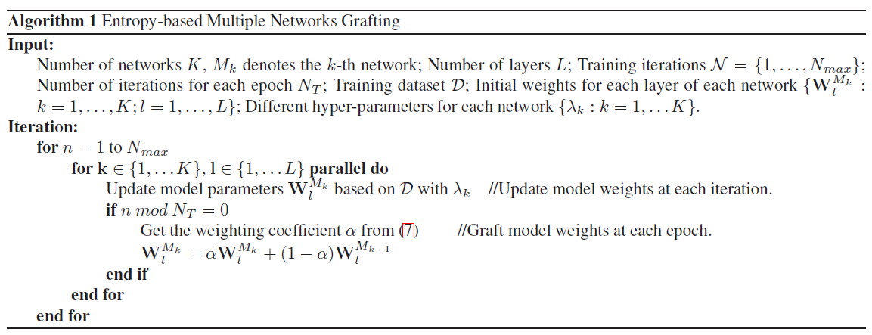
Network Grafting

Slide 10
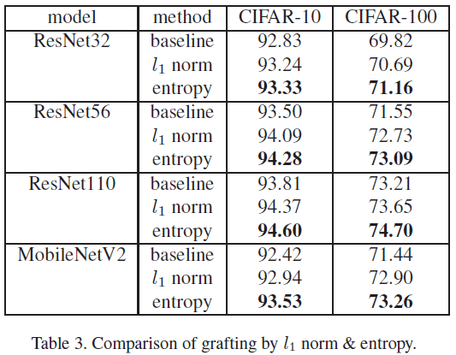
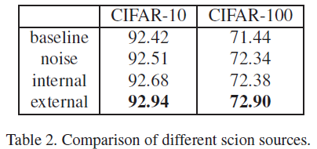
Ablation

Slide 11
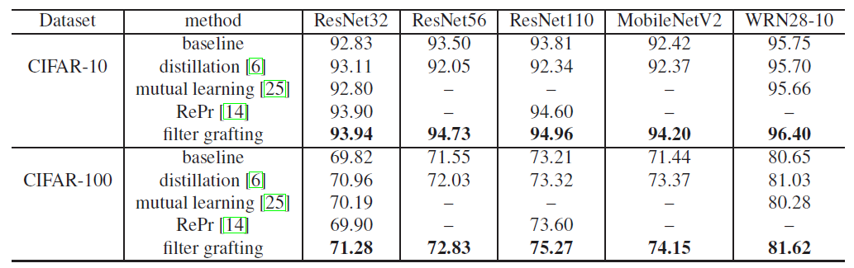
Experiment

Slide 12
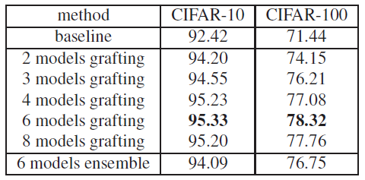
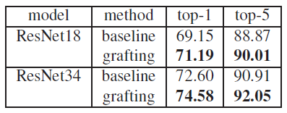
Experiment

Slide 13
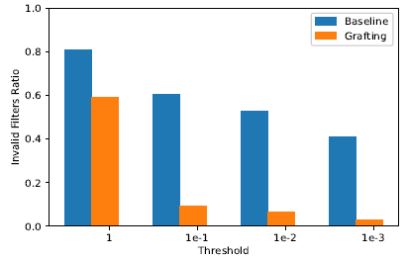
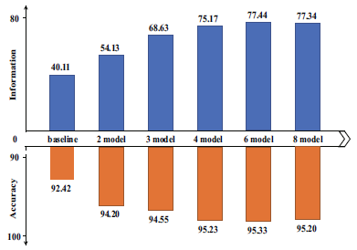
Statistics

Slide 14
SGAS: Sequential Greedy Architecture Search

Slide 15
Correlation issue in DARTS
DARTS pipeline
Search phase: search over a pre-defined search space with a lightweight proxy model on a small proxy dataset
Evaluation phase: after the best architecture cell/encoding is obtained, the final architecture is built and trained from scratch
Assumption: the true performance during evaluation can be inferred during the search phase
This assumption usually does not hold due to the discrepancy in dataset, hyper-parameters and network architectures
Degenerate search-evaluation correlation

Slide 16
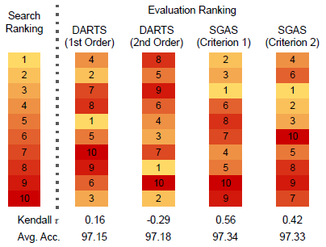
Correlation issue in DARTS

Slide 17
Sequential greedy search
Core problem
Discrepancy between the search and evaluation phases
Negative effect of weight sharing
Solve the bi-level optimization in a sequential greedy fashion
Divide path selection problem into sub-problems
Based on the DAG, pick the operation for edges greedily iteratively
A greedy optimal choice is made for the selected edge by replacing the corresponding mixture operation with the best one
Therefore the architectural parameters the weights of the remaining paths are no longer needed

Slide 18
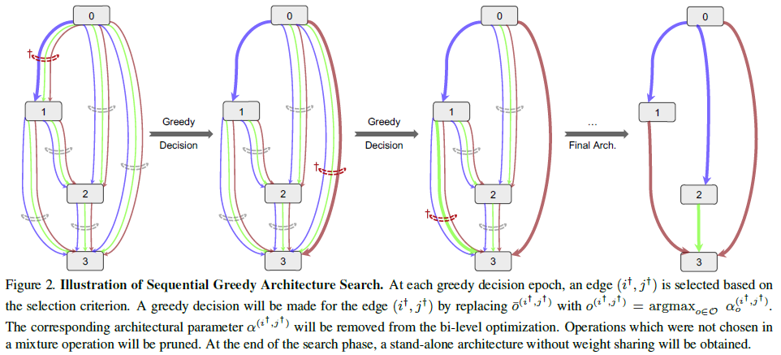
Sequential greedy search

Slide 19
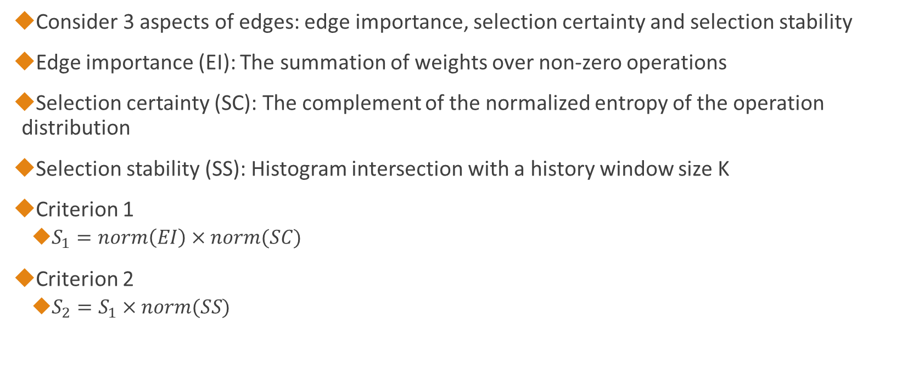
Selection criterion
Consider 3 aspects of edges: edge importance, selection certainty and selection stability
Edge importance (EI): The summation of weights over non-zero operations
Selection certainty (SC): The complement of the normalized entropy of the operation distribution
Selection stability (SS): Histogram intersection with a history window size K
Criterion 1
$S_{1}=norm\left(EI\right)×norm(SC)$
Criterion 2
$S_{2}=S_{1}×norm(SS)$

Slide 20
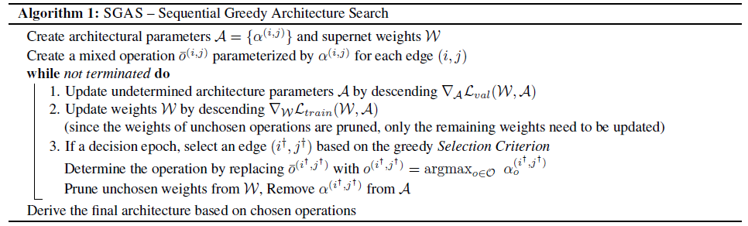
SGAS

Slide 21
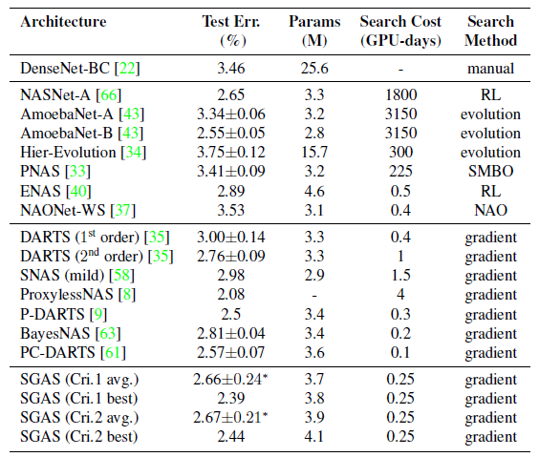
Experiments on CIFAR-10

Slide 22
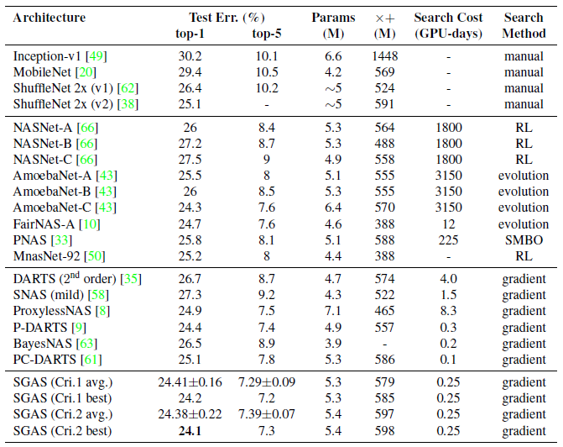
Experiments on ImageNet

Slide 23
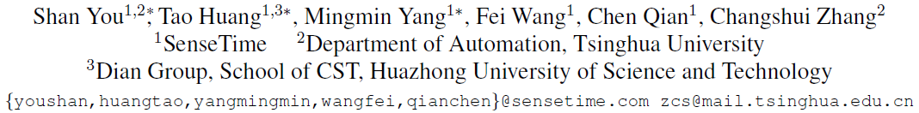
GreedyNAS: Towards Fast One-Shot NAS with Greedy Supernet

Slide 24
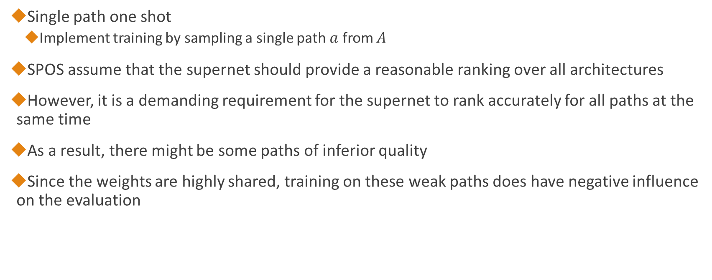
Single-path one-shot
Single path one shot
Implement training by sampling a single path $a$ from $A$
SPOS assume that the supernet should provide a reasonable ranking over all architectures
However, it is a demanding requirement for the supernet to rank accurately for all paths at the same time
As a result, there might be some paths of inferior quality
Since the weights are highly shared, training on these weak paths does have negative influence on the evaluation

Slide 25
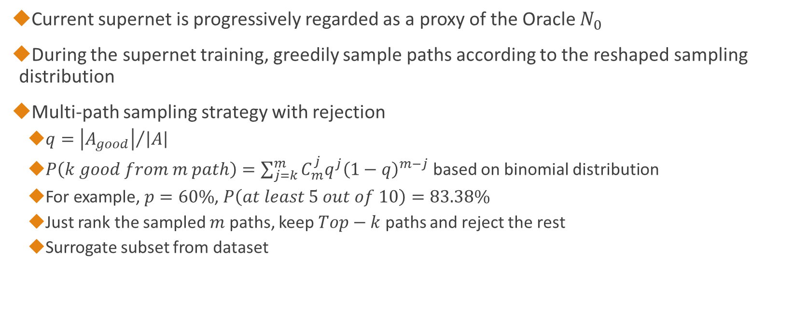
Greedy path filtering
Current supernet is progressively regarded as a proxy of the Oracle $N_{0}$
During the supernet training, greedily sample paths according to the reshaped sampling distribution
Multi-path sampling strategy with rejection
$q={\left|A_{good}\right|}/{\left|A\right|}$
$P\left(k good from m path\right)=\sum_{j=k}^{m}{C_{m}^{j}q^{j}{\left(1−q\right)}^{m−j}}$ based on binomial distribution
For example, $p=60\%$, $P\left(at least 5 out of 10\right)=83.38\%$
Just rank the sampled $m$ paths, keep $Top−k$ paths and reject the rest
Surrogate subset from dataset

Slide 26
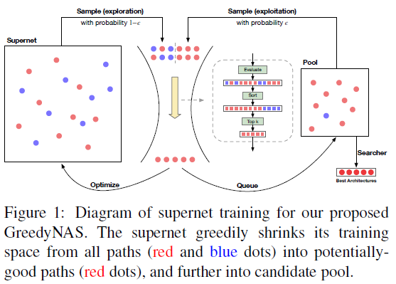
GreedyNAS pipeline

Slide 27
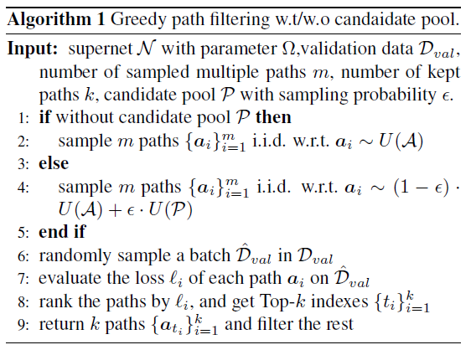
Exploration and exploitation

Slide 28
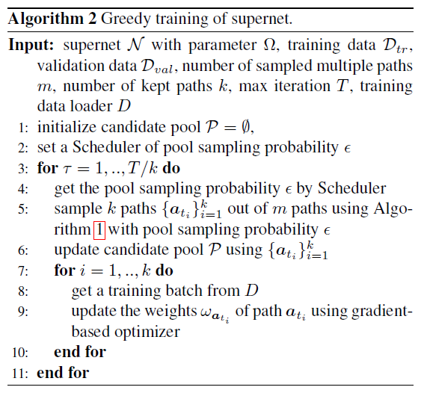
Greedy training

Slide 29
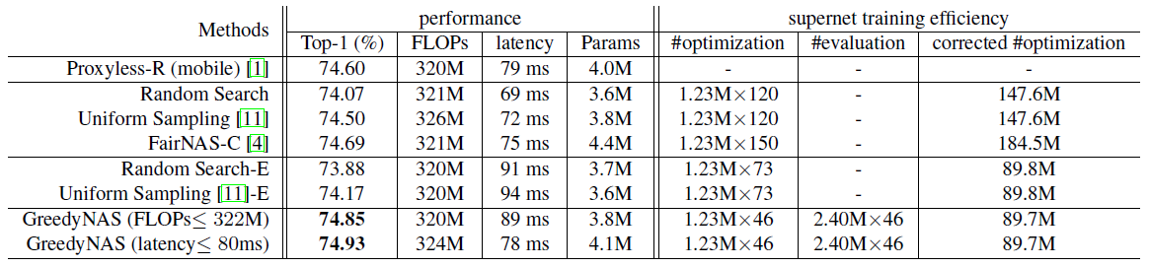
Experiment on ImageNet

Slide 30
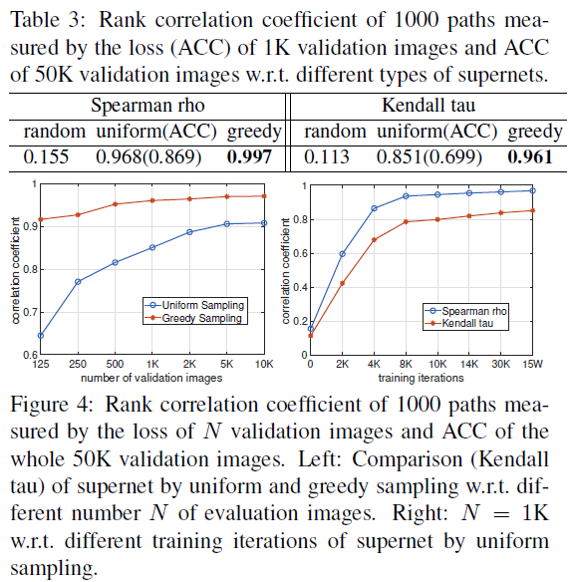
Ablation – rank correlation

Slide 31
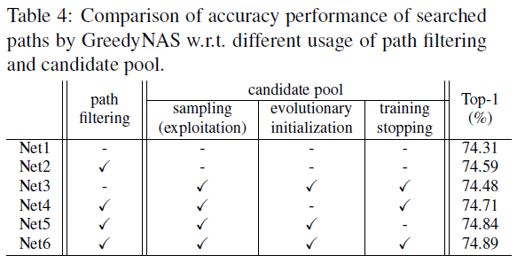
Ablation – candidate pool

