Slide 1
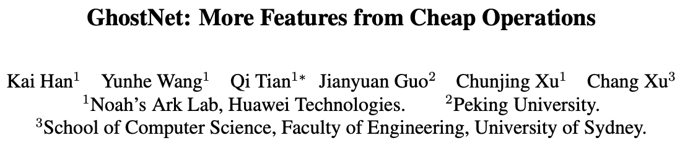

Slide 2
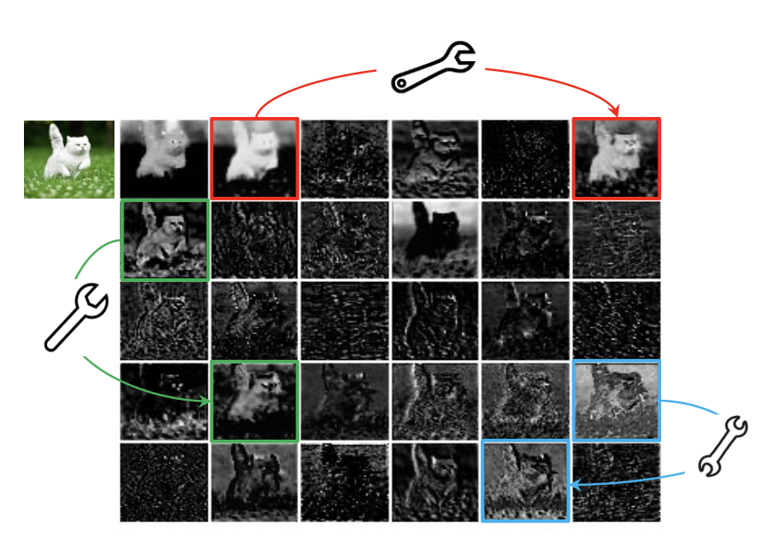
Motivation
Abundant and even redundant information in the feature maps of well-trained deep neural networks often guarantees a comprehensive understanding of the input data.

Slide 3
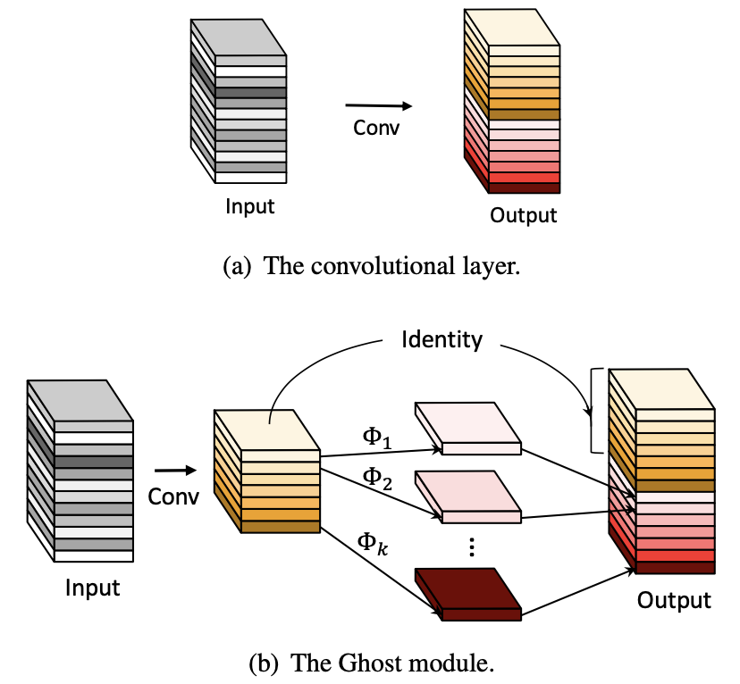
Method
Depthwise convolution

Slide 4
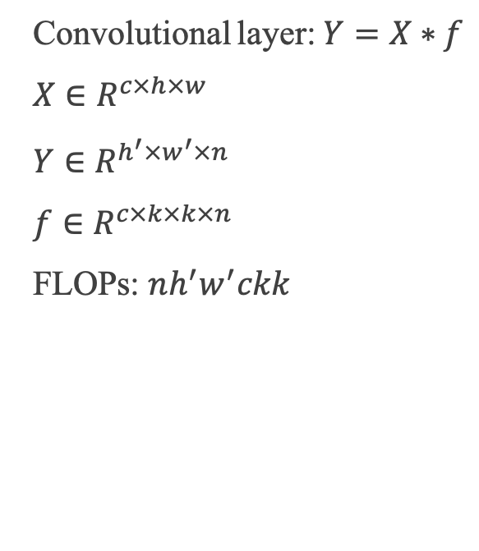
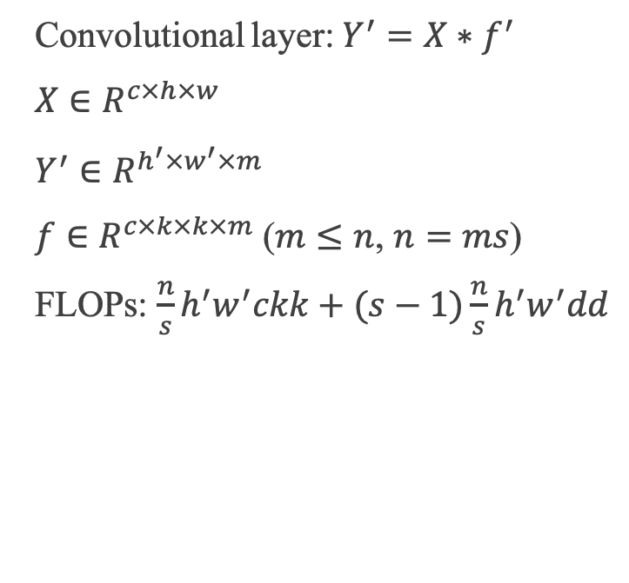
Analysis
Convolutional layer: $Y=X∗f$
$X∈R^{c×h×w}$
$Y∈R^{h^{′}×w^{′}×n}$
$f∈R^{c×k×k×n}$
FLOPs: $nh^{′}w^{′}ckk$
Convolutional layer: $Y^{′}=X∗f^{′}$
$X∈R^{c×h×w}$
$Y^{′}∈R^{h^{′}×w^{′}×m}$
$f∈R^{c×k×k×m}$ ($m≤n$, $n=ms$)
FLOPs: $\frac{n}{s}h^{′}w^{′}ckk+(s−1)\frac{n}{s}h^{′}w^{′}dd$

Slide 5
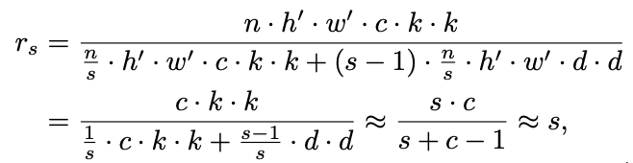

Analysis
Speed-up ratio:
Compression ratio:

Slide 6
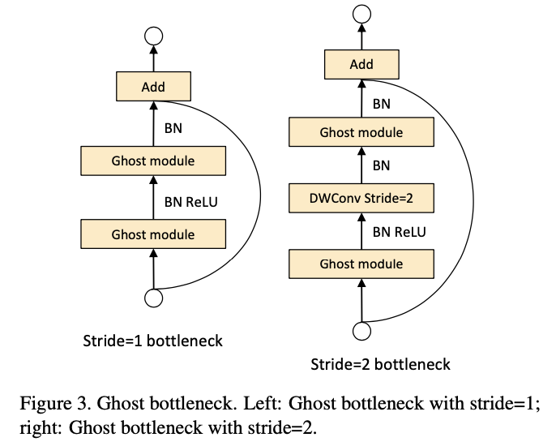
Bottleneck

Slide 7
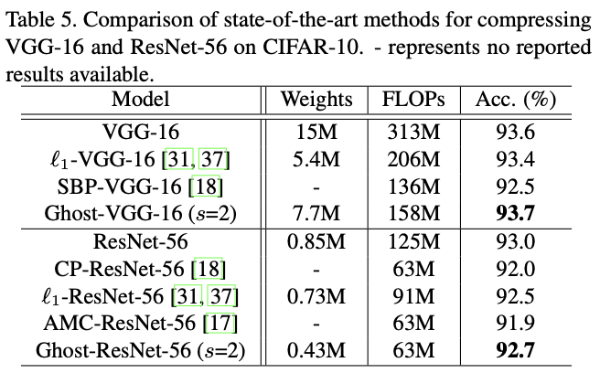
Experiment on CIFAR-10

Slide 8
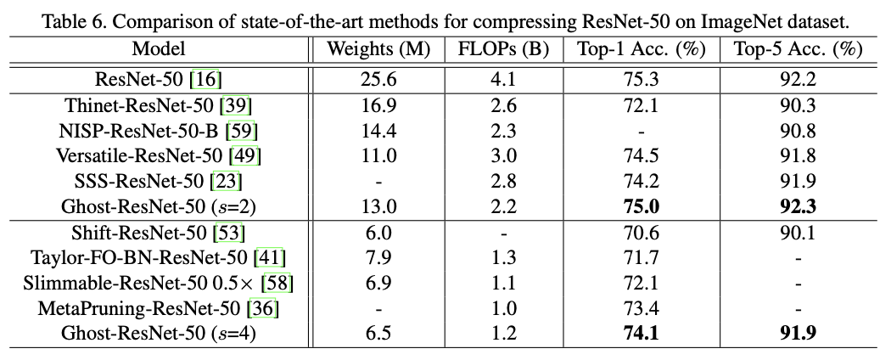
Experiment on ImageNet

Slide 9
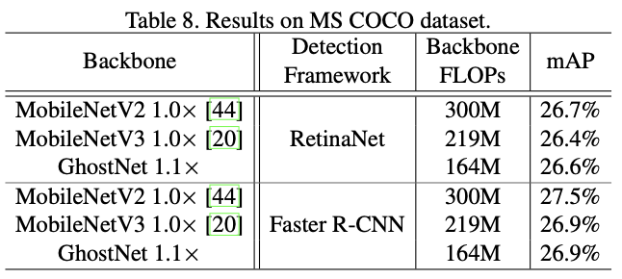
Object Detection on MS COCO

Slide 10
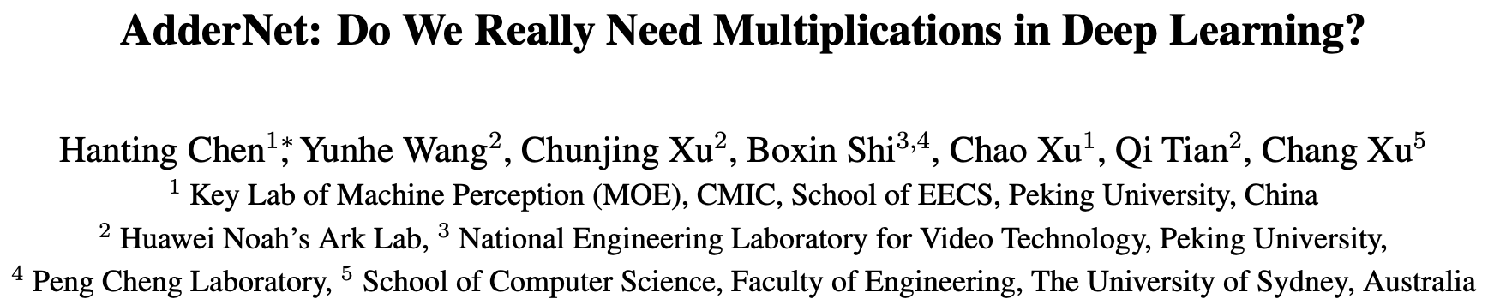

Slide 11
Motivation
It is widely known that multiplication is slower than addition.
Most of the computations in deep neural networks are multiplications between float-valued weights and float-valued activations during the forward inference.
We propose adder networks that maximize the use of addition while abandoning convolution operations.

Slide 12
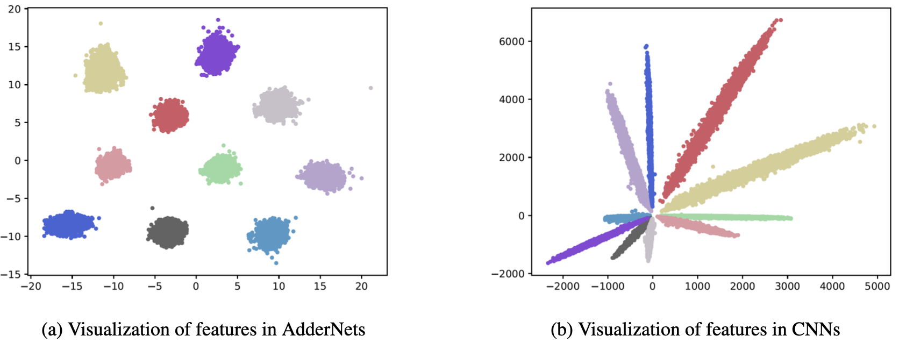
Visualization

Slide 13
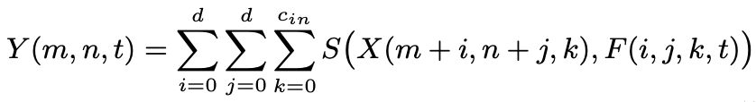
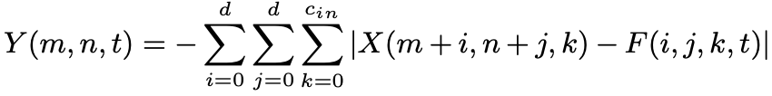
Method
Convolution
Adder Networks: $l_{1}$ distance and batch normalization

Slide 14
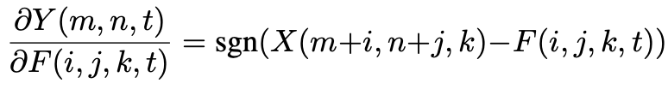
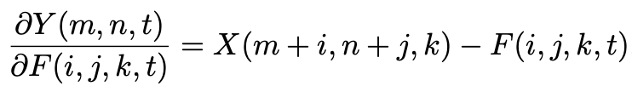

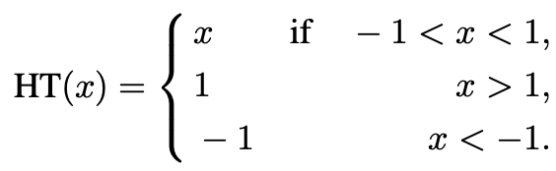
Optimization

Slide 15
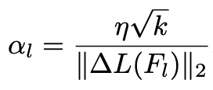
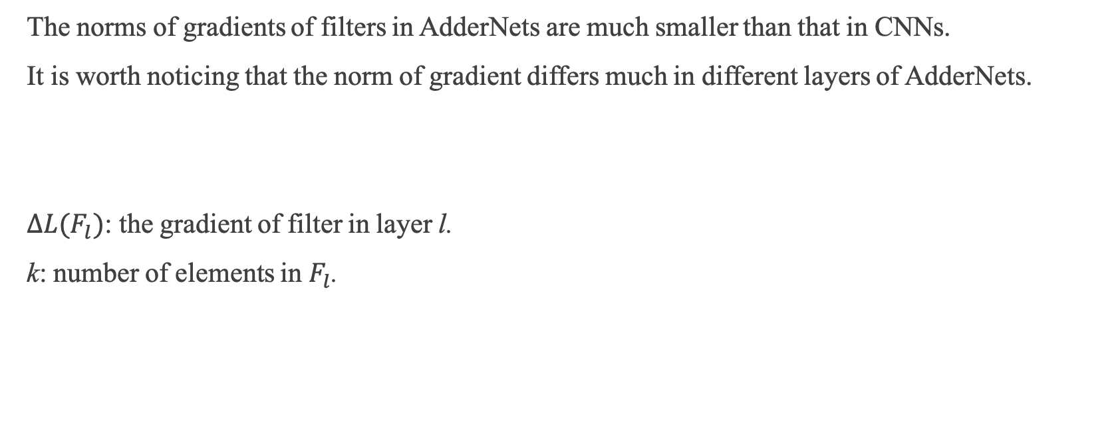
Learning Rate
The norms of gradients of filters in AdderNets are much smaller than that in CNNs.
It is worth noticing that the norm of gradient differs much in different layers of AdderNets.
$∆L(F_{l})$: the gradient of filter in layer l.
k: number of elements in $F_{l}$.

Slide 16
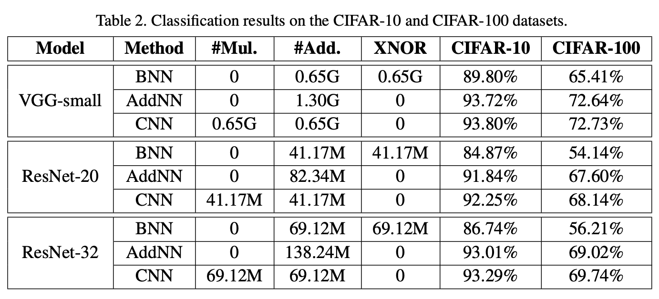
Experiment

Slide 17
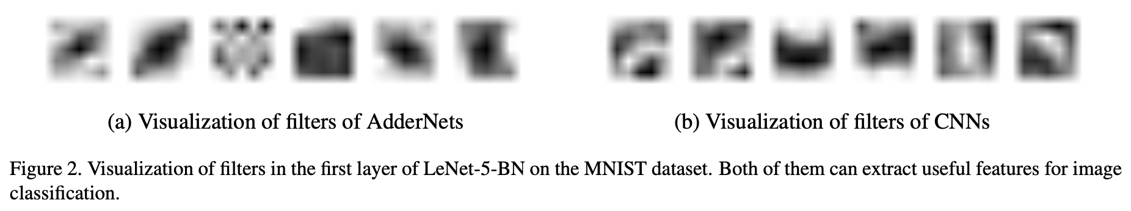
Filter Visualization

