Slide 1
Few-shot segmentation on medical Images
ECCV 2020

Slide 2
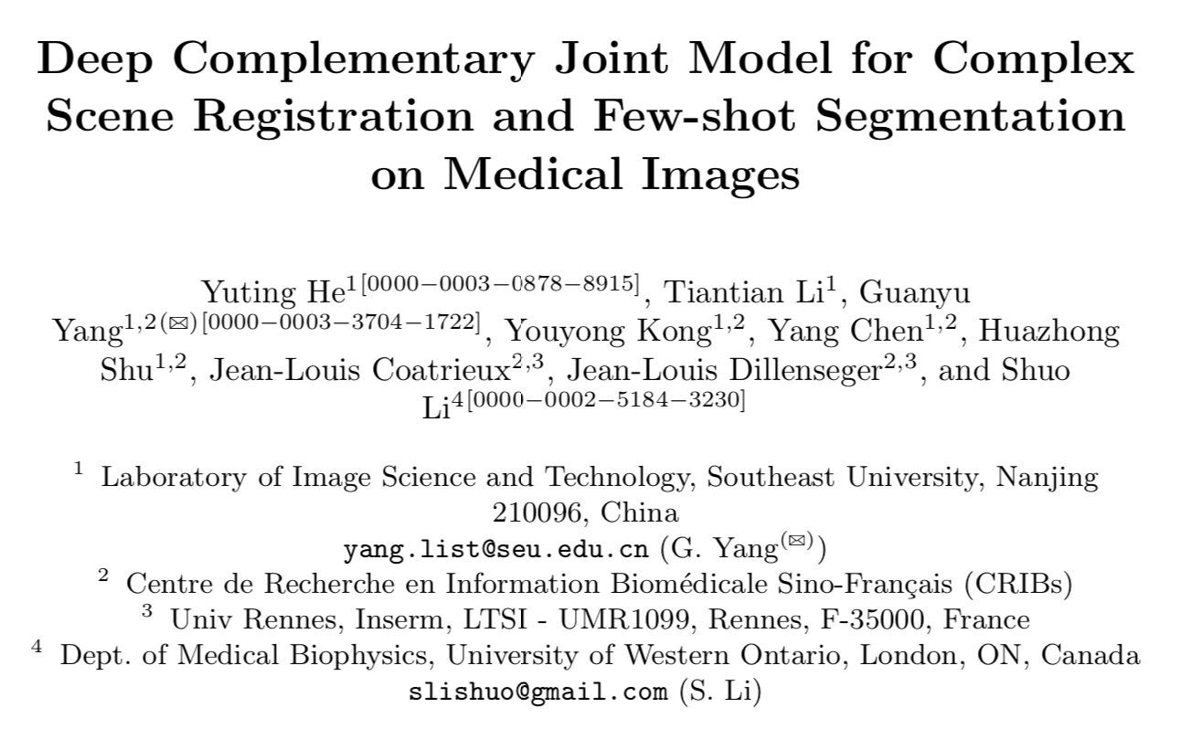
ECCV 2020

Slide 3
Contribution
– build a novel complementary topology of registration and segmentation for the first time, and propose the DeepRS model utilizing the data generation ability of registration for few-shot segmentation, and the label-free region constraint ability of segmentation for complex scene registration.
– propose a deep structure sampling (DSS) block adding a random perturbation factor to the registration for sustainable data augmentation ability.
– propose an alignment confidence map (ACM) method which efficiently utilizes the supervision information in weakly supervised data thus bringing powerful segmentation generalization.
– propose a deep-based region constraint (DRC) strategy which frees up the label requirements of label-based methods achieving finer registration on ROIs.

Slide 4
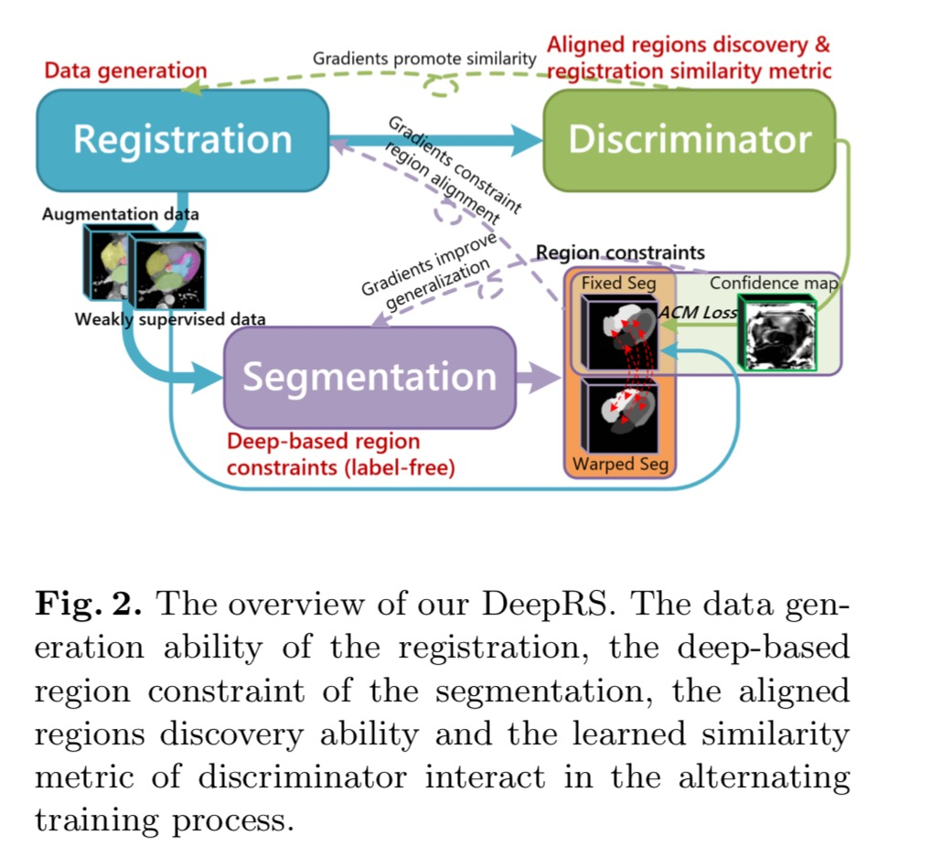
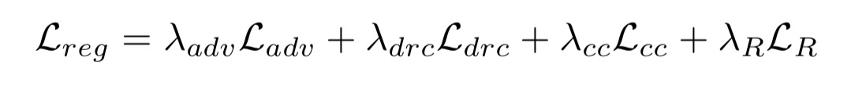

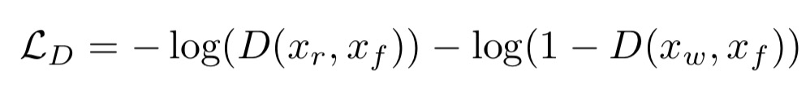


Slide 5
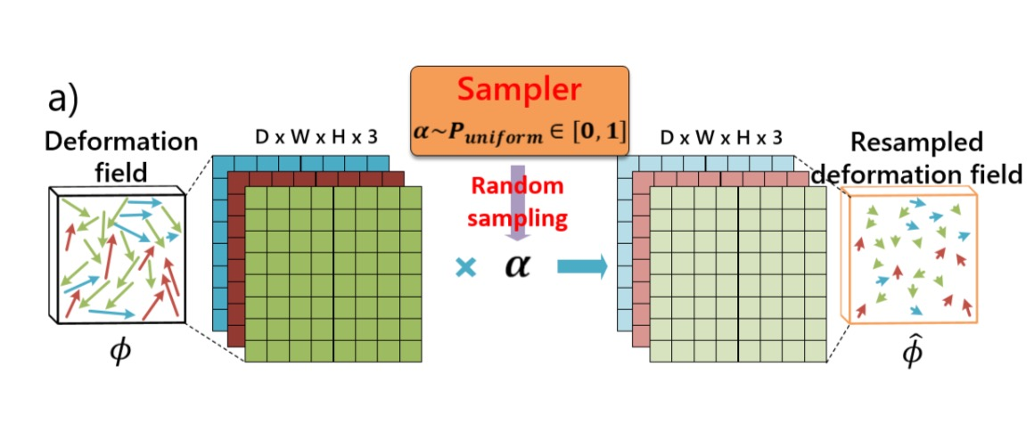
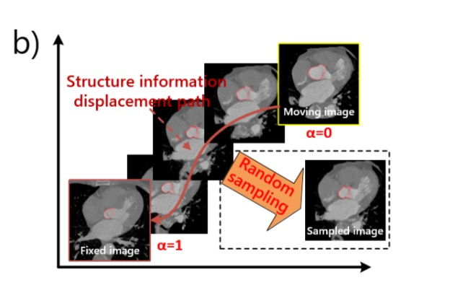
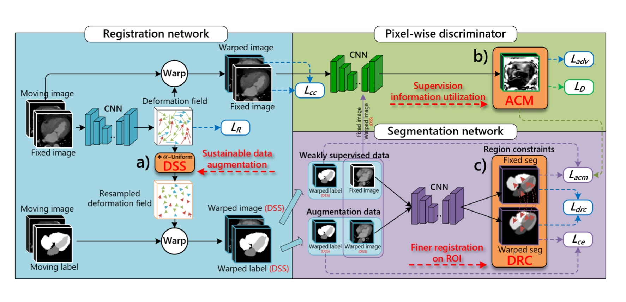
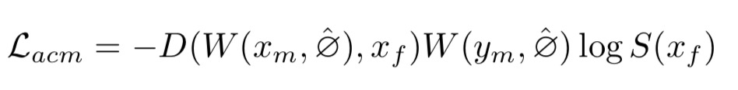

Slide 7
Experiment
CT dataset of MM-WHS 2017 Challenge which has complex backgrounds (lung, rib cage, etc.)
consists of 20 labeled and 40 unlabeled CT images
experiments aim to register and segment seven cardiac structures
compare model’s segmentation performance with three general segmentation networks (3D U-Net[3], V-Net[25], 3D FCN[24])
also compare two unsupervised registration models (VoxelMorph-2[2], Adv-Reg[7])
two registration and segmentation joint models (DeepAtlas[37], HybridCNN[22]) are compared

Slide 8
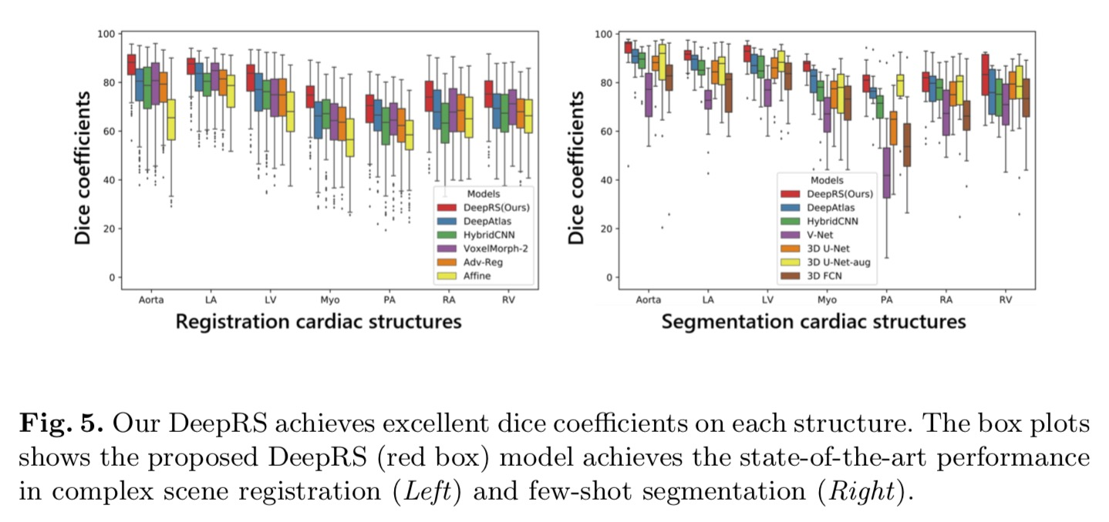
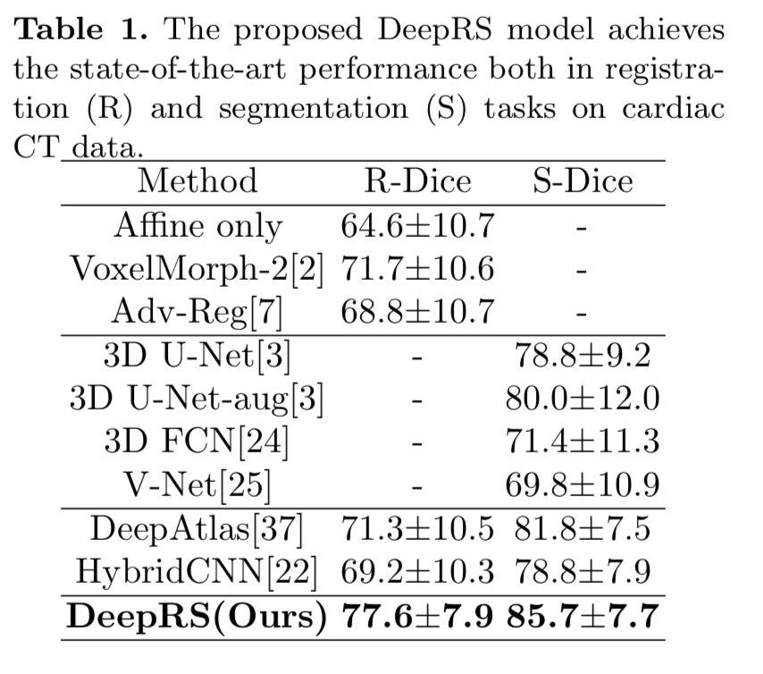
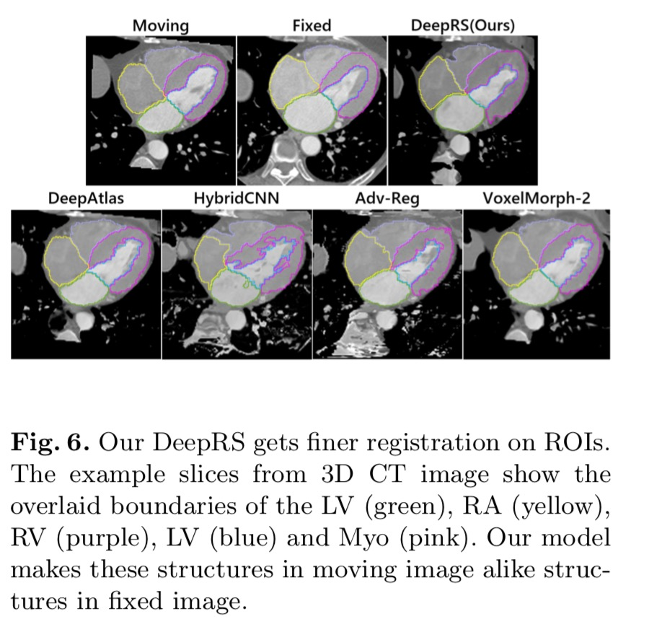
Results

Slide 9
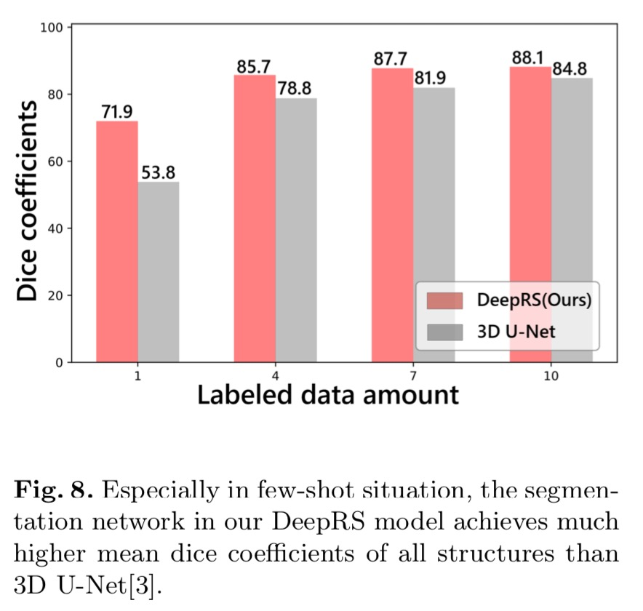
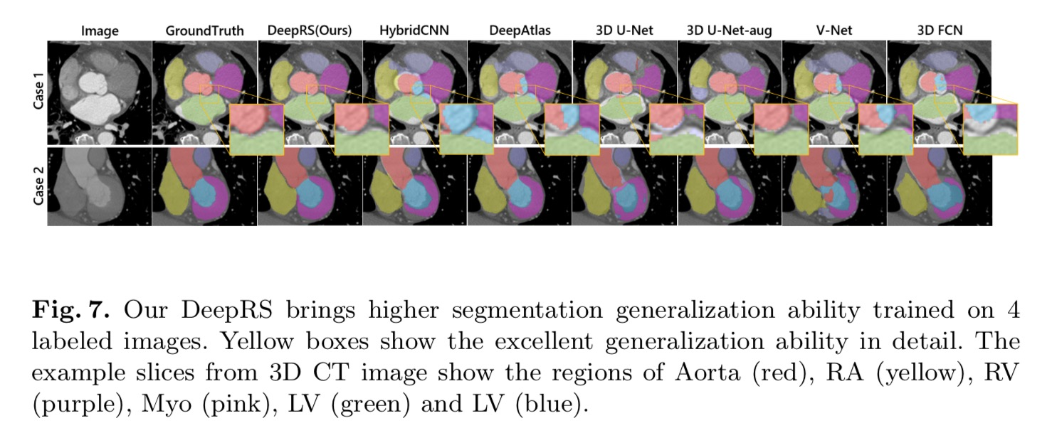
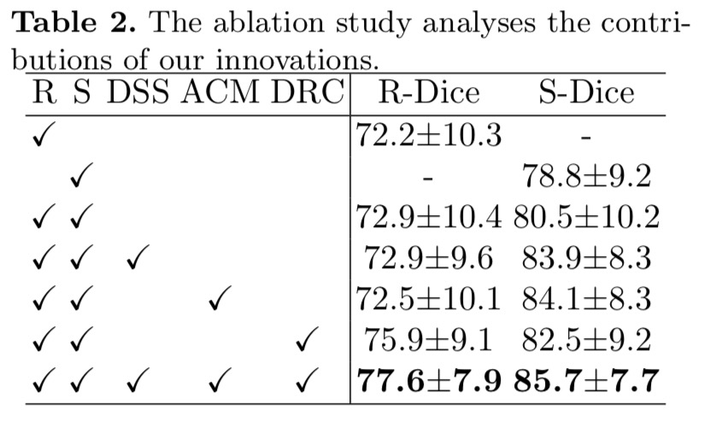
Ablation Study

Slide 10
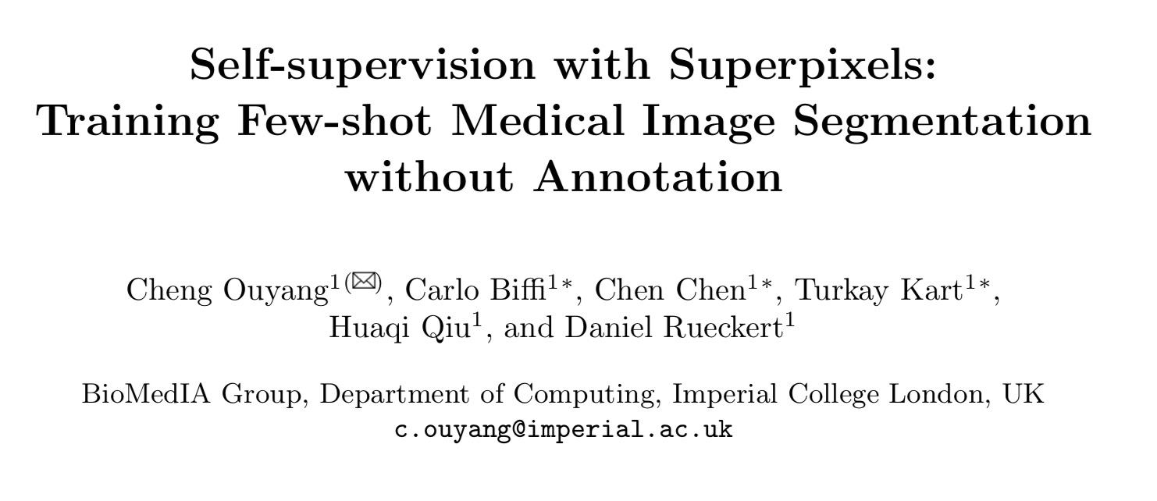
ECCV 2020

Slide 11
Contribution
– propose SSL-ALPNet, the first work that explores self-supervised learn- ing for few-shot medical image segmentation, to the best of our knowledge. It outperforms peer FSS methods, which usually require training with manual annotations, by merely training on unlabeled images.
– propose adaptive local prototype pooling, a local representation computation module that significantly boosts performance of the state-of-the-art prototypical networks on medical images. – for the first time evaluated FSS on different imaging modalities, segmentation classes and with the presence of patient pathologies. The established evaluation strategy not only highlights wide applicability of our work, but also facilitates future works that seek to evaluate FSS in a more realistic scenario.

Slide 12
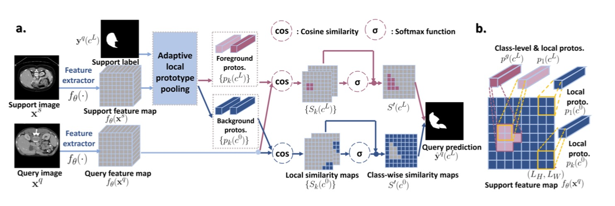
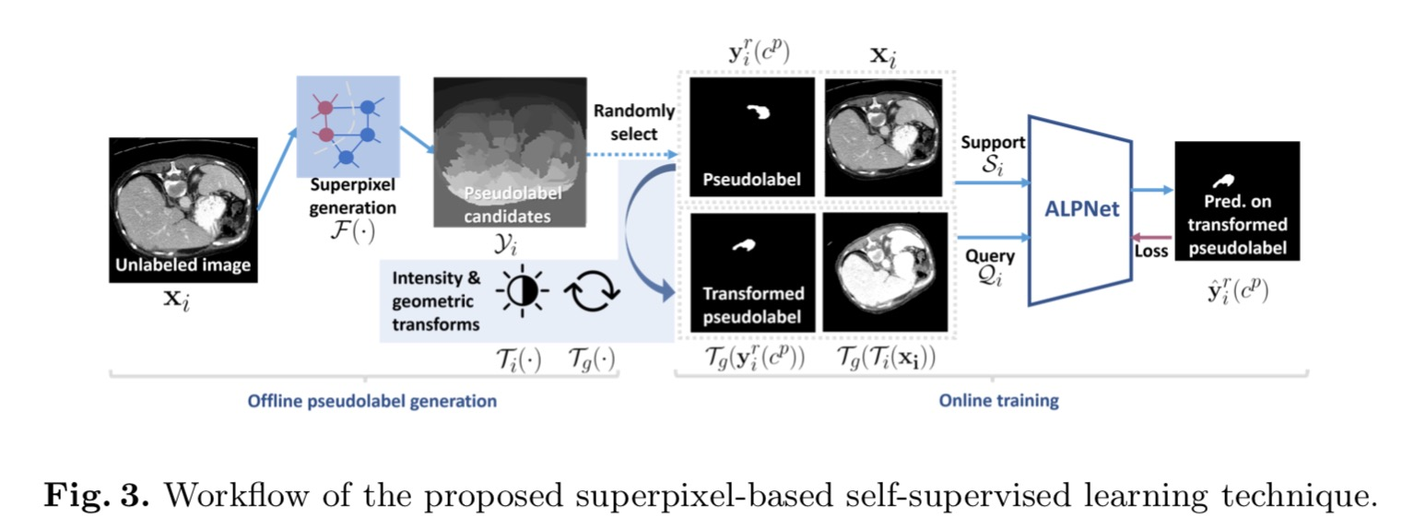

Slide 13
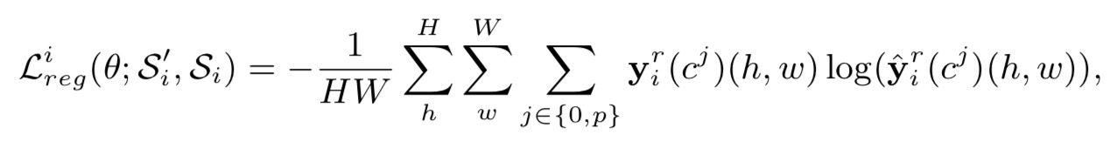
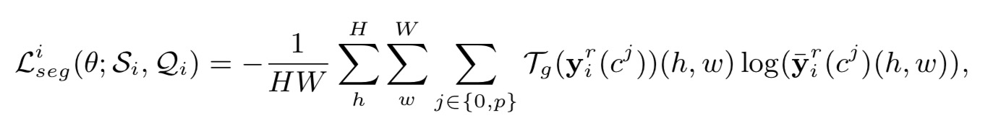
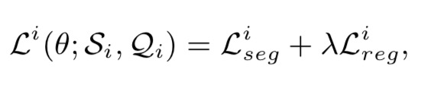

Slide 14
Experiment
Data: three scenarios: abdominal organs segmentation for CT and MRI (Abd-CT and Abd-MRI) and cardiac segmentation for MRI (Card-MRI).
construct a shared label set containing left kidney, right kidney, spleen and liver
To measure the overlapping between prediction and ground truth: Dice score

Slide 15
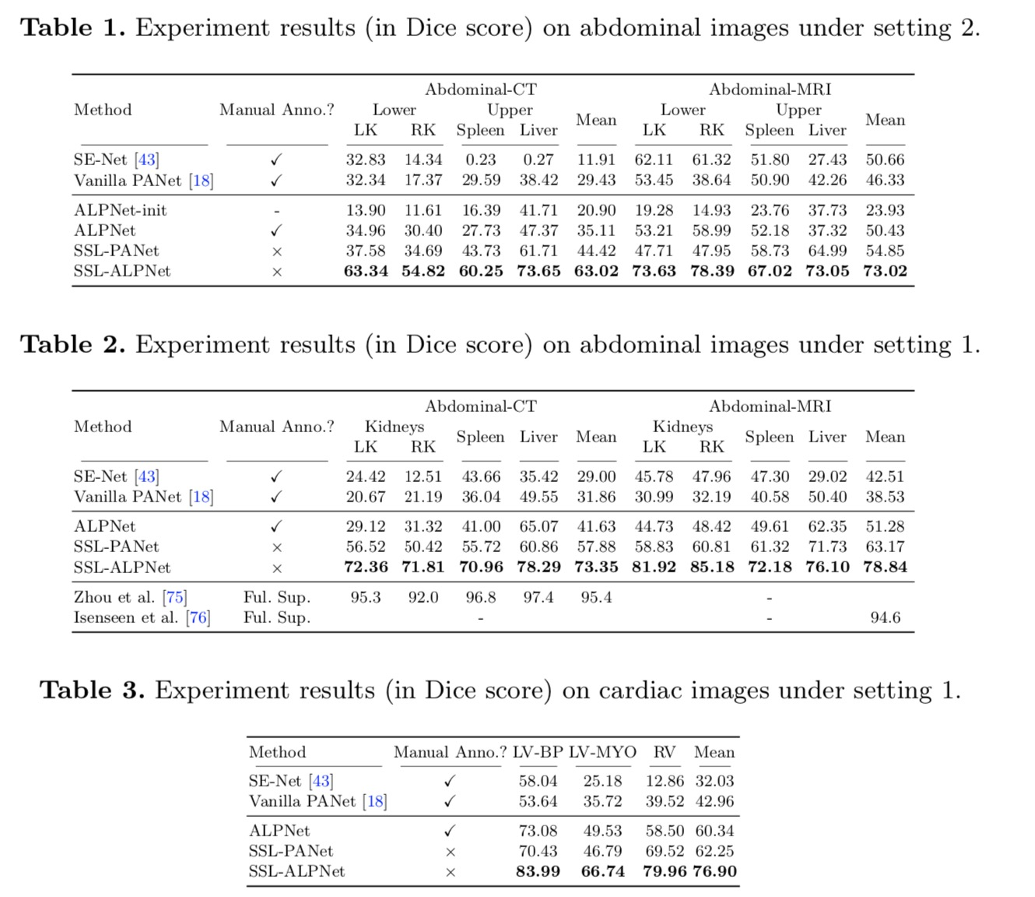
Results

Slide 16
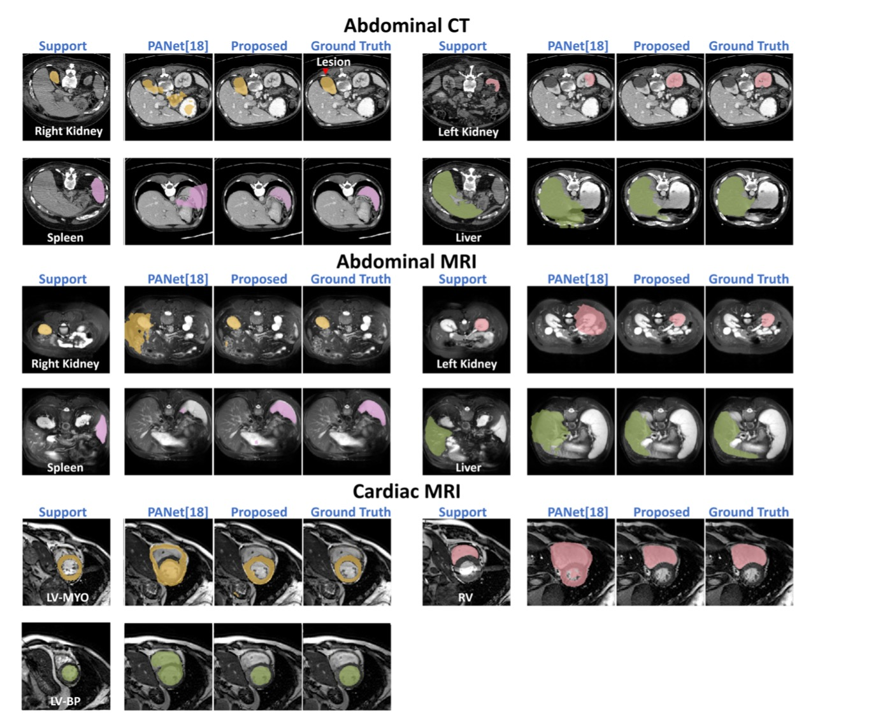
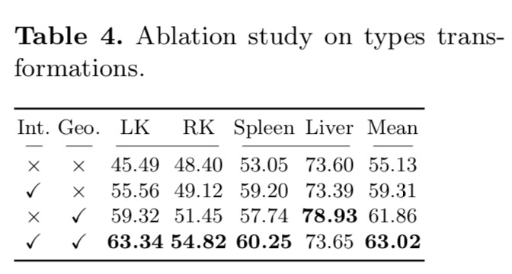
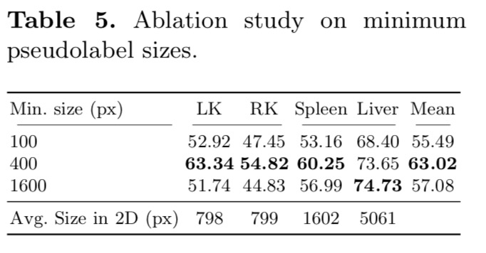
Ablation Study

Slide 17
Thanks

